Slide 1

Sparrow
Distributed Low-Latency Spark Scheduling
Kay Ousterhout, Patrick Wendell, Matei Zaharia, Ion Stoica

Slide 2
Outline
The Spark scheduling bottleneck
Sparrow’s fully distributed, fault-tolerant technique
Sparrow’s near-optimal performance

Slide 3
Spark Today
User 1
Spark Context
Worker
Worker
Query Compilation
Worker
User 2
Worker
Storage
Worker
Scheduling
User 3
Worker

Slide 4
Spark Today
User 1
Spark Context
Worker
Worker
Query Compilation
Worker
User 2
Worker
Storage
Worker
Scheduling
User 3
Worker

Slide 5
Job Latencies Rapidly Decreasing
2012: Impala query
2010: Dremel Query
2010:
In-memory Spark query
2009: Hive query
2013:
Spark streaming
2004: MapReduce
batch job
10 min.
10 sec.
100 ms
1 ms
Notes:
Originally: jobs were many hours. Since beginning, push to drive down latencies. Innovations include better query languages (hive), better data layout/more parallelism (dremel), storing data in memory (Spark). These short data analytics jobs are still doing a large amt of computation, still processing lots of data, just doing so very quickly. We expect this trend to continue.

Slide 6
Job latencies rapidly decreasing

Slide 7
Job latencies rapidly decreasing
+
Spark deployments growing in size
Scheduling bottleneck!

Slide 8
Spark scheduler throughput:
1500 tasks / second
Cluster size
(# 16-core machines)
Task Duration
10 second
1000
1 second
100
10
100 ms

Slide 9
Optimizing the Spark Scheduler
0.8: Monitoring code moved off critical path
0.8.1: Result deserialization moved off critical path
Future improvements may yield 2-3x higher throughput

Slide 10
Is the scheduler the bottleneck in my cluster?

Slide 11
Task launch
Worker
Worker
Worker
Cluster Scheduler
Worker
Worker
Worker
Task completion

Slide 12
Task launch
Worker
Worker
Worker
Cluster Scheduler
Worker
Worker
Worker
Task completion

Slide 13
Task launch
Worker
Worker
Worker
Cluster Scheduler
Worker
Scheduler delay
Worker
Worker
Task completion

Slide 14
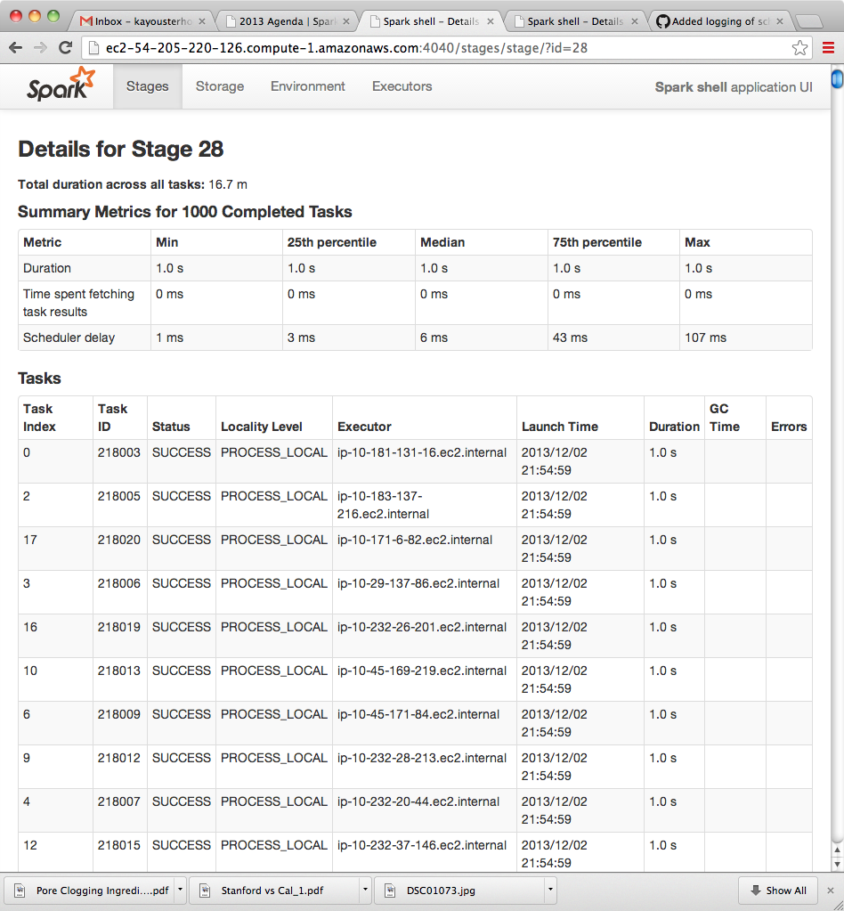

Slide 15
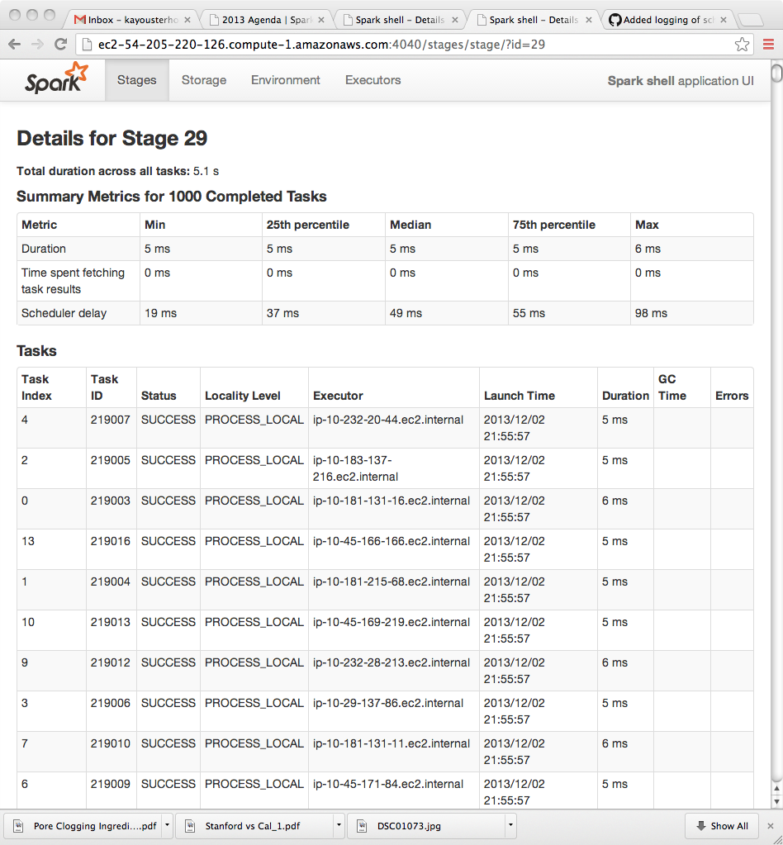

Slide 16
Spark Today
User 1
Spark Context
Worker
Worker
Query Compilation
Worker
User 2
Worker
Storage
Worker
Scheduling
User 3
Worker

Slide 17
Future Spark
User 1
Scheduler
Query compilation
Worker
Worker
Benefits:
High throughput
Fault tolerance
Worker
User 2
Scheduler
Query compilation
Worker
Worker
User 3
Scheduler
Query compilation
Worker

Slide 18
Future Spark
User 1
Scheduler
Query compilation
Worker
Worker
Storage: Tachyon
Worker
User 2
Scheduler
Query compilation
Worker
Worker
User 3
Scheduler
Query compilation
Worker

Slide 19
Scheduling with Sparrow
Worker
Scheduler
Worker
Stage
Scheduler
Worker
Scheduler
Worker
Worker
Scheduler
Worker

Slide 20
Batch Sampling
4 probes (d = 2)
Worker
Scheduler
Worker
Stage
Scheduler
Worker
Scheduler
Worker
Worker
Scheduler
Worker
Place m tasks on the least loaded of 2m workers
Notes:
Basic idea: use randomization with refinement!

Slide 21
Queue length poor predictor of wait time
80 ms
155 ms
Worker
Worker
530 ms
Poor performance on heterogeneous workloads

Slide 22
Late Binding
4 probes (d = 2)
Worker
Scheduler
Worker
Stage
Scheduler
Worker
Scheduler
Worker
Worker
Scheduler
Worker
Place m tasks on the least loaded of d•m workers

Slide 23
Late Binding
4 probes (d = 2)
Worker
Scheduler
Worker
Stage
Scheduler
Worker
Scheduler
Worker
Worker
Scheduler
Worker
Place m tasks on the least loaded of d•m workers

Slide 24
Late Binding
Worker requests task
Worker
Scheduler
Worker
Stage
Scheduler
Worker
Scheduler
Worker
Worker
Scheduler
Worker
Place m tasks on the least loaded of d•m workers

Slide 25
What about constraints?

Slide 26
Per-Task Constraints
Worker
Scheduler
Worker
Stage
Scheduler
Worker
Scheduler
Worker
Worker
Scheduler
Worker
Probe separately for each task

Slide 27
Technique Recap
Worker
Scheduler
Batch sampling
+
Late binding
+
Constraints
Worker
Scheduler
Worker
Worker
Scheduler
Worker
Scheduler
Worker

Slide 28
How well does Sparrow perform?

Slide 29
How does Sparrow compare to Spark’s native scheduler?
100 16-core EC2 nodes, 10 tasks/job, 10 schedulers, 80% load

Slide 30
TPC-H Queries: Background
TPC-H: Common benchmark for analytics workloads
Shark: SQL execution engine
Spark
Sparrow

Slide 31
TPC-H Queries
Percentiles
95
Within 12% of ideal
Median queuing delay of 9ms
75
50
25
5
100 16-core EC2 nodes, 10 schedulers, 80% load
Notes:
2 minute sampled period in the middle of the experiment (4000 queries)

Slide 32
Policy Enforcement
Priorities
Serve queues based on strict priorities
Fair Shares
Serve queues using weighted fair queuing
High Priority
Worker
User A (75%)
Worker
Low Priority
User B (25%)

Slide 33
Weighted Fair Sharing
Notes:
User 0: submits at rate to use entire cluster, user 1: adjusts submission rate every 10 seconds.

Slide 34
Fault Tolerance
✗
Spark Client 1
Scheduler 1
Spark Client 2
Scheduler 2
Timeout: 100ms
Failover: 5ms
Re-launch queries: 15ms

Slide 35
Making Sparrow feature-complete
Interfacing with UI
Delay scheduling
Speculation

Slide 36
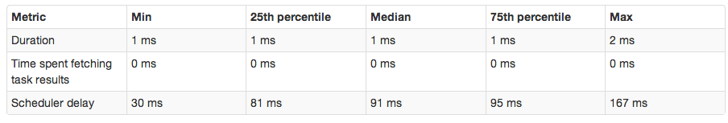
www.github.com/radlab/sparrow
(1) Diagnosing a Spark scheduling bottleneck
Worker
Scheduler
Worker
(2) Distributed, fault-tolerant scheduling with Sparrow
Scheduler
Worker
Worker
Scheduler
Worker
Scheduler
Worker

