Slide 1

Online Doctor Appointment System(ODAS)
Kayra POLAT
Baturalp KIZILTAN

Slide 2
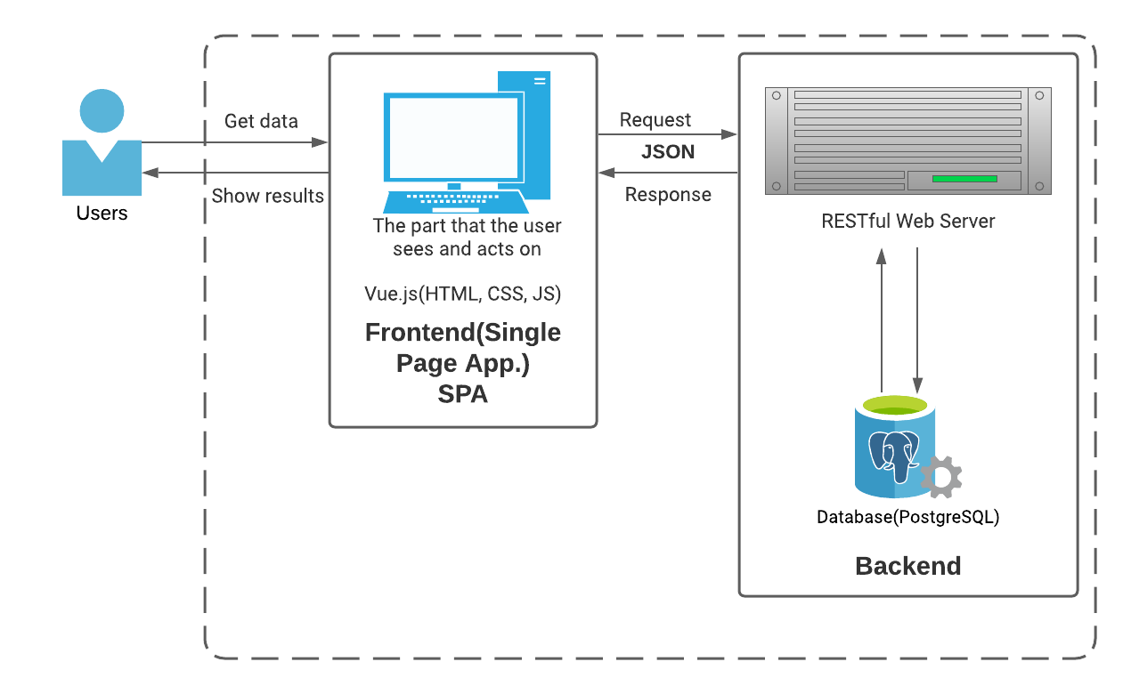


High Level Architecture
CLIENT-SERVER WEB APPLICATION

Slide 3
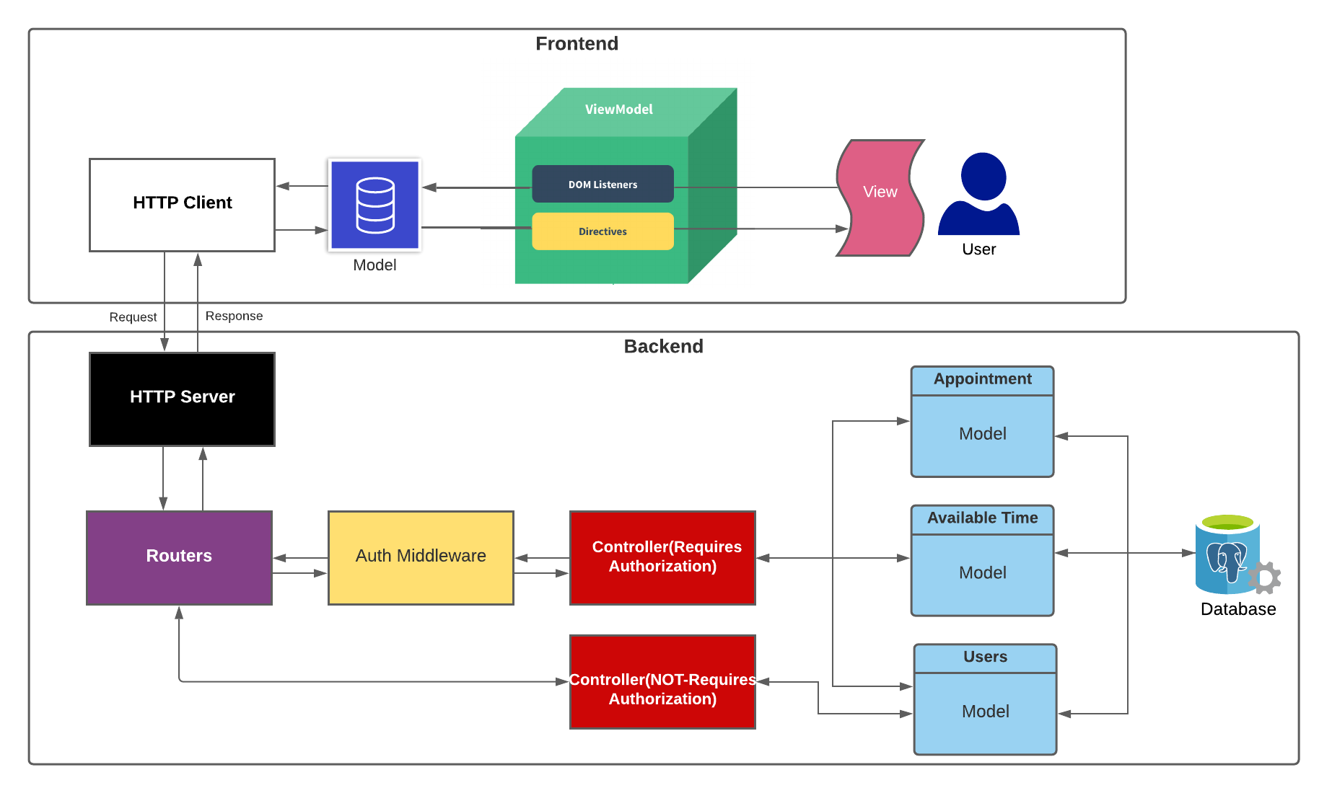
Low Level Architecture

Slide 4
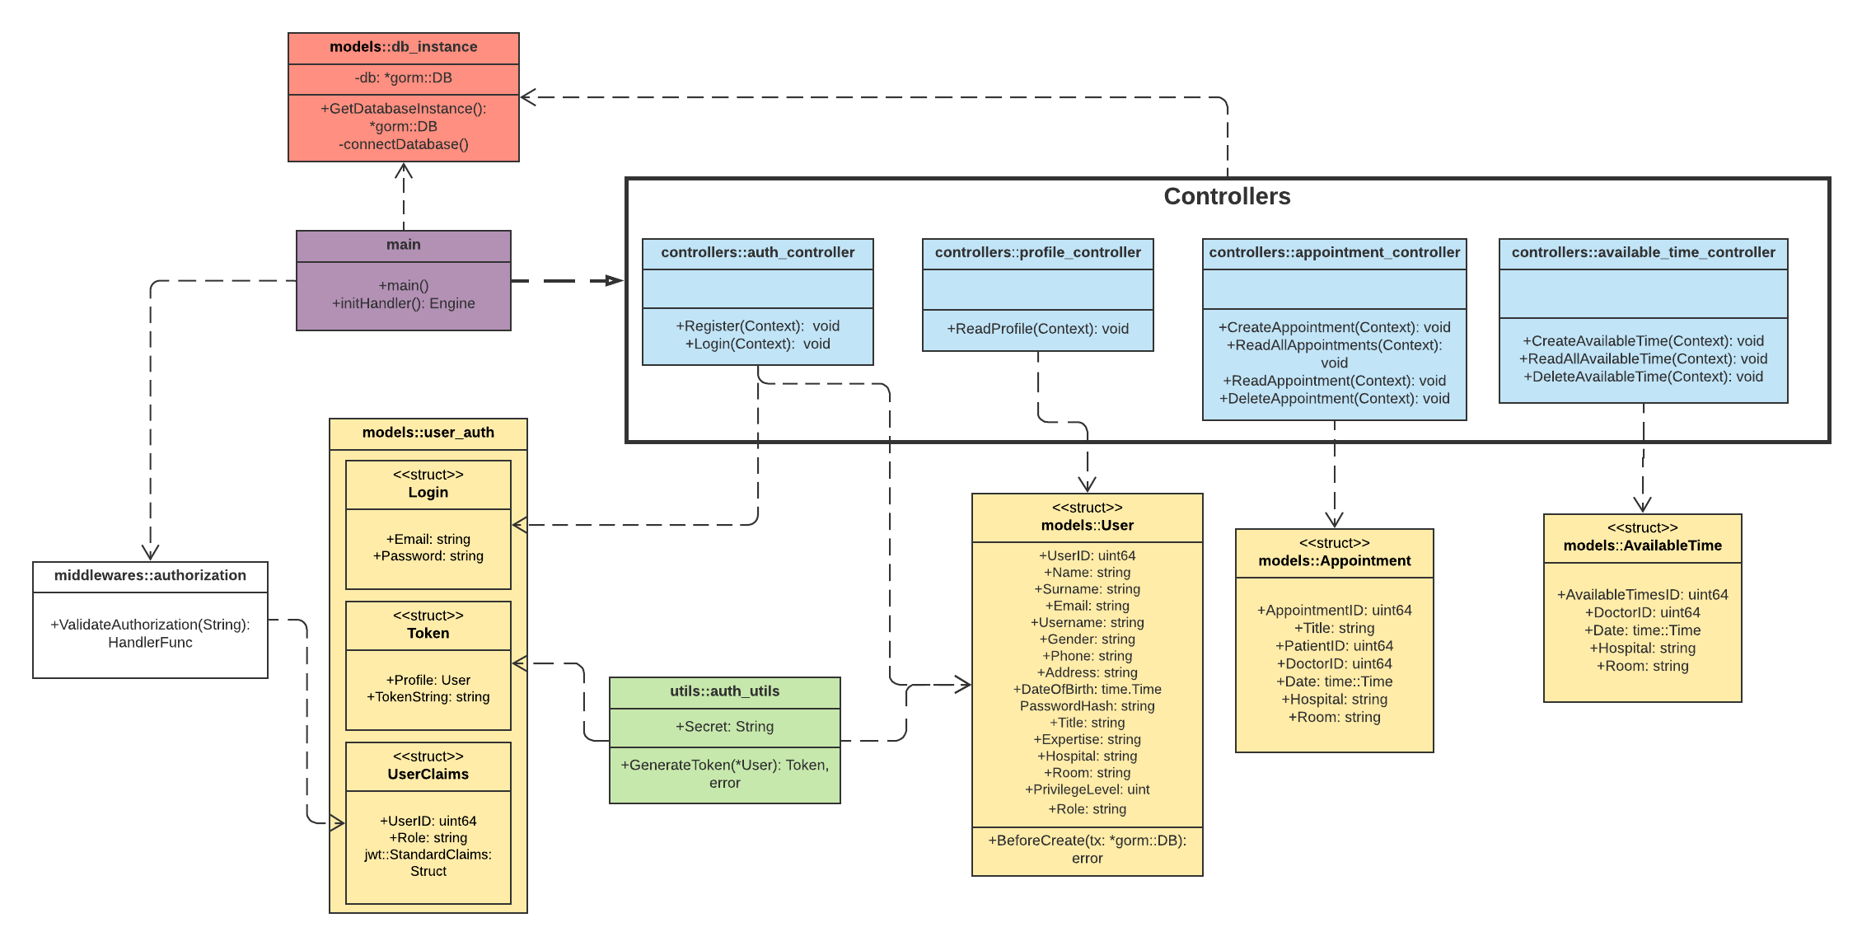
UML Class Diagram

Slide 5
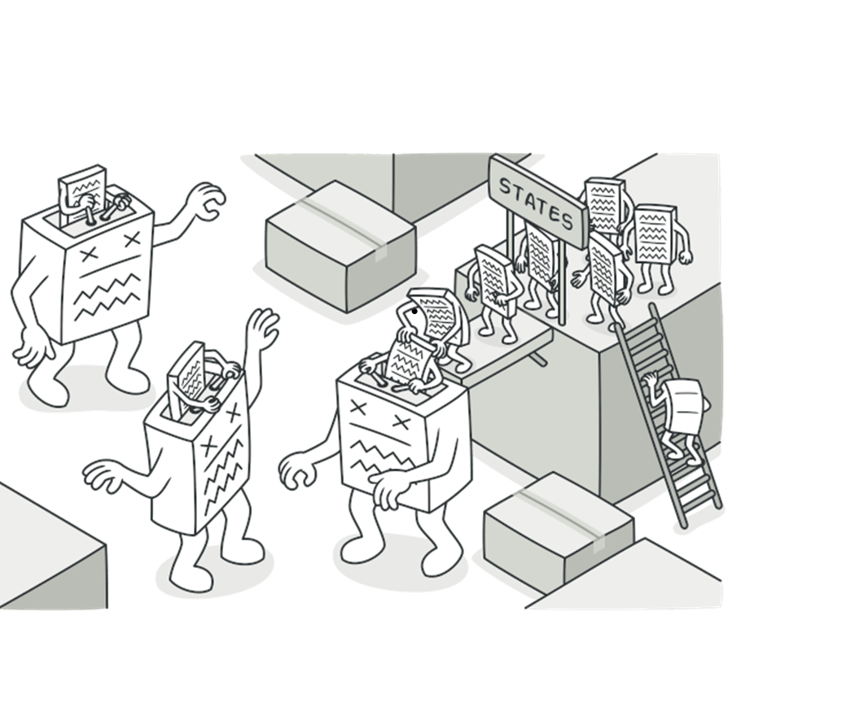
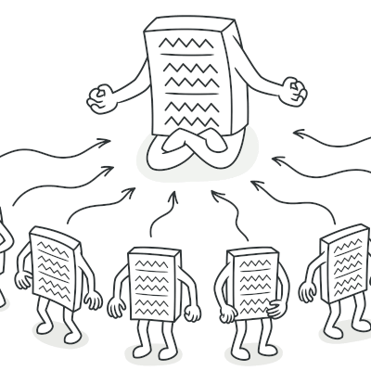
Design Patterns
SINGLETON
STATE

Slide 6
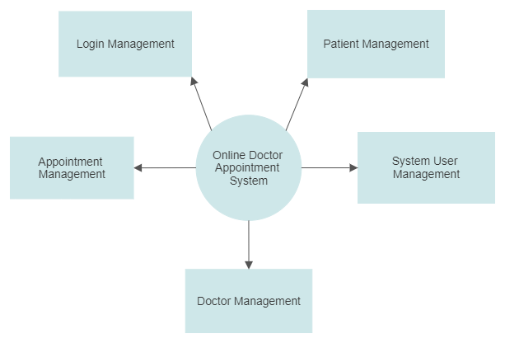
External Perspective

Slide 7





Technologies

