Slide 1



ADD COMPANY NAME
Company Profile
Write company name here
Information available in audio.

Slide 2


Agenda
About the Company | 3
Our Mission and Vision | 4
Our Goals | 5
Our Traction | 6
Our Market | 7
Our Milestones | 8
Our Management Team | 9
Our Offered Services | 10
Financial Guidance | 11
Contact Information | 13

Slide 3

About the Company
  Write the overview of your company here.
  Briefly tell your company's history and products.
Drag and drop your photo or video! Click the sample photo or video and delete. Select yours from the uploads tab, drag, and then drop inside the frame!
Back to Agenda

Slide 4
Our Mission and Vision
Mission
Write the company's mission statement here.
Briefly elaborate on what you want to discuss.
Vision
Write the company's vision
statement here.
Back to Agenda

Slide 5







Goal # 1
Elaborate on your
first goal here.
Our Goals
Goal # 2
Briefly elaborate on what you want to discuss.
Elaborate on your
second goal here.
Goal # 3
Elaborate on your
third goal here.
Back to Agenda

Slide 6

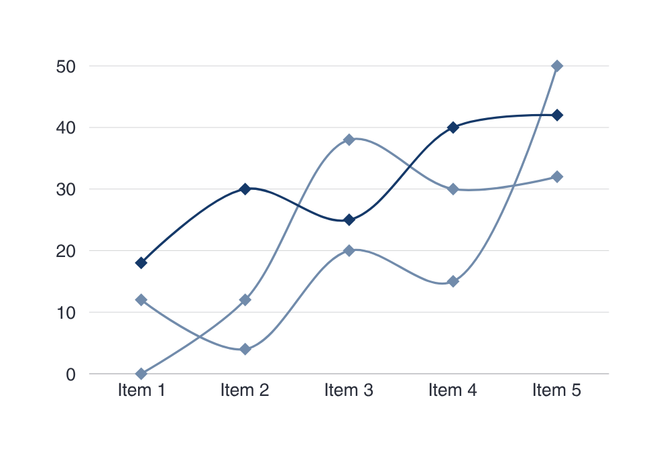
Our Traction
Back to Agenda
Briefly elaborate on what you want to discuss.
Monthly Revenue:
10 BILLION
Average Revenue/Customer:
5 BILLION
Monthly Revenue Growth:
1 BILLION

Slide 7

Our Market
10 Billion
Briefly elaborate on what you want to discuss.
5 Billion
10 BILLION
Total Available
Market (TAM)
5 BILLION
1 Billion
Serviceable Available Market (SAM)
1 BILLION
Serviceable Obtainable Market (SOM)
Back to Agenda

Slide 8
Our Milestones
Briefly elaborate on what you want to discuss.
2022
2023
2024
2025
Write an achievement, successful project or milestone here.
Write an achievement, successful project or milestone here.
Write an achievement, successful project or milestone here.
Write an achievement, successful project or milestone here.
Back to Agenda

Slide 9





Ananya Kumar
Chief Executive Officer
Our Management Team
Raja Sinha
Chief Finance Officer
Binita Das
Director
Akash Tiwari
Briefly elaborate on what you want to discuss.
Accountant
Rani Bhadauria
Finance Manager
Back to Agenda

Slide 10

Our Offered Services
List your company's services/products.
List your company's services/products.
Briefly elaborate on what you want to discuss.
List your company's services/products.
List your company's services/products.
List your company's services/products.
Back to Agenda

Slide 11
Financial Guidance
Briefly elaborate on what you want to discuss.
*Rupee amounts are in millions | FY '25 | FY '26 | YOY change
Revenue | ₹ 000 | ₹ 000 | %
Expenses
Profit
Dividend/share
Customise this table! Just right-click on any cell to see all the available table functions.
To merge, first highlight two or more cells, then click "Merge Cells" to organize your table according to your needs!
Back to Agenda

Slide 12



Use this for a photo caption.
Drag and drop your photo or video! Click the sample photo or video and delete. Select yours from the uploads tab, drag, and then drop inside the frame!
Back to Agenda

Slide 13



Connect with us.
Email
hello@reallygreatsite.com
Social Media
@reallygreatsite
Call us
123-456-789

Slide 14
Collaborate on a Whiteboard
Write a note here
Write a note here
Tip: Collaboration makes teamwork easier! Click "Share" and invite your teammates to fill this up. Use this page for bulletins, brainstorms, and other fun team ideas.
Right-click on the background of the slide, or on the thumbnail below, for the option to expand this page into a whiteboard for more space!
Copy a note, drag to the board, and write your ideas.
Copy a note, drag to the board, and write your ideas.

Slide 15
Add even more sub-ideas
Add more sub-ideas
Add more sub-ideas
Add even more sub-ideas
Add a related idea
Collaborate on a Whiteboard
Add a
main topic
Add a related idea
Add a related idea
Add even more sub-ideas
Add a related idea
Tip: Collaboration makes teamwork easier! Click "Share" and invite your teammates to fill this up. Use this page for bulletins, brainstorms, and other fun team ideas.
Right-click on the background of the slide, or on the thumbnail below, for the option to expand this page into a whiteboard for more space!
Add more sub-ideas
Add even more sub-ideas
Add more sub-ideas

Slide 16







Resource Page
Use these design resources in your Canva Presentation. Happy designing!
Delete or hide this page before presenting.

Slide 17











Resource Page
Use these design resources in your Canva Presentation. Happy designing!
Delete or hide this page before presenting.

Slide 18
Resource Page
Find the magic and fun in presenting with Canva Presentations.
Press the following keys while on Present mode!
B | for blur | C | C for confetti
D | for a drumroll | M | M for mic drop
O | for bubbles | Q | Q for quiet
U | for unveil | # | Any number from 0-9 for a timer

Slide 19
Resource Page
Presenting live not your thing? No worries! Record your Canva Presentation your audience can watch at their own pace. Don't forget to delete or hide this page before presenting.
1 | Click the Share button on the top right corner of your screen and select 'Present and Record.'
2 | Click ‘Go to recording studio,’ where you can choose the video and audio source for your video presentation.
3 | Feel free to choose the ‘No camera’ option and record your voice only.
4 | Start recording, and press pause in between takes if you have to.
5 | Once you're done, download your Canva Presentation in MP4 file format or get a link to your Talking Presentation and share it with others.
6 | You can also record a video inside the editor! Go to 'Uploads' and click on 'Record yourself'.

