Slide 1



SIDANG TUGAS AKHIR — TAHUN AJARAN 2025/2026
Company Profile
Di Universitas Pembangunan Nasional "Veteran" Jakarta | Kayra Sahadewa (0099160298) | Pembimbing: Desi Anita, S.Kom. | RPL SMK Tunas Media
SMK Tunas Media • UPN "Veteran" Jakarta

Slide 2

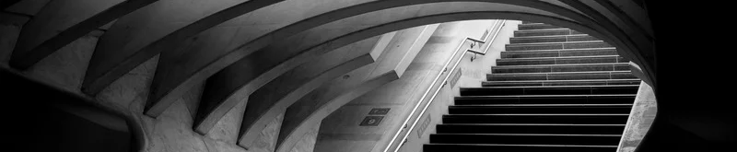
DAFTAR ISI & AGENDA PRESENTASI
Latar Belakang & Urgensi Masalah | 3
Rumusan Masalah & Solusi | 4
Tujuan Penelitian Strategis | 5
Indikator Operasional 8 Lab UPNVJ | 6
Perbandingan Sistem Berjalan vs Usulan | 7
Metodologi Waterfall (SDLC) | 8
Aktor & Hak Akses Sistem (RBAC) | 9
Fitur Unggulan Sistem Informasi | 10
Hasil Pengujian Whitebox & Blackbox | 11
Kesimpulan, Saran & Tanya Jawab | 13

Slide 3
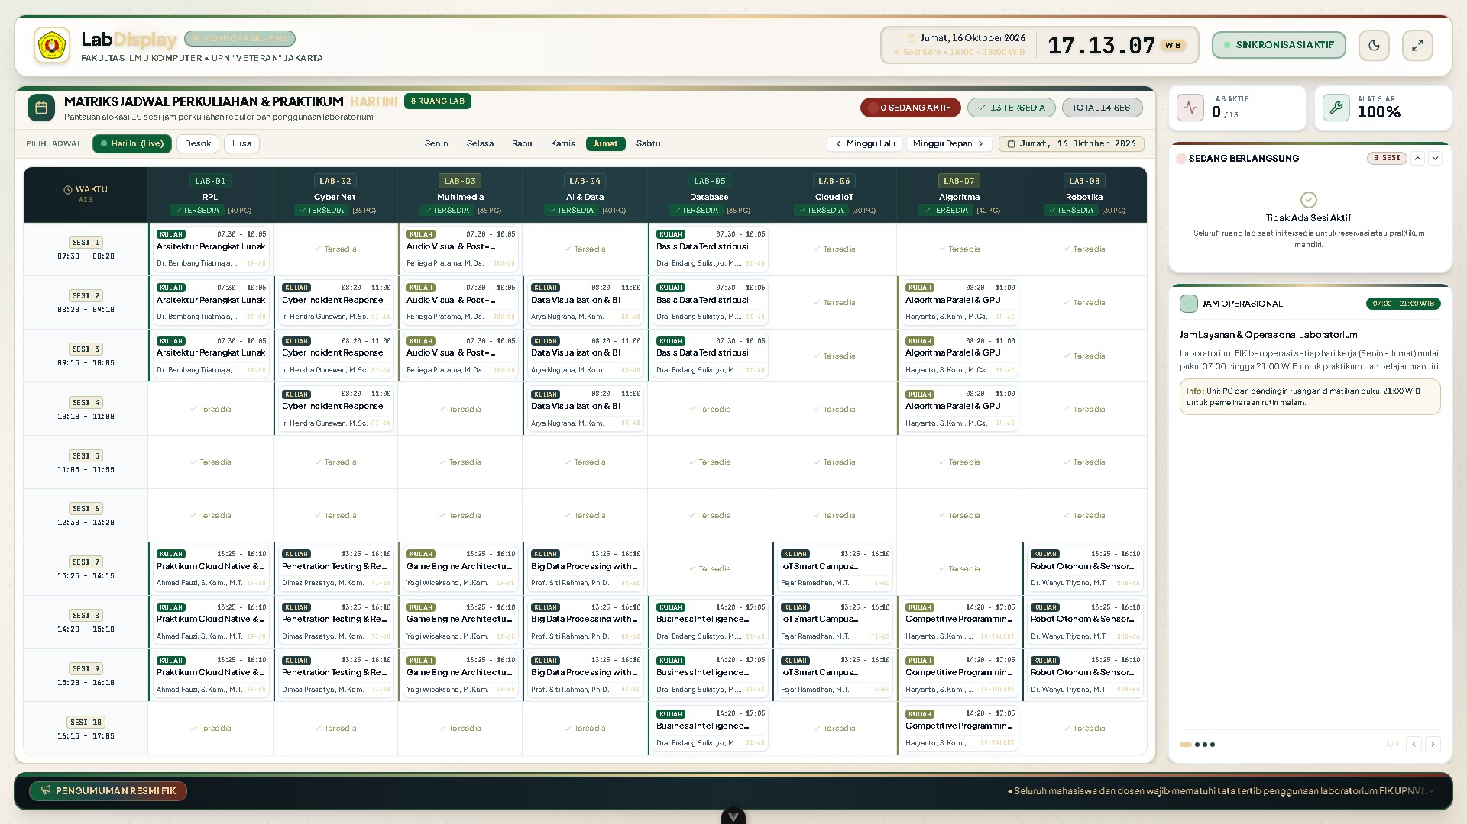
About the Company
  UPN "Veteran" Jakarta memiliki 8 laboratorium komputer aktif (LAB-RPL, MULTIMEDIA, JARINGAN, IOT, dll) dengan intensitas pemakaian tinggi lebih dari 120 jam per minggu.
  Pengelolaan jadwal konvensional via papan tulis dan ketiadaan display otomatis di lorong kerap memicu bentrok waktu pemakaian dan mengganggu jalannya perkuliahan praktikum.
Layar Display Kiosk TV 8 Laboratorium Full HD di Lorong Kampus
Back to Agenda

Slide 4
Our Mission and Vision
Solusi Usulan Terpadu
Membangun sistem berbasis web dengan WebSocket Socket.IO zero-reload, fitur permohonan pinjam lab mandiri, dan live check-in praktikum.
Landasan utama dalam perancangan dan pengembangan sistem informasi display jadwal lab.
Rumusan Masalah
Write the company's vision
dan sinkronisasi display seketika (< 500 ms) di lorong laboratorium?
Back to Agenda

Slide 5







1. Otomasi Validasi Jadwal
Elaborate on your
Menjamin 100% bebas bentrok (conflict-free).
Our Goals
2. Display Kiosk Real-Time
Tiga sasaran strategis utama pengembangan sistem display laboratorium komputer.
Elaborate on your
Menampilkan status okupansi 8 lab di layar TV lorong 24/7 dengan transmisi WebSocket (< 500 ms).
3. Digitalisasi Administrasi
Elaborate on your
Digitalisasi alur peminjaman lab (proposal 5MB), check-in praktikum, pelaporan PC error, dan ekspor Excel.
Back to Agenda

Slide 6

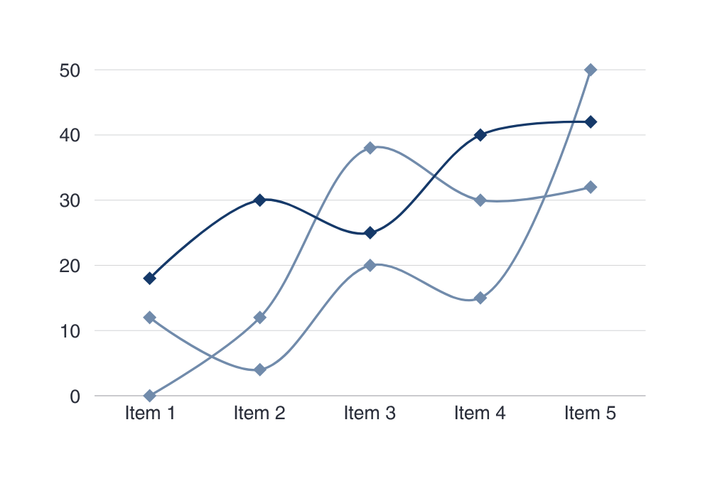
Indikator Operasional & Capaian Sistem
Back to Agenda
Metrik operasional 8 laboratorium komputer aktif di UPN "Veteran" Jakarta.
Laboratorium Komputer Terintegrasi ke Display TV
8 LAB
Total Intensitas Jam Perkuliahan & Praktikum per Minggu
> 120 JAM
Latensi Transmisi Data Real-Time WebSocket Zero-Reload
< 500 MS

Slide 7

Our Market
Sistem Konvensional
Perbandingan efisiensi alur kerja operasional lama dibandingkan sistem usulan.
Sistem Terintegrasi
SISTEM LAMA
Total Available
izin pinjam lab dengan formulir fisik berbelit.
SISTEM USULAN
100% Bebas Bentrok
Basis data terpusat 24/7, pemblokiran bentrok otomatis seketika, layar Kiosk Full HD live,
HASIL EFISIENSI
Eliminasi 100% bentrok jadwal dan transparansi status ruang bagi seluruh civitas akademika UPNVJ.
Back to Agenda

Slide 8
Our Milestones
Pendekatan bertahap sekuensial guna menjamin mutu, stabilitas, dan akurasi perangkat lunak.
01. Analisis
02. Desain
03. Pengkodean
04. Pengujian
Wawancara dengan Laboran dan observasi langsung pada 8 lab di UPNVJ.
Perancangan Use Case, ERD basis data, dan arsitektur WebSocket Gateway.
Implementasi Frontend Vue 3 TailwindCSS dan Backend Node.js / Express.
Pengujian Whitebox (Basis Path overlap) dan Blackbox (12 skenario uji klien).
Back to Agenda

Slide 9

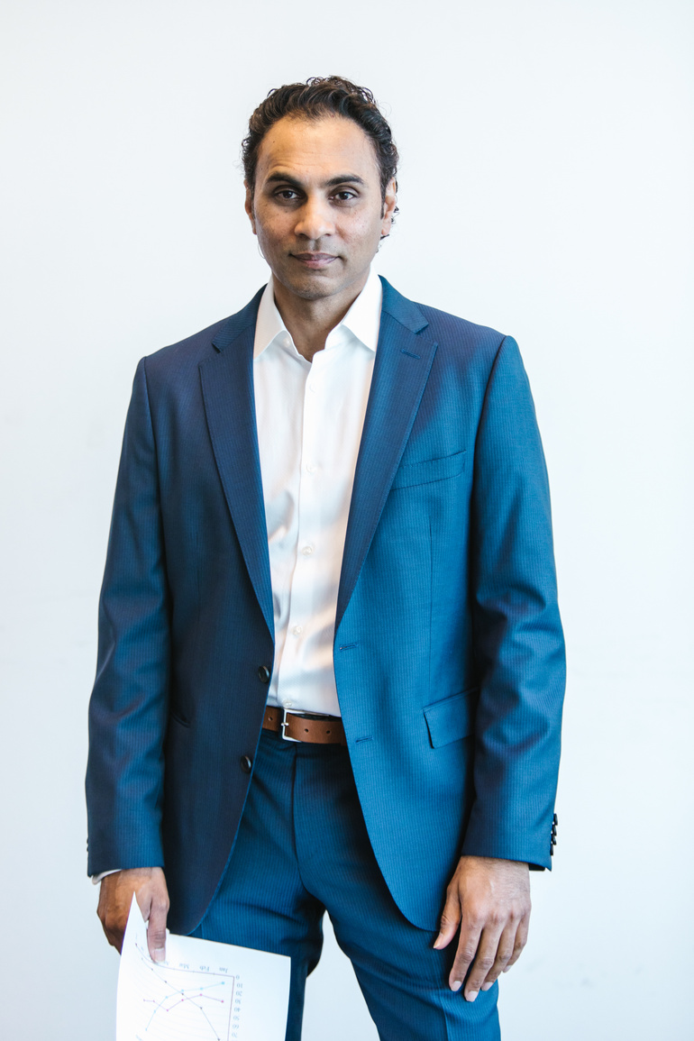

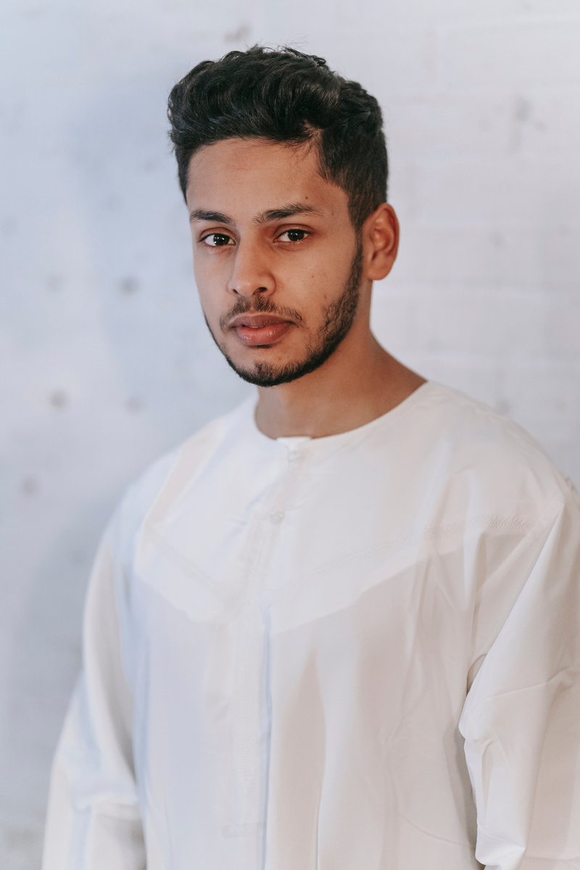

Administrator
Kelola master 8 lab, manajemen akun & role, kalender fakultas, siaran darurat.
Hak Akses Sistem (RBAC Matrix)
Laboran
Verifikasi jadwal kuliah, approval peminjaman lab, sesi praktikum, rekap Excel.
Dosen & Mahasiswa
Melihat kalender lab, pengajuan pinjam + upload proposal 5MB, lapor PC rusak.
Display Kiosk TV
Pemisahan wewenang aktor secara tegas demi integritas data dan keamanan operasional.
Layar pasif 24/7 di koridor kampus, update seketika via WebSocket tanpa login.
Sistem Daemon
Sinkronisasi otomatis status jadwal dan validasi background.
Back to Agenda

Slide 10

Our Offered Services
1. Kalender Jadwal Interaktif & Filter Lab Fleksibel
2. Engine Deteksi Bentrok Otomatis (Conflict-Free)
Modul fungsional terintegrasi untuk mendukung seluruh kebutuhan operasional laboratorium.
3. Pengajuan Peminjaman Mandiri & Upload Proposal 5MB
4. Live Check-In / Check-Out Sesi Praktikum Mahasiswa
5. Pelaporan Tiket Kendala PC Rusak & Ekspor Excel
Back to Agenda

Slide 11
Financial Guidance
Evaluasi mutu perangkat lunak berstandar akademik Bab IV Tugas Akhir.
*Pengujian menyeluruh logika internal dan fungsionalitas antarmuka sistem | White Box Testing | Black Box Testing | Hasil Evaluasi
Cakupan Uji | 100% LULUS | 100% LULUS | %
Metrik Pengujian
Kecepatan Respon
Status Kelaikan
Customise this table! Just right-click on any cell to see all the available table functions.
To merge, first highlight two or more cells, then click "Merge Cells" to organize your table according to your needs!
Back to Agenda

Slide 12
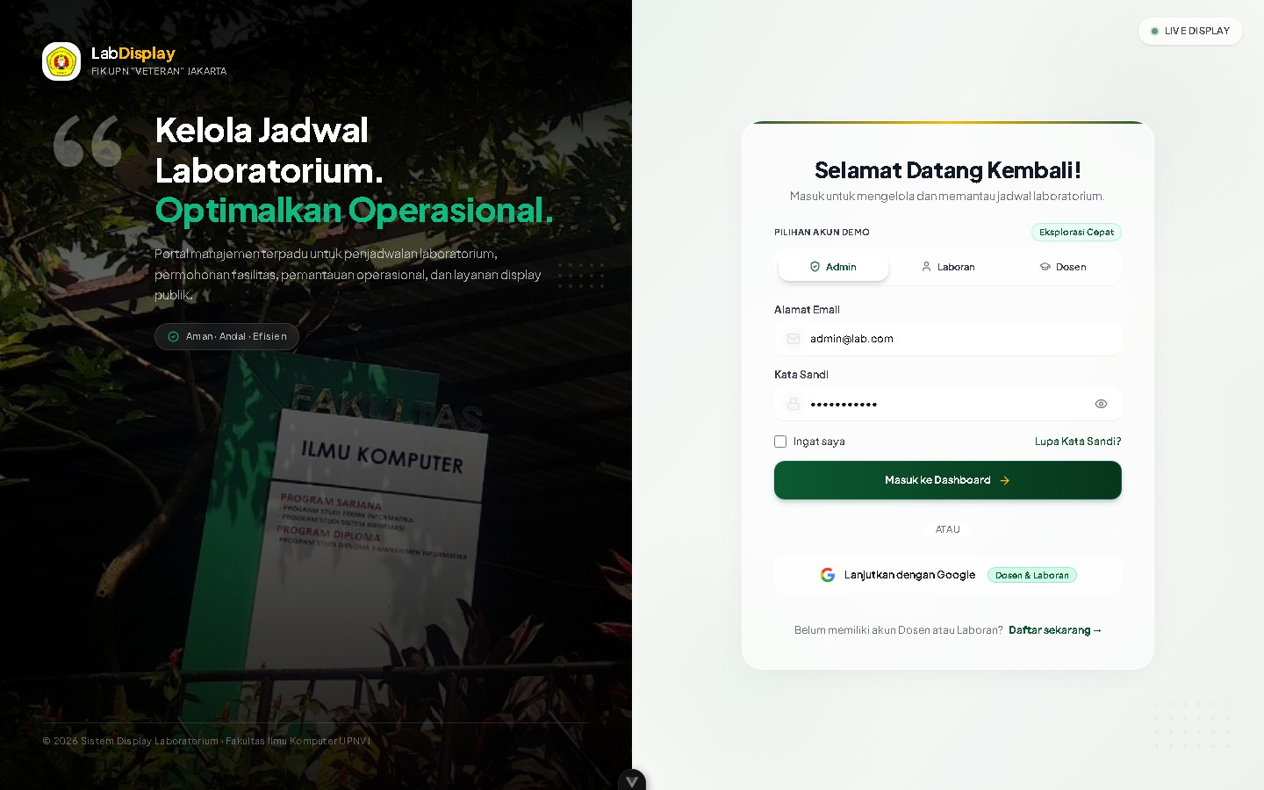
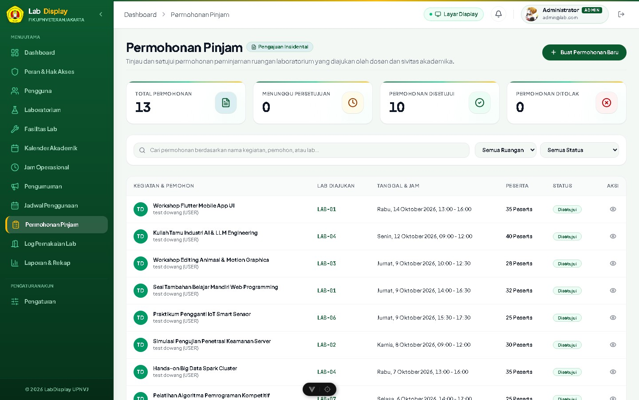
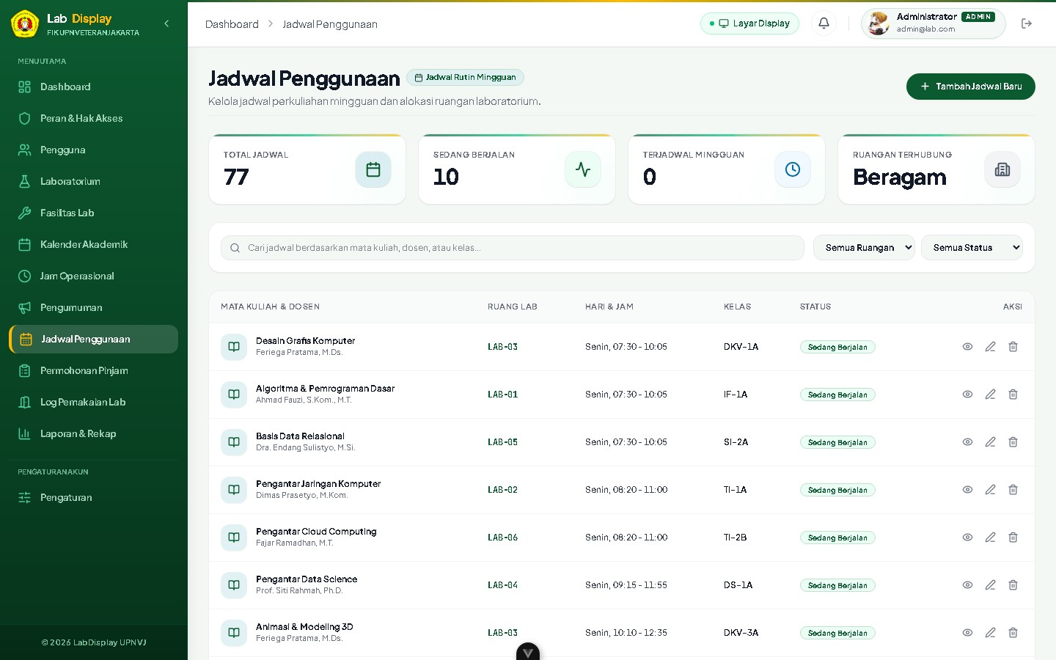
Implementasi Antarmuka: Display Kiosk TV & Dasbor Manajemen Jadwal
Layar TV Kiosk lorong 1080p menampilkan status live 8 lab secara seketika (< 500 ms) tanpa reload browser.
Back to Agenda

Slide 13



Connect with us.
Program Studi Rekayasa Perangkat Lunak
Kayra Sahadewa (0099160298)
SMK Tunas Media
Guru Pembimbing: Desi Anita, S.Kom.
Sesi Tanya Jawab (Q&A) & Uji Petik
Universitas Pembangunan Nasional "Veteran" Jakarta

Slide 14
Collaborate on a Whiteboard
Write a note here
Write a note here
Tip: Collaboration makes teamwork easier! Click "Share" and invite your teammates to fill this up. Use this page for bulletins, brainstorms, and other fun team ideas.
Right-click on the background of the slide, or on the thumbnail below, for the option to expand this page into a whiteboard for more space!
Copy a note, drag to the board, and write your ideas.
Copy a note, drag to the board, and write your ideas.

Slide 15
Add even more sub-ideas
Add more sub-ideas
Add more sub-ideas
Add even more sub-ideas
Add a related idea
Collaborate on a Whiteboard
Add a
main topic
Add a related idea
Add a related idea
Add even more sub-ideas
Add a related idea
Tip: Collaboration makes teamwork easier! Click "Share" and invite your teammates to fill this up. Use this page for bulletins, brainstorms, and other fun team ideas.
Right-click on the background of the slide, or on the thumbnail below, for the option to expand this page into a whiteboard for more space!
Add more sub-ideas
Add even more sub-ideas
Add more sub-ideas

Slide 16







Resource Page
Use these design resources in your Canva Presentation. Happy designing!
Delete or hide this page before presenting.

Slide 17











Resource Page
Use these design resources in your Canva Presentation. Happy designing!
Delete or hide this page before presenting.

Slide 18
Resource Page
Find the magic and fun in presenting with Canva Presentations.
Press the following keys while on Present mode!
B | for blur | C | C for confetti
D | for a drumroll | M | M for mic drop
O | for bubbles | Q | Q for quiet
U | for unveil | # | Any number from 0-9 for a timer

Slide 19
Resource Page
Presenting live not your thing? No worries! Record your Canva Presentation your audience can watch at their own pace. Don't forget to delete or hide this page before presenting.
1 | Click the Share button on the top right corner of your screen and select 'Present and Record.'
2 | Click ‘Go to recording studio,’ where you can choose the video and audio source for your video presentation.
3 | Feel free to choose the ‘No camera’ option and record your voice only.
4 | Start recording, and press pause in between takes if you have to.
5 | Once you're done, download your Canva Presentation in MP4 file format or get a link to your Talking Presentation and share it with others.
6 | You can also record a video inside the editor! Go to 'Uploads' and click on 'Record yourself'.

