Slide 1
ECE5578 Multimedia Communication: Homework 1 Spring 2020
By Matthew Kayrish

Slide 2
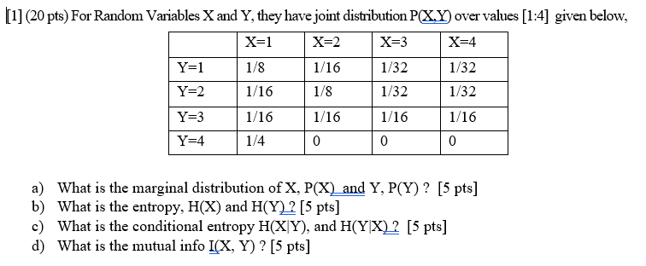
Homework 1: Problem 1

Slide 3
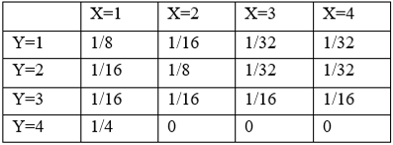
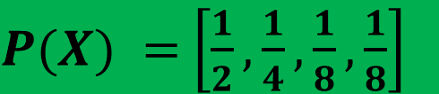
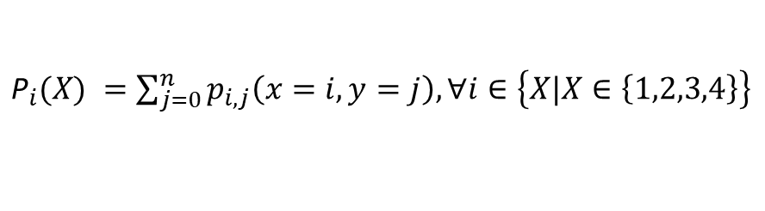




Homework 1: Problem 1(a)
What is the marginal distribution of X, P(X) and Y, P(Y)?
${\text{P}}_{i}(X) =\sum_{j=0}^{n}{p_{i,j}\left(x=i, y=j\right),∀i∈\left\{X|X∈\left\{1,2,3,4\right\}\right\}}$
${\text{P}}_{1}(X) =$ 1/2
$${\text{P}}_{2}(X) =1/4$$
$P(X) =$ $\left[\frac{1}{2},\frac{1}{4},\frac{1}{8},\frac{1}{8}\right]$
$${\text{P}}_{3}(X) =1/8$$
${\text{P}}_{4}(X) =$1/8

Slide 4
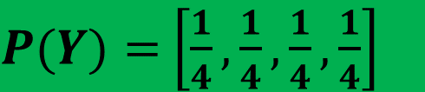
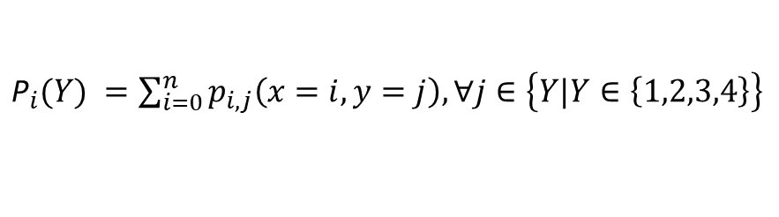




Homework 1: Problem 1(a)
What is the marginal distribution of X, P(X) and Y, P(Y)?
${\text{P}}_{i}(Y) =\sum_{i=0}^{n}{p_{i,j}\left(x=i, y=j\right),∀j∈\left\{Y|Y∈\left\{1,2,3,4\right\}\right\}}$
${\text{P}}_{1}(Y) =$ 1/4
$${\text{P}}_{2}(Y) =1/4$$
$P(Y)=$ $\left[\frac{1}{4},\frac{1}{4},\frac{1}{4},\frac{1}{4}\right]$
${\text{P}}_{3}(X) =1/$4
${\text{P}}_{4}(X) =$1/4

Slide 5
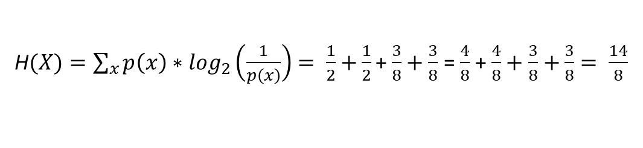

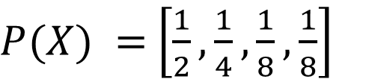
Homework 1: Problem 1(b)
What is the entropy, H(X) and H(Y)?
$P(X) =$ $\left[\frac{1}{2},\frac{1}{4},\frac{1}{8},\frac{1}{8}\right]$
H$(X)=\sum_{x}{p\left(x\right)∗\log_{2}\left(\frac{1}{p\left(x\right)}\right)= \frac{1}{2}∗\log_{2}\left(\frac{1}{1/2}\right)+}\frac{1}{4}∗\log_{2}\left(\frac{1}{1/4}\right)$ + $\frac{1}{8}∗\log_{2}\left(\frac{1}{1/8}\right)+$ $\frac{1}{8}∗\log_{2}\left(\frac{1}{1/8}\right)$
H$(X)=\sum_{x}{p\left(x\right)∗\log_{2}\left(\frac{1}{p\left(x\right)}\right)= \frac{1}{2}+}\frac{1}{2}$ + $\frac{3}{8}+\frac{3}{8}$ = $\frac{4}{8}$ + $\frac{4}{8}+\frac{3}{8}$ $+\frac{3}{8}= \frac{14}{8}$
H$(X)=$ $\frac{7}{4}$

Slide 6
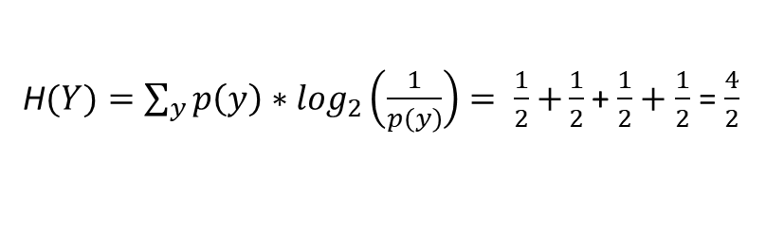

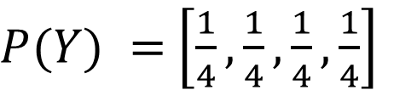
Homework 1: Problem 1(b)
What is the entropy, H(X) and H(Y)?
$P(Y) =$ $\left[\frac{1}{4},\frac{1}{4},\frac{1}{4},\frac{1}{4}\right]$
H$(Y)=\sum_{y}{p\left(y\right)∗\log_{2}\left(\frac{1}{p\left(y\right)}\right)= \frac{1}{4}∗\log_{2}\left(\frac{1}{1/4}\right)+}\frac{1}{4}∗\log_{2}\left(\frac{1}{1/4}\right)$ + $\frac{1}{4}∗\log_{2}\left(\frac{1}{1/4}\right)+$ $\frac{1}{4}∗\log_{2}\left(\frac{1}{1/4}\right)$
H$(Y)=\sum_{y}{p\left(y\right)∗\log_{2}\left(\frac{1}{p\left(y\right)}\right)= \frac{1}{2}+}\frac{1}{2}$ + $\frac{1}{2}+\frac{1}{2}$ = $\frac{4}{2}$
H$(Y)=$ 2

Slide 7

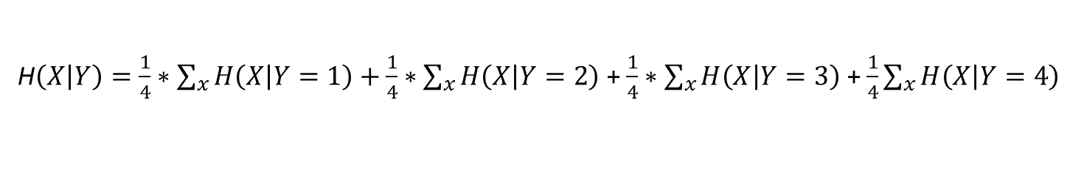
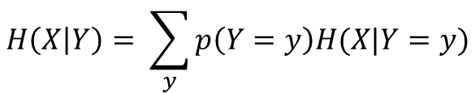
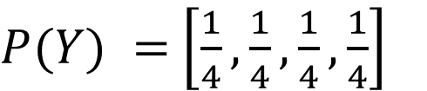
Homework 1: Problem 1(c)
What is the conditional entropy, H(X|Y) and H(Y|X)?
$P(Y) =$ $\left[\frac{1}{4},\frac{1}{4},\frac{1}{4},\frac{1}{4}\right]$
$$H\left(X | Y\right)= \sum_{y}{p\left(Y=y\right)H(X|Y=y)}$$
H$\left(X | Y\right)=\frac{1}{4}∗\sum_{x}{H\left(X | Y=1\right)}+$ $\frac{1}{4}∗\sum_{x}{H\left(X | Y=2\right)}$ + $\frac{1}{4}∗\sum_{x}{H\left(X | Y=3\right)}$ + $\frac{1}{4}\sum_{x}{H\left(X | Y=4\right)}$
H$\left(X | Y\right)=\frac{1}{4}∗\left(\frac{1}{2}+\frac{1}{2}+\frac{3}{8}+\frac{3}{8}\right)+$ $\frac{1}{4}∗\left(\frac{1}{2}+\frac{1}{2}+\frac{3}{8}+\frac{3}{8}\right)$ + $\frac{1}{4}∗\left(\frac{1}{2}+\frac{1}{2}+\frac{1}{2}+\frac{1}{2}\right)$ + $\frac{1}{4}∗\left(0+0+0+0\right)$
H$\left(X | Y\right)=\frac{1}{4}∗\frac{14}{8}+$ $\frac{1}{4}∗\frac{14}{8}$ + $\frac{1}{4}∗\frac{4}{2}$ + $\frac{1}{4}∗0$ = $\frac{7}{16}+$ $\frac{7}{16}$ + $\frac{8}{16}$ + $\frac{0}{16}= \frac{22}{16}$
H$\left(X | Y\right)=\frac{11}{8}$

Slide 8
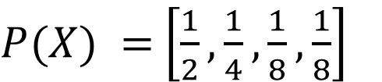
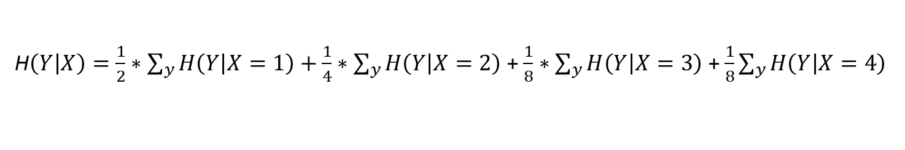

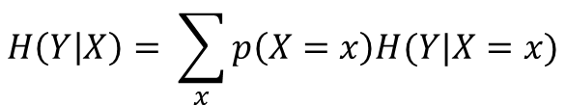
Homework 1: Problem 1(c)
What is the conditional entropy, H(X|Y) and H(Y|X)?
$P(X) =$ $\left[\frac{1}{2},\frac{1}{4},\frac{1}{8},\frac{1}{8}\right]$
$$H\left(Y | X\right)= \sum_{x}{p\left(X=x\right)H(Y|X=x)}$$
H$\left(Y | X\right)=\frac{1}{2}∗\sum_{y}{H\left(Y | X=1\right)}+$ $\frac{1}{4}∗\sum_{y}{H\left(Y | X=2\right)}$ + $\frac{1}{8}∗\sum_{y}{H\left(Y | X=3\right)}$ + $\frac{1}{8}\sum_{y}{H\left(Y | X=4\right)}$
H$\left(Y | X\right)=\frac{1}{2}∗\left(\frac{1}{2}+\frac{3}{8}+\frac{3}{8}+\frac{1}{2}\right)+$ $\frac{1}{4}∗\left(\frac{1}{2}+\frac{1}{2}+\frac{1}{2}+0\right)$ + $\frac{1}{8}∗\left(\frac{1}{2}+\frac{1}{2}+\frac{1}{2}+0\right)$ + $\frac{1}{8}∗\left(\frac{1}{2}+\frac{1}{2}+\frac{1}{2}+0\right)$
H$\left(Y | X\right)=\frac{1}{2}∗\frac{14}{8}+$ $\frac{1}{4}∗\frac{3}{2}$ + $\frac{1}{8}∗\frac{3}{2}$ + $\frac{1}{8}∗\frac{3}{2}$= $\frac{14}{16}+$ $\frac{6}{16}$ + $\frac{3}{16}$ + $\frac{3}{16}= \frac{26}{16}$
H$\left(Y | X\right)=\frac{13}{8}$

Slide 9
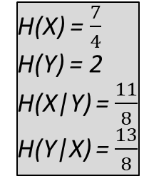
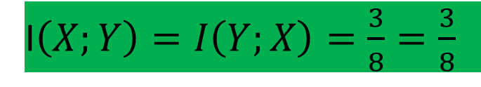
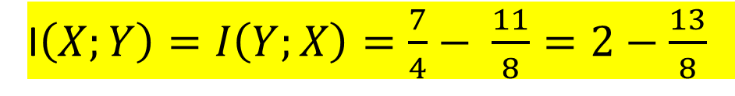
Homework 1: Problem 1(d)
What is the mutual information, I(X,Y)?
I$\left(X;Y\right)=I\left(Y;X\right)=H\left(X\right)−H\left(X | Y\right)=H\left(Y\right)−H(Y|X)$
H(X) = $\frac{7}{4}$
H(Y) = 2
H(X|Y) = $\frac{11}{8}$
H(Y|X) = $\frac{13}{8}$
I$\left(X;Y\right)=I\left(Y;X\right)=\frac{7}{4}− \frac{11}{8}=2−\frac{13}{8}$
I$\left(X;Y\right)=I\left(Y;X\right)=\frac{3}{8}=\frac{3}{8}$

Slide 10

Homework 1: Problem 2

Slide 11
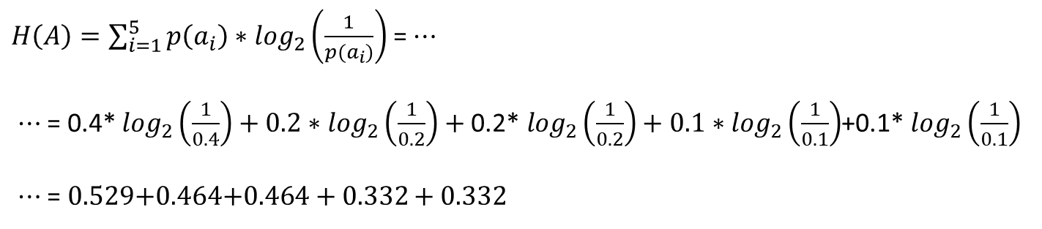


Homework 1: Problem 2(a)
$A=\left\{a_{1},a_{2},a_{3},a_{4},a_{5}\right\}$; P = $\left[0.4, 0.2, 0.2, 0.1, 0.1\right]$
What is the Entropy of this Source?
ENTROPY:
$H\left(A\right)=\sum_{i=1}^{5}{p\left(a_{i}\right)∗\log_{2}\left(\frac{1}{p(a_{i})}\right)}$ = $⋯$
$⋯$ = 0.4* $\log_{2}\left(\frac{1}{0.4}\right)+0.2∗\log_{2}\left(\frac{1}{0.2}\right)+\text{0.}\text{2}\text{∗ }\log_{2}\left(\frac{1}{0.2}\right)+0.1∗\log_{2}\left(\frac{1}{0.1}\right)$+0.1* $\log_{2}\left(\frac{1}{0.1}\right)$
$⋯$ = 0.529$+0.464\text{+}0.464+0.332$ + 0.332
$H\left(A\right)=$2.12

Slide 12
Homework 1: Problem 2(a)
$A=\left\{a_{1},a_{2},a_{3},a_{4},a_{5}\right\}$; P = $\left[0.4, 0.2, 0.2, 0.1, 0.1\right]$
Compute the Huffman Code. Show the Steps and the Prefix Tree.
a₁ = 0.4
a₂ = 0.2
a₃ = 0.2
a₄ = 0.1
a₅ = 0.1
0.4
0.4
0.4
0.6
1
1
1
0
1.0
0.2
0.4
01
01
00
0.6
0.4
0.2
000
000
0.4
1
0.2
0010
0.2
01
Symbol | Code
a₁ | 1
a₂ | 01
a₃ | 000
a₄ | 0010
a₅ | 0011
001
0011
Huffman Code =

Slide 13
Homework 1: Problem 2(a)
$A=\left\{a_{1},a_{2},a_{3},a_{4},a_{5}\right\}$; P = $\left[0.4, 0.2, 0.2, 0.1, 0.1\right]$
Compute the Huffman Code. Show the Steps and the Prefix Tree.
a₁ = 0.4
a₂ = 0.2
a₃ = 0.2
a₄ = 0.1
a₅ = 0.1
0
1
1
Symbol | Code
a₁ | 1
a₂ | 01
a₃ | 000
a₄ | 0010
a₅ | 0011
00
01
01
001
000
Huffman Code =
000
0010
0011
0010
0011

Slide 14

Homework 1: Problem 2(a)
$A=\left\{a_{1},a_{2},a_{3},a_{4},a_{5}\right\}$; P = $\left[0.4, 0.2, 0.2, 0.1, 0.1\right]$
What is the difference between average coding length and entropy?
FROM SLIDE 11: $H\left(A\right)=$2.12
a₁ = 0.4
a₂ = 0.2
a₃ = 0.2
a₄ = 0.1
a₅ = 0.1
1
01
Average Coding Length = $\frac{0.4∗1+0.2∗2+0.2∗3+0.1∗4+0.1∗4}{0.4+0.2+0.2+0.1+0.1}= \frac{2.2}{1}=2.2$
000
0010
H(A) = 2.12 bits/symbol vs. L = 2.2 bits/symbol
Difference of 0.08 bits/symbol
0011

Slide 15
Homework 1: Problem 2(b)

Slide 16
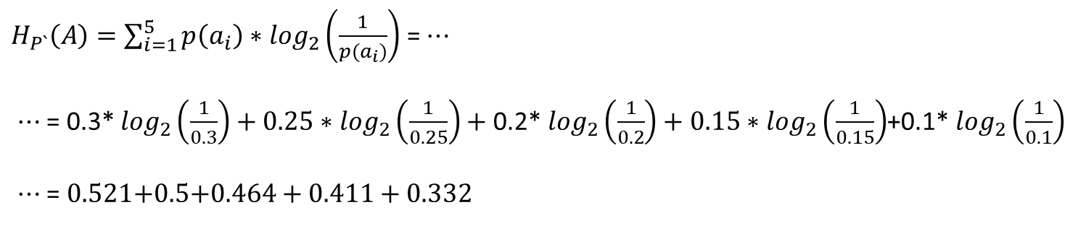

Homework 1: Problem 2(b)
$A=\left\{a_{1},a_{2},a_{3},a_{4},a_{5}\right\}$; P = $\left[0.4, 0.2, 0.2, 0.1, 0.1\right];P`= \left[0.3 0.25, 0.2, 0.15, 0.1\right]$
What is the Entropy of P`?
ENTROPY:
$H_{P`}\left(A\right)=\sum_{i=1}^{5}{p\left(a_{i}\right)∗\log_{2}\left(\frac{1}{p(a_{i})}\right)}$ = $⋯$
$⋯$ = 0.3* $\log_{2}\left(\frac{1}{0.3}\right)+0.25∗\log_{2}\left(\frac{1}{0.25}\right)+\text{0.}\text{2}\text{∗ }\log_{2}\left(\frac{1}{0.2}\right)+0.15∗\log_{2}\left(\frac{1}{0.15}\right)$+0.1* $\log_{2}\left(\frac{1}{0.1}\right)$
$⋯$ = 0.521$+0.\text{5}\text{+}0.464+0.$411 + 0.332
$H_{P`}\left(A\right)=$2.23

Slide 17
Homework 1: Problem 2(b)
$A=\left\{a_{1},a_{2},a_{3},a_{4},a_{5}\right\}$; P = $\left[0.4, 0.2, 0.2, 0.1, 0.1\right]$
Design a new Huffman Code for this Distribution.
a₁ = 0.3
a₂ = 0.25
a₃ = 0.2
a₄ = 0.15
a₅ = 0.1
0.3
0.3
0.4
0.45
0.45
0.65
00
00
00
1
0
0.25
0.25
0.25
1.0
010
010
010
0.4
0.2
0.25
0.65
0.45
111
00
111
110
0.45
0.25
1
1100
0.25
0.2
11
01
110
111
Symbol | Code
a₁ | 00
a₂ | 010
a₃ | 111
a₄ | 1100
a₅ | 1101
1101
Huffman Code =

Slide 18
Homework 1: Problem 2(b)
$A=\left\{a_{1},a_{2},a_{3},a_{4},a_{5}\right\}$; P = $\left[0.4, 0.2, 0.2, 0.1, 0.1\right]$
Design a new Huffman Code for this distribution. Show the Prefix Tree.
a₁ = 0.3
a₂ = 0.25
a₃ = 0.2
a₄ = 0.15
a₅ = 0.1
0
1
00
11
Symbol | Code
a₁ | 00
a₂ | 010
a₃ | 111
a₄ | 1100
a₅ | 1101
00
01
010
110
Huffman Code =
010
111
111
1100
1101
1100
1101

Slide 19
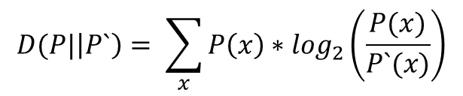


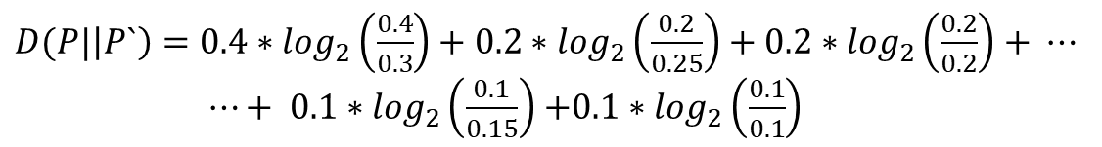
Homework 1: Problem 2(b)
$A=\left\{a_{1},a_{2},a_{3},a_{4},a_{5}\right\}$; P = $\left[0.4, 0.2, 0.2, 0.1, 0.1\right];P`= \left[0.3 0.25, 0.2, 0.15, 0.1\right]$
What is the Relative Entropy between P and P`?
ASSUMPTIONS:
P is True Distribution.
P` is Observed Distribution.
$$D(P|\left|P`\right)= \sum_{x}{P\left(x\right)∗\log_{2}\left(\frac{P(x)}{P`(x)}\right)}$$
$D(P|\left|P`\right)=0.4∗\log_{2}\left(\frac{0.4}{0.3}\right)+0.2∗\log_{2}\left(\frac{0.2}{0.25}\right)+0.2∗\log_{2}\left(\frac{0.2}{0.2}\right)$ $+ ⋯$
$⋯+ 0.1∗\log_{2}\left(\frac{0.1}{0.15}\right)$ $+0.1∗\log_{2}\left(\frac{0.1}{0.1}\right)$
$D(P|\left|P`\right)=0.166−0.0644+0$ $−$ 0.0585 + 0
$$D(P|\left|P`\right)=0.0431$$

Slide 20
Homework 1: Problem 2(b)
$A=\left\{a_{1},a_{2},a_{3},a_{4},a_{5}\right\}$; P = $\left[0.3, 0.25, 0.2, 0.15, 0.1\right]$
What is the average coding length difference of this new code?
a₁ = 0.3
a₂ = 0.25
a₃ = 0.2
a₄ = 0.15
a₅ = 0.1
00
010
Average Coding Length = $\frac{0.3∗2+0.25∗3+0.2∗3+0.15∗4+0.1∗4}{0.3+0.25+0.2+0.15+0.1}= \frac{2.95}{1}=2.95$
111
1100
H_{P`}(A)= 2.23 bits/symbol vs. L = 2.95 bits/symbol
Difference of 0.72 bits/symbol
1101

Slide 21
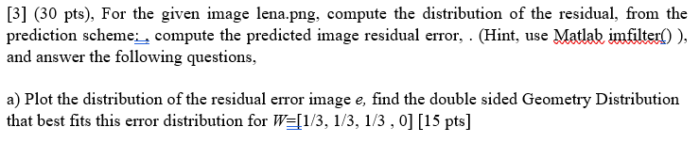
Homework 1: Problem 3

Slide 22
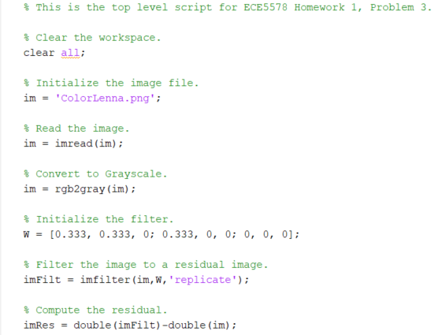
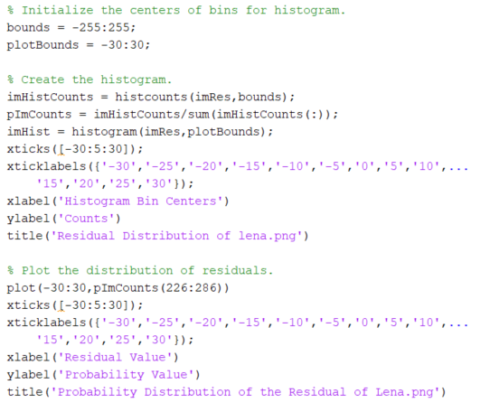
Homework 1: Problem 3(a)
Generate the Residual Error:

Slide 23
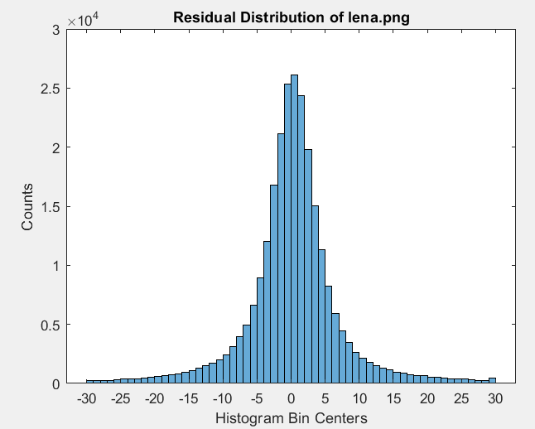
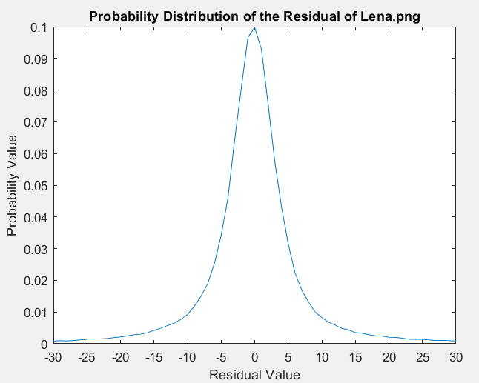
Homework 1: Problem 3(a)
Generate the Residual Error:

Slide 24
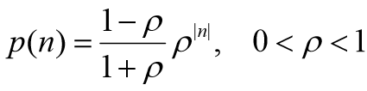
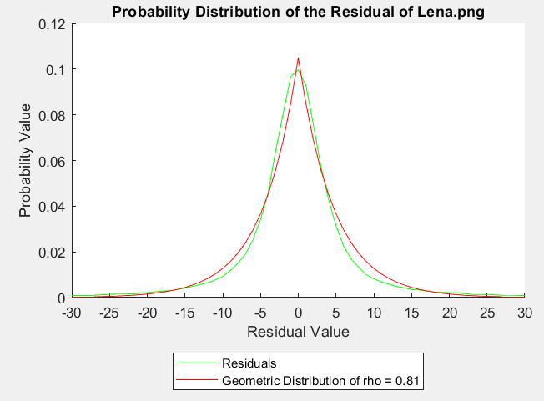
Homework 1: Problem 3(a)
Find the double sided Geometry Distribution that best fits the error.
Find the best value for ρ.
Choose ρ = 0.81

Slide 25
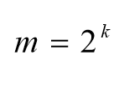
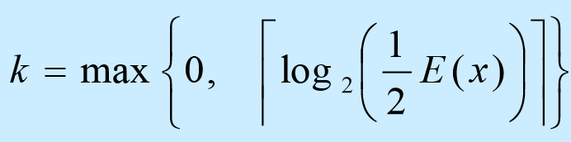


Homework 1: Problem 3(b)
Find m, such that $ρ^{m}≤\frac{1}{2}$.

Slide 26

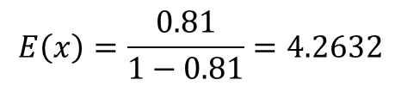
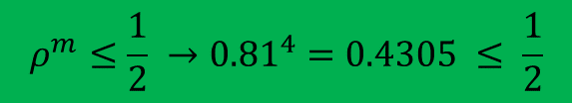

Homework 1: Problem 3(b)
$$E\left(x\right)=\frac{0.81}{1−0.81}=4.2632$$
Find m, such that $ρ^{m}≤\frac{1}{2}$.
$k=max\left\{0,\left\lceil \log_{2}\left(\frac{4.2632}{2}\right)\right\rceil \right\}$= max$\left\{0,\left\lceil 1.0919\right\rceil \right\}$=2
$$m=2^{k}=2^{2}=4$$
$$ρ^{m}≤\frac{1}{2} →{0.81}^{4}=0.4305 ≤ \frac{1}{2}$$

Slide 27
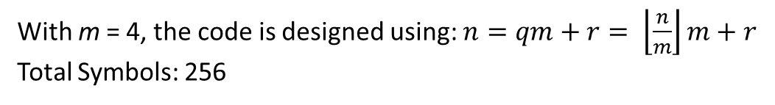
Homework 1: Problem 3(b)
With m = 4, the code is designed using: $n=qm+r= \left\lfloor \frac{n}{m}\right\rfloor m+r$
Total Symbols: 256
n | q | r | Code | Symbol
0 | 0 | 0 | 000 | 0
1 | 0 | 1 | 001 | -1
2 | 0 | 2 | 010 | 1
3 | 0 | 3 | 011 | -2
4 | 1 | 0 | 1000 | 2
5 | 1 | 1 | 1001 | -3
6 | 1 | 2 | 1010 | 3
7 | 1 | 3 | 1011 | -4
8 | 2 | 0 | 11000 | 4
9 | 2 | 1 | 11001 | -5
10 | 2 | 2 | 11010 | 5
11 | 2 | 3 | 11011 | -6
n | q | r | Code | Symbol
12 | 3 | 0 | 111000 | 6
13 | 3 | 1 | 111001 | -7
14 | 3 | 2 | 111010 | 7
15 | 3 | 3 | 111011 | -8
16 | 4 | 0 | 1111000 | 8
17 | 4 | 1 | 1111001 | -9
18 | 4 | 2 | 1111010 | 9
19 | 4 | 3 | 1111011 | -10
20 | 5 | 0 | 11111000 | 10
21 | 5 | 1 | 11111001 | -11
22 | 5 | 2 | 11111010 | 11
23 | 5 | 3 | 11111011 | -12
n | q | r | Code | Symbol
252 | 63 | 0 | 111111111111111111111111111111111111111111111111111111111111111000 | -127
253 | 63 | 1 | 111111111111111111111111111111111111111111111111111111111111111001 | 127
254 | 63 | 2 | 111111111111111111111111111111111111111111111111111111111111111010 | -128
255 | 63 | 3 | 111111111111111111111111111111111111111111111111111111111111111011 | 128
…

Slide 28
Homework 1: Problem 3(b)
With m = 4, the code is designed using: $n=qm+r= \left\lfloor \frac{n}{m}\right\rfloor m+r$
Total Symbols: 256
n | q | r | Code | Symbol
0 | 0 | 0 | 000 | 0
1 | 0 | 1 | 001 | -1
2 | 0 | 2 | 010 | 1
3 | 0 | 3 | 011 | -2
4 | 1 | 0 | 1000 | 2
5 | 1 | 1 | 1001 | -3
6 | 1 | 2 | 1010 | 3
7 | 1 | 3 | 1011 | -4
Very Common Symbols
Very Uncommon Symbols
n | q | r | Code | Symbol
252 | 63 | 0 | 111111111111111111111111111111111111111111111111111111111111111000 | -127
253 | 63 | 1 | 111111111111111111111111111111111111111111111111111111111111111001 | 127
254 | 63 | 2 | 111111111111111111111111111111111111111111111111111111111111111010 | -128
255 | 63 | 3 | 111111111111111111111111111111111111111111111111111111111111111011 | 128

Slide 29
Homework 1: Problem 3(b)
The pixels with small residuals occur more often, and therefore have shorter codes.
The pixels with large residuals occur very infrequently, and therefore have longer codes.
n is a unique identifier.
q is the quotient. It represents the unary group, and is a series of ‘1’s followed by a ‘0’.
r is the remainder. It represents the index within a unary group.
code is the codeword consisting of a series of ‘0’s and ‘1’s in an unary group and identifier within that group.
symbol is the symbol transmitted by that code.

