Slide 1
ECE5584 Digital Image Processing: Homework 4 Image Restoration with Deep Learning Supplemental Report Fall 2019
By Matthew Kayrish and Maiyue Zhang

Slide 2
Homework 4: Scope of Report
The Scope of this report is to include supplemental information that is not present in the original report. Included in this report are:
Trained Networks:
Gaussian Smoothing Noise Only
Motion Blurring Only
The results of image denoising on these networks vs the Wiener Filter

Slide 3
Training Parameters for the Next 8 Slides
Learning Rate: 1e-3
30 epochs
Noise Parameters:
Motion Blurring Only
Gaussian Smoothing Only
Number of Training Samples:
500 Samples
100 Samples
50 Samples
25 Samples
Number of Convolutional Layers:
4 Blocks
8 Blocks

Slide 4
Training Parameters: Noise Parameters
For Motion Noise/Blurring
Angle from 0: 11
Length: 21
For Gaussian Smoothing Noise
Mean: 0
Std.: 2.0

Slide 5
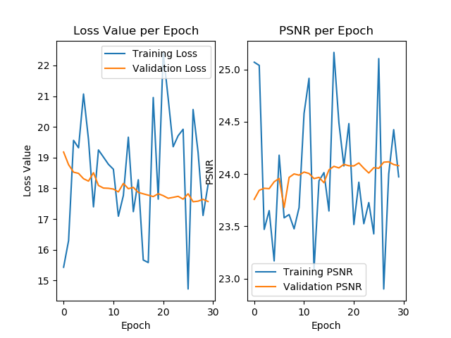
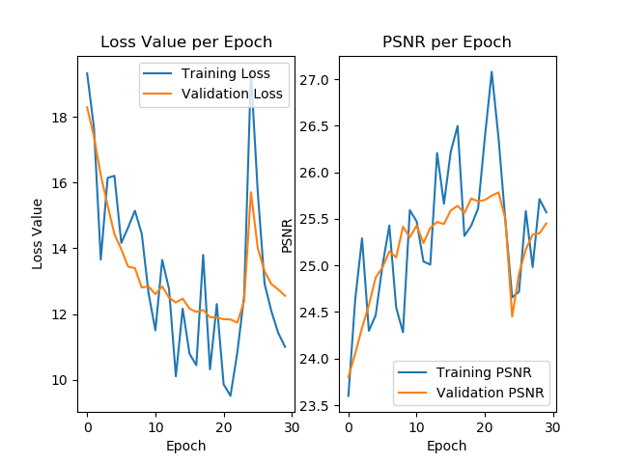
Training Results: 500 Training Images
Motion Noise Only: 4 Blocks vs 8 Blocks
4 Blocks
8 Blocks

Slide 6
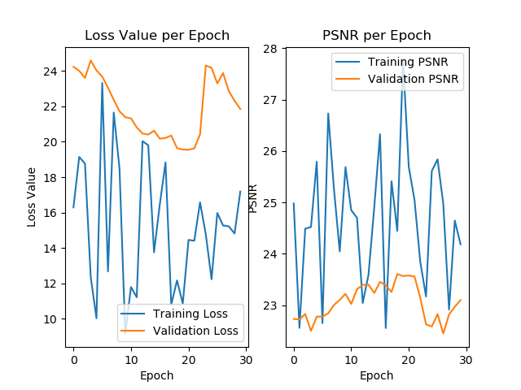
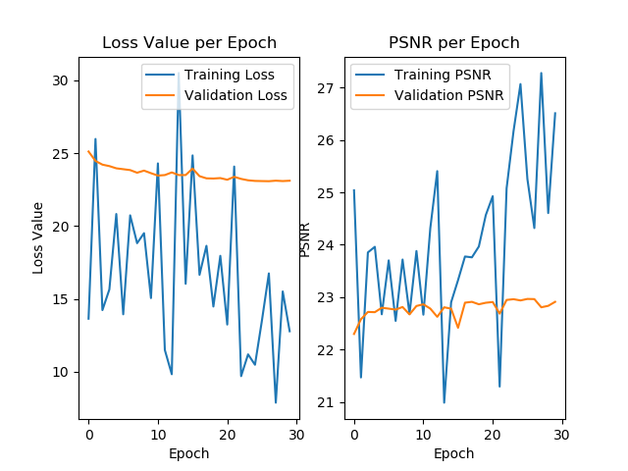
Training Results: 100 Training Images
Motion Noise Only: 4 Blocks vs 8 Blocks
4 Blocks
8 Blocks

Slide 7
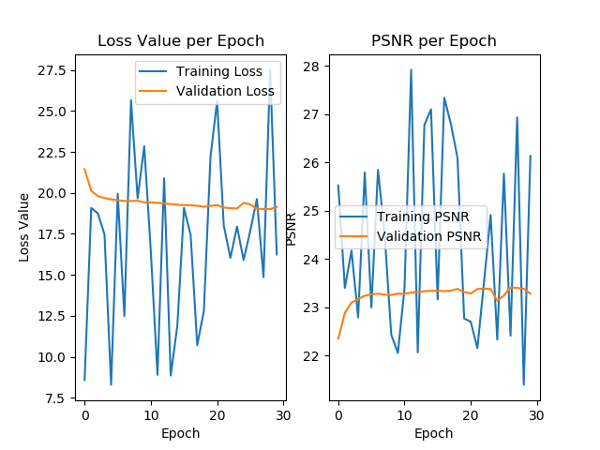
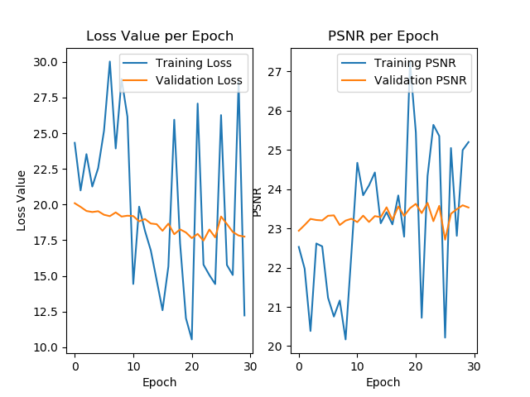
Training Results: 50 Training Images
Motion Noise Only: 4 Blocks vs 8 Blocks
4 Blocks
8 Blocks

Slide 8
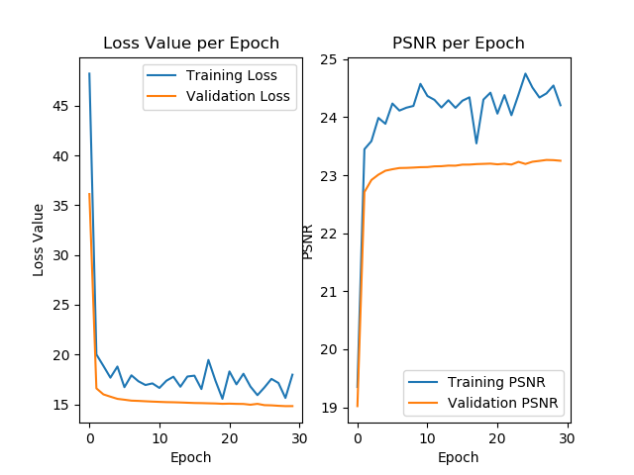
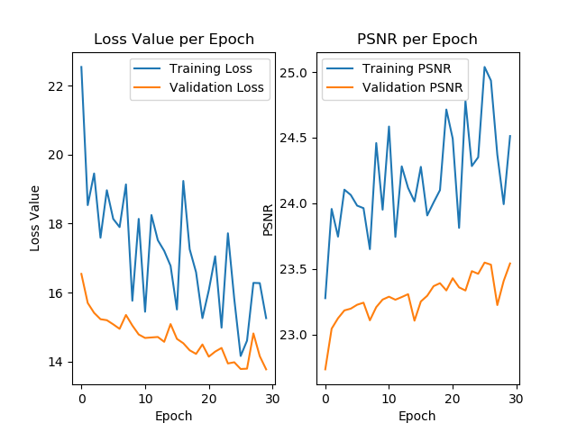
Training Results: 25 Training Images
Motion Noise Only: 4 Blocks vs 8 Blocks
4 Blocks
8 Blocks

Slide 9
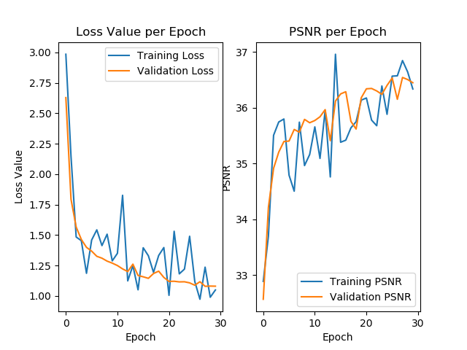
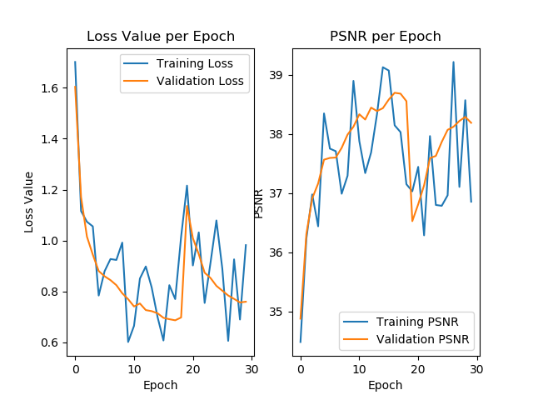
Training Results: 500 Training Images
Smoothing Noise Only: 4 Blocks vs 8 Blocks
4 Blocks
8 Blocks

Slide 10
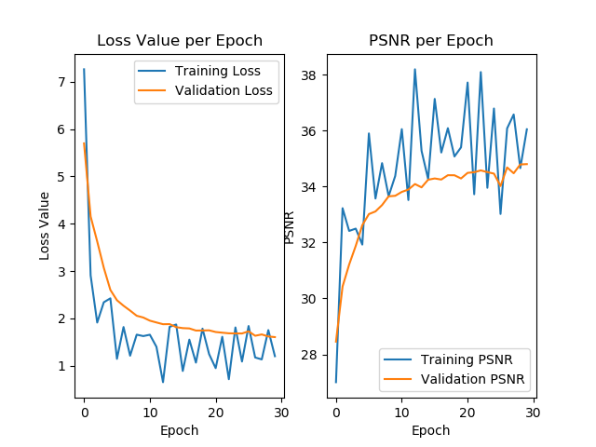
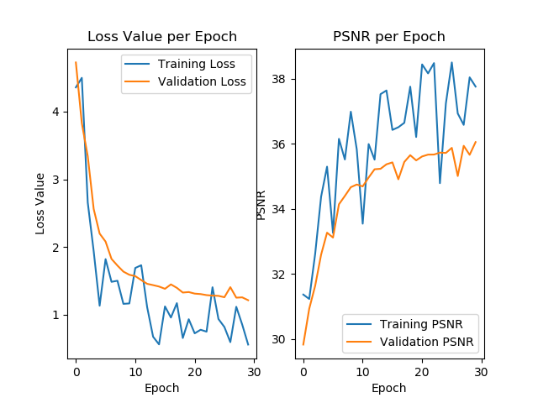
Training Results: 100 Training Images
Smoothing Noise Only: 4 Blocks vs 8 Blocks
4 Blocks
8 Blocks

Slide 11
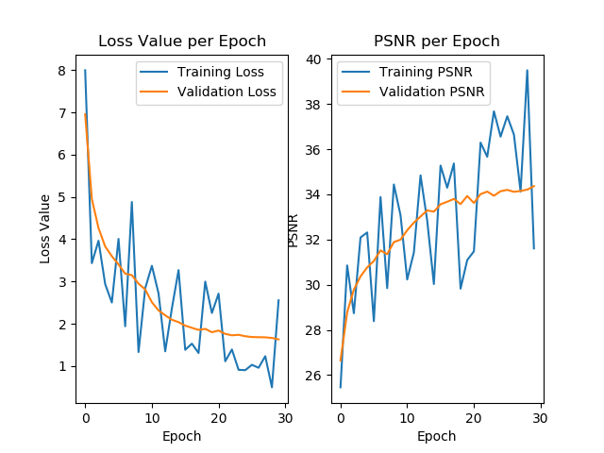
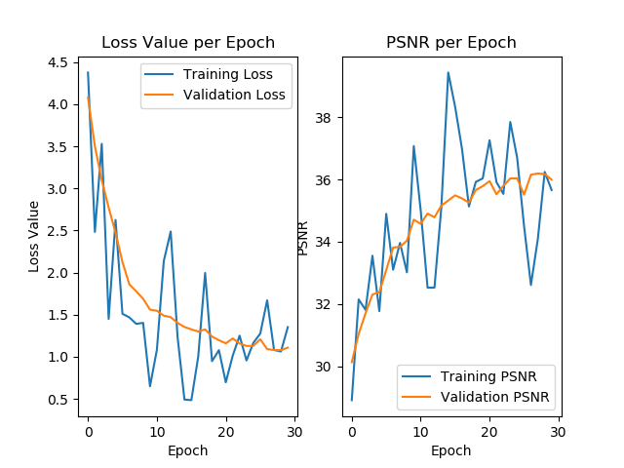
Training Results: 50 Training Images
Smoothing Noise Only: 4 Blocks vs 8 Blocks
4 Blocks
8 Blocks

Slide 12
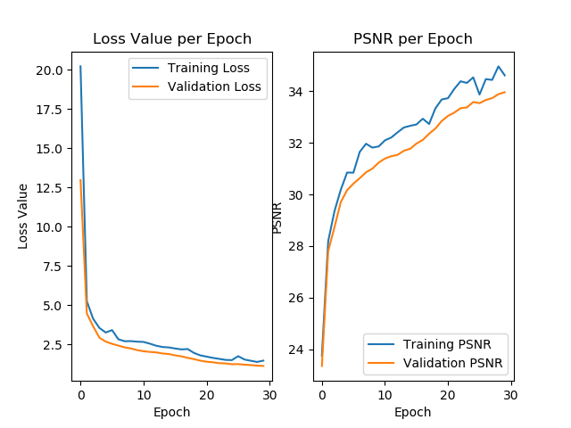
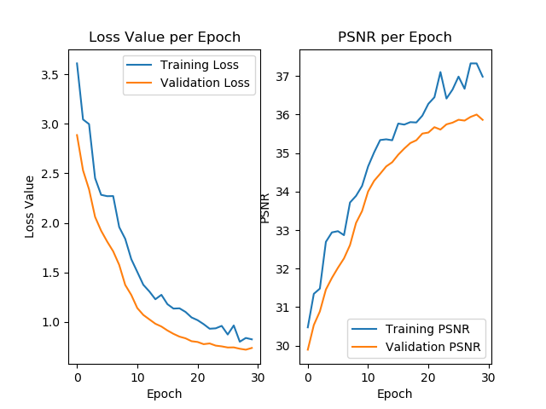
Training Results: 25 Training Images
Smoothing Noise Only: 4 Blocks vs 8 Blocks
4 Blocks
8 Blocks

Slide 13
Discussion: Number of Samples Impact on Training
As you increase the number of training samples, the model will converge faster. This is shown by the changes in the loss curve. With 500 samples, the convergence is evident very early, Where as with 25 samples, the convergence does not occur until approximately epoch ‘20’.

Slide 14
Discussion: Number of Layers Impact on Training
In all cases, 8 block networks give slightly higher PSNR and slightly lower loss at convergence than 4 block networks.

Slide 15
Testing Parameters:
For Testing, we chose the models trained with 500 training images since they seemed to have the best convergence.
We tested our network against Lena and Cameraman
For Motion Noise/Blurring
Angle from 0: 11
Length: 21
For Gaussian Smoothing Noise
Mean: 0
Std.: 2.0

Slide 16
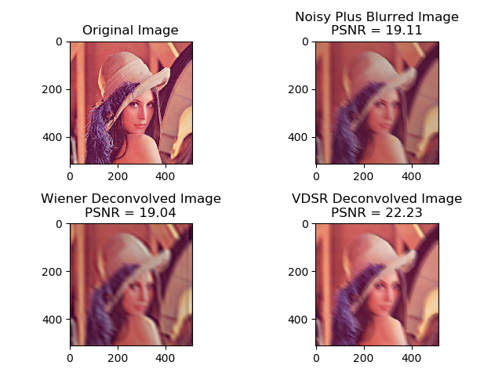
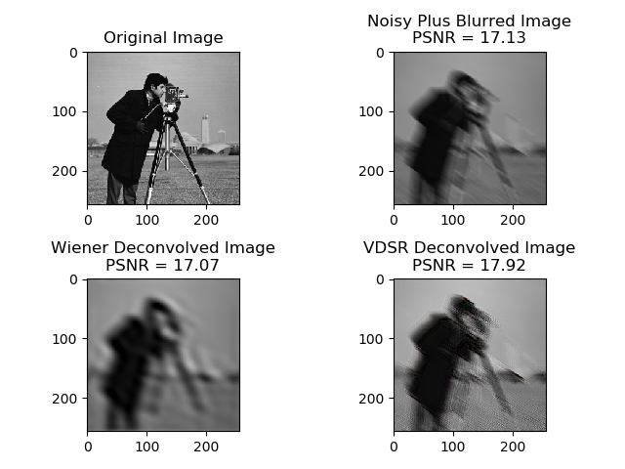
Testing: Motion Noise 4 Layers

Slide 17
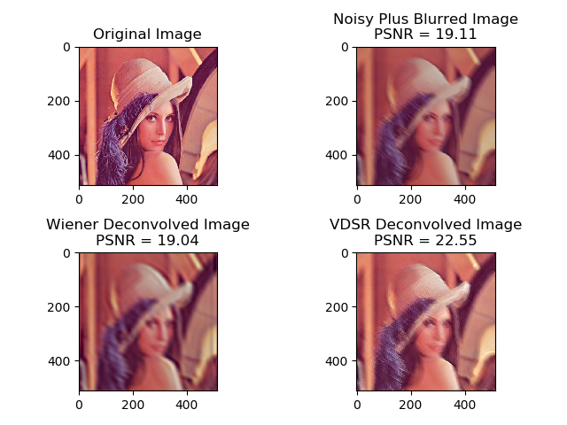
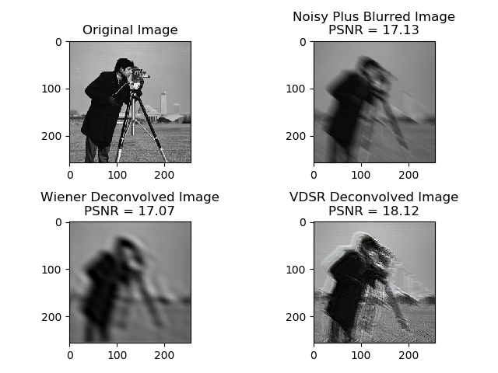
Testing: Motion Noise 8 Layers

Slide 18
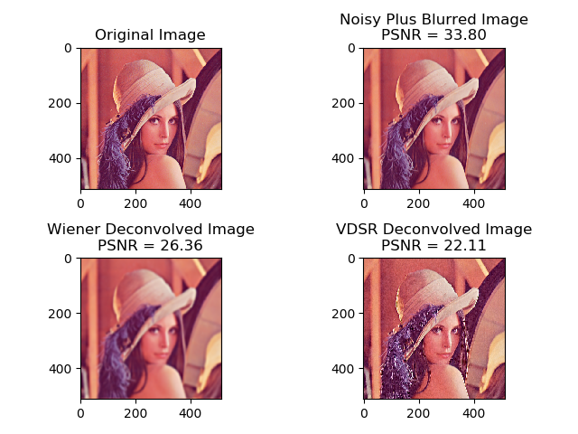
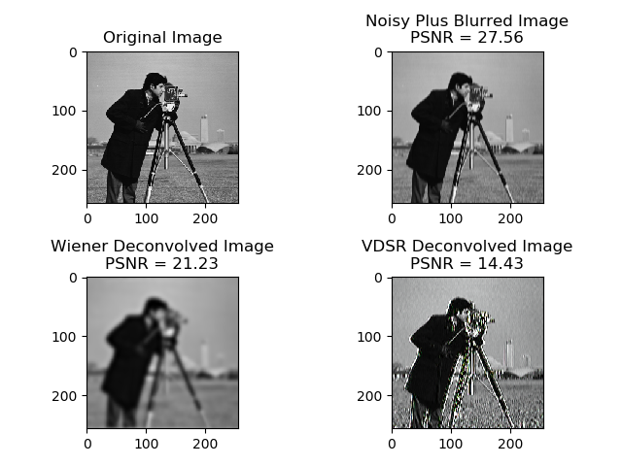
Testing: Smoothing Noise 4 Layers

Slide 19
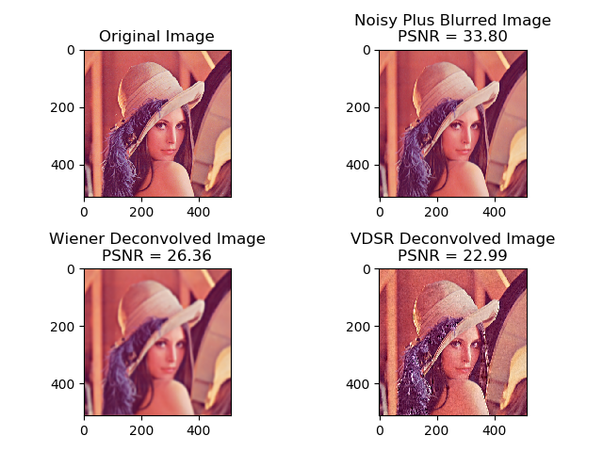
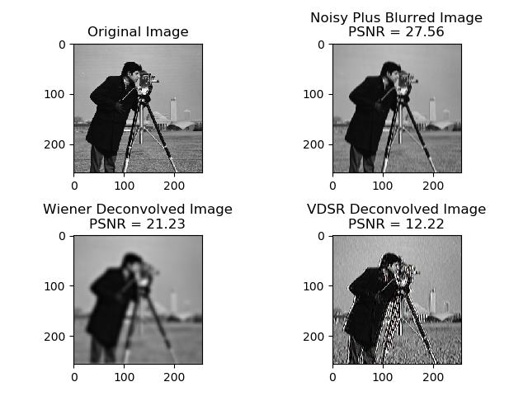
Testing: Smoothing Noise 8 Layers

Slide 20
Discussion: Testing – Wiener Filter
Motion Only Noise: the Wiener filter performed very well. It was effective at smoothing the image and providing a solid PSNR. This is because the Wiener filter is capable of removing the high frequency components of motion blurring.
Smoothing Noise Only: the Wiener Filter performed moderately. It was not able to reproduce an image of the same PSNR as the original image. This is because the smoothing noise does not have many high frequency components.

Slide 21
Discussion: Testing – CNN
Motion Only Noise: the CNN was able to produce a better PSNR than both the original noisy image and the Wiener Filter. This is because the CNN is capable of learning the high frequency components of motion blurring.
Smoothing Noise Only: the CNN seemed to struggle for the Gaussian Smoothing noise. It performed worse than the Wiener Filter. This is because the smoothing noise smooths out the residuals that the CNN needs to learn.

Slide 22
Conclusion: CNN vs Wiener Filter
CNN
Wiener Filter
Filters out Motion Noise effectively
Struggles in filtering out Gaussian Smoothing effectively
The CNN performs better when the residuals are large. Therefore, when the blurring is caused by Gaussian smoothing, the CNN struggles.
Better for Additive Gaussian White Noise
Filters out both Motion Noise quite well because it addresses the high frequency components.
Does not perform as well for Gaussian Smoothing because there are less high frequency components.
Performs better than CNN for Gaussian Smoothing.
Not as good for Additive Gaussian White Noise.
CNN outperformed the Wiener Filter for Image Denoising when Gaussian White
Noise was Present. The Wiener Filter outperformed the CNN when Gaussian White
Noise was not present. This because the Wiener filter is effective for High frequency
components, whereas the CNN is better for learning residuals.

