Slide 1
ECE5584 – Digital Image Processing Homework 1 Fall 2019
By Matthew Kayrish

Slide 2
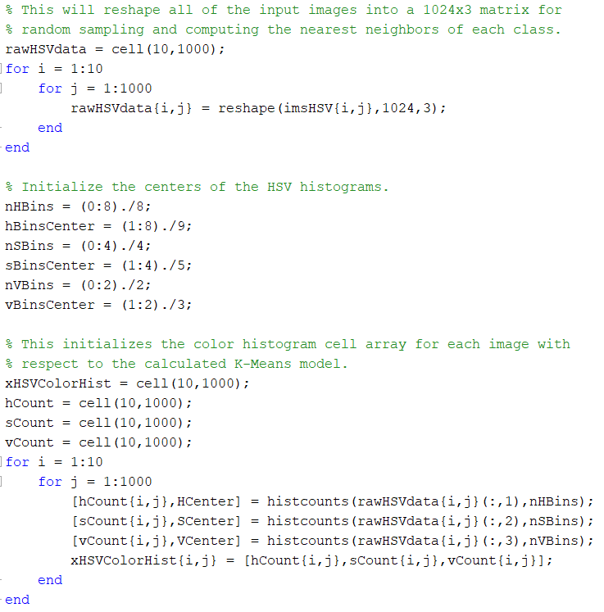
Problem 1: Histogram
“For each image compute the HSV space 64-dimension color histogram by uniformly quantize the space into H: 8 S: 4 V: 2 bins.”

Slide 3
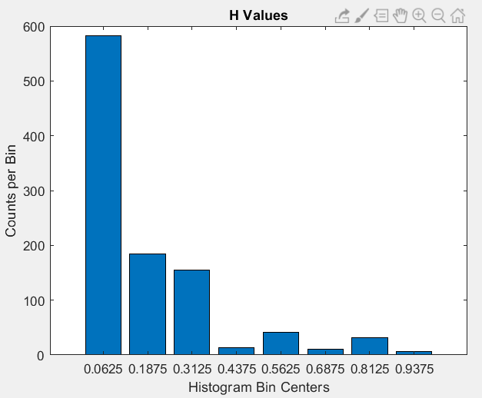
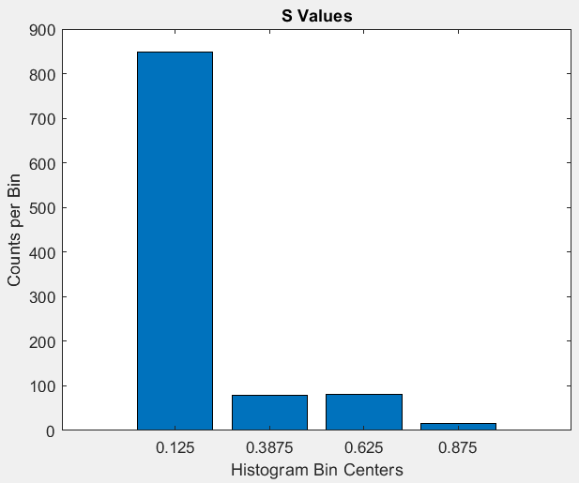
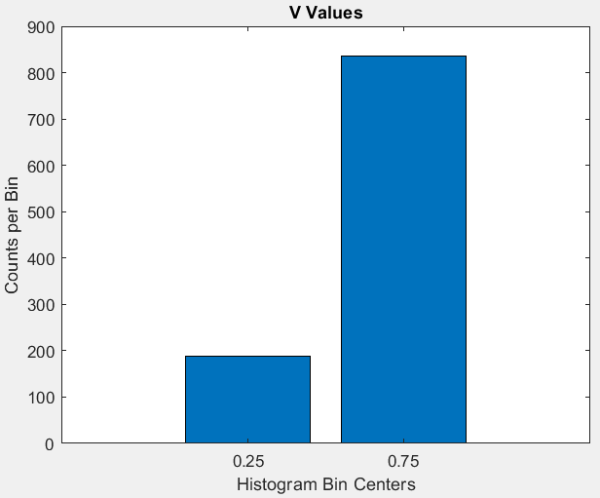
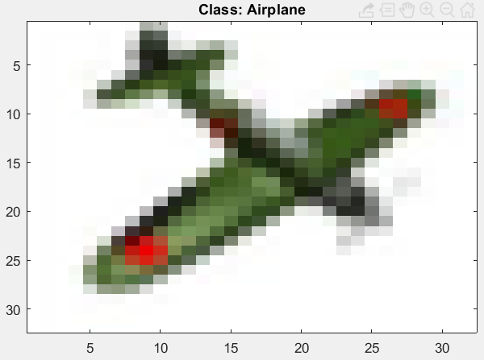
Problem 1: Histogram Example

Slide 4
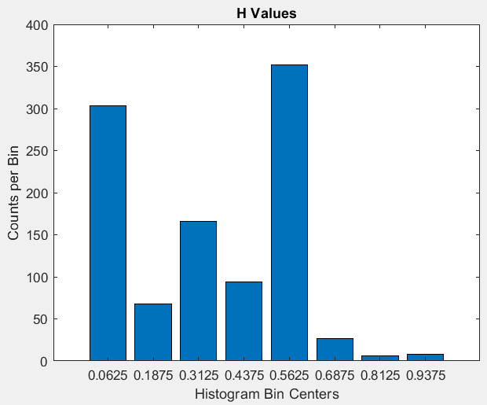
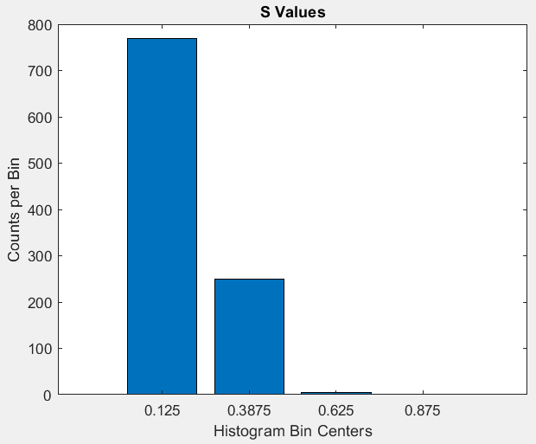
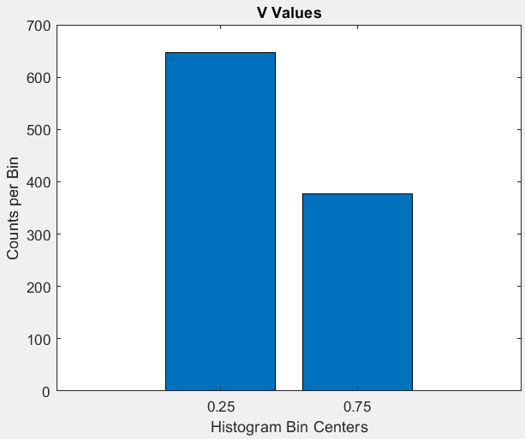
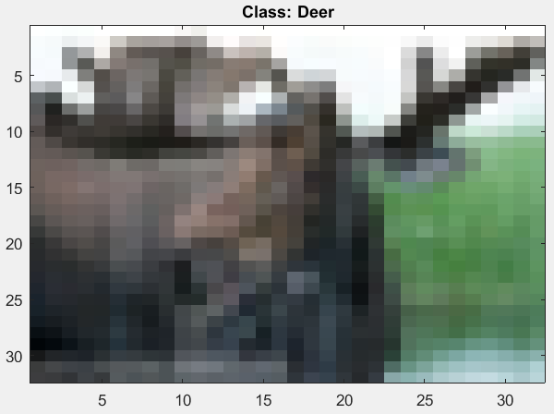
Problem 1: Histogram Example

Slide 5
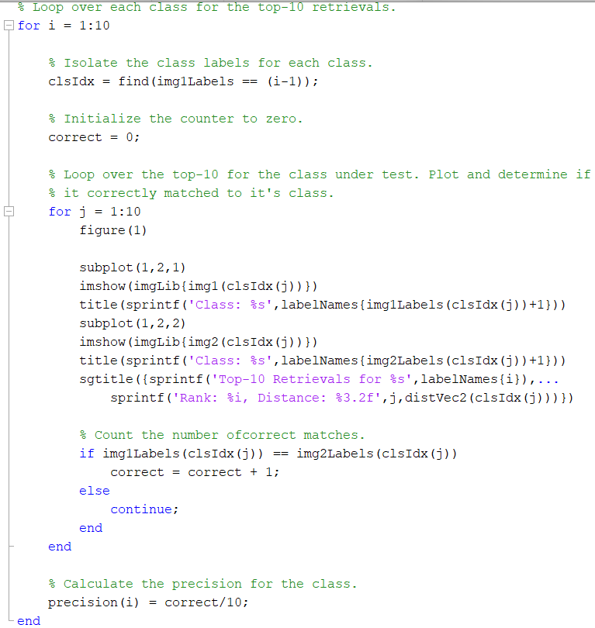
Problem 1: Image Retrieval
“Conduct top-10 retrieval for the labels illustrated above w.r.t the test data set (100 labels, 100 images each), and show results and matlab code.”

Slide 6
Problem 1: Image Retrieval
Overall Precision for Class-wise Top-10: 25%
Class | Precision
Airplane | 20%
Automobile | 40%
Bird | 20%
Cat | 20%
Deer | 40%
Dog | 10%
Frog | 10%
Horse | 0%
Ship | 60%
Truck | 30%

Slide 7
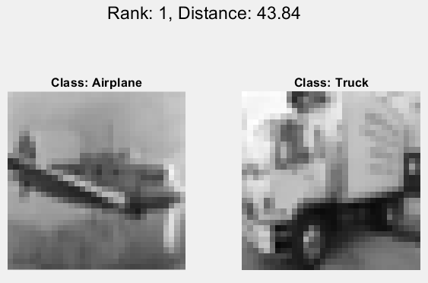
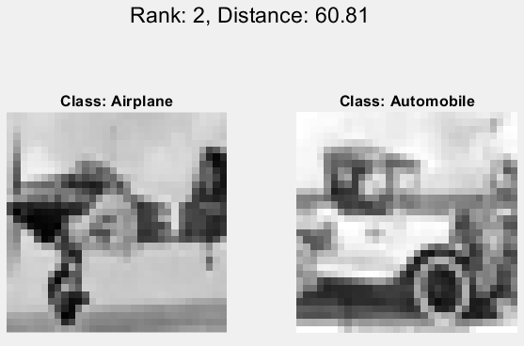
Problem 1: Airplane Retrieval
Top-10 Precision for Airplane Retrieval: 20%

Slide 8
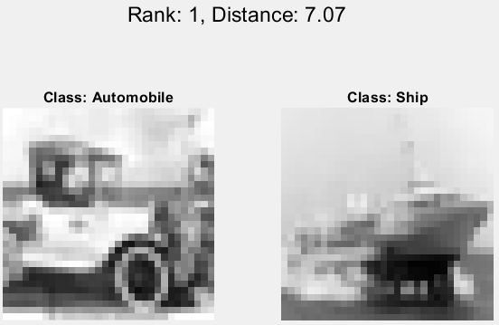
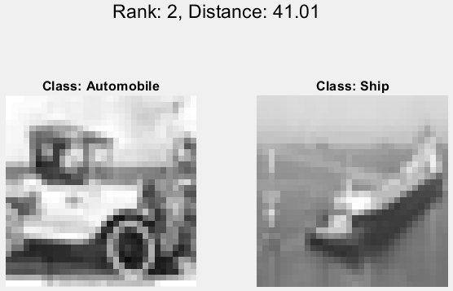
Problem 1: Automobile Retrieval
Top-10 Precision for Automobile Retrieval: 40%

Slide 9
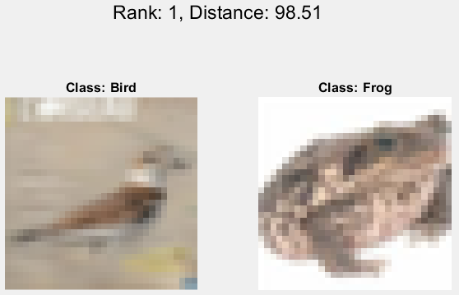
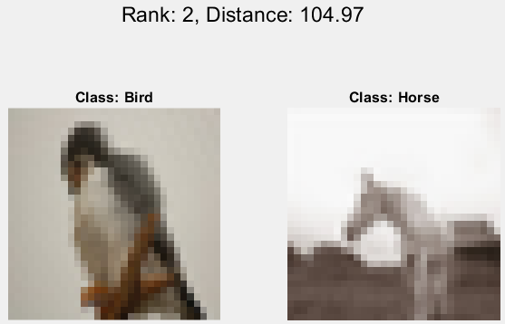
Problem 1: Bird Retrieval
Top-10 Precision for Bird Retrieval: 20%

Slide 10
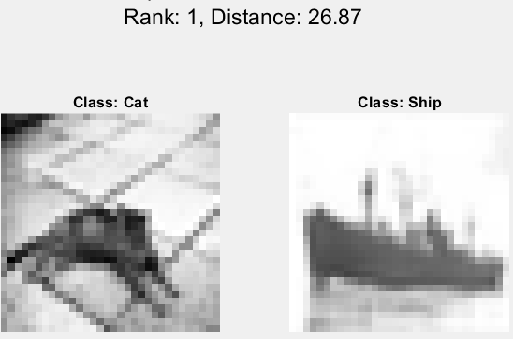
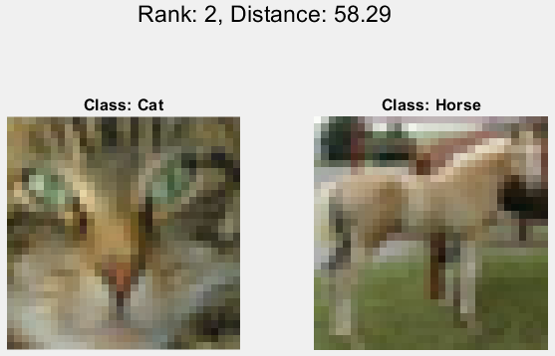
Problem 1: Cat Retrieval
Top-10 Precision for Cat Retrieval: 20%

Slide 11
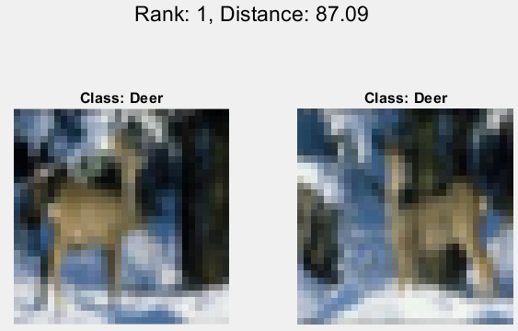
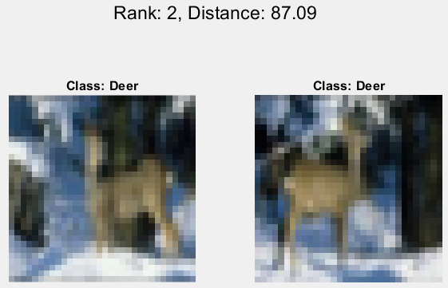
Problem 1: Deer Retrieval
Top-10 Precision for Deer Retrieval: 40%

Slide 12
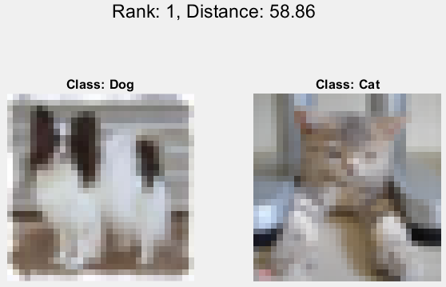
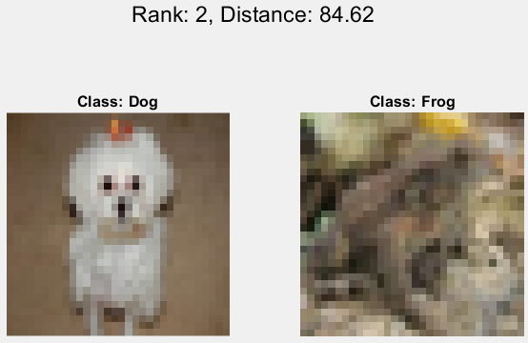
Problem 1: Dog Retrieval
Top-10 Precision for Dog Retrieval: 10%

Slide 13
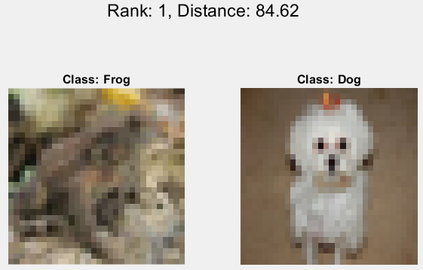
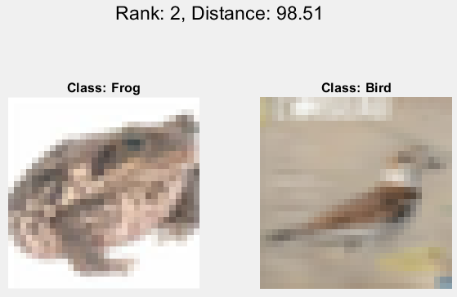
Problem 1: Frog Retrieval
Top-10 Precision for Frog Retrieval: 10%

Slide 14
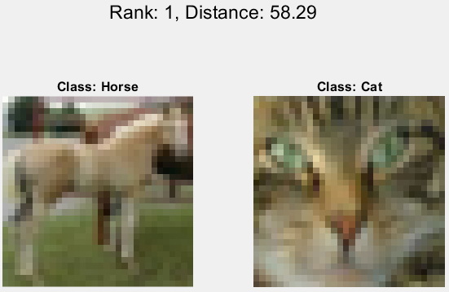
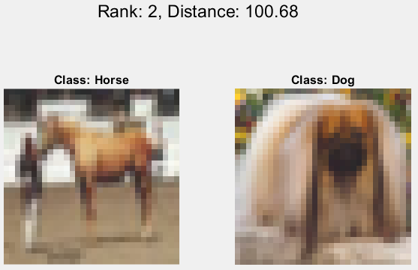
Problem 1: Horse Retrieval
Top-10 Precision for Horse Retrieval: 0%

Slide 15
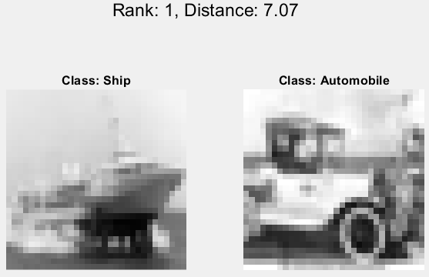
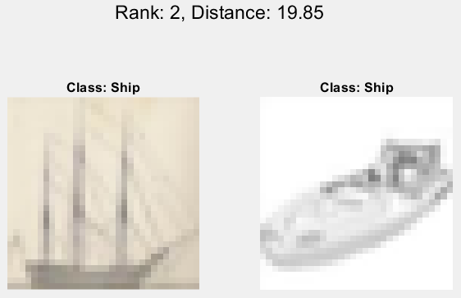
Problem 1: Ship Retrieval
Top-10 Precision for Ship Retrieval: 60%

Slide 16
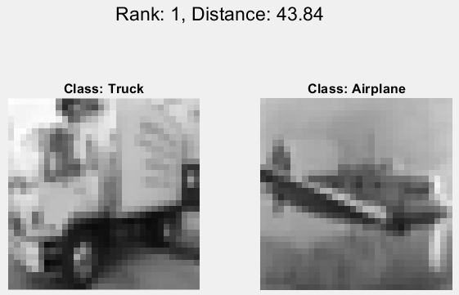
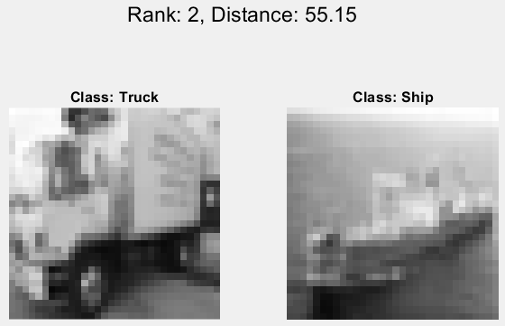
Problem 1: Truck Retrieval
Top-10 Precision for Truck Retrieval: 30%

Slide 17
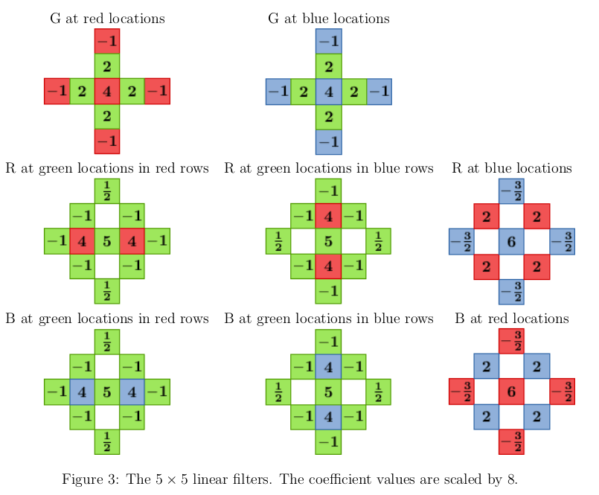
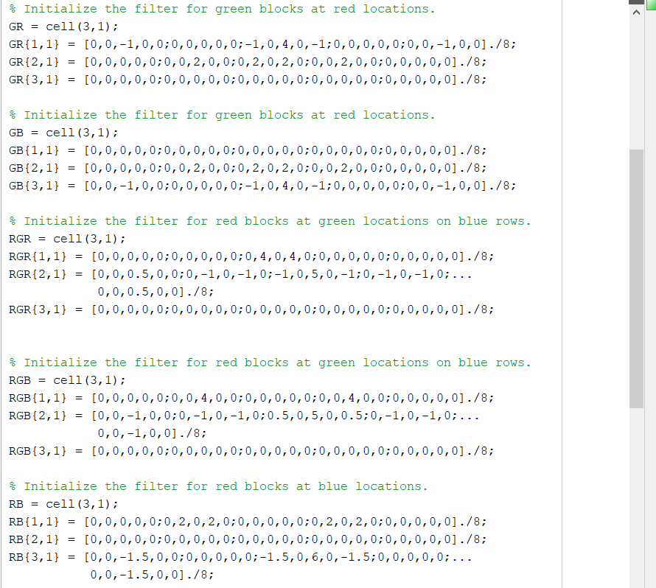
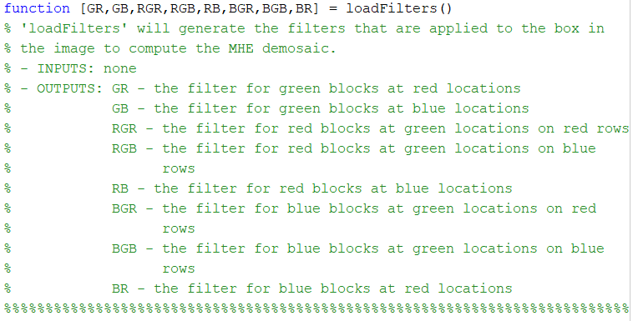
Problem 2: Demosaicing
“Demosaic: implement the demosaicing algorithm discussed in class.”

Slide 18
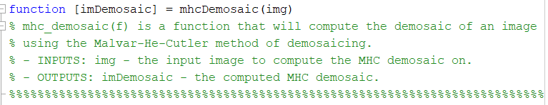
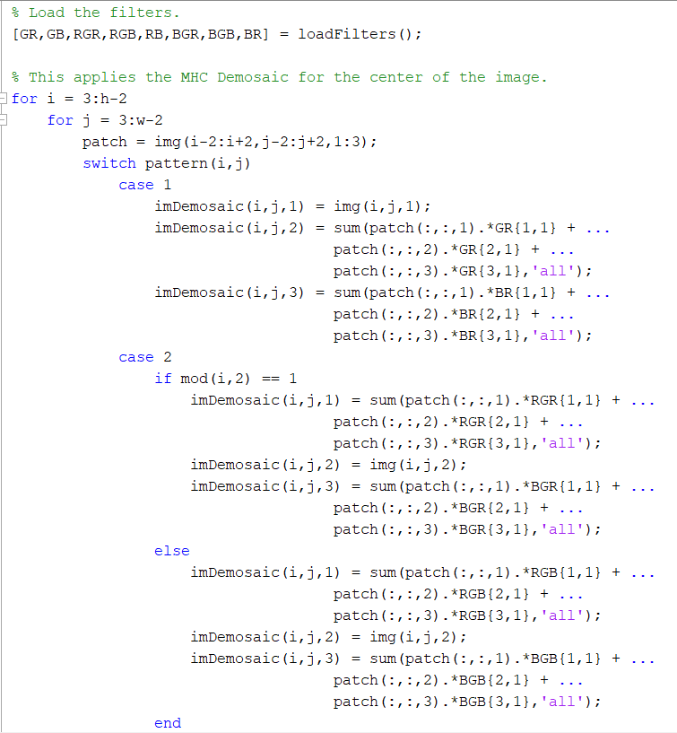
Problem 2: Demosaicing
“Demosaic: Create a function: [im]=mhc_demosaic(f).”

Slide 19
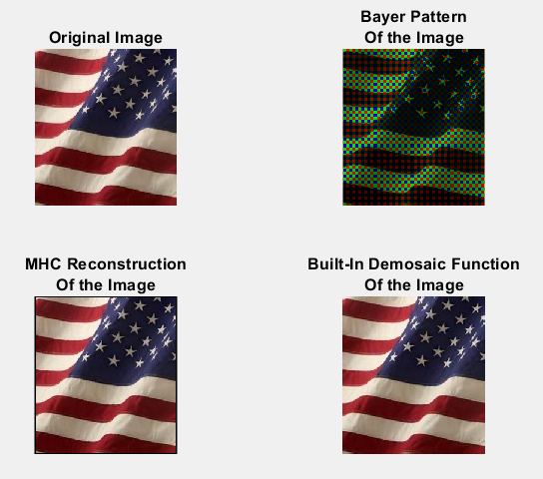
Problem 2: Demosaicing – Image 1
“Then plot the demosaic results. Compare this with im2 = demosaic(f), which is a built-in matlab function.”

Slide 20
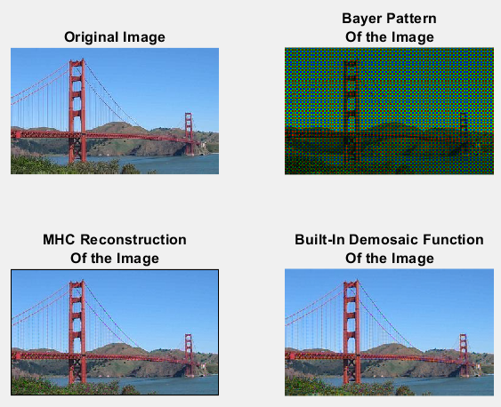
Problem 2: Demosaicing – Image 2
“Then plot the demosaic results. Compare this with im2 = demosaic(f), which is a built-in matlab function.”

