Slide 1
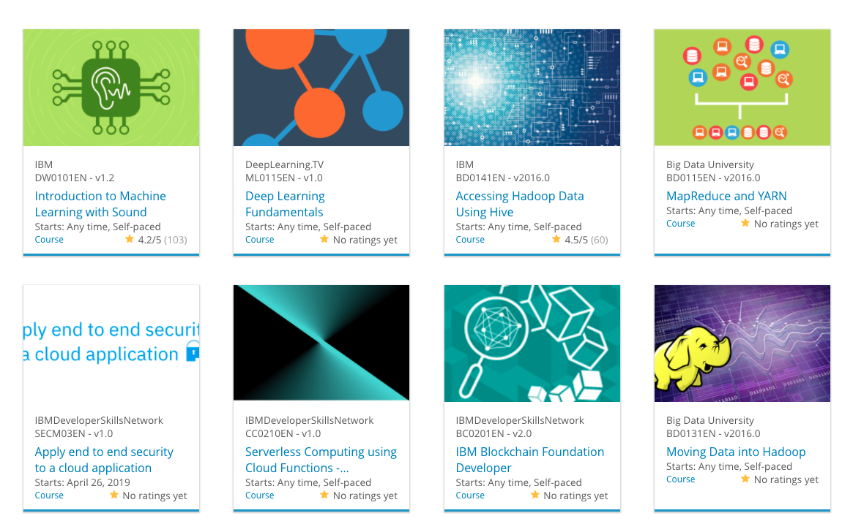

Build a Personalized Online Course Recommender System with Machine Learning
Kay Sun
September 28, 2022

Slide 2

Outline
Introduction and Background
Exploratory Data Analysis
Content-based Recommender System using Unsupervised Learning
Collaborative-filtering based Recommender System using Supervised learning
Conclusion
Appendix

Slide 3
Introduction
Goal of project is to build a personalized online courses recommender system for students based on different recommendation models available.
Data available includes
Courses with one-hot encoding of their genre
User ratings of courses
User profile with one-hot encoding of their genre
Models include
Content based using
User profiles and course genre
Course similarity
Clustering
Collaborative filtering using
KNN
NMF
NN
Evaluate the performances of the different models in predicting courses for students.

Slide 4
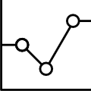
Exploratory Data Analysis

Slide 5
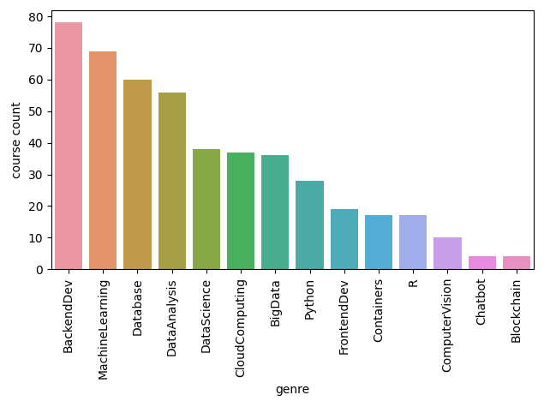
Course counts per genre
Top 3 most popular course genres are Backend Dev, Machine Learning and Datase.
3 Least popular course genres are Computer Vision, Chatbot and Blockchain.

Slide 6
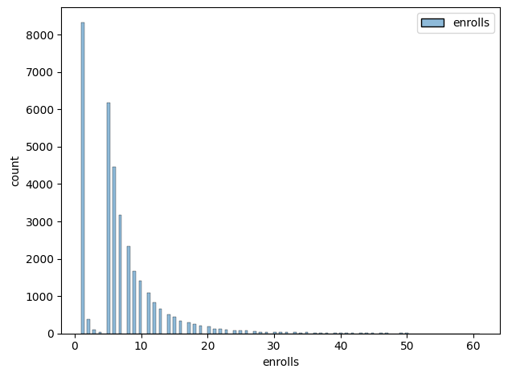
Course enrollment distribution
Histogram of course enrollments.
Most students just enroll to 1 course to try out the course content.
Sharp drop for 2 to 4 enrolled courses.
But after 5 enrolled courses, distribution resumes a normal distribution.
Seems to indicate most students will try out a course. Those who like the courses offered will enroll in at least 5 more.
Those who don’t like the courses offered will mostly abandon. Very few will try out another 2 to 4 more.

Slide 7
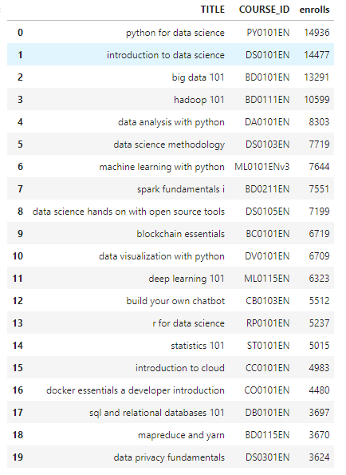
20 most popular courses
Top 3 most popular courses are Python for Data Science, Introduction to Data Science and Big Data 101.
Top 8 most popular courses are in field of data science.
3 Least popular courses are SQL and Relational Databases 101, MapReduce and Yarn, and Data Privacy Fundamentals.
Enrollments for top 3 courses are at least 4 times that out the 3 least popular ones.

Slide 8
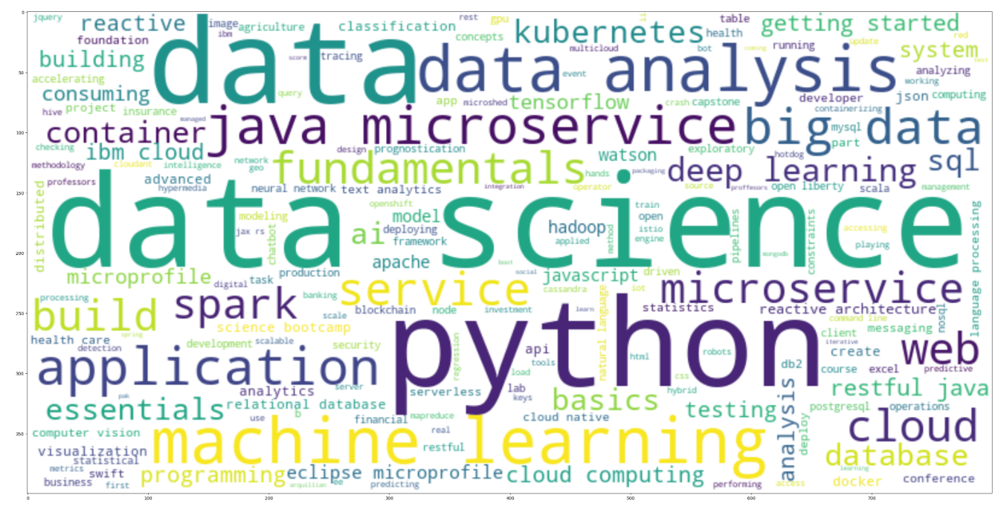
Word cloud of course titles
Most popular courses based on course titles relates to python, data science, data analysis and machine learning.

Slide 9
Content-based Recommender System using Unsupervised Learning
Cluster2
Cluster1

Slide 10
Flowchart of content-based recommender system using user profile and course genres
Course genre vectors – one hot encoding of genres for each course.
User profile vectors – one hot encoding of user’s ratings and interests for each genre.
Dot Product of 2 vectors to produce a recommendation score for each user.
Apply threshold on the score such that only those above threshold will be recommended. Threshold can be absolute value or relative based on the score range.
Final output is the recommendation scores for courses for the user.
Course Genre Vectors
Dot Product
Recommendation Score
Threshold check
Recommendation Scores for courses
User Profile Vectors

Slide 11
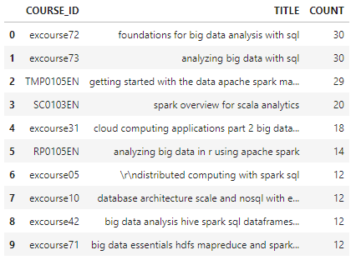
Evaluation results of user profile-based recommender system
Recommendation score is normalized by its maximum so its range is now from 0 to 1.
On average, how many new courses have been recommended per test user: 7.7894736842105265
Top-10 commonly recommended courses across all users

Slide 12
Flowchart of content-based recommender system using course similarity
Course genre vectors – one hot encoding of genres for each course.
Similarity calculation of 2 vectors to produce a similarity score between 2 courses.
Similarity based on cosines, elucidean, Jaccard.
Repeat similarity calculation between all pairs of courses to generate a matrix of similarity scores where the indices are the 2 course indices.
For each enrolled and unselected course, extract similarity score from matrix and apply threshold such that only those above threshold will be recommended. Threshold can be absolute value or relative based on the score range.
Enrolled Course Genre Vectors
Course 1 Genre Vectors
Similarity Calculation:
Cosine or Elucidean, Jaccard
Similarity Score Matrix
Threshold check
Similarity Scores for courses
Course 2 Genre Vectors
Test Course Genre Vectors

Slide 13
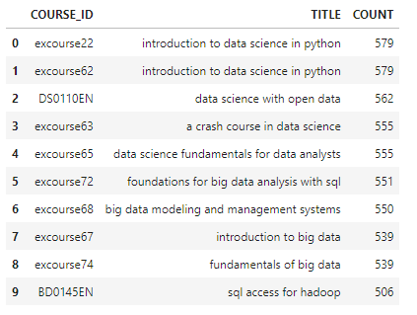
Evaluation results of course similarity based recommender system
Similarity based on cosine, which ranges from 0 to 1.
On average, how many new courses have been recommended per test user: 11.573753814852493
Top-10 commonly recommended courses

Slide 14
Flowchart of clustering-based recommender system
User profile genre vectors – one hot encoding of genres for each course.
Extract genre or features out and normalize them by either min/max or standard scaler.
Apply PCA dimension reduction on a range of components and find its optimum. Apply this optimum to get the reduced number of features.
Apply reduced featured to K-Means clusters on a range of clusters to find its optimum. Apply this optimum to get the PCA-KNN model.
Use PCA-KNN model to predict which cluster test users belong to according to their user profile genre vectors.
Test User Profile Genre Vectors
Normalize Features:
Min/Max, Standard
K-Means Clustering:
Find Optimum
User Profile Genre Vectors
Extract Features
PCA:
Find Optimum
Reduced Features
PCA-KNN Model
Predict Cluster

Slide 15
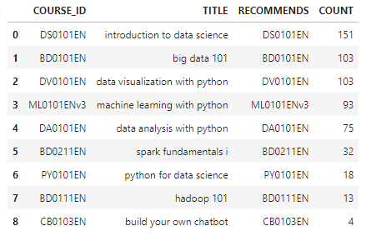
Evaluation results of clustering-based recommender system
Optimum number of PCA components = 9
Optimum number of K-Means clusters = 11
Recommend only courses with more than 100 enrollments.
On average, how many new courses have been recommended per test user: 1.249
Top-10 commonly recommended courses

Slide 16
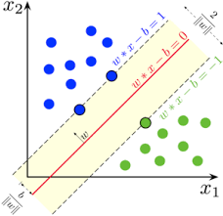
Collaborative-filtering Recommender System using Supervised Learning

Slide 17
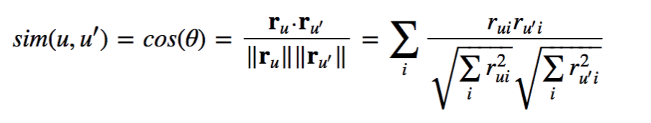
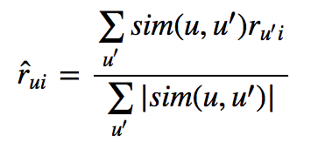
Flowchart of KNN based recommender system
Input data is user-item-rating interaction matrix.
Raw data is split into train-test split by percentage, e.g., 25%.
Surprise scikit learn KNN model is initiated using hyperparameters (similarity measurement = cosine, user_based=True, minimum cluster k = 1). Train dataset is fitted to model.
Cosine similarity formula
Normalized rating by total users ratings
Predictions are then made on the trained model using the test dataset.
Root mean square error between the predictions and test dataset where truth is known.
User-Item-Rating (raw) data
KNNBasic
Data Fit
RMSE
Predictions
Test User-Item-Rating

Slide 18
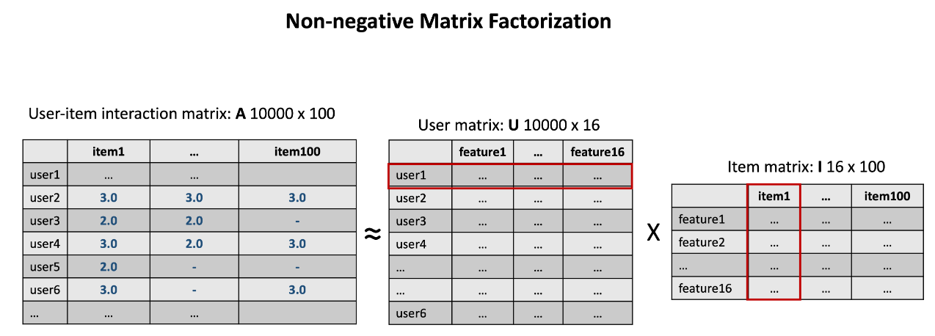
Flowchart of NMF based recommender system
Input data is user-item-rating interaction matrix.
Raw data is split into train-test split by percentage, e.g., 30%.
Surprise scikit learn NMF model is initiated using hyperparameters (n_factors, n_epochs). Train dataset is fitted to model.
NMF: A = U x I
Lower number of features by reducing
into lower dimensional space.
Predictions are then made on the trained model using the test dataset.
Root mean square error between the predictions and test dataset where truth is known.
User-Item-Rating (raw) data
NMF Data Fit
RMSE
Predictions
Test User-Item-Rating

Slide 19
Flowchart of Neural Network Embedding based recommender system
Input data is user-item-rating interaction matrix.
Surprise scikit learn NMF model is initiated using hyperparameters (n_factors, n_epochs). Train dataset is fitted to model to get the User Embedding and Item Embedding Feature Vectors.
2 Vectors are then merged either by addition, multiplication, min/max or average.
Merged dataset is then split into training and test dataset.
Linear Regression, or other regression ML model, is fitted with the training dataset.
Predictions of ratings are then made on the trained model using the test dataset.
Root mean square error between the predictions and test dataset where truth is known.
User-Item-Rating (raw) data
User Embedding Feature Vector
Merge:
Addition,
Multiple,
Min/max,
average
NMF Data Fit
Linear Regression
Data Fit
Predictions
RMSE
Item Embedding Feature Vector
Test User-Item-Rating

Slide 20
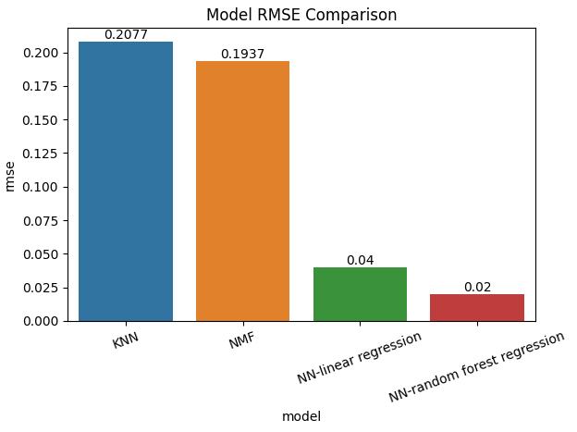
Compare the performance of collaborative-filtering models
KNN and NMF models result in similar RMSE values.
Much lower RMSE is with NN-linear regression. The combination of dimensionality reduction and linear regression produced lower RMSE than NMF alone.
Even lower RMSE is with NN-random forest regression.
Further optimization of hyperparameters given more computation resources may result in even lower RMSE.

Slide 21
Optional: Build a course recommender system app with Streamlit
Streamlit app screenshot1
Streamlit app screenshot2
A published Streamlit App URL for a live demo

Slide 22
Conclusions
Most popular courses based on course titles relates to python, data science, data analysis and machine learning.
Content based recommendation models based on user profiles and course genre, course similarity and clustering mostly recommended data science related courses, which could be simply due to the high popular of these courses and number of course with genres related to data science.
Stricter constraints, like higher recommendation score thresholds and higher minimum number of enrolled, results in fewer courses being recommended. Adjusting these variables will change the number of recommended courses.
Of the different collaborative filtering models evaluated, NN-random forest regression performed best in predicting ratings for courses by users.
Further ML regression models and optimization of hyperparameters given more computation resources may result in even lower RMSE.

Slide 23
Appendix
course_genre_url = https://cf-courses-data.s3.us.cloud-object-storage.appdomain.cloud/IBM-ML321EN-SkillsNetwork/labs/datasets/course_genre.csv
ratings_url = https://cf-courses-data.s3.us.cloud-object-storage.appdomain.cloud/IBM-ML321EN-SkillsNetwork/labs/datasets/ratings.csv
profile_genre_url = https://cf-courses-data.s3.us.cloud-object-storage.appdomain.cloud/IBM-ML321EN-SkillsNetwork/labs/datasets/user_profile.csv
test_users_url = https://cf-courses-data.s3.us.cloud-object-storage.appdomain.cloud/IBM-ML321EN-SkillsNetwork/labs/datasets/rs_content_test.csv
sim_url = https://cf-courses-data.s3.us.cloud-object-storage.appdomain.cloud/IBM-ML321EN-SkillsNetwork/labs/datasets/sim.csv
user_emb_url = https://cf-courses-data.s3.us.cloud-object-storage.appdomain.cloud/IBM-ML321EN-SkillsNetwork/labs/datasets/user_embeddings.csv
item_emb_url = https://cf-courses-data.s3.us.cloud-object-storage.appdomain.cloud/IBM-ML321EN-SkillsNetwork/labs/datasets/course_embeddings.csv

