Slide 1
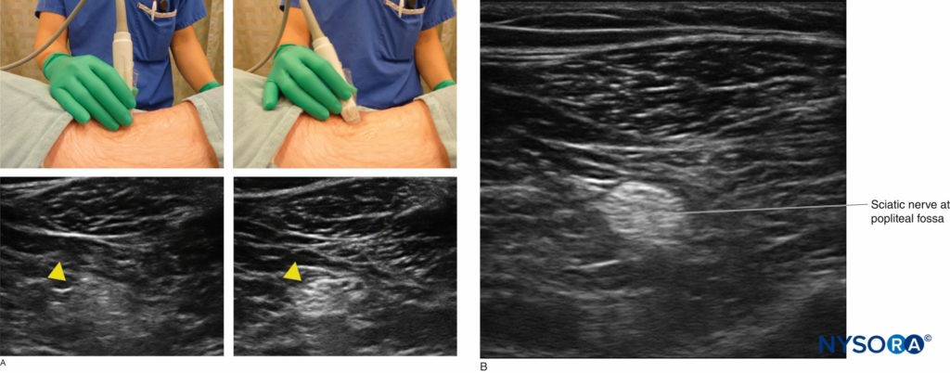
Project Topic:
Automated Nerve Segmentation from Ultrasound Images for Guided Regional Anesthesia
What is Ultrasound Guided Regional Anesthesia?
One alternative to prescription narcotics for postoperative pain management is with a targeted pain relief system that automatically delivers a controlled amount of local anesthetic to the surgical site or in close proximity to nearby nerves, for up to 5 days, using specially designed indwelling catheters.
https://www.nysora.com/topics/equipment/introduction-ultrasound-guided-regional-anesthesia/

Slide 2
1. Design User Experience
Task Analysis
User: Radiologists specializing in US guided pain management.
Task: Identify nerves from US image for targeting of catheter placement.
Insights: Deep learning models can be trained to aid in more accurately identifying nerves in US images for proper catheter placement by making realtime inference with the moving US images and overlaying the predicted segmentations for immediate visualization to the users.
TRIGGER: US acquisition.
ACTION: Radiologist interprets in realtime borders of nerves.
OBJECTIVE: Place catheter in closest position to border of nerves.

Slide 3
1. Design User Experience
AI Specific Considerations
Interaction: Deep learning models make realtime inference with the acquired moving US images and overlaying the predicted segmentations for immediate visualization to the users.
User Inputs
Input: US images
Output: Overlaid DL predicted segmented nerve contours onto US images.
Transparency
Explain to radiologists the DL model and how it is trained and works.
Provide/cite scientific papers and patents to support the technology.
Uncertainty
Provide probabilities of segmentation.
Color code contours – e.g. green for above 80% confidence, yellow for 65% confidence, red for below 50%.
Feedback Loop
No mechanism in application for radiologist to provide feedback.
Radiologists can personally express whether they agree with the segmentation borders or not. They can provide their nerve segmentation as labels and the DL model can be retrained to be customized to their preferences.

Slide 4
2. Privacy and Ethical Implications
Privacy Considerations
Privacy-related Concerns
US images fall under medical data.
Contains PHI that may be used to identify the patient.
Applicable Privacy Laws
HIPAA
DL model is used by healthcare provider, which is a covered entity under HIPAA.
GDPR if medical data is collected from and model used in EU.
Protect Privacy
US images used in training must be
collected with patient consent, explaining to them what the images are used, purpose, duration of us, and their right to opt out when requested.
de-identification applied to strip any identifiers from US images.
Trained DL model only contains weights and no identifiers, cannot be used to trace back to patient providing the training US images.

Slide 5
2. Privacy and Ethical Implications
Ethical Considerations
Sources of bias
Representation bias
Training dataset need to represent all demographics – age, gender, race, BMI, to account for any anatomical differences in nerves.
Measurement bias
Labeling of nerve contours as truth by radiologists to be used in supervised training may introduce bias as one radiologist’s expert interpretation of the borders of the nerve may differ from another.
Can be minimized by having a good number of radiologists providing the labels and applying majority rule to the contours.
Ethical AI
Fairness
Ensure training dataset of US images are from wide demographics and of sufficient sample size to account for anatomical variabilities.
Accountability
DL model developers are responsible for accuracy of automatic nerve segmentations.
Radiologists evaluate the accuracy of the nerve segmentation and determine based on their expertise and experience whether the DL model is performing at an acceptable level.
Radiologists can provide their own truth labels for retraining of DL models to improve their accuracies.
Transparency
Difficult to interpret DL model.
Explain how truth labels contain features that the DL model is learning to determine whether pixel is a nerve or not. Provide examples of similar truth labels and nerve predictions to show how the model is detecting similarities.

