Slide 1
1. Modeling Approach
Computed using Azure Machine Learning AutoML
Modeling Type
Regression
Output is continuous
Features
Temperature, Ambient Pressure, Relative Humidity and Exhaust Vacuum
Target
Net hourly electrical energy output
Algorithms
XGBoostRegressor, Gradient Boosted Machine, Random Forrest, Decision Tree, Elastic Net
Normalizer
MinMaxScaler, MaxAbsAScaler, RobustScaler, StandardScalerWrapper
Different ranges from different features require normalization.
Metric
Normalized root mean square error

Slide 2
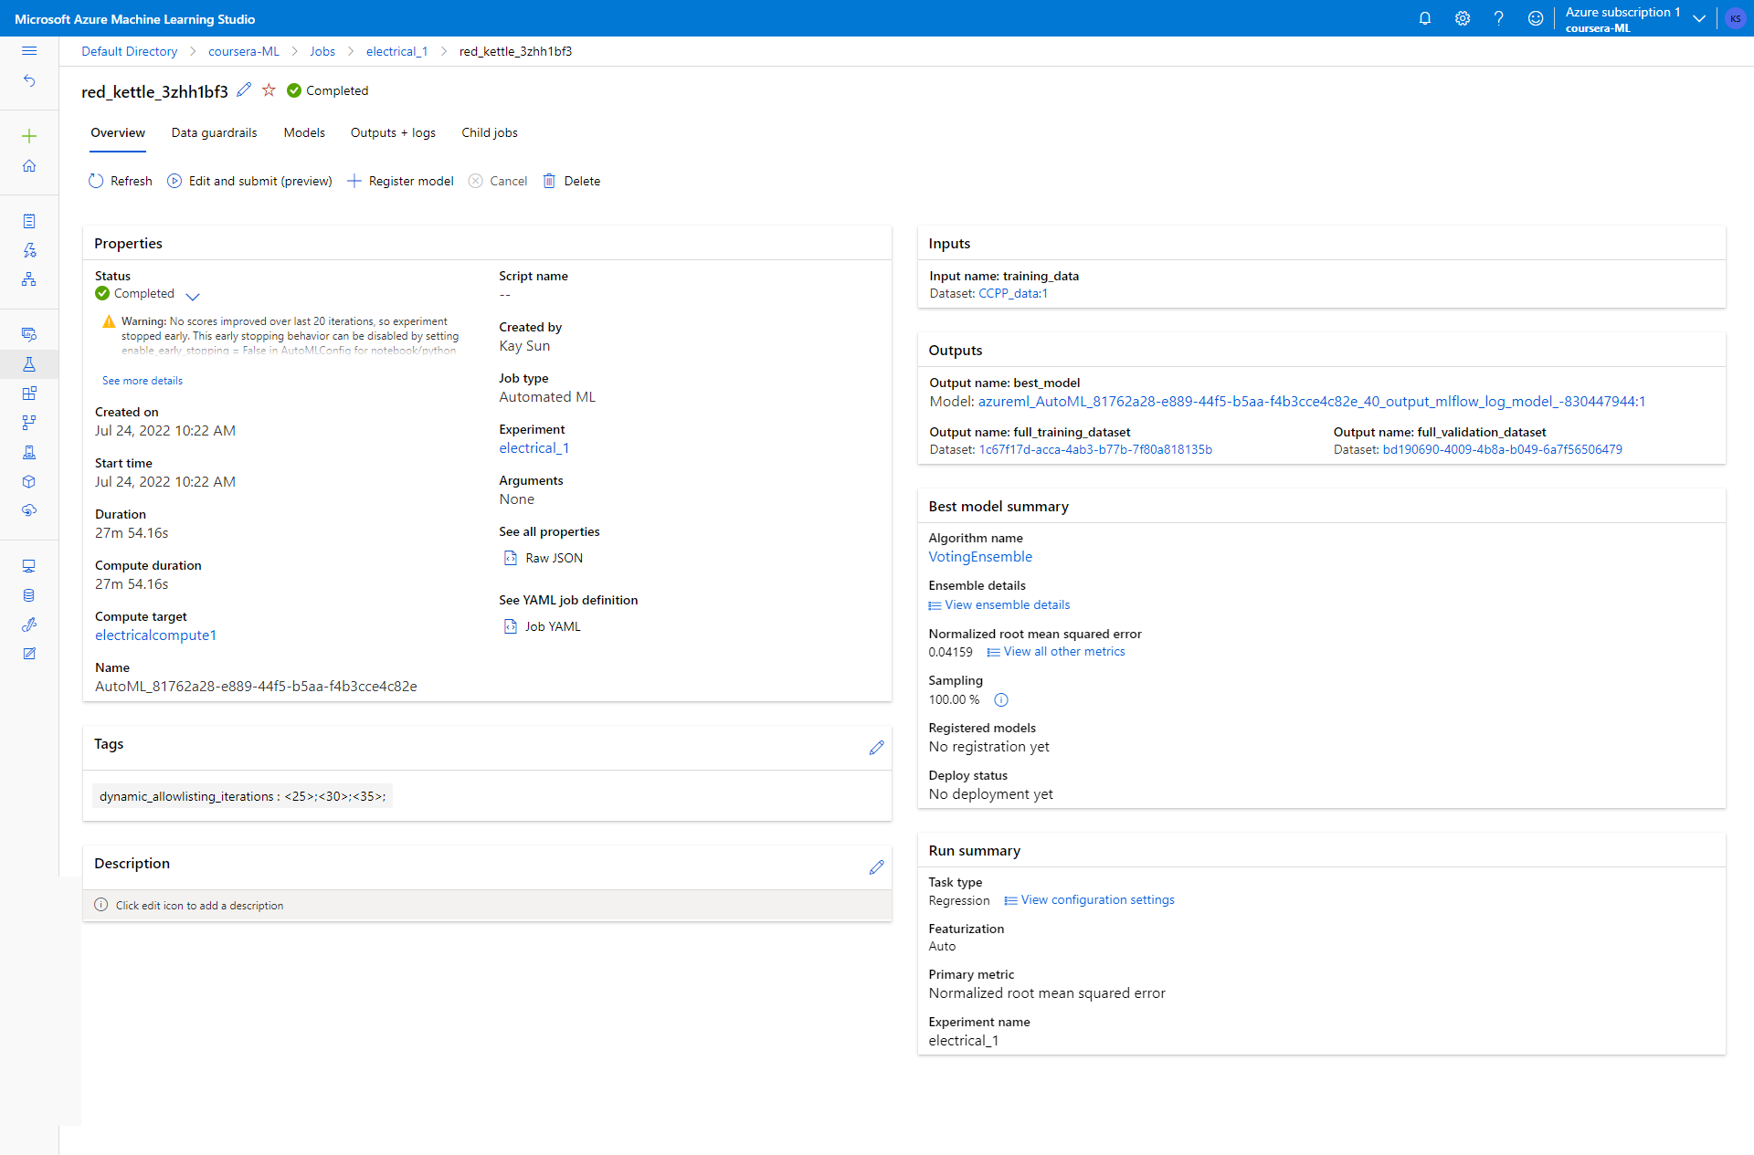

Slide 3
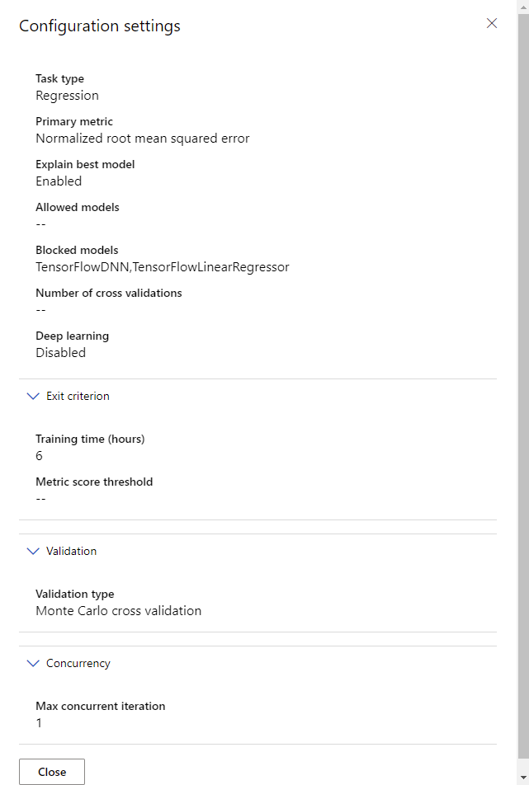
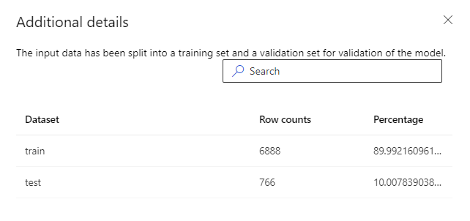
2. Modeling Building
Model Types
XGBoostRegressor, Gradient Boosted Machine, Random Forrest, Decision Tree, Elastic Net
Normalizer of Features
MinMaxScaler, MaxAbsAScaler, RobustScaler, StandardScalerWrapper
Different ranges from different features require normalization.
Hyperparameters
Azure Machine Learning AutoML performs hyperparameter optimization for each model and normalized features.
Training Set Split
90-10% split
Validation Type
Monte Carlo cross validation

Slide 4
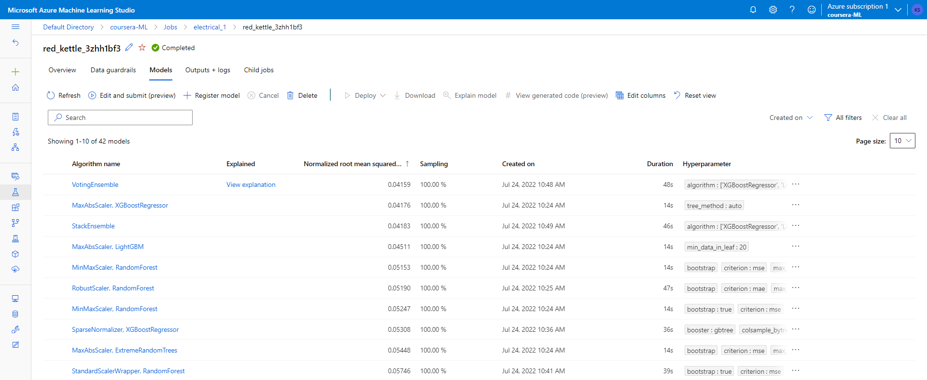
3. Modeling Evaluation
Metric evaluated on test dataset
Normalized root mean square error.
Features have different ranges, so have to normalize.
Since outliers are not prominent in dataset, RMSE is preferred for regression predictions.

Slide 5
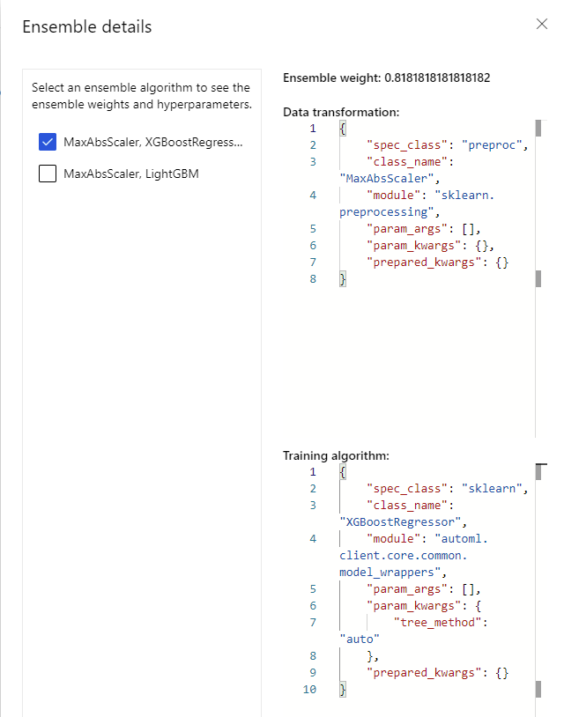
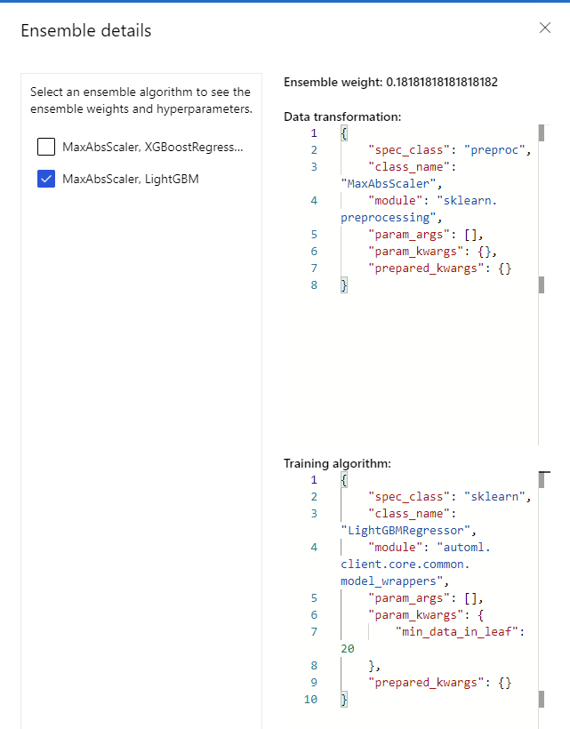
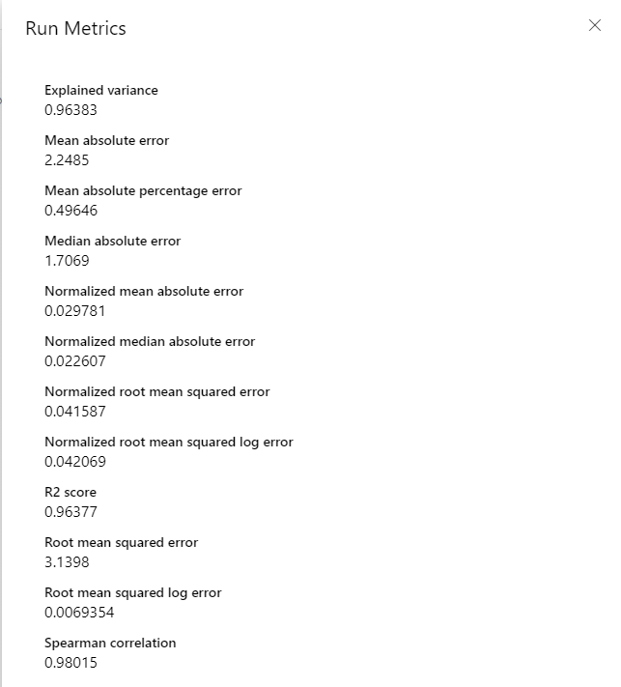
3. Modeling Interpretation
Best Model
VotingEnsemble consists of ensemble of MaxAbsScaler, XGBoostRegressor and MaxAbsScaler, LightGBM, with weights of 0.818 and 0.181 respectively.
Normalized RMSE = 0.04159

Slide 6
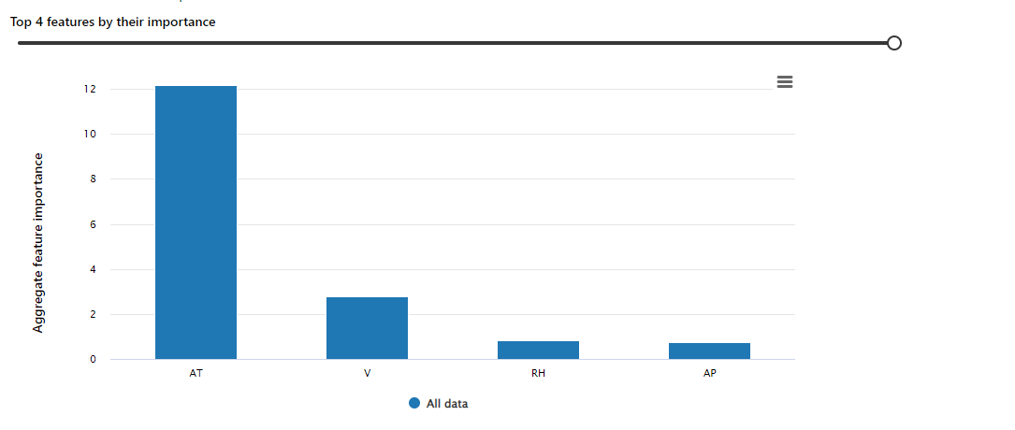
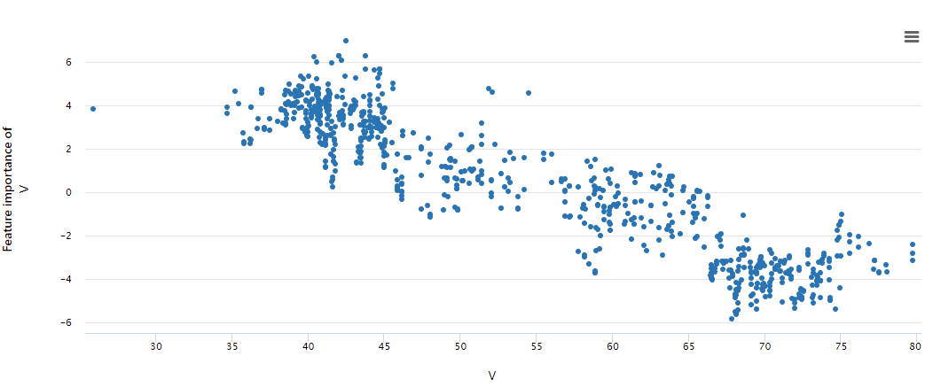
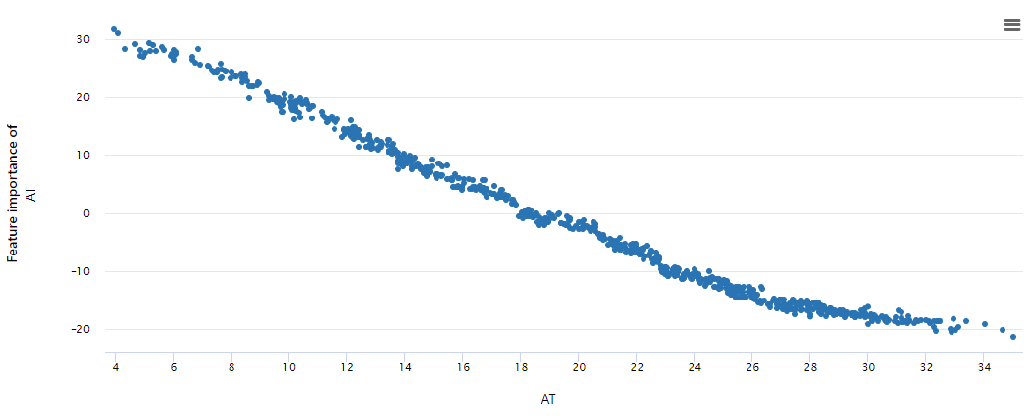
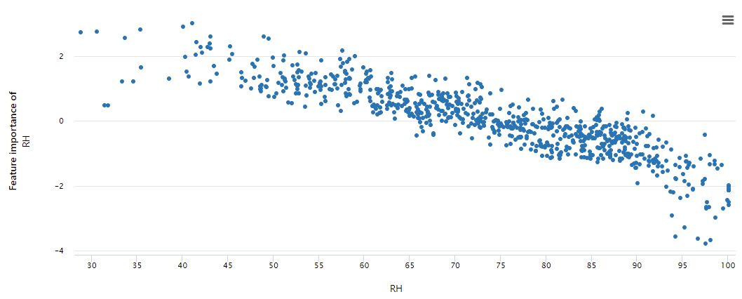
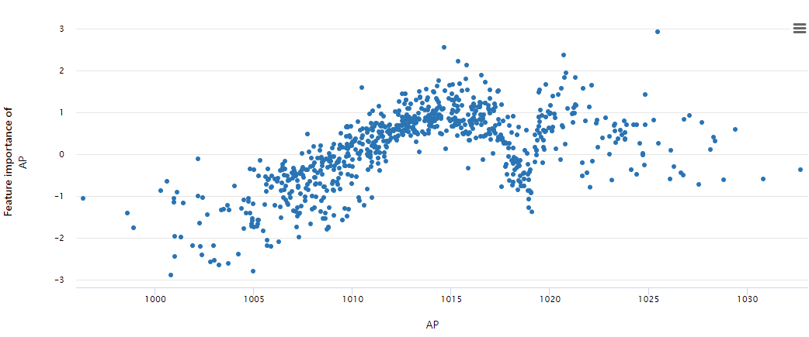
3. Modeling Interpretation
Explain Best Model
Most important feature is temperature
Less important features are exhaust vacuum, relative humidity and pressure according to correlation and spread.

