Slide 1
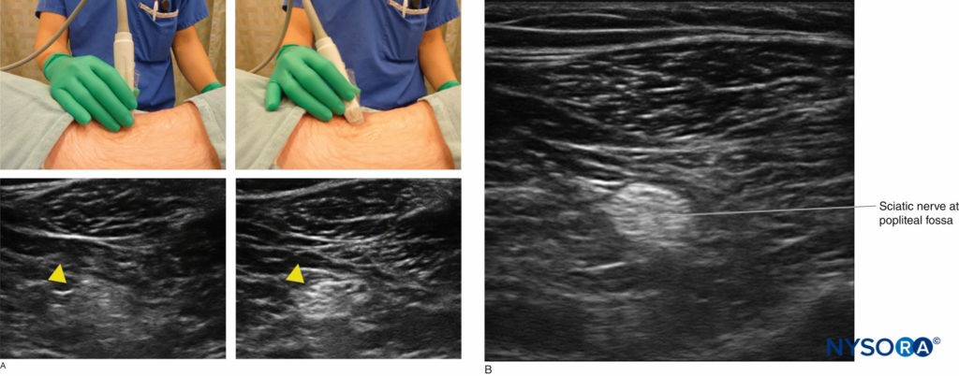
Project Topic:
Automated Nerve Segmentation from Ultrasound Images for Guided Regional Anesthesia
What is Ultrasound Guided Regional Anesthesia?
One alternative to prescription narcotics for postoperative pain management is with a targeted pain relief system that automatically delivers a controlled amount of local anesthetic to the surgical site or in close proximity to nearby nerves, for up to 5 days, using specially designed indwelling catheters.
https://www.nysora.com/topics/equipment/introduction-ultrasound-guided-regional-anesthesia/

Slide 2
1. Opportunity evaluation
Is there a problem?
In order for this pain relief system to be effective, the anesthetic delivering catheters must be critically positioned near pain signal transmitting nerves, requiring US guidance for insertion.
Despite the high safety and effectiveness of using sound waves to visualize internal tissues as well as the portability and accessibility of US even in smaller clinics, it is a challenging medical imaging tool to master, often requiring years of specialized training to learn the unintuitive coordination between the almost abstract US images and the placement of the transducer (angle, pressure, motion).
Can ML help solve problem?
Deep learning models can be trained to aid in more accurately identifying nerves in US images for proper catheter placement by making realtime inference with the moving US images and overlaying the predicted segmentations for immediate feedback to the users.
Training data can be collected from current patients.
Does someone care?
An accurate and automated nerve segmentation can improve nerve targeting and hence pain relief in patients.
May reduce time and cost in procedure to place catheters.
Can be used as training tool for radiology students learning US.

Slide 3
2. CRISP-DM Business Understanding
Define the problem
Target user:
Radiologists
Problem:
Difficult to interpret US images, requires significant training and expertise. Higher barrier for new, less experienced radiologists.
Why it matters:
Aid in nerve segmentation may lower barrier for less experienced radiologists, ensures catheter placement is consistency accuracy for pain relief for patients, reduce procedure time per patient.
Current state:
Radiologists must rely solely on their training and experience to visually recognize borders of nerves from US images.
Define success
Expected impact:
Reduce time in procedure, minimize treatment cost.
Improved pain relief of patients.
Metrics:
Outcome – Reduce procedure time and improved pain relief of patients.
Output – Dice score of accuracy of nerve segmentation.
Targets:
Outcome – Reduce procedure time by X minutes and improved pain relief of patients by Y%.
Output – Dice score of at least Z%.
Constraints:
Inference to predict nerve segmentation from US must be in realtime for realtime feedback.
Identify factors
Quality of US images.
Variety and volume of US images.
Accuracy of nerve segmentation labels.

Slide 4
3. Solution validation plan
Solution concept
Deep learning model will be trained on US images with labeled nerves.
US images from US machine will be streamed into a secondary computing unit for inference (predict nerve segmentation) using the DL model and the contours will be overlaid onto the original US images for radiologists to view in realtime.
Validation
Prediction accuracy and latency time will be tested on test dataset.
Testing by radiologists

Slide 5
4. ML system design
Cloud vs. Edge
Inference must be made at edge. No latency is required as realtime predictions for visualization is expected.
Offline vs. Online learning
Offline learning as new US training data will require cleaning and labeling before retraining can be performed.
Batch vs. Online predictions
Online prediction as inference will be made on the US images acquired in realtime.

Slide 6
5. Potential risks in production
Potential training-serving skew if trained US images are different in quality than the US machine used by certain hospitals.
Excessive latency during inferences prevents realtime prediction on US images.

