Slide 1
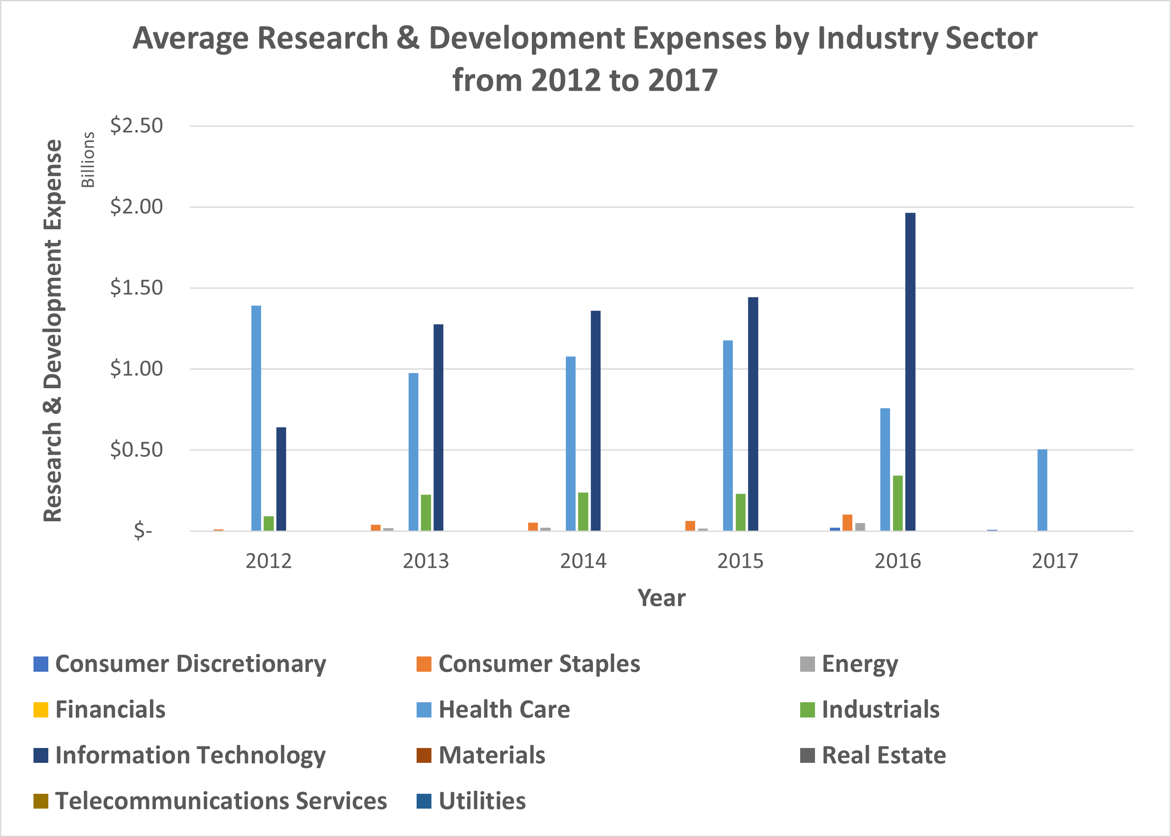
Which Industry Sector Spends The Most on Research & Development on Average?
Top 3 industries that spend the most on R&D on average are IT, Healthcare and Industrials.
IT and Industrial sectors has been spending more each year since 2012 on R&D, with the former spending much more and faster than latter.
IT spending on R&D grew from $0.64 to $1.97 billion, while Industrials only increased from $0.09 to 0.34 billions.
Healthcare sector has been spending gradually less each year since 2012 on R&D, decreasing from $1.39 billion to $0.5 billion.

Slide 2
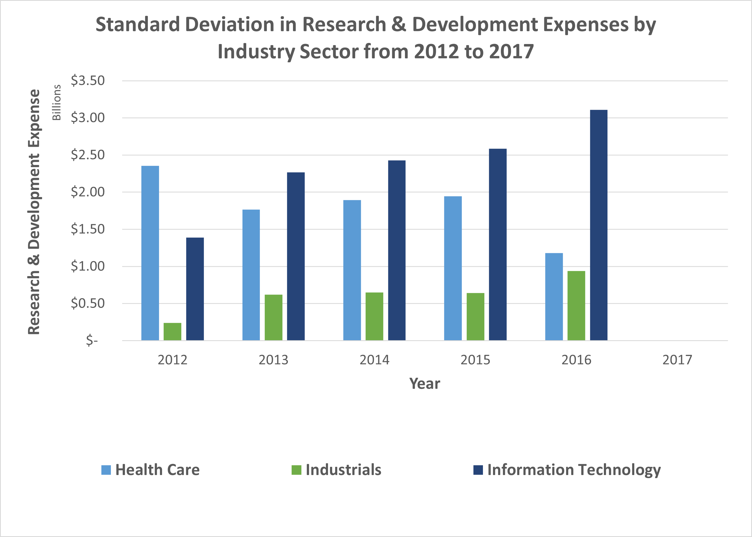
Which Industry Sector Spends The Most on Research & Development on Average?
Standard deviations for R&D expenses in IT and Industrial sectors has been increasing more each year.
Standard deviations for IT increased from $1.39 to $3.11 billion, about 1.6 to 2 times higher than the average as more IT companies spend more than average on R&D. Similar for Industrials, standard deviations increased from $0.2 to 0.9 billions, about 2.2 to 2.6 times higher than average.
Standard deviations for Healthcare sector decreased each year since 2012 from $2.36 to $1.18 billion, about 1.7 to 2.3 times above average.
While the absolute standard deviations for the 3 sectors varied greatly, these variations relative to their corresponding averages remain mostly constant around 2 times.

Slide 3
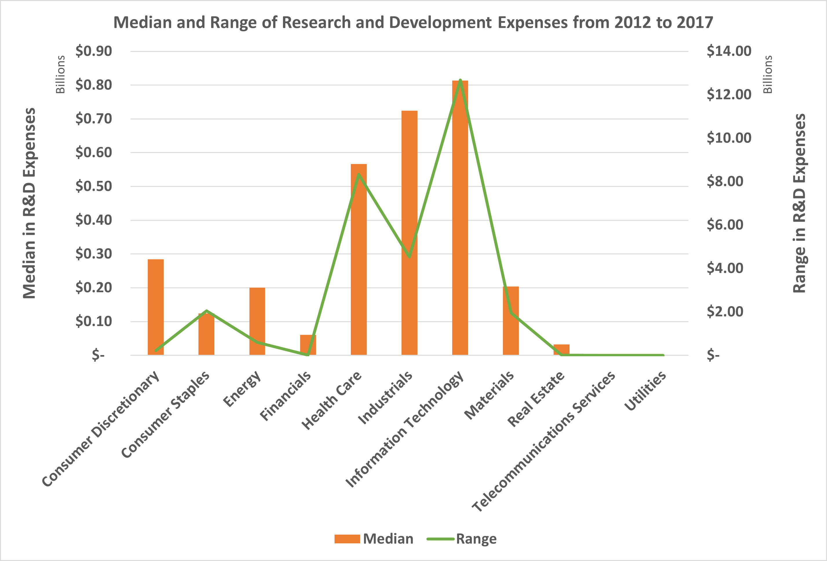
Which Industry Sector Spends The Most on Research & Development on Average?
Looking at the median R&D expenses across all the years from 2012 to 2017, the top 3 industries that spend the most on R&D on average are IT, Healthcare and Industrials.
These 3 industries spend at least 2 times more in R&D than the next highest spender – Consumer Discretionary.
Range of the R&D expenses were also highest for these top 3 industries with Industrials having the lowest range despite being 2nd highest in median spending.
This indicates most companies within Industries spend a narrower range or variation for R&D than IT or Healthcare.
Consumer Discretionary had a higher median and smaller range than Consumer Staples. This meant most companies in Consumer Discretionary spent similar amounts than Consumer Staples which had companies spending a larger variation.

