Slide 1
Udacity Data Visualization nanodegree
Mid Term Project
Kay Sun
October 20 2023

Slide 2
Problem Statement
What are the key movie features the top 5% movies have compared to the bottom 95% movies when considering profits?
Notes:
Specific, measurable and actionable with key movie features, top5%/bottom95%, profits.

Slide 3
Issue tree
What are the key movie features the top 5% movies have compared to the bottom 95% movies when considering profits?
Type of Genre?
Specific Production Companies?
Seasonality of Release Date?
Runtime of movie?
More experienced companies like Disney
Summer
Winter
Shorter movie
Action
Fall
Comedy
Less experienced, more independent companies
Longer movie
Family
Spring
Drama
Horror
Adventure
Sci-Fiction
Romance
Thriller
History
Notes:
Key features – genre, production companies, seasonality of release date, movie runtime.

Slide 4
Synthesis
GENRE
PRODUCTION COMPANY
Drama, Comedy, and Romance are most common genres to both Top and Bottom movies.
Adventure, Action, Animation are most profitable genres.
Productive production companies make many movies.
Some are top grossing or most are not. Hit or miss.
RELEASE DATE
MOVIE RUNTIME
Q2 and Q4 are most profitable for Top Movies.
All quarters are loss for Bottom Movies
Median runtime of 100 mins similar for Top and Bottom Movies.
Notes:
Top and Bottom Movies are typicall Drama, Comedy and Romance. Most profilable are Action, Adventure, Animation.
Top Movies most profitable releases are in Q2 and Q4, Summer and Holidays.
No guarantee production company can result in top profits.
No correlations with movie runtime with profits.

Slide 5
RECOMMENDATION
GENRE
PRODUCTION COMPANY
Adventure, Action, Animation are most profitable genres.
Target these genres for next potential Top Movie if budget is at least $23 million.
Disney, Columbia, Universal are a few of top production companies.
Beware they can also make the least profitable movies.
RELEASE DATE
MOVIE RUNTIME
Release movies in Q2 (Summer) and Q4 (Holidays).
Runtime is heavily influenced by human behavior and psychology.
Too long loses interest and too short can’t make the emotional investment.
Median runtime of 100 mins.
Notes:
Pick Action, Adventure and Animation for next Top Movie if budget is at least $23 million.
Release in Q2 or Q4.
Pick Disney, Columbia or Universal to make movie but beware they might fail.
Keep movie runtime to around 100 mins.

Slide 6
Analysis Overview
What drives the profitability for the Top 5% of movies?
Profit = Revenue - Budget
GENRE
PRODUCTION COMPANY
Compare profits by genres for Top and Bottom Movies to find the most common genres and most/least profitable.
Compare profits by production companies for Top and Bottom Movies to find the most common genres and most/least profitable.
RELEASE DATE
MOVIE RUNTIME
Compare profits by quarter for Top and Bottom Movies to find the most profitable release date.
Compare profits by runtime for Top and Bottom Movies to find any correlation.
6
Notes:
Profit defined by Revenue – Budget.
Describe each cohort analysis by common traits and most/least probability.

Slide 7
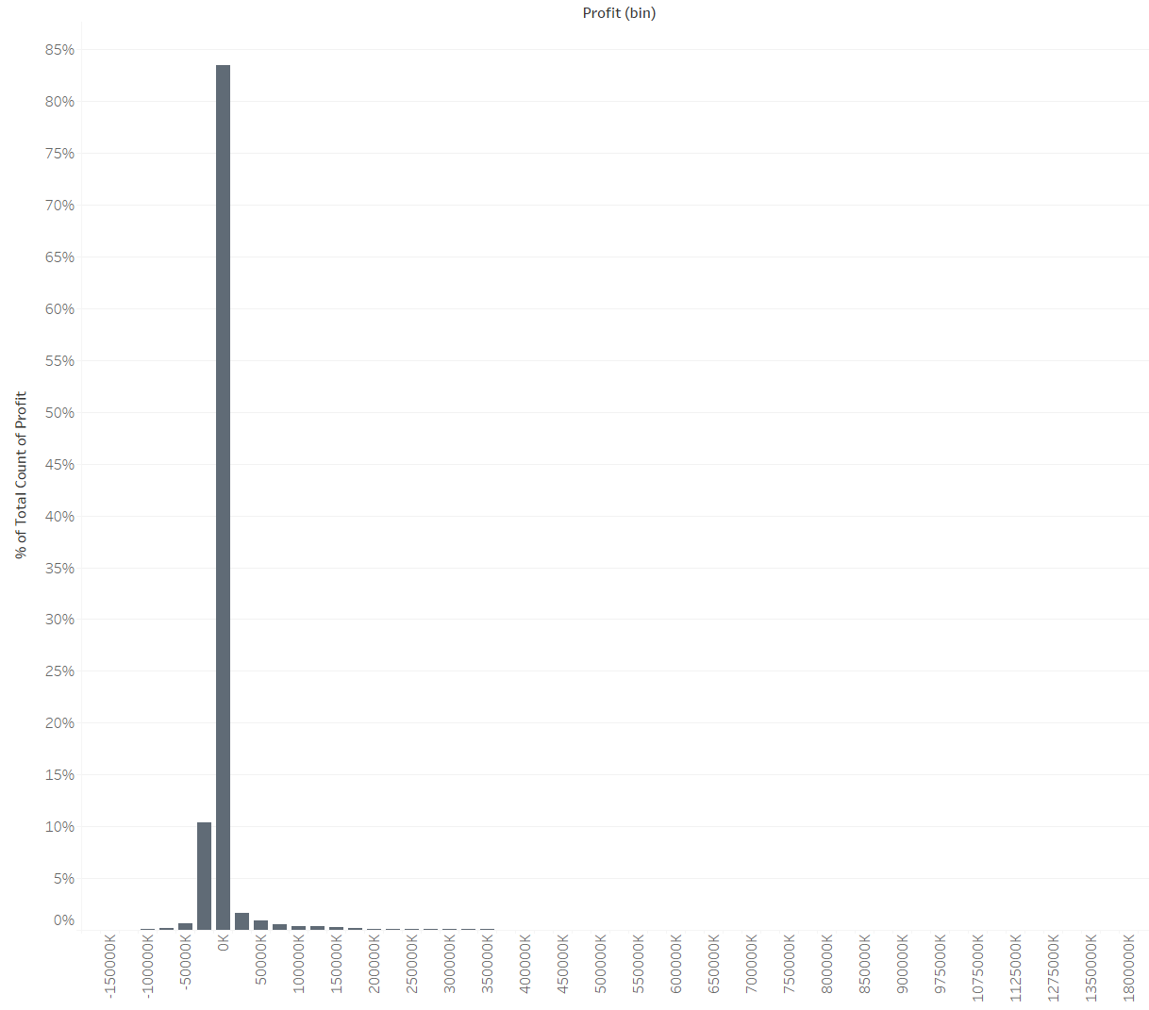
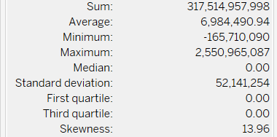
Most Movies do not make any Profits
Profit defined by Revenue - Budget.
Profit is highly skewed with all movies making a median of no profits but mean of $7 million.
Include extremes to explore why the Top 5% of movies have in common compared to the Bottom 95%.
7
Notes:
Evaluate profits of all movies. State median movies had no profits and a mean of $7 millions. Need to include the extremes since they are the Top 5% movies that we want to explore and replicate.

Slide 8
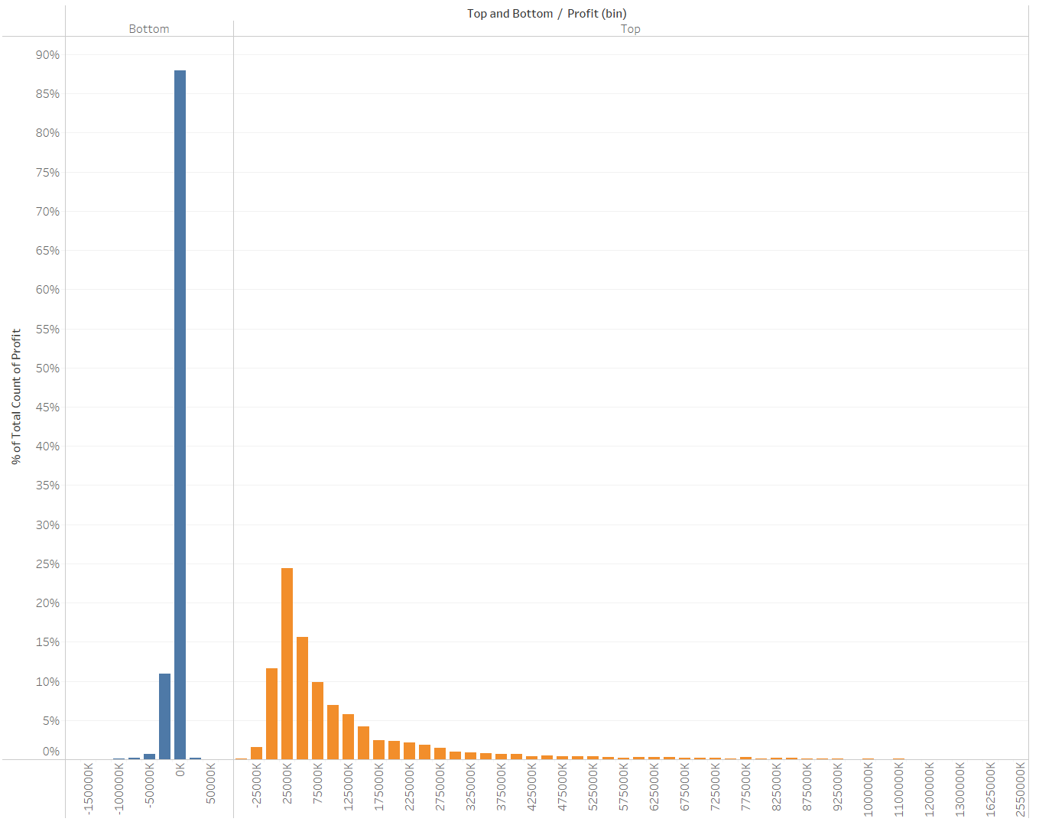
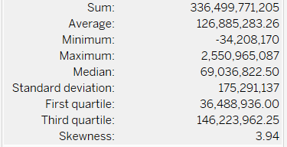
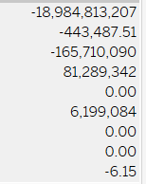
Top 5% of movies makes much more profits than Bottom 95% of movies
Top Bottom
Split all movies into 2 cohorts – Top 5% and Bottom 95% by profits.
Many more Bottom Movies than Top Movies.
Median profit of Top Movies is much higher at $69 million while median Bottom Movies is $0.
8
Notes:
Splitting into 2 cohorts and their distributions.

Slide 9
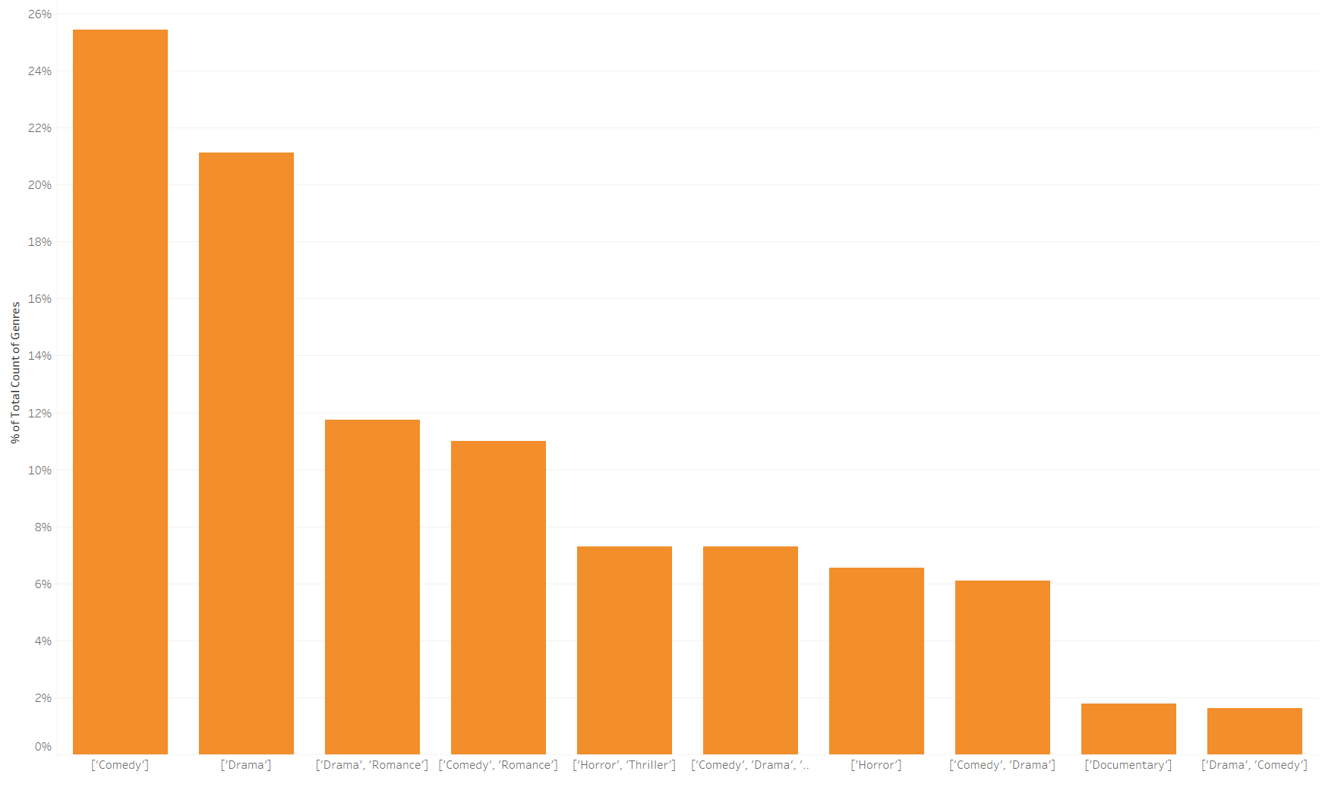
Comedy, drama, romance are most common genres to Top 5% of movies
Genres to Top Movies
Comedy
Drama
Drama, Romance
Comedy, Romance
9
Notes:
Most common genres for Top Movies.

Slide 10
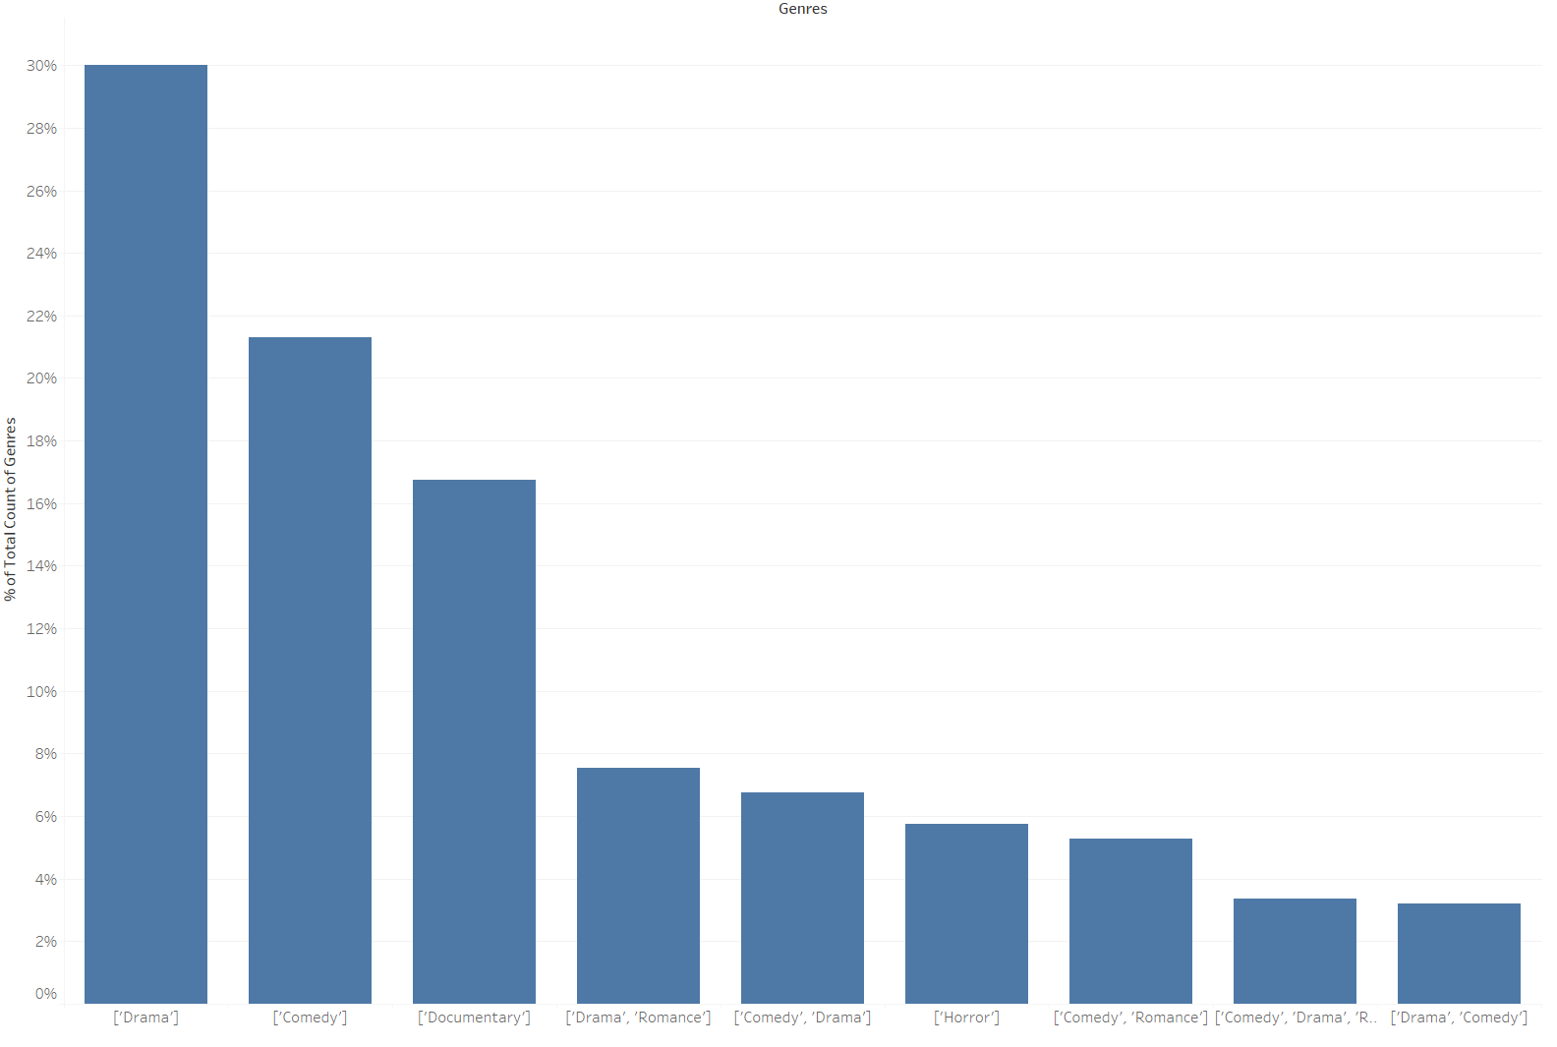
drama, Comedy, documentary, romance are most common genres to bottom 95% of movies, similar to top movies
Genres to Bottom Movies similar to that of Top Movies
Comedy
Drama
Drama, Romance
Documentary
10
Notes:
Most common genres for Bottom Movies are similar to Top Movies. No distinguishing traits.

Slide 11
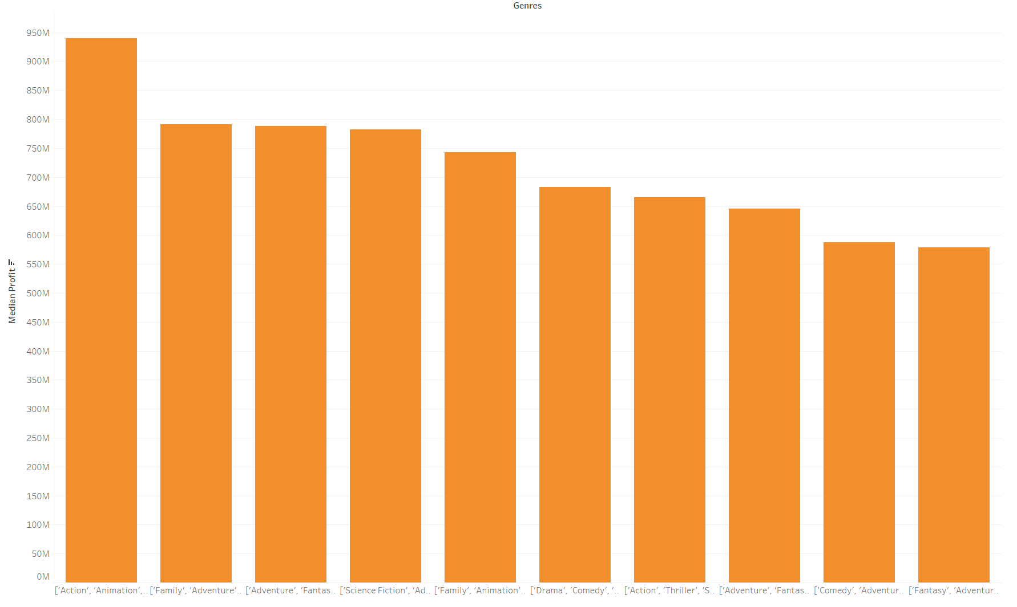
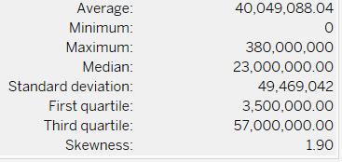
Adventure, Action, Animation GENREs are most profitable genres to Top 5% of movies
Most profitable genres to Top Movies
Action, Animation
Family, Adventure
Adventure, Fantasy
Science Fiction, Adventure
Target these genres for next potential Top Movie if budget is at least $40 million.
Top Movies Budget
11
Notes:
Most profitable genres for Top Movies and their higher budgets. Target these genres with enough budget.

Slide 12
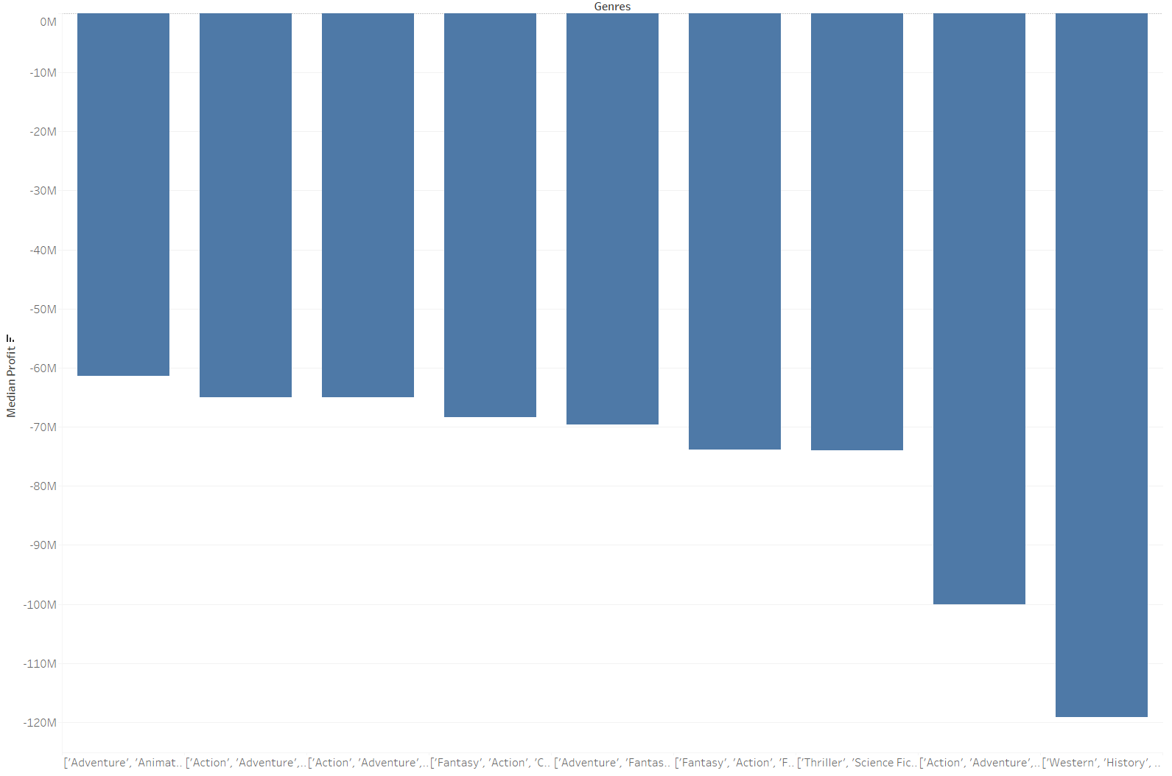
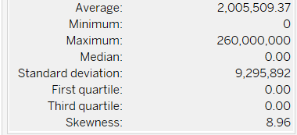
drama, crime, Thriller are most Profitable genres to bottom 95% of movies
Genres to least profitable Bottom Movies
Wester, History
Action, Adventure
Thriller, Science Fiction
Fantasy, Action
Avoid these genres if budget less than budget is at $40 million.
Bottom Movies Budget
12
Notes:
Least profitable genres for Bottom Movies and their lower budgets. These genres should be avoided if not enough budget.

Slide 13
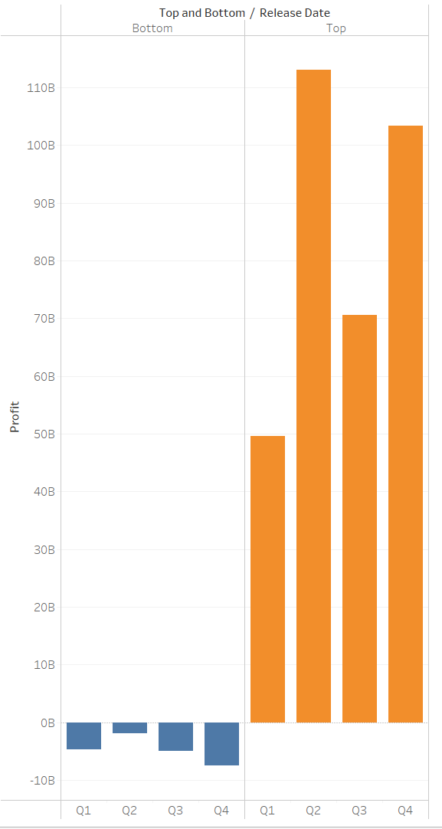
Q2 and Q4 are most profitable for Top 5% of movies all quarters are loss for Bottom 95% Of movies
Q2 and Q4 are more profitable for Top Movies.
Q4 is typically the worst profits for Bottom Movies.
Q2 is best profits for Bottom Movies, but all quarters are negative profits.
13
Notes:
Release movies in Q2 as Summer movie or Q4 as holiday movie like Top Movie.

Slide 14
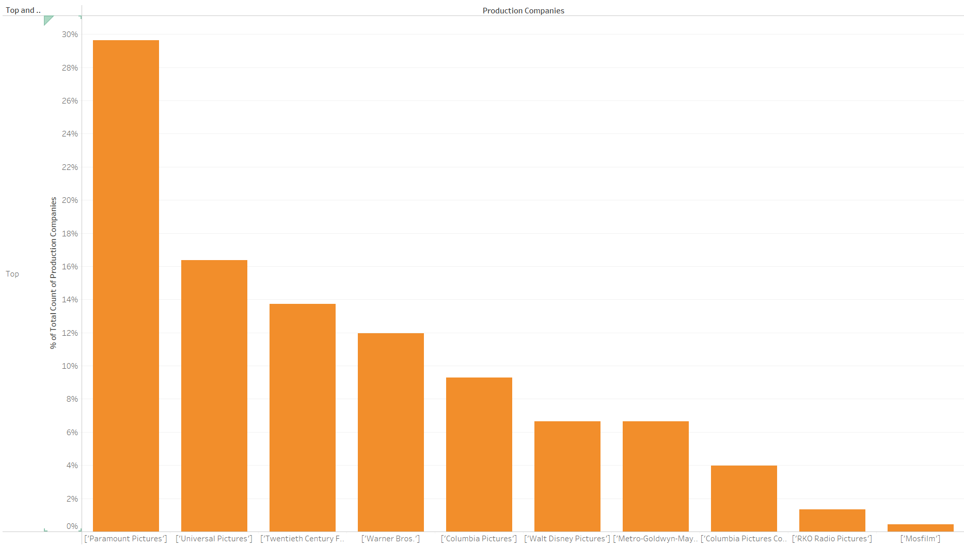
Paramount, Universal, 20th century fox are the common production companies to the Top Movies
Production companies to Top Movies
Paramount
Universal
20th Century Fox
Warner Bros
14
Notes:
Paramount, Universal and 20th Fox makes the most movies for Top Movies.

Slide 15
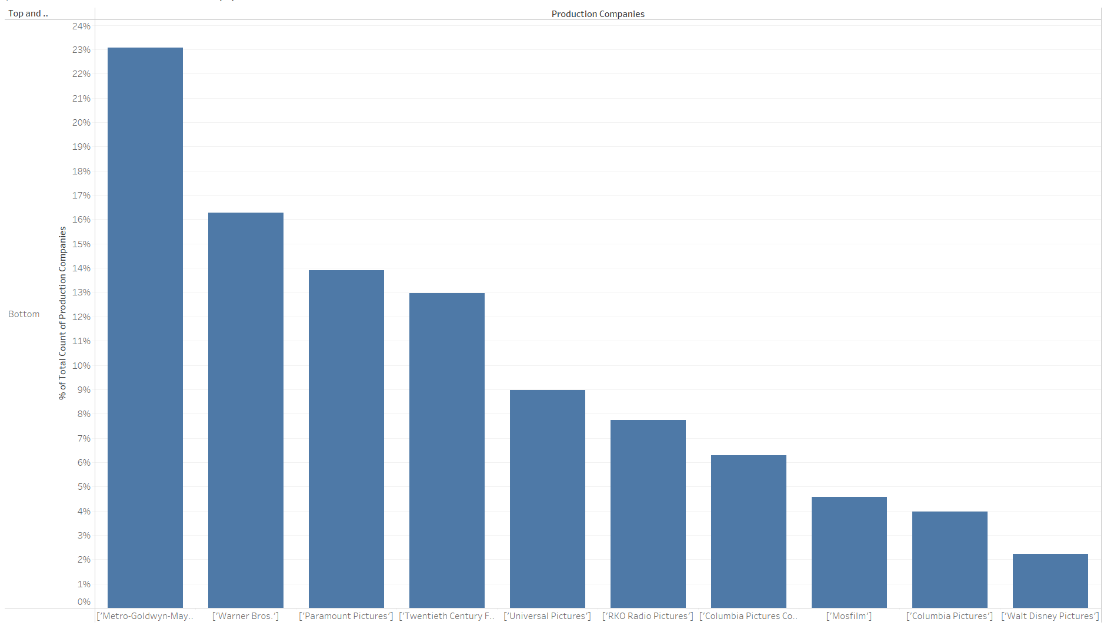
productive production companies make both top and bottom Movies
MGM, Warner Bros, 20th Century Fox, RKO, Mosfilm also are maker of Top Movies.
Productive production companies make many movies which can be top grossing or not. Hit or miss.
15
Notes:
MGM, Warner Bros and 20th Fox also makes the most movies for Bottom Movies. They are the top productive but no guarantee for top grossing.

Slide 16
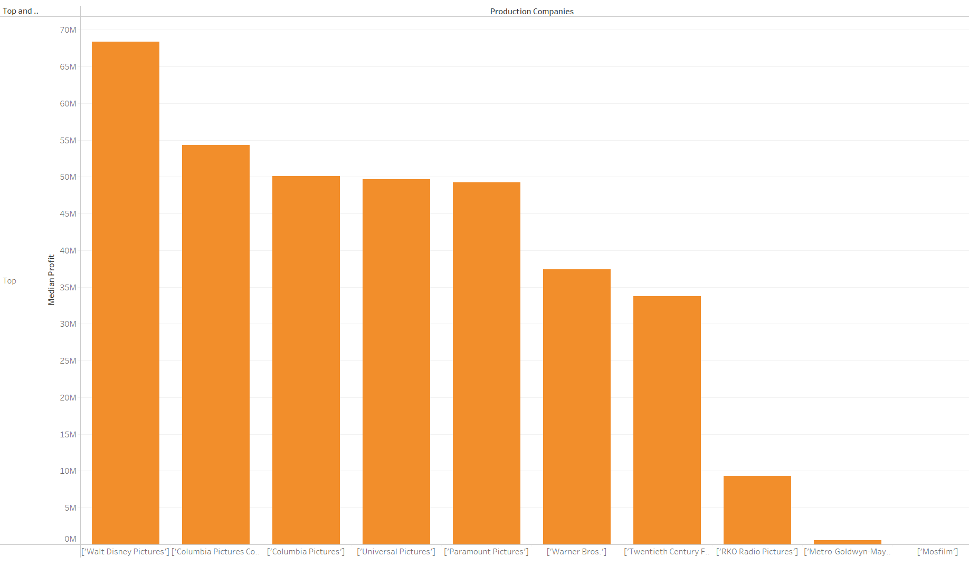
Disney, Columbia, Universal make most median profits for the Top Movies
Target these production companies when making next Top Movies.
16
Notes:
Disney, Universal and Columbia makes the most profit movies for Top Movies. Target these production companies.

Slide 17
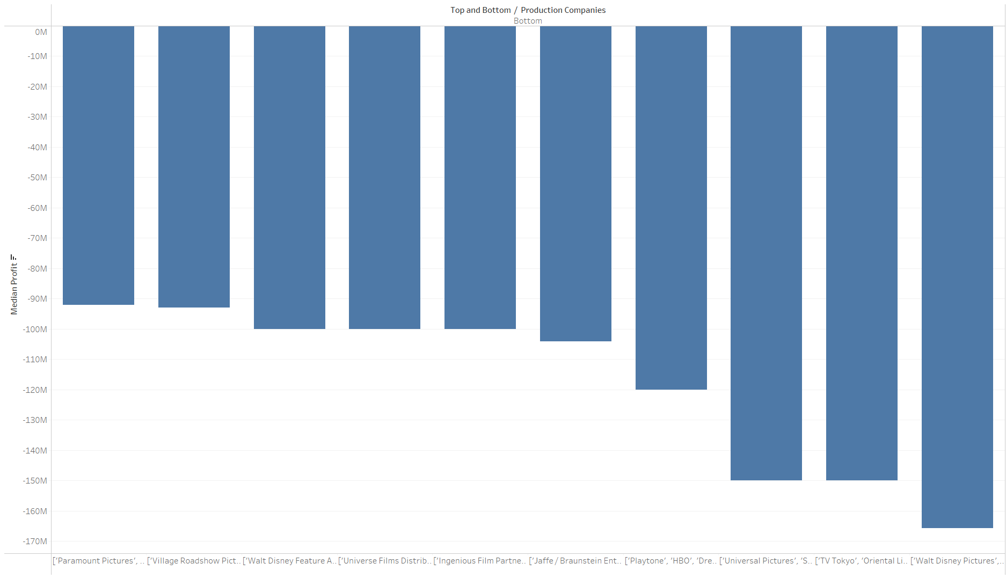
paramount, Disney, relativity make least median profits for the bottom Movies
Disney and Universal also makes most and least profitable movies.
Hit or miss movie making.
17
Notes:
Disney, Universal also makes the least profit movies for Bottom Movies. Hits and misses with movies, production companies are no guarantees.

Slide 18
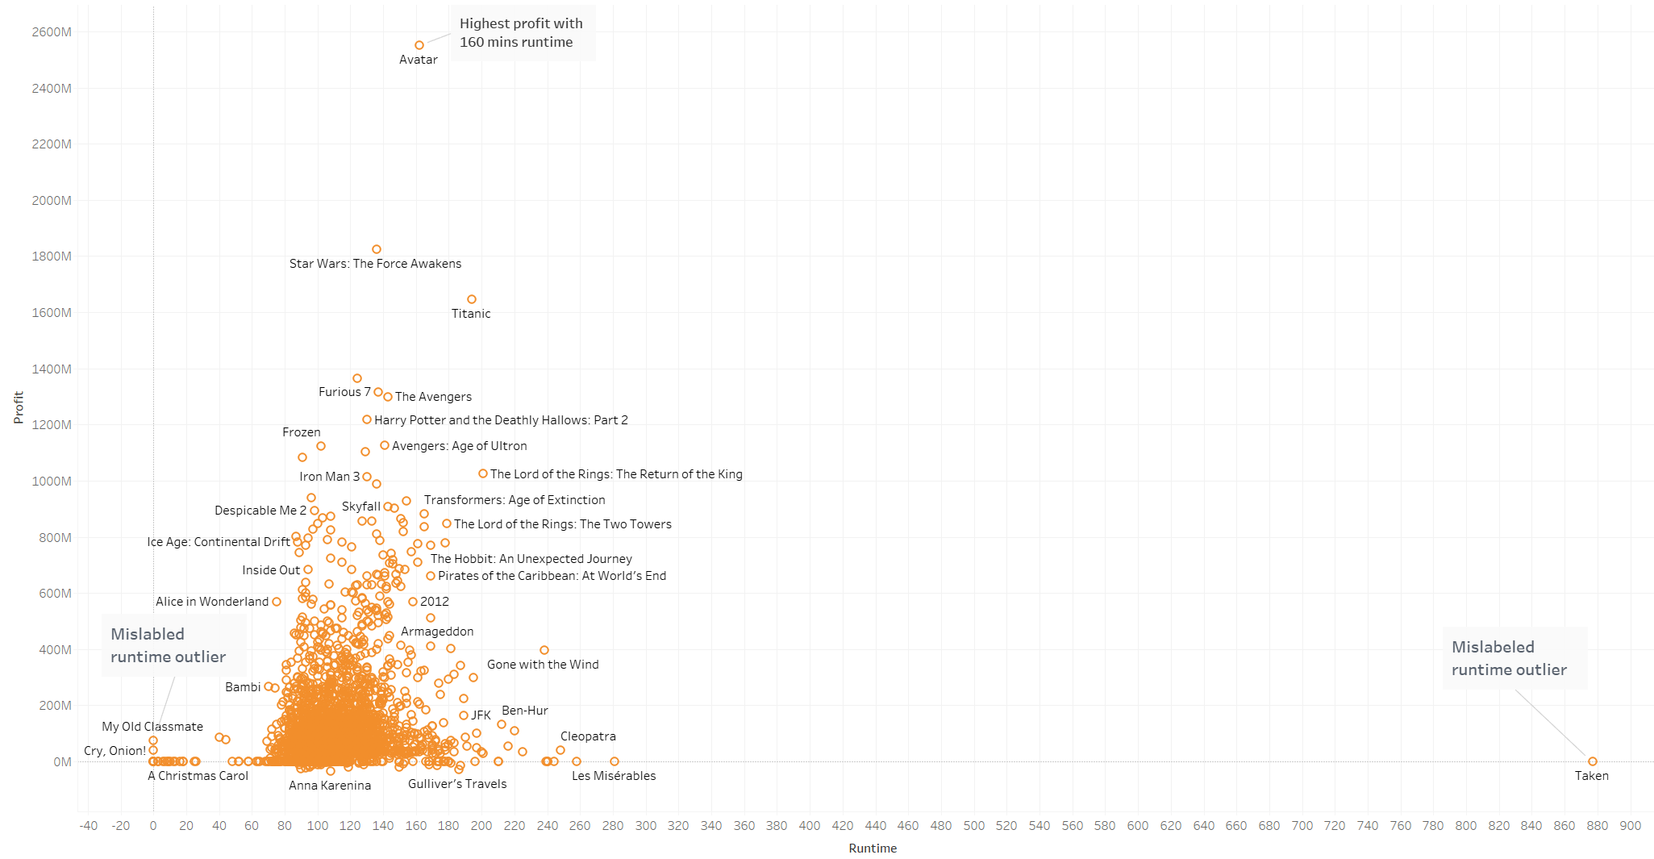
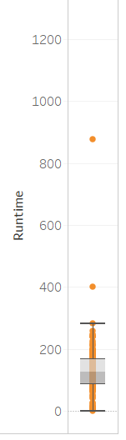
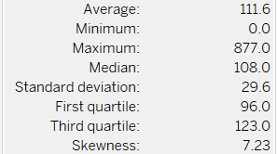
Longer movies does not indicate more profits for top movies
Weak correlation of Profit vs Runtime, R2=0.0272.
Median runtime of 108 mins.
Runtime is heavily influenced by human behavior and psychology.
18
Notes:
Median movie runtime is 108 minutes for Top Movies, no correlation between Runtime and Profits.

Slide 19
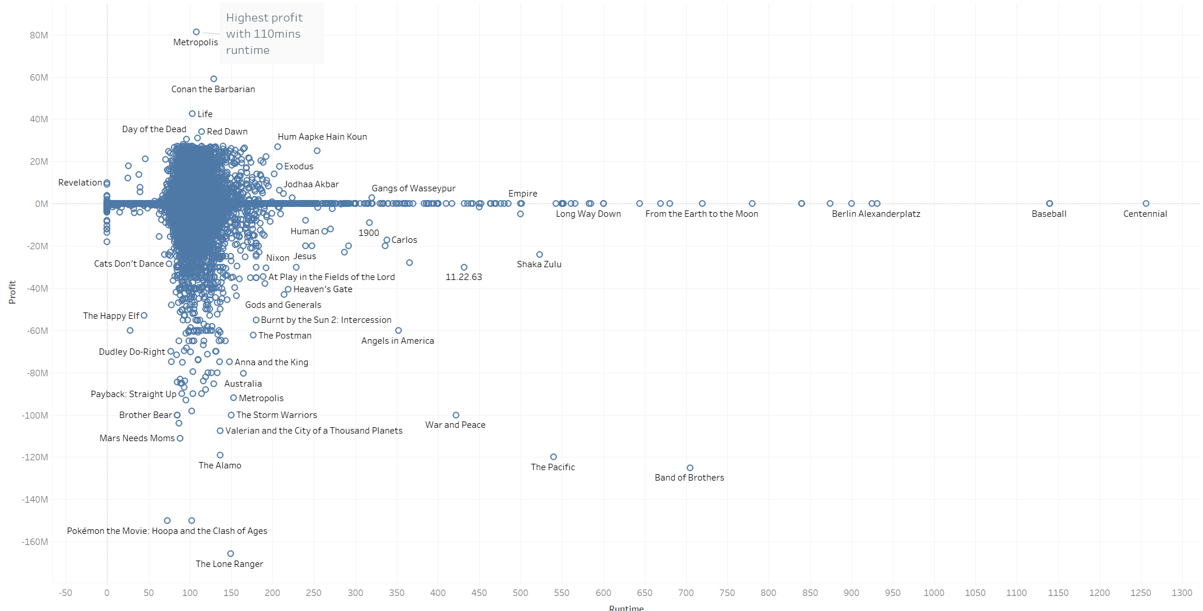
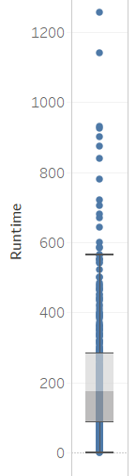
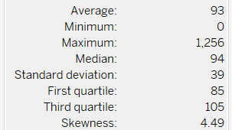
Longer movies does not indicate more profits for Bottom movies
Weak correlation of Profit vs Runtime, R2=0.0026.
Median runtime of 94 mins, similar to Top Movies.
19
Notes:
Similar for Bottom Movies, median movie runtime is 94 minutes, no correlation between Runtime and Profits. Runtimes are more of a human endurance and psychology than profits.

Slide 20
Limitations and biases
Limitation
Raw data is messy, have to be parsed to separate out like genre and production companies.
Data Collection
Popularity and voter ratings were sourced from 1 website – GroupLens.
Potential errors as dataset was assembled as part of an education coursework and not an official release with quality checks.
Data Processing
Missing data for some fields.
Mislabel data for some fields.
Data Insights
Profit defined by Revenue – Budget may not be present the P/E relationship. There could be extraneous factors like tax incentives, insurance payouts, etc.
Notes:
Weakness in data, missing data, incorrect data, profits may not be a sole good indicator.

Slide 21
Next steps
Impute missing values
Remove outliers.
Expand to include other datasets.
Expand to include analysis of other features and multi-variate analysis for combination of features.
Notes:
Fix missing data and outliers. Supplement data with more datasets and expand analyses.

