Slide 1
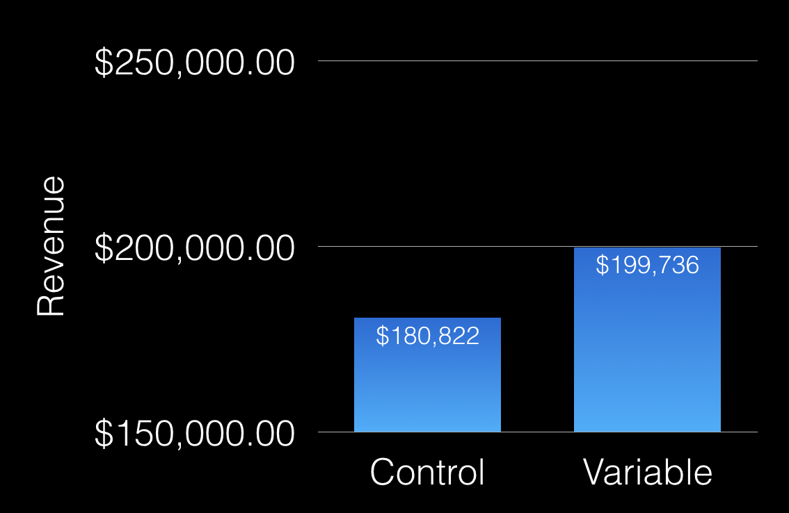
Does free shipping increase total revenue?

Slide 2
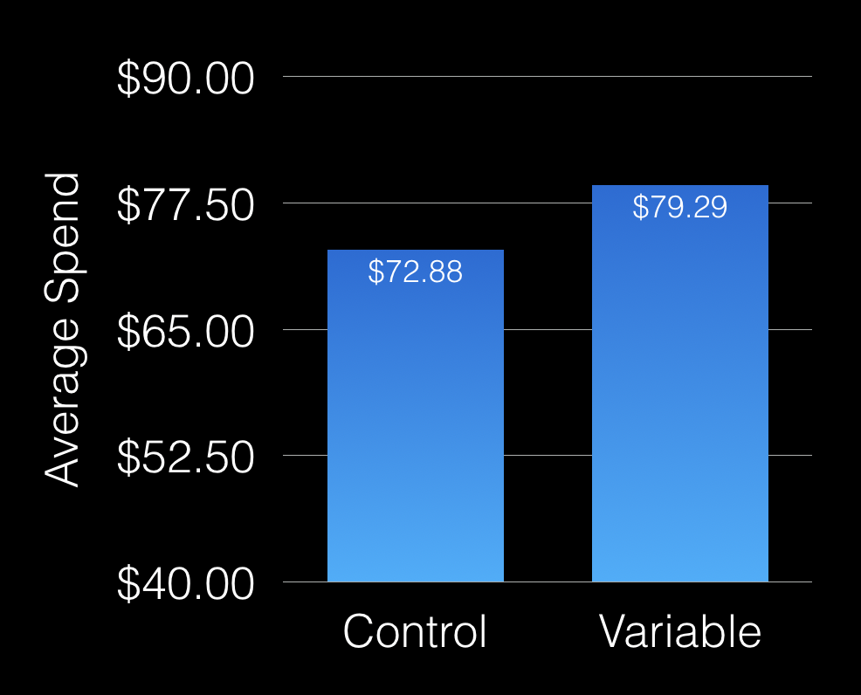
What is the average spend per customer?

Slide 3
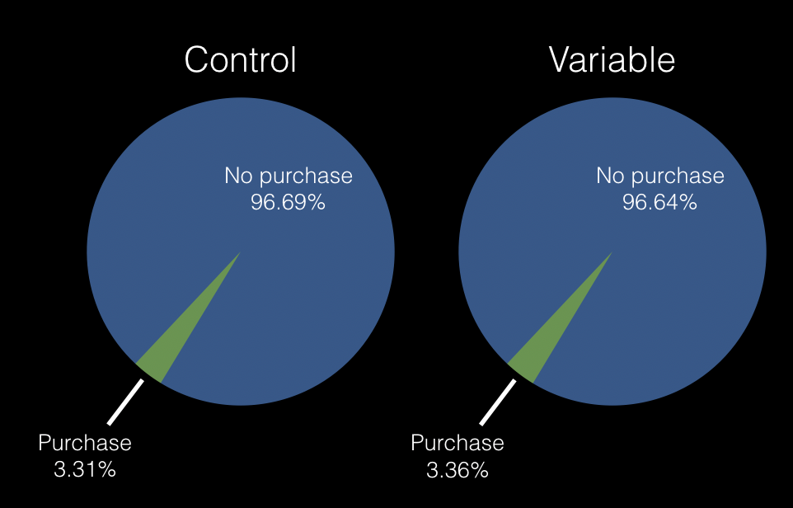
What percentage of visitors actually purchased?

Slide 4
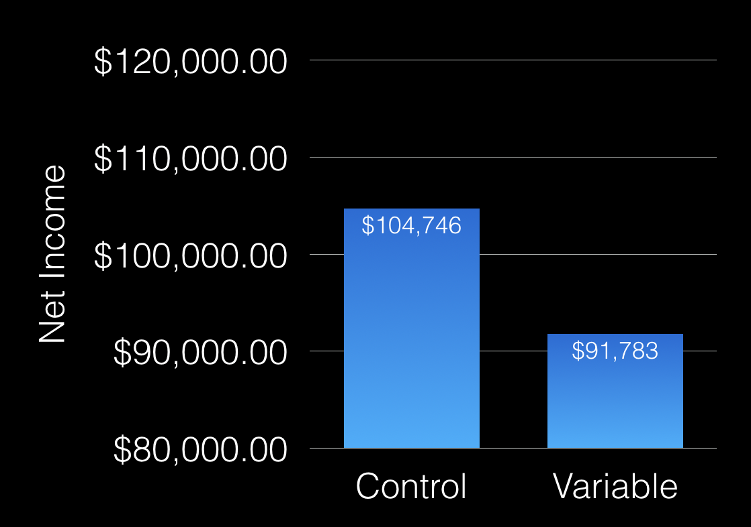
So does free shipping actually increase net income?

Slide 5
Does free shipping increase net income for particular products?
10, 12, 16, 18, 22, 28, 30, 35, 36, 39, 4, 40, 48, 51, 52, 56, 59, 61, 63, 65, 67, 70, 73, 75, 76, 80

