Slide 1

Applying Iterative Design Principles to a Live Product
Name:
Date:

Slide 2

How to use this Template
Make a copy of this Google Slide deck.
We have provided these slides as a guide to ensure that you submit all the required components to successfully complete your project.
When presenting your project, please only think of this as a guide. We encouraged you to use creative freedom when making changes as long as the required information is present.
Remember to delete this and all of the other example slides before you submit your project.
Remember to add your name and the date to the cover slide
Remove this slide

Slide 3
Step 1
Select KPIs
&
Evaluate Previous Multivariate Experiment Results

Slide 4
Select KPIs for Flyber Analyses
For the data available, which KPI(s) best match Flyber’s business model?
How would you calculate these KPI(s) using the available event data logs?
List other KPIs that might be important to Flyber but are not calculable based on available data

Slide 5
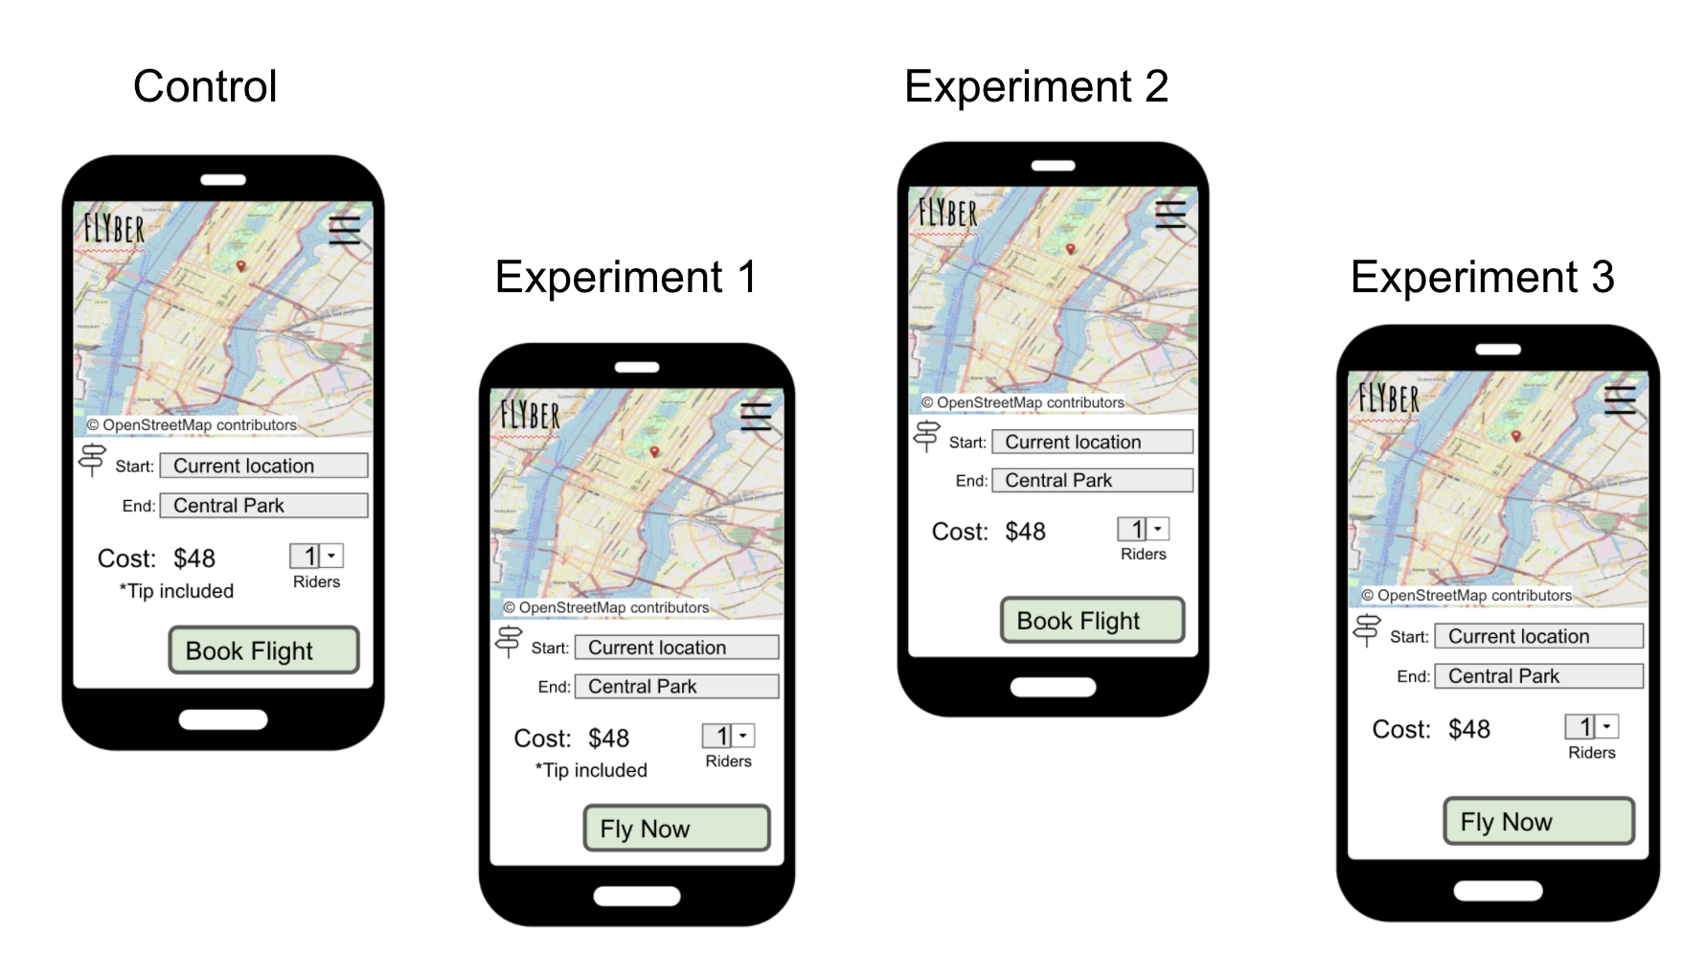
Describe the First Multivariate Experiment
Describe the elements tested during the multivariate experiment. You can use the image below when referencing the tests

Slide 6
Review Multivariate Test Results: Visualization
Provide a visual representation of the impact of the experiment on the conversion rate of users booking a flight (out of all users opening the app)

Slide 7
Review Multivariate Test Results: Significance Test
Determine if there was a significant difference between the experiments and control states.
Explain how you would perform a t-test to determine if the experimental results had a greater impact on the booking conversion rate than the control state
List the test results (p value) for each experiment compared to the control
Using the statistical significance calculator of your choice, determine which experiments, if any, had a significant result at the 95% level. Include your calculations as part of your explanation
Based on your statistical significance calculations, recommend if any of the experiments should be expanded

Slide 8
Step 2
Funnel & Cohort Analyses

Slide 9
User Funnel
Identifying the different stages the user funnel
Based on the event types in the data provided, list the 3 or more steps a user can take from opening the app to final booking of a ride
Provide a graph showing the funnel from step to step, including drop off rates.

Slide 10
User Segments
Identify 2 demographic attributes present in the data that allow for segment analysis
For each demographic attribute, provide the number of users in each segment group
For each demographic attribute, identify the segment group with the largest number of users

Slide 11
Segment Analysis of Funnel
Identify Opportunities for Improvement
Perform a funnel analysis by segment for all identified demographic attributes and describe the results
If underperformance for a segment in an attribute is identified, add a visual showing the average funnel conversion by segment group for that demographic

Slide 12
Step 3
Hypothesis & Next Steps

Slide 13
Review Qualitative Data
Read user interviews to understand “why” any funnel under-performance seen in Step 2 might occur
List your hypothesis for what customer need is being under-served
Provide 3 or more quotes as evidence for this hypothesis

Slide 14
Suggested Features & Experimentation Plan
Share your hypothesis using the following format: We believe [observed quantitative effect] Because [hypothesized user “why”] And that by [general change/opportunity for Flyber to improve] for [targeted cohort] we will see [expected effect ]
Suggest 2 or more features that would match your hypothesis and determine a plan for multivariate testing, including describing the control and experimental conditions
Determine who should be exposed to the experimental changes
List any additional metrics that would be helpful to collect from your suggested features

Slide 15
Appendix
Raw Data

Slide 16
Additional Info
You could include supporting or additional information that can support your previous slides but isn’t necessary for every person to see that looks at your slides.

