Slide 1
Digital Transformation Roadmap
Udacity recommends that you complete this document, to support the success of your digital transformation initiative. It is not required.
The other project document, the Talent Transformation Plan, is required to complete for the project.

Slide 2
Digital Transformation Purpose & Strategic Priorities
Purpose of Digital Transformation
Describe the purpose of your organization’s digital transformation initiative here, based on your discussions with key stakeholders.
Digital Transformation Goal #1
Describe a goal of your initiative in some detail here
Digital Transformation Goal #2
Describe a goal of your initiative in some detail here
Digital Transformation Goal #3
Describe a goal of your initiative in some detail here

Slide 3
Align with Overarching Company Mission & Priorities
Digital Transformation Purpose
Input your digital transformation purpose here (same as previous page).
Alignment with Overarching Company Mission
Input how the transformation purpose aligns with the company’s North Star here…
Digital Transformation Goal #1
Input a goal of your digital transformation here (same as previous page).
Alignment with Overarching Company Priority
Input how this goal aligns with a company goal or priority here…
Digital Transformation Goal #2
Input a goal of your digital transformation here (same as previous page).
Alignment with Overarching Company Priority
Input how this goal aligns with a company goal or priority here…
Digital Transformation Goal #3
Input a goal of your digital transformation here (same as previous page).
Alignment with Overarching Company Priority
Input how this goal aligns with a company goal or priority here…

Slide 4
Create Your Problem Statements
*Copy this template to create up to 10 problem statements and their possible solutions.
TODAY
Input the description of the customer persona here…
HAVE TO
Input the description of the customer pain point here…
WHEN
Input the description of the context in which that pain point occurs here…
Possible Solution
Input the description of a possible solution to this problem, applying a transformative technology you’ve learned about here…

Slide 5
Sample: Amazon Go Problem Statement
TODAY
tech-savvy urban shoppers
HAVE TO
waste time standing in line
WHEN
they only need a few items from the store
Amazon Go Solution:
A completely touch-free and line-free checkout process: Just Walk Out Technology automatically detects when products are taken from or returned to the shelves and keeps track of them in a virtual cart. When customers are done shopping, they can just walk out the store. Customers then receive a receipt and a charge on their Amazon account.

Slide 6
Key Decisions
Instructions:
Key decisions need to be made throughout your digital transformation roadmap planning. Address the following questions with appropriate stakeholders to support your successful digital transformation.

Slide 7
Technology
Which transformative technology(s) will power the digital transformation?
Technology Decision
Input decision here…

Slide 8
Process
What will your process be for engaging with stakeholders and making decisions during the transformation effort? What new processes need to be established to support the transformation?
Process Decision
Input decision here…

Slide 9
Strategy
Which area of digital transformation will you work on?
Strategy Decision
Input decision here…

Slide 10
Talent
Will you train the entire organization in developing a transformational and flexible mindset, or a subset of the organization? What will be the process of removing toxic and inflexible employees who can be detrimental to the effort?
Talent Decision
Input decision here…

Slide 11
Funding
If all milestones and KPIs are met, how can you ensure funding will be protected for the initiative?
Funding Decision
Input decision here…

Slide 12
Structure
Will the digital transformation effort be secluded and allowed to run on its own, or housed within the larger organization?
Structure Decision
Input decision here…

Slide 13
Risk Profile
What will the risk tolerance be for the digital transformation?
Risk Profile Decision
Input decision here…

Slide 14
Transformation Overview Planning Roadmap
Note: You can choose whether this roadmap calendar corresponds to the calendar year or not.
The quarter in which you begin planning your transformation initiative could be Y1-Q1, or you can choose to make January-March be Q1.

Slide 15
Transformation Overview Planning Roadmap
Mark an X or fill color in boxes to show timeframe for activities for 3 years of initiative. Add activities as needed.
Activity |  |  | Y1 - Q1 |  |  | Y1 - Q2 |  |  | Y1 - Q3 |  |  | Y1 - Q4 |  |  | Y2 |  |  |  | Y3
 |  |  | M1 | M2 | M3 | M1 | M2 | M3 | M1 | M2 | M3 | M1 | M2 | M3 | Q1 | Q2 | Q3 | Q4 | Q1 | Q2 | Q3 | Q4
Determine Strategy & Secure Stakeholder Agreement |  |  | x | x
Initiate Communication Commitment |  |  | x | x | x
Prioritize Business Use Cases |  |  | x | x
Create Talent Transformation Plan |  |  | x | x | x
Legal / Regulatory Plan
IT/Data/Security Plans
Product Development Plan

Slide 16
Sample: Transformation Overview Planning Roadmap
Activity |  |  | Y1 - Q1 |  |  | Y1 - Q2 |  |  | Y1 - Q3 |  |  | Y1 - Q4 |  |  | Y2 |  |  |  | Y3
 |  |  | M1 | M2 | M3 | M1 | M2 | M3 | M1 | M2 | M3 | M1 | M2 | M3 | Q1 | Q2 | Q3 | Q4 | Q1 | Q2 | Q3 | Q4
Determine Strategy & Secure Stakeholder Agreement |  |  | x | x
Initiate Communication Commitment |  |  | x | x | x
Prioritize Business Use Cases |  |  | x | x
Create Talent Transformation Plan |  |  | x | x | x
Legal / Regulatory Plan |  |  |  |  |  |  |  |  | x | x
IT/Data/Security Plans |  |  |  |  |  | x | x | x | x | x | x | x
Product Development Plan |  |  |  |  |  |  |  | x | x | x | x | x | x | x | x | x | x

Slide 17
Communication Commitment & Logs
Instructions:
To keep yourself accountable, make a commitment of how often and to whom you will communicate Digital Transformation updates. Then track your communication using the Communication Commitment & Logs table.
We suggest you communicate weekly with stakeholders and all levels of the organization (when appropriate).
Create your own spreadsheet to continue your logs for the long-term.

Slide 18
Communication Commitment & Logs
Digital Transformation Communication Frequency Commitment Statement
Input your commitment statement here…
Date Sent | Communication Input (email, meeting, slack) | Audience Receiving Communication | Feedback from Audience

Slide 19
Sample: Communication Commitment & Logs
Digital Transformation Communication Frequency Commitment Statement
Digital transformation updates will be sent out to the entire company at the beginning of every week
Date Sent | Communication Input (email, meeting, slack) | Audience Receiving Communication | Feedback from Audience
12/05/2020 | All-hands meeting, presentation | Entire company | Positive feedback, sent link to presentation via email to entire company
12/10/2020 | Email, company monthly newsletter | Entire company
12/15/2020 | Email, video recording | Entire company, external stakeholders | External stakeholders to host a follow up meeting to discuss roadmaps and anticipated funding
12/20/2020 | Slack and email | C-suite, entire company | Congratulated on small wins, majority of company is engaged
01/03/2021 | All-hands meeting, presentation | Entire company | A lot of questions regarding projections of upskilling and talent transformation

Slide 20
Potential Business Use Cases
Based on the potential solutions to the problems you’ve articulated previously, briefly describe here up to 10 potential business use cases for your digital transformation initiative. It will also be helpful if you create a title for each.
# | Business Use Case Title | Description
1
2
3
4
5
6
7
8
9
10

Slide 21
Business Use Case Prioritization Checklist
Gathering data through the activities here, for each of your potential business use cases, will help you in choosing which of your use cases to prioritize for implementation.
Activity | Check When Complete
After potential use cases are identified, interview legal and IT stakeholders to identify areas potential challenges with legal regulations, data requirements, devops, etc
For each use case, catalog impact to potential revenue, customer experience, employee productivity, employee experience/morale, resourcing on other projects
Gather information on financial requirements to implement each use case, challenges surfaced in previous interviews, time to market, etc

Slide 22
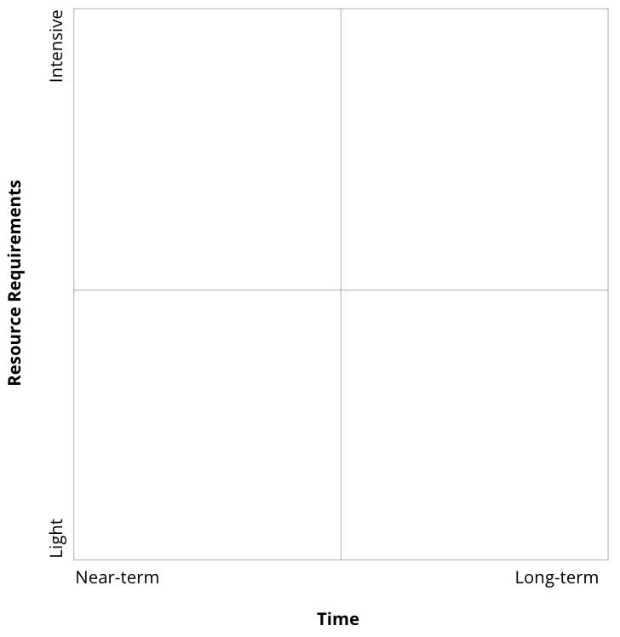
Business Use Case Opportunity Matrix
Title each of your business use cases (BUCs).
Then drag and drop the pink circles onto the matrix (up to 10).
Then decide on the top 3 BUCs.
BUC 1 Title
BUC 2 Title
BUC 3 Title
BUC 4 Title
BUC 5 Title
BUC 6 Title
BUC 7 Title
BUC 8 Title
BUC 9 Title
BUC 10 Title

Slide 23
Sample:
Business Use Case Opportunity Matrix
Image Diag
Cybersecurity Strategy
Chatbot
AWS

Slide 24
Business Use Case #1 Roadmap
Add all critical activities specific to your prioritized business use case. Mark an X or fill color to indicate timeline for each.
Activity |  |  | Y1 - Q1 |  |  | Y1 - Q2 |  |  | Y1 - Q3 |  |  | Y1 - Q4 |  |  | Y2 |  |  |  | Y3
 |  |  | M1 | M2 | M3 | M1 | M2 | M3 | M1 | M2 | M3 | M1 | M2 | M3 | Q1 | Q2 | Q3 | Q4 | Q1 | Q2 | Q3 | Q4
Create a brief (including basic business case data) and get stakeholder buy-in
Create KPIs
Initiate funding process

Slide 25
Business Use Case #2 Roadmap
Add all critical activities specific to your prioritized business use case. Mark an X or fill color to indicate timeline for each.
Activity |  |  | Y1 - Q1 |  |  | Y1 - Q2 |  |  | Y1 - Q3 |  |  | Y1 - Q4 |  |  | Y2 |  |  |  | Y3
 |  |  | M1 | M2 | M3 | M1 | M2 | M3 | M1 | M2 | M3 | M1 | M2 | M3 | Q1 | Q2 | Q3 | Q4 | Q1 | Q2 | Q3 | Q4
Create a brief (including basic business case data) and get stakeholder buy-in
Create KPIs
Initiate funding process

Slide 26
Business Use Case #3 Roadmap
Add all critical activities specific to your prioritized business use case. Mark an X or fill color to indicate timeline for each.
Activity |  |  | Y1 - Q1 |  |  | Y1 - Q2 |  |  | Y1 - Q3 |  |  | Y1 - Q4 |  |  | Y2 |  |  |  | Y3
 |  |  | M1 | M2 | M3 | M1 | M2 | M3 | M1 | M2 | M3 | M1 | M2 | M3 | Q1 | Q2 | Q3 | Q4 | Q1 | Q2 | Q3 | Q4
Create a brief (including basic business case data) and get stakeholder buy-in
Create KPIs
Initiate funding process

