Slide 1
Project Overview
(Music school platform)
Main functions,
UI design,
triggers, constraints
Data security
normalizaton
Presented by: Kalyaporn Theppunkulngam 6580863

Slide 2
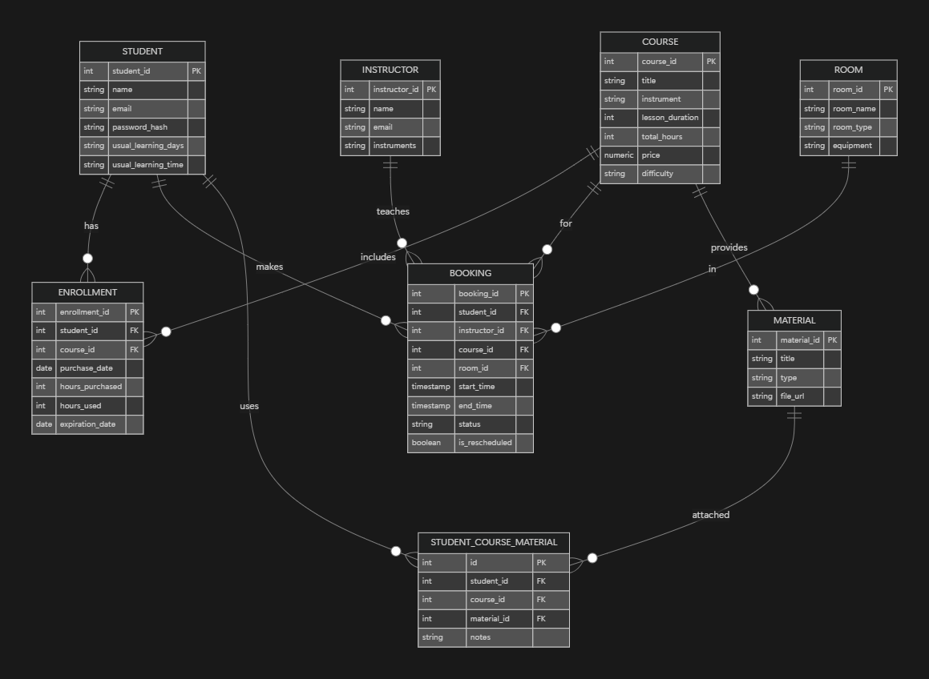
Main Functions -> ER design

Slide 3
Main Functions -> Core UI Features
- STUDENT
- INSTRUCTOR
- COURSE
- ROOM
- BOOKING
- PAYMENT
- Login page
- Dashboard
- Booking/ reschedule
- Lesson Details
- Student’s profile

Slide 4
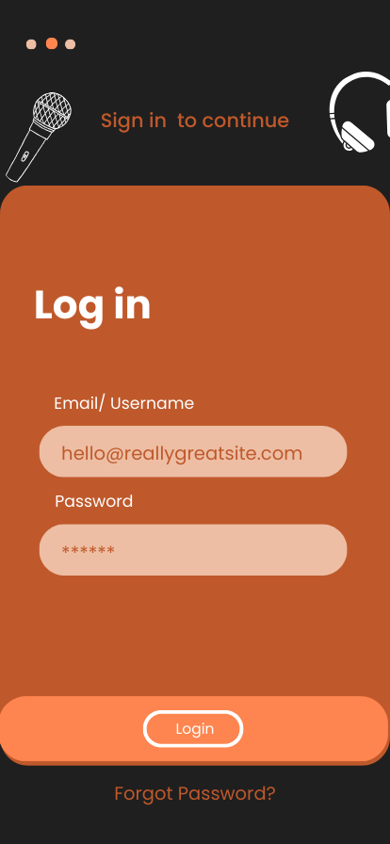
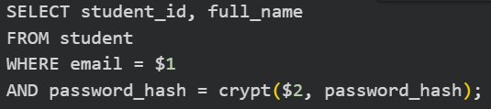
LOGIN Page
Call: fn_login(email, password_hash)
On success → navigate to Dashboard Page
Output: user_id, role, full_name

Slide 5
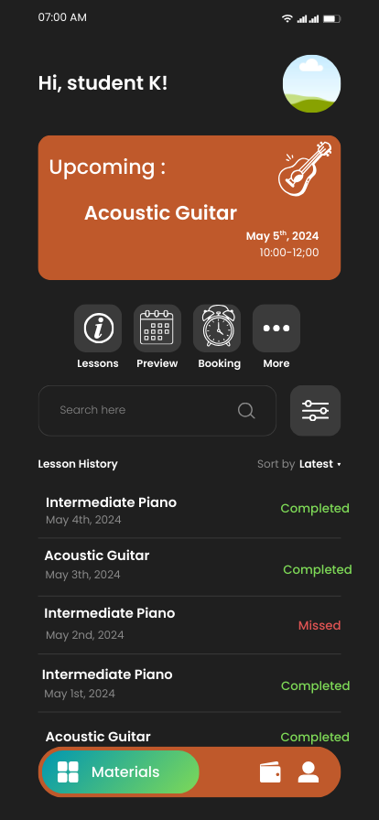
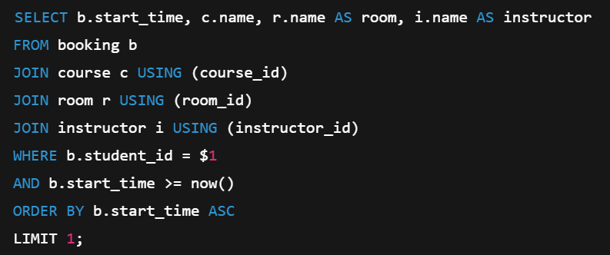
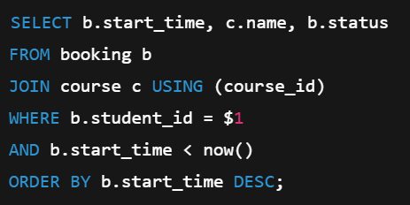
Home/ Dashboard Page
Call: fn_get_upcoming_lessons(student_id)
fn_get_lesson_history(student_id)

Slide 6
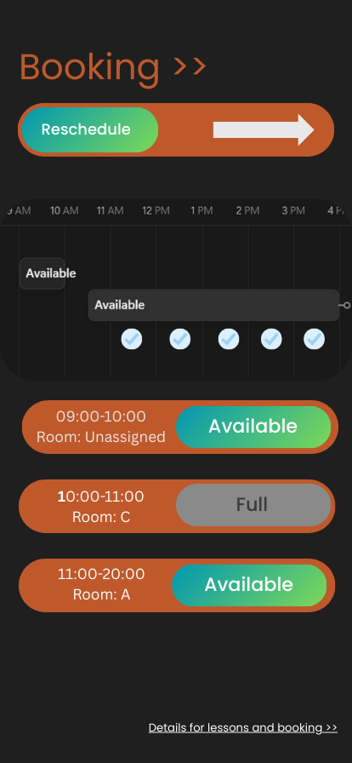
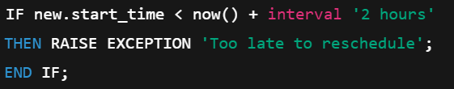
Booking + Reschedule Page
Call (constraint): fn_reschedule_booking(booking_id, new_start, new_end, room_id)
Call: fn_get_available_times(date)
output : boolean value ‘available’ or ‘full’
Call: fn_get_available_rooms(start_time, end_time)
Output: room list that is not booked yet

Slide 7
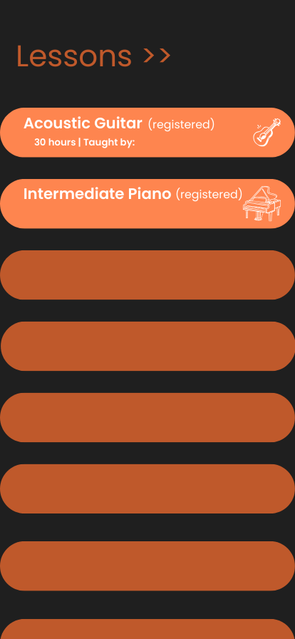
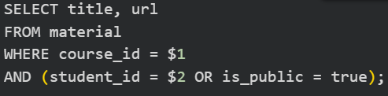
Lesson Details Page
Call: fn_get_lesson_details(booking_id)
output : (coursename, instructor, room, date/time)
Call: get_courses_materials(course_id, student_id)
output : title,url, file type

Slide 8
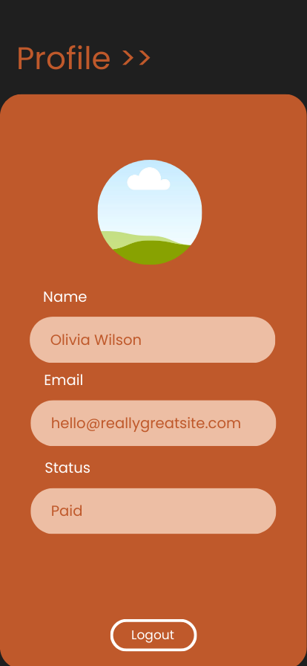
Student’s Profile Page
Call: fn_get_student_profiles(student_id)
output : full name, email, payment status

Slide 9
Normalization (3F)
Entries list such as musical instruments has been split
No partial dependency: function does not storing data repeatedly
No transitive dependencies: all non-keys depend only one key

Slide 10
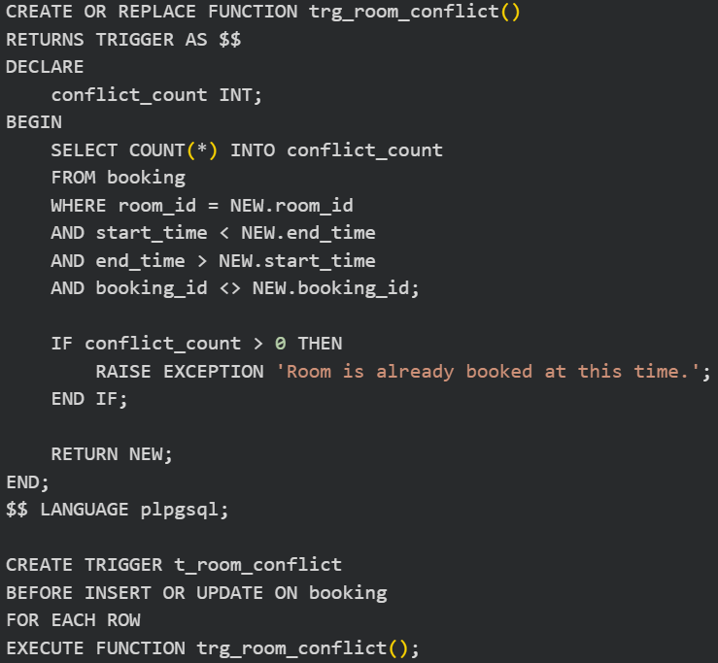
Triggers & Constraints (Data Integrity)
Prevent double booking
Prevent booking <2 hours before class
Auto-update lesson status
Example constraint: foreign keys -> every booking must be valid student/ couse/ room/ instructor

Slide 11
Data Security
Password hashing
Role-based access (student vs admin)
Transactional consistency

