Slide 1

Analysis of Seven-day Averages on Crop Tests
Presented by Kaytie Moyer

Slide 2
A QUICK LOOK AT OUR PROGRAMMING LANGUAGE
Python is a high-level programming language that includes data structures, dynamic typing and binding.
Easy to learn, great tool for all levels of experience with programming.
First launched in 1991 as Python 0.9.0
The Python Package Index has over 290,000 packages within the official repository.
For more information check out https://python.org

Slide 3
Project overview
Each sample is given a start date and end date. The number of days from the start date to the end date should ideally be seven days or less to “pass”.
Samples with timeframes of eight days or more would be considered “fail” status.
There are three sections to the project; data collection, cleaning and organizing the data, and graphing the data to display it visually.
The entire project took place in Microsoft Excel, then Jupyter Notebook (Python 3).

Slide 4
The Data
Three data sets were used with the algorithm. One data set (the original) is property of the company and while used with permission, cannot be re-distributed. The second data set is a re-creation of the original to provide an opportunity for public testing.
All three data sets held just over 100 samples and had to have a start date between August 1 and August 31, 2019 in order to be included in the data set.
The third data set had some blank start and end dates to replicate human error.

Slide 5
The Process (Gathering the Data)
This process was completed on a Windows 10 system, using Python 3.9.0.
The original data was entered into a macro in Microsoft Excel and output as an xlsx file. The other data sets were created through Microsoft Excel as a xlsx sheet.
These were converted into csv files through Microsoft Excel and imported into Jupyter Notebook with the below code.
df = pd.read_csv('C:/Users/Name/Desktop/School/data.csv', parse_dates=[0,1])
print(df)

Slide 6
The Process (Organizing the Data)
A third column (diff) is added to the start and end date column to calculate the number of days between the two dates.
df[‘diff’]=(df[‘End date’] – df[‘Start date’]).dt.days
All boxes containing blanks or corrupted data are dropped.
df.dropna(inplace=True)
The start and end date columns are dropped, and two new columns replace them; under (under 7 days) and over (8 days or more).
category=df.groupby(‘diff’)\
.agg(under=pd.NamedAgg(column='diff',
aggfunc=lambda x: (x < 8).sum()),
over=pd.NamedAgg(column='diff',
aggfunc=lambda x: (x > 7).sum()))\ .reset_index()

Slide 7
The Process (Organizing the Data)
Finally is removing the “diff” label from the column, and changing the under and over column heads to pass and fail.
category_p=category[[‘under’,’over’]]
‘’’category_p=columns=[‘pass’,’fail’]
category_p.head()

Slide 8
The process (Visualizing the Results)
Now, the results are plotted with the following code onto a bar graph in order to show the number of samples that have been tested in less then seven days and pass, against the number of samples that tested longer than eight days and failed the seven-day average.
my_plot = category_pf.plot(kind=‘bar’,title=“Pass/Fail results of seven-day-averages in Department”)my_plot.set_xlabel(“Pass or Fail Results”)my_plot.set_ylabel(“Amount”)

Slide 9
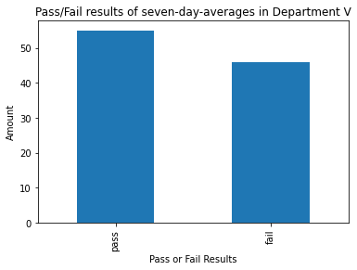
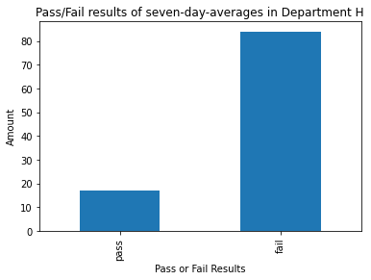
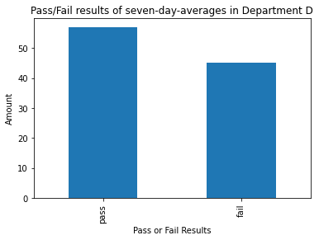
The process (Visualizing the Results)
Department V is the result of the original data. Department H is the result of the 2nd set of mimicry data. Department D is the result of the third set of data that had missing start and end dates.

Slide 10
Tools
Python 3.9.0
Jupyter Notebook
Numpy - (https://numpy.org/)
Pandas - (https://pandas.pydata.org)
Pandas_profiling - (https://pandas-profiling.github.io/pandas-profiling/docs/master/index.html)
Matplotlib - (https://matplotlib.org/)
Datetime - (https://docs.python.org/3/library/datetime.html)
Seaborn - (https://seaborn.pydata.org/#:~:text=Seaborn%20is%20a%20Python%20data,can%20read%20the%20introductory%20notes.)

Slide 11
Credits
A lot of gratitude is owed to
Stackoverflow.com for helping me discover solutions to error messages I’d never seen before.
Regis University for teaching me skills in Python and giving me confidence in my abilities to run projects like this.
My supervisor B., who gave me the inspiration for this project and helped me relate it to our real-world job.

