Slide 1
Week 6 Assignment MSDS 670 Data Visualization
Kaytie Moyer
Regis University
October 3, 2021

Slide 2
Summary
The Week 6 Project demonstrates results taken from data provided by Cook County State Attorney’s office in Illinois from 2010 to 2021.
The data involved is used as a means to communicate the demographic data collected by the State Attorney’s (SA) office for research and problem-solving means.
The file available for download held four files, each focusing on a separate part of the felony arrest and incarceration process.
I focused on the "Initiation" or intake part of the process, where each person arrested was reported with their gender, race, arresting offence, and the results of those arrests ending in criminal charges or release.
This was done to answer the question; which demographics in Cook County are at highest risk of committing felonies, and which felonies are offenders arrested for the most?

Slide 3
Data and Methodology
The data was sourced from the Cook County SA’s office, located in the state of Illinois. A link is provided in the references for personal viewing and use.
The original data included three other sets, but only the initiation.csv data set was used for this project.
The records involved in initiation.csv held over 42,000 reports of individuals who had been involved in felony charges and arrests. Each report was sourced from a police officer employed with the Cook County Police Department, Sheriff Department, or State Troopers.

Slide 4
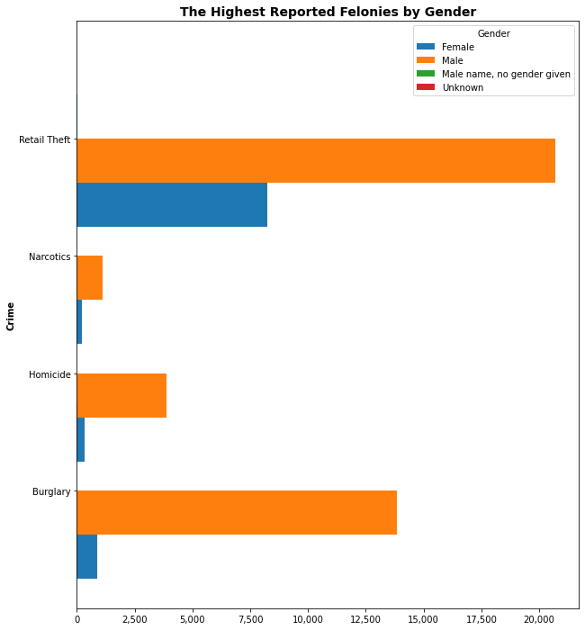
Highest Reported Felonies by Gender
Very little amounts of case numbers reported male names with no gender given, and unknown genders.
Men committed the highest number of felonies in each category, reaching over 100% more counts than females in all four categories.
Retail theft was the highest committed felony for both men and women.
Burglary was the second highest committed felony for both men and women.

Slide 5
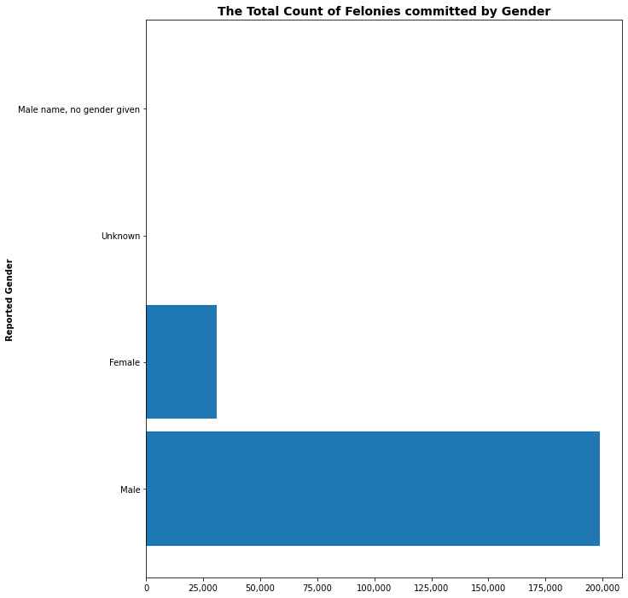
Total Count of Felonies by Gender
Very small amounts of cases reported a male name with no gender given, or unknown gender.
The highest number of felonies committed were reportedly by men.
Women committed about one-eighth of the crimes that men committed in total.

Slide 6
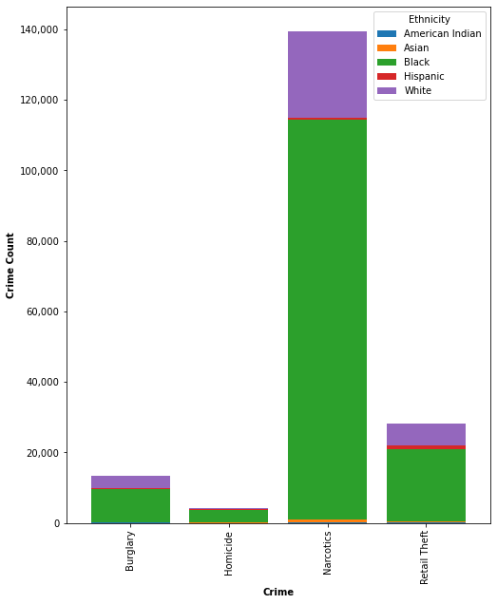
Highest Reported Felonies by Ethnicity
Narcotic-related charges were the highest committed felonies for all ethnic groups.
Retail theft was the second highest reported felony category for all ethnic groups.
Members of the white ethnic group were reported as the highest number of offenders in all four felony categories.
Members of the black ethnic group were the second highest number of offenders in all four categories.

Slide 7
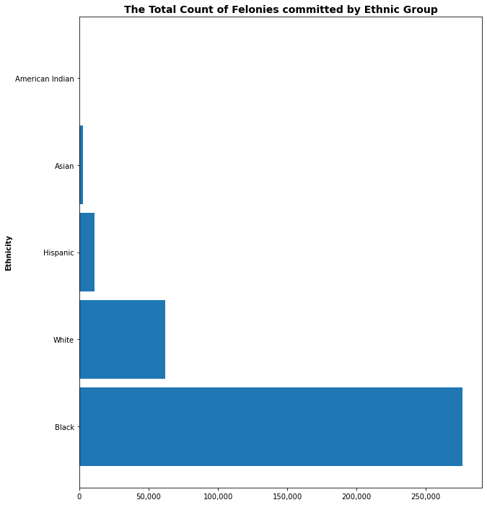
Total Count of Felonies by Ethnic Group
American Indians committed the smallest number of felonies.
In total, members of the black ethnic group were arrested for more felonies than any other group by more than one hundred percent.
Members of the white ethnic group, despite committing the most crimes in the Retail Theft, Narcotic, Robbery and Homicide categories, committed the second-most felonies in total.

Slide 8
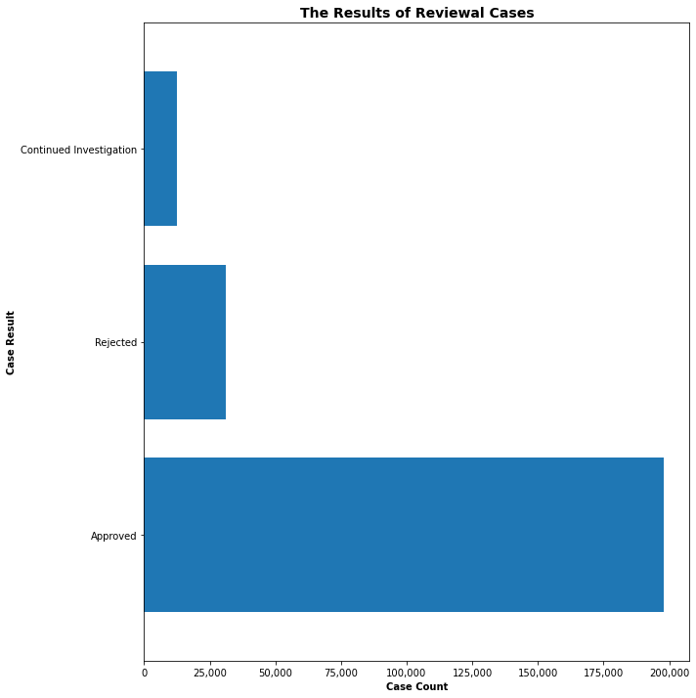
Results of Reviewal Cases
Each felony charge is reviewed by a judge and the state attorney to determine if charges should be pressed (approved), if the charge was incorrect and the person of interest should be released (rejected), or if the case could warrant a charge but requires more evidence (continued investigation).
Most of the cases were approved, and charges were filed.
Less then one-third of cases were rejected, and the person of interest released.

Slide 9
Conclusion
The demographics that appear to be at highest risk from the initiation.csv are men of both black and white ethnicities.
Outsource programs that intend to help with felony offenders should consider that white ethnicities committed the highest amounts of crimes in narcotic, retail theft, homicide, and burglary related crimes, while members of the black ethnic group committed the highest number of crimes overall.
Future research should determine which areas of Cook County have the highest output for felony arrests, in order to help outsource programs target troubled areas.
Further research should also be completed to confirm that arrests are made without bias, and that the demographics are truly representative.

Slide 10
References
https://www.cookcountystatesattorney.org/data
John Koenig’s Matplotlib content starting in Week 5 of MSDS 670, found at https://worldclass.regis.edu/d2l/le/content/273433/Home
https://towardsdatascience.com/how-to-make-bar-and-hbar-charts-with-labels-using-matplotlib-b701ce70ba9c
https://pandas.pydata.org/docs/reference/api/pandas.DataFrame.plot.barh.html
https://codefather.tech/blog/unhashable-type-python/
https://matplotlib.org/stable/gallery/lines_bars_and_markers/bar_stacked.html

