Slide 1
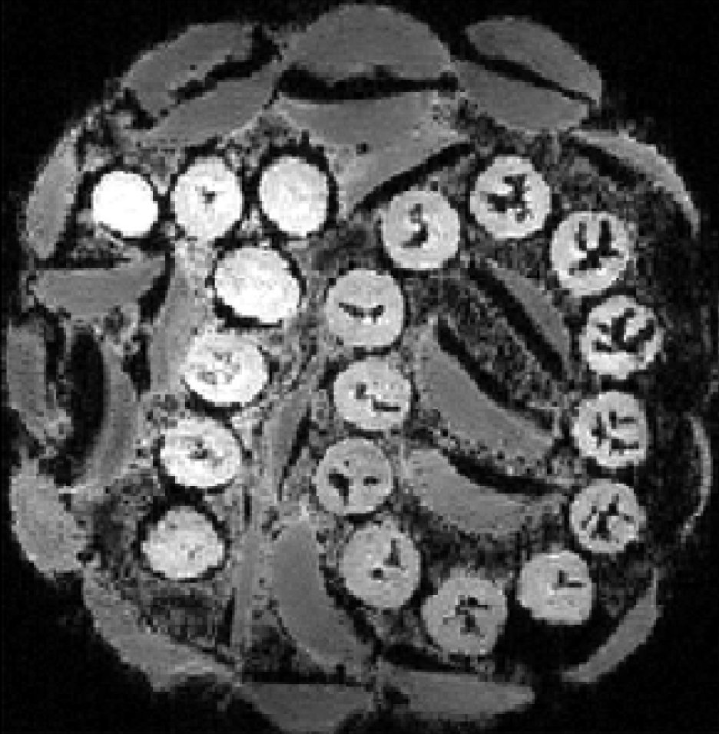
A Taste of MRI Physics

Slide 2
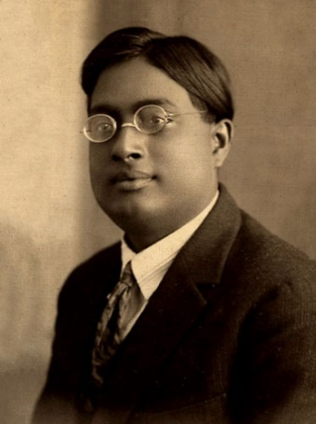
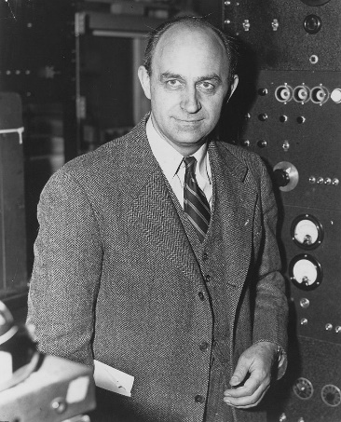
Angular Momentum and Spin
All particles are either “bosons” or “fermions”.
ħ ≈ 1.0546×10⁻³⁴ J-s
Satyendra Bose
Enrico Fermi
The angular momentum of any boson measured in any direction must be a multiple of ħ.
The angular momentum of any fermion measured in any direction must be a multiple of ħ plus ħ/2.
The magnitude of the angular momentum of any particle in any direction cannot exceed ħ times the spin.
For bosons, the “spin” is a nonnegative integer: 0, 1, 2…
For fermions, the “spin” is a nonnegative half-integer: 1/2, 3/2, 5/2…

Slide 3
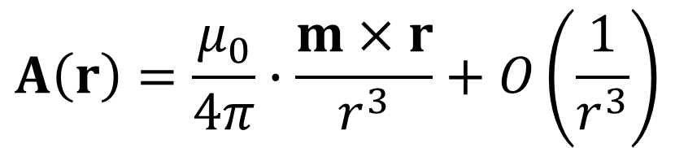
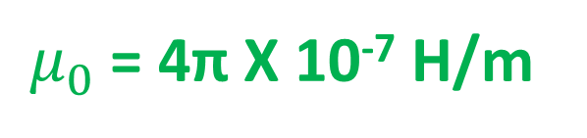
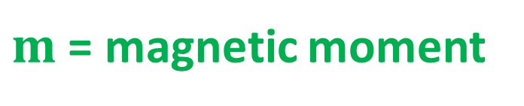
Magnetic Moment
The “vector potential” generated by a particle at rest has the form:
$$A\left(r\right)=\frac{μ_{0}}{4π}∙\frac{m×r}{r^{3}}+O\left(\frac{1}{r^{3}}\right)$$
$m$ = magnetic moment
$μ_{0}$ = 4π X 10⁻⁷ H/m
$$B\left(r\right)=∇×A\left(r\right)$$

Slide 4
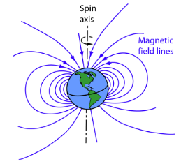
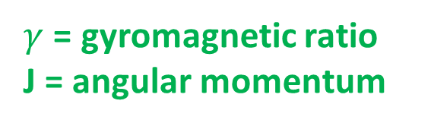
Gyromagnetic Ratio
The magnetic moment of a particle is usually proportional to its angular momentum:
$$m=γJ$$
$γ$ = gyromagnetic ratio
J = angular momentum

Slide 5
Gyromagnetic Ratio
particle | spin | γ (rad s⁻¹ T⁻¹)
electron | 1/2 | -176.1 X 10⁹
positron | 1/2 | 176.1 X 10⁹
muon | 1/2 | -851.6 X 10⁶
photon | 1 | 0
proton | 1/2 | 267.5 X 10⁶
neutron | 1/2 | -183.3 X 10⁶
³He | 1/2 | -203.8 X 10⁶
¹⁹F | 1/2 | 251.7 X 10⁶
³¹P | 1/2 | 108.3 X 10⁶
Earth | - | ~10⁻¹¹*
*|m|/|J|

Slide 6
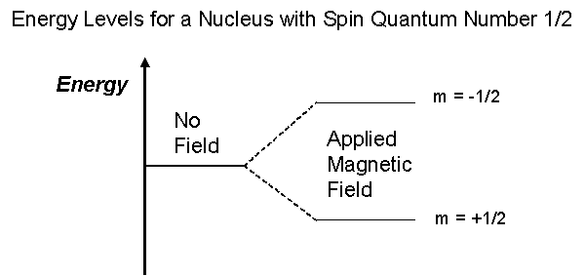
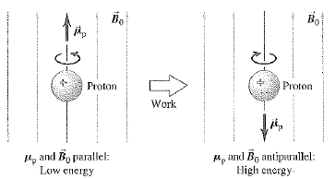

Energy of Magnetic Moment in Applied Magnetic Field
$$E=E_{0}−B_{ext}∙m$$
$$E=E_{0}−γB_{ext}∙J$$
So for spin ½, the only two possible energy states are:
$$E=E_{0}±{\frac{1}{2}ħγB}_{ext}$$

Slide 7
Larmor Frequency
When proton decays from high energy state to low energy state, it emits a photon.
The energy of the photon is E_{γ} = ħγB_{ext}.
According to the Einstein relation, E_{γ} = ħω.
Thus the frequency of the emitted photon is ω = γB_{ext}.
This is called the Larmor frequency and plays a central role in MRI.
For B_{ext} = 3 T, the proton Larmor frequency is 128 MHz.
For B_{ext} = 7 T, the proton Larmor frequency is 298 MHz.

Slide 8
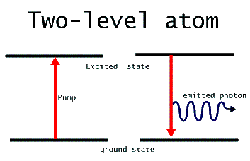
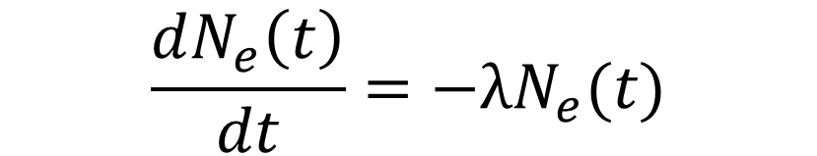

Decay to Ground State
Since the probability of emitting a photon at any given time is completely random, we must have
$$\frac{dN_{e}\left(t\right)}{dt}=−λN_{e}(t)$$
$$→N_{e}\left(t\right)={N_{e}\left(0\right)e}^{−λt}$$

Slide 9
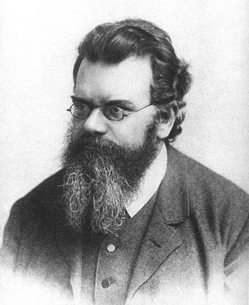

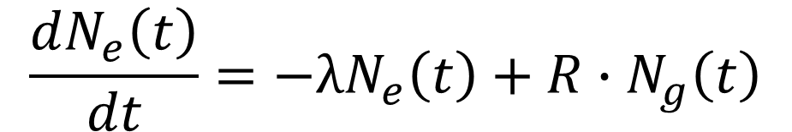
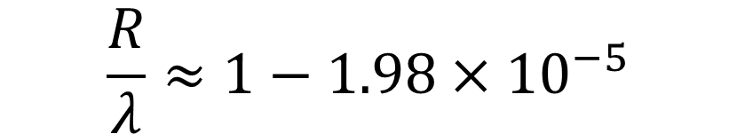
Decay at Finite Temperature
$$\frac{dN_{e}\left(t\right)}{dt}=−λN_{e}\left(t\right)+R∙N_{g}\left(t\right)$$
From statistical mechanics, one has
$$R={λe}^{−ℏω/k_{B}T}$$
Ludwig Boltzmann
k_{B} ≈ 1.381 X 10⁻²³ J/K
At body temperature (310 K)
$$\frac{R}{λ}≈{1−1.98×10}^{−5}$$

Slide 10
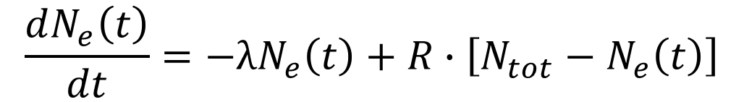
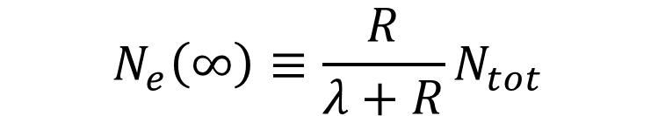
Decay at Finite Temperature
The total number of protons is
$$N_{tot}=N_{g}(t)+N_{e}(t)$$
Thus we have
$$\frac{dN_{e}\left(t\right)}{dt}=−λN_{e}\left(t\right)+R∙\left[N_{tot}−N_{e}\left(t\right)\right]$$
The solution of this equation is
$$N_{e}\left(t\right)=N_{e}\left(∞\right)+\left[N_{e}\left(0\right)−N_{e}\left(∞\right)\right]e^{−\left(λ+R\right)t}$$
$$N_{e}\left(∞\right)≡\frac{R}{λ+R}N_{tot}$$

Slide 11
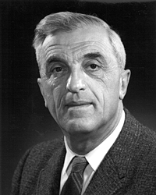
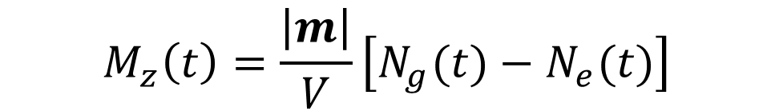
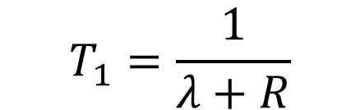
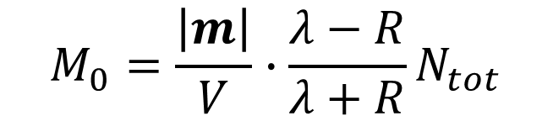
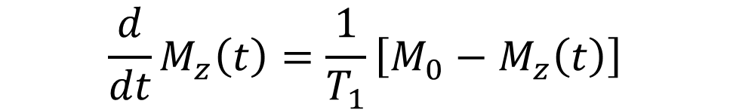
Bloch Equation: Longitudinal Relaxation
The net magnetization is
$$M_{z}\left(t\right)=\frac{\left|m\right|}{V}\left[N_{g}(t)−N_{e}(t)\right]$$
The decay equation can then be recast as
Felix Bloch
$${\frac{d}{dt}M}_{z}\left(t\right)=\frac{1}{T_{1}}\left[M_{0}−M_{z}\left(t\right)\right]$$
with
$$T_{1}=\frac{1}{λ+R}$$
$$M_{0}=\frac{\left|m\right|}{V}∙\frac{λ−R}{λ+R}N_{tot}$$

Slide 12
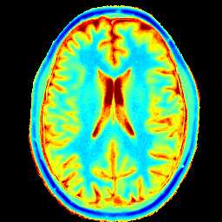
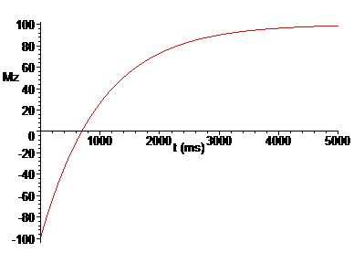
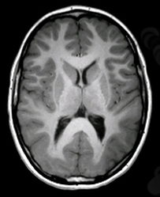
Bloch Equation: Longitudinal Relaxation
The solution is
$$M_{z}\left(t\right)=M_{0}+\left[{M_{z}\left(0\right)−M}_{0}\right]e^{−t/T_{1}}$$
T₁ map
MP-RAGE

Slide 13


