Slide 1

CSE325: Operating Systems Section: 02 Sweet Harmony Group: 8
Submitted By
Muhammad Abdul Kayum
ID: 2023-2-60-082
Afia Mahpara
ID: 2023-2-60-011
Md. Hasib Ali
ID: 2023-3-60-186

Slide 2
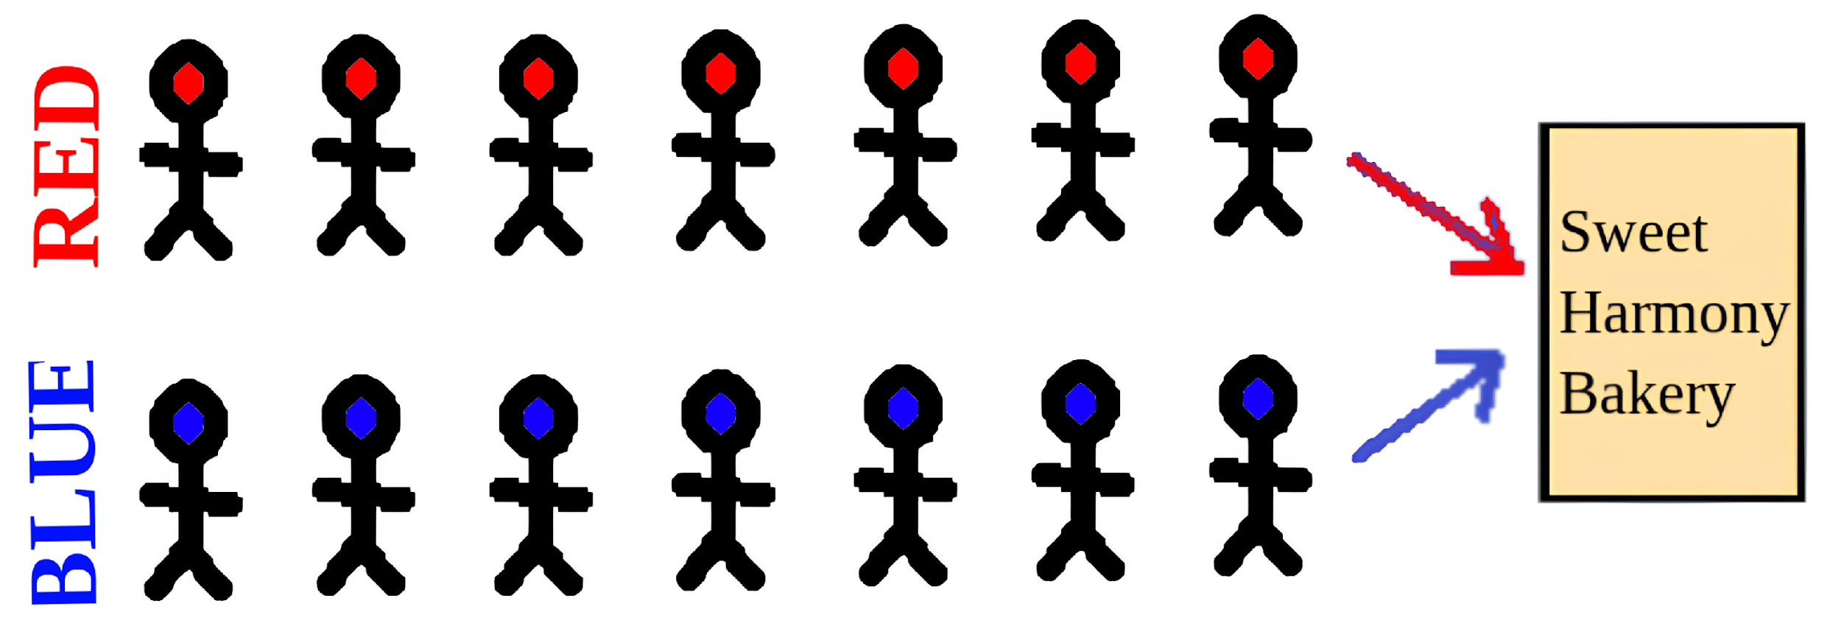
Introduction & Problem Statement
Sweet Harmony: A bakery with limited number of seats
Unique rule: inside must always have equal numbers of red‑ and blue‑clothed customers
The core problem:
Let customers enter only if outfit balance + table space allow
Keep others waiting politely (queue) until the rule is satisfied
Update counts (red, blue, free tables) safely in parallel — many customers act at once

Slide 3
Key Concepts Used
Threads: Each customer is simulated as a separate thread to act independently, like real people arriving, waiting, eating, and leaving.
Mutex: Used to safely update shared data like the number of red and blue customers inside, prevents race conditions. (pthread_mutex_t)
Semaphores: Control the limited number of tables. A customer must wait if no table is free. (table_sem, etc)
Condition Variables: Handle the outfit rule, customers wait if entering would break the red-blue balance. (pthread_cond_t)
Critical Sections: Any part of the code that reads or modifies shared variables (like red count, blue count, or table access) is protected.

Slide 4
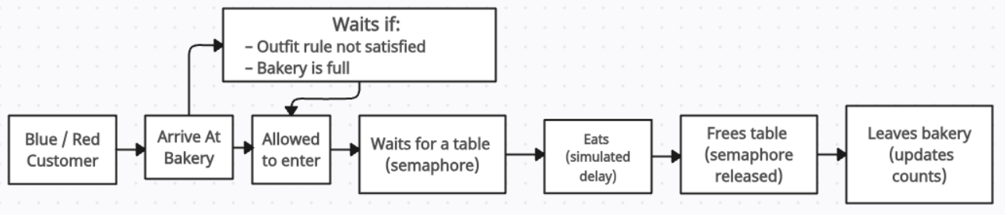
System Design & Visualization
Queue Style Leaving: The customers (red/blue) follow FIFO style when leaving the bakery
Balanced entry logic: A customer enters only if their outfit keeps red/blue counts equal and there’s space inside.
Efficient resource control: Uses a semaphore for tables and mutex + condition variable to manage entry rules.

Slide 5
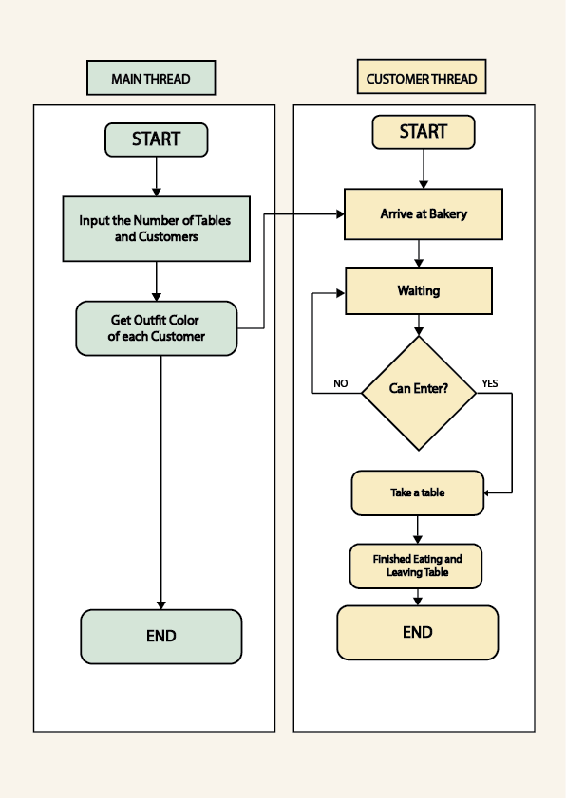
Control Flow of the Code

Slide 6
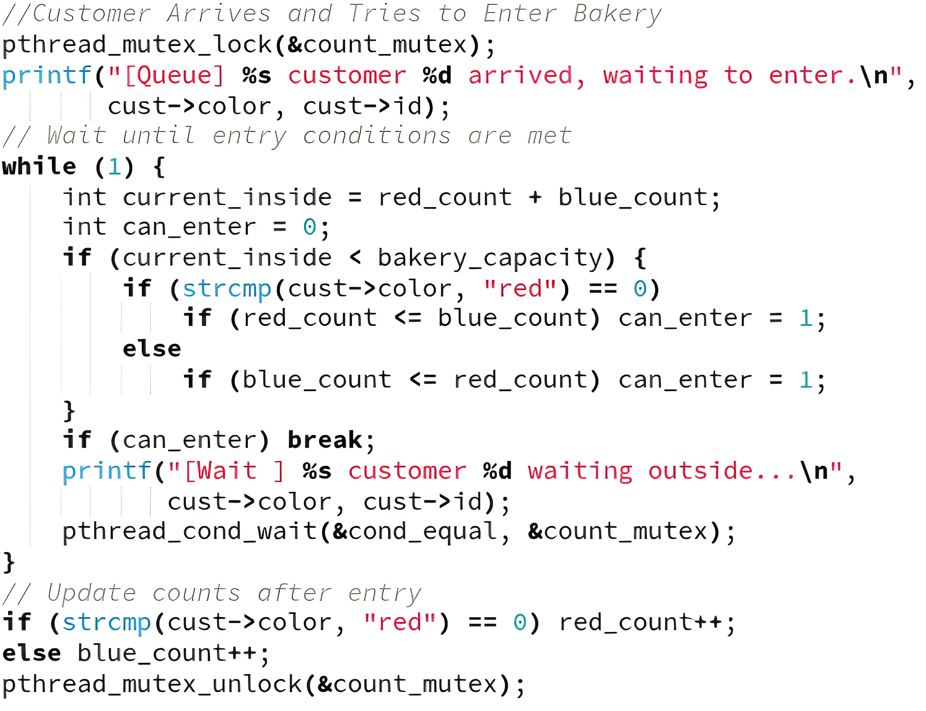
Code: Entry and Waiting Logic

Slide 7
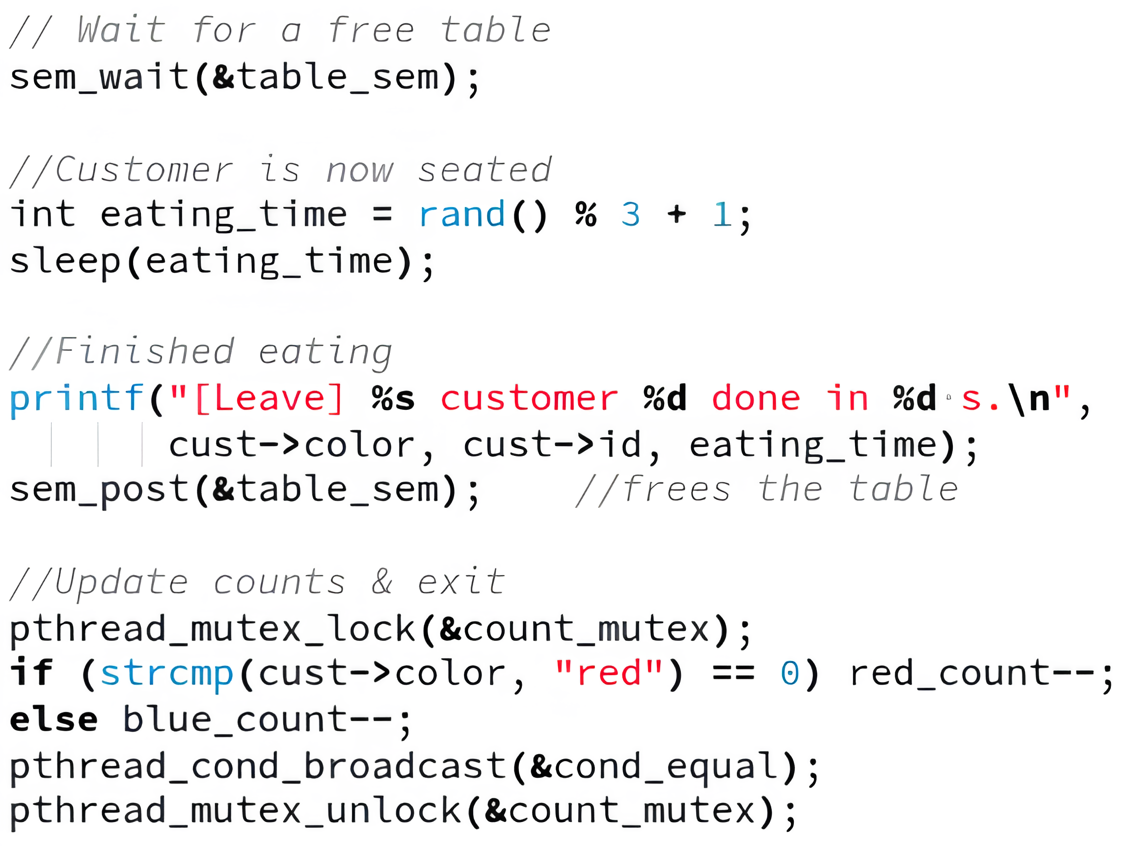
Code: Table Management and Leaving

Slide 8
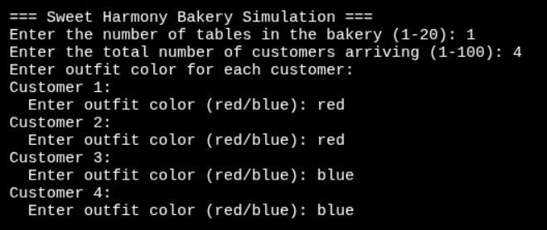
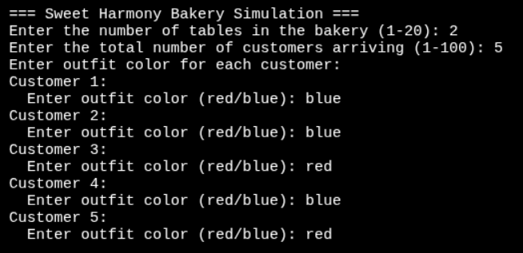
Taking Input
Problem - 1
Problem - 2

Slide 9
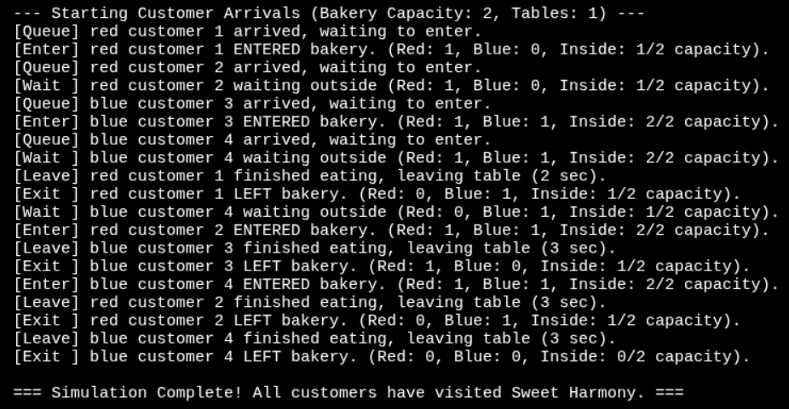
Output and Simulation – problem 1

Slide 10
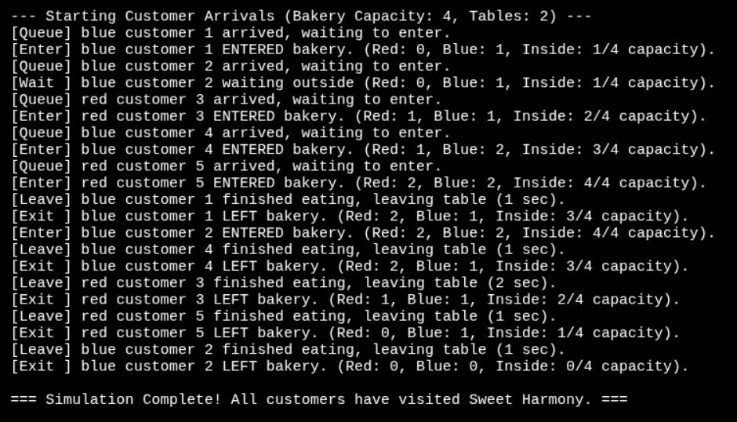
Output and Simulation – problem 2

Slide 11
Conclusion
Our simulation consistently keeps red = blue inside while respecting table limits.
We have successfully implemented Semaphores, mutexes, and condition variables work together to solve a real concurrency puzzle.
Properly Enter and Exit of Customer is handled with Queue.
Future work: Scale to larger crowds, introduce more outfit categories, or add a visual dashboard for live monitoring.
Real‑world relevance: Similar patterns apply to load‑balanced servers, ticket counters, or any shared‑resource system.

