Slide 1

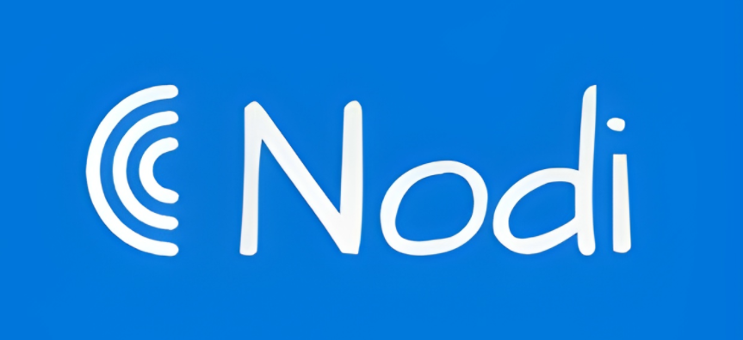
Presentation On
A Bangladeshi Streaming Platform
Presented By:
Muhammad Abdul Kayum
ID: 2023-2-60-082
Fahim Monaym
ID: 2023-1-60-219
Halima Sadia
ID: 2021-3-60-280
Shanta Singha
ID: 2021-3-60-298
​
Mahadi Hasan ​
ID: 2021-3-60-270

Slide 2

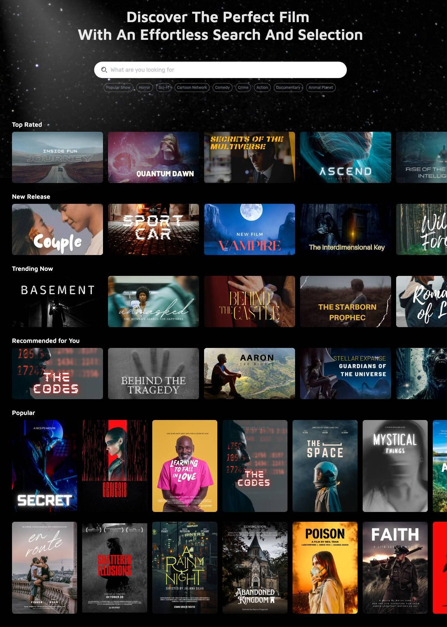
"Nodi: Streaming Life"
A Bangladeshi all-in-one streaming platform.
Built for local audiences with affordable access, and a wide range of entertainment.
Affordable Local Solution
Homegrown alternative to global streaming giants.
Shanta Singha ID:2021-3-60-298

Slide 3

SWOT Analysis
Shanta Singha ID:2021-3-60-298
Strengths
Localized content
All-in-one streaming
Weaknesses
New brand, low current awareness
Limited initial content library
Opportunities
Rising demand for Bangla content
Growing internet and smartphone users
Threats
Strong global competitors (e.g., Netflix, Spotify)
Piracy and free alternatives

Slide 4
Market Need & Product Idea
A platform for music, movies, sports, and series that is fast and cost effective.
Foreign platforms don’t focus on Bangla content or dubbing to Bangla.
Nodi offers an all-in-one streaming app with local and dubbed content just for Bangladesh.
Shanta Singha ID:2021-3-60-298

Slide 5
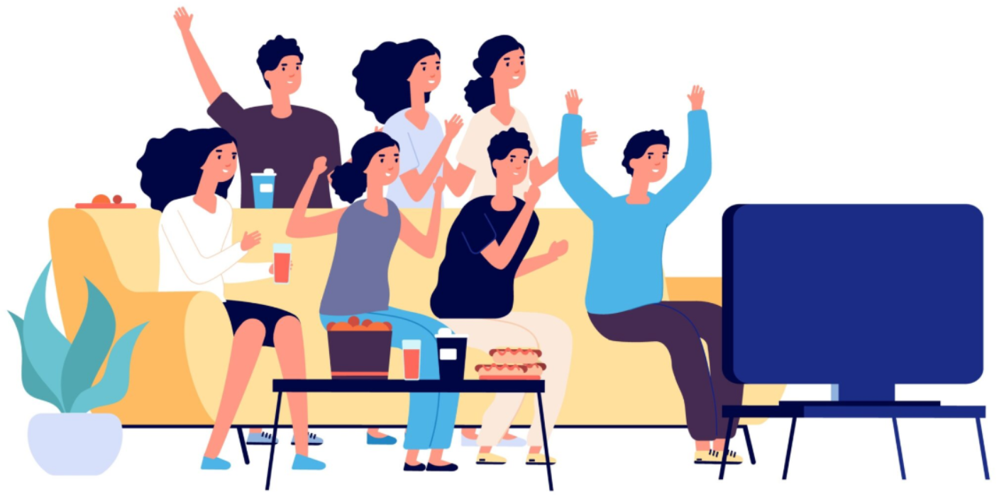
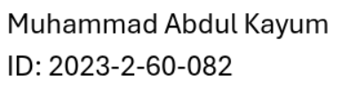
Target Market & Segmentation Strategy
Target Group: Young adults, students, and working people aged 15–35
Segmentation:
Demographic (age, income)
Behavioral (streaming habits)
Geographic (urban areas first)

Slide 6
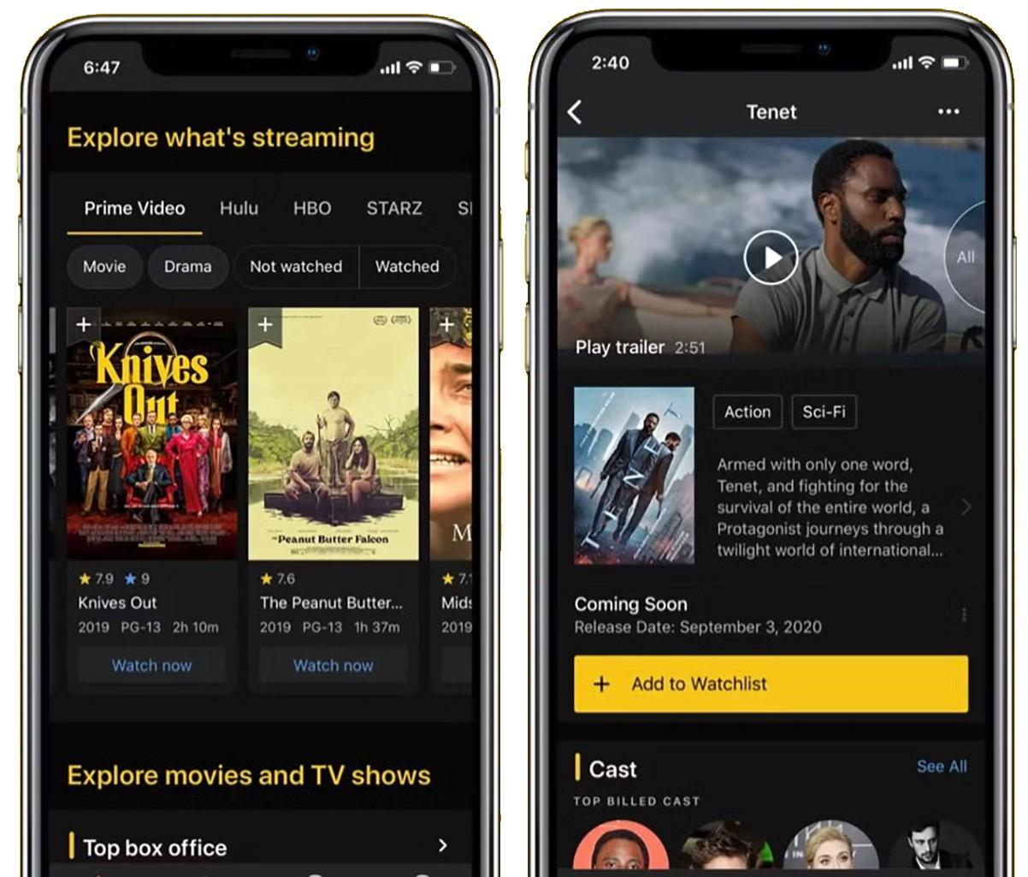
Differentiation & Product Positioning
All-in-One Entertainment Hub
Cultural Relevance
Affordable & Flexible
User-Friendly Experience

Slide 7
Branding Strategy
Brand Name: short and memorable
Points of Parity (POP):High-quality streaming, mobile access, wide content library
Point of Difference (POD): Bangla-dubbed content, regional films, etc
Brand Equity: social media, offering a smooth experience.
Brand Ambassador
Tagline: “nodi: streaming life”

Slide 8
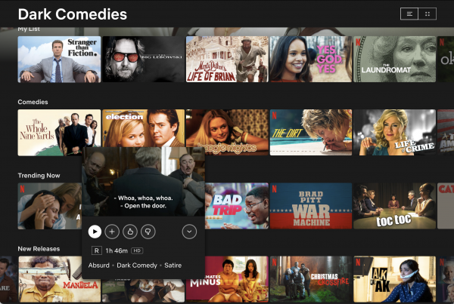
Marketing Mix – Product Strategy
A digital product that customers can access through mobile apps, smart TVs, and the web.
Core Product: Entertainment, movies, sports, and dubbed content etc..
Actual Product: A user-friendly app and website with variety of content
Augmented Product: 24/7 customer support, offline downloads, exclusive content for subscribers.

Slide 9
Marketing Mix – Place & Promotion
Distribution (Place)
Google Play, iPhone App Store and Website
Collaborations with ISPs and telecoms(Robi, GP)
Nationwide access
Promotion Strategy (IMC approach)
Digital-first: Facebook, YouTube, and TikTok ads
Referral programs
Telecom(GP, Robi) collaborations
Free trial campaigns
discounts for first-time users.

Slide 10

Marketing Mix – Pricing
We offer multiple services(movies, music, sports, series) in one platform, it gives more value than competitors who focus on just one type of content.
Suggested pricing:
Free Tier: Limited access with ads
Basic Plan: Tk. 49/month – Access to full content library with occasional ads
Premium Plan: Tk. 149/month – Ad-free, HD quality, and exclusive content access
Yearly Plan: Tk. 999/year - One year of all premium content

Slide 11
Marketing Mix Summary (4P Recap)
Product : a service full of entertainment as well as future potential to get high market share
Price : has different pricing plan with discount in order to offer entertainment to all
Place/Distribution : as a digital service, available in android app store, apple app store, dedicated website, lightweight version to reach rural area
Promotion : targeting a wide area by taking multiple promotional steps including social media, TV ads, billboard-banners, public events and referral program

Slide 12
Financial Projections: Expenses
Item | Estimated Cost
App development & maintenance | 9,00,000
Server & hosting cost | 5,00,000
Employee salary (Tech & Support) | 8,00,000
Marketing & Promotion | 13,00,000
Content license & dubbing | 8,00,000
Office Rent & Utilities | 3,00,000
Internet & Software Tools | 2,00,000
Customer support | 1,50,000
Miscellaneous Expenses | 1,50,000
Total | 51,00,000

Slide 13
Financial Projections: Sales & Forecast

Slide 14

Implementation Timeline
Launch Time: Within 3 months of completing app development and content preparation.
Launch Area: All over Bangladesh, with a focus on urban and semi-urban areas.
Initial Focus: Students, young professionals, and entertainment lovers.

Slide 15
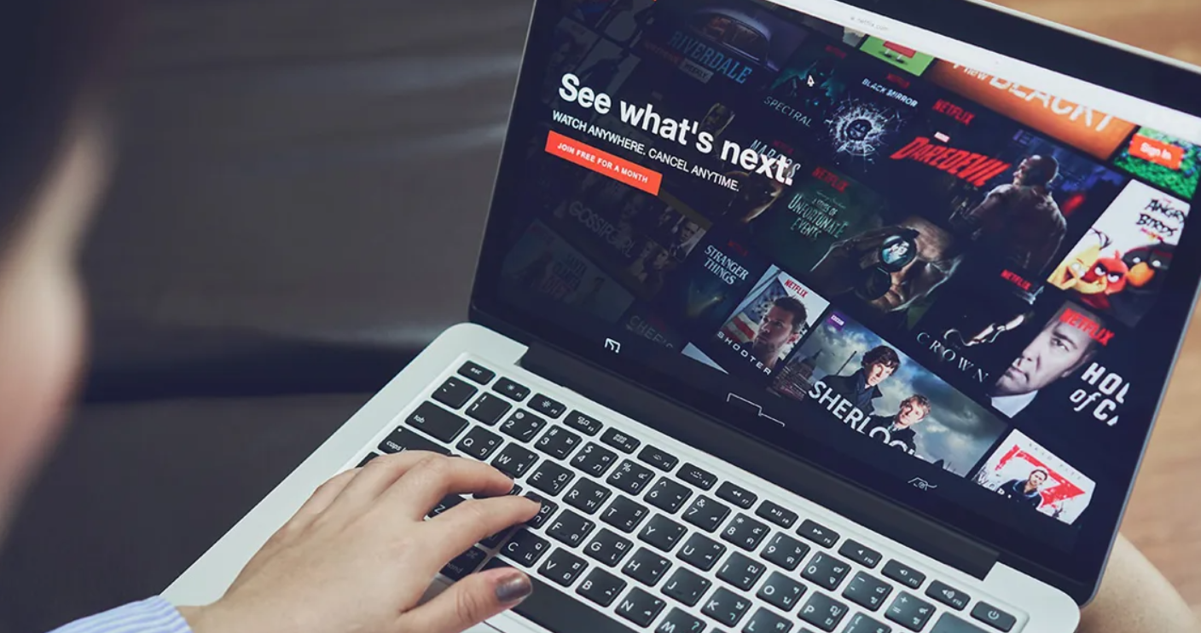
Organizational Structure & Control
4 main departments:
Technical Team (App, Server, Updates)
Content Team (Licensing, Dubbing, Uploading)
Marketing Team (Promotion, Social Media, Ads)
Customer Support Team (Help desk, Feedback)

Slide 16

Risk Management & Contingency Plans
Key Risks:
Global competitors (Netflix, Spotify)
High content costs
Technical issues (app crashes, streaming lag)
Low brand awareness
Regulatory hurdles
Contingency Plans:
Unique Bangla content & low prices
Bulk licensing & ad-supported revenue
Scalable tech & ISP partnerships
Free trials & influencer campaigns
Compliance with local regulations

Slide 17
Conclusion
Our Platform’s Vision: Affordable, all-in-one streaming for Bangladesh
Why Nodi?
Local & International dubbed content
Starts at Tk. 49/month
User-friendly app & website
Impact: Empowers creators, connects communities
Our Confidence: Ready to lead with strong strategy & tech
Join Us: Stream Bangladesh’s vibrant culture!

Slide 18
