Slide 1
Generative Adversarial Learning for Reducing Manual Annotation in Semantic Segmentation on Large Scale Microscopy Images
Kumar Ayush

Slide 2

Motivation

Slide 3

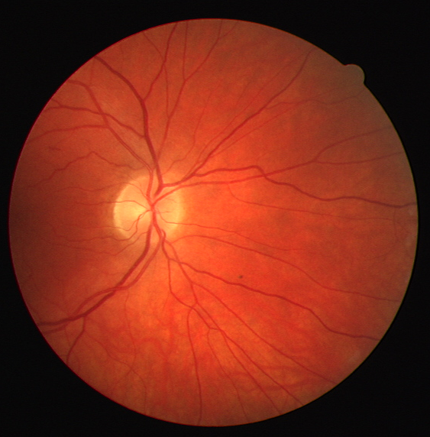
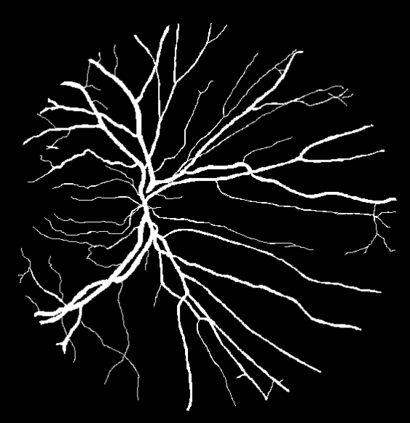
Labeling Data
Human Expert/Special Equipment/Experiment
Unlabeled Data
Labeled Data
Cheap and Abundant!
Expensive and Scarce!
Convolutional Neural Network(CNN) based semantic segmentation require extensive pixel level manual annotation which is daunting for large microscopic images.

Slide 4
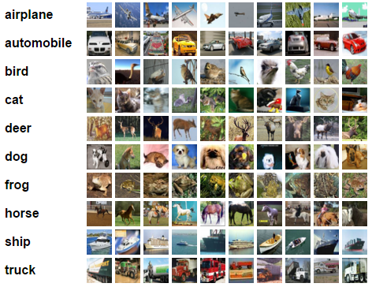
Success of Generative Adversarial Networks
Radford et al., have shown convincing evidence that unsupervised training of a deep convolutional adversarial pair learns a hierarchy of representations.
They have demonstrated the applicability of these rich image representations for supervised tasks such as CIFAR-10 classification.
Reference : Unsupervised Representation Learning with Deep Convolutional Generative Adversarial Networks.
A. Radford, L. Metz, S. Chinatala. ICLR 2016
CIFAR-10

Slide 5
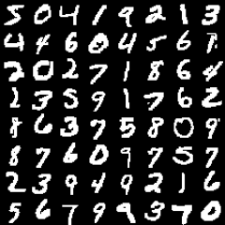
Success of Generative Adversarial Networks
Augustus Odena, extended GANs to the semi-supervised context by forcing the discriminator network to output class labels.
It was shown that SGAN improves classification performance on restricted data sets over a baseline classifier with no generative component.
Reference : Semi-Supervised Learning with Generative Adversarial Networks. Augustus Odena. Data Efficient Machine Learning workshop at ICML 2016
MNIST

Slide 6
Objective

Slide 7
Generative Adversarial Learning
for Reducing Manual Annotation in
Semantic Segmentation on Large Scale Microscopy Images
Automated Vessel
Segmentation in Retinal Fundus Image as Test Case

Slide 8
Generative Adversarial Networks

Slide 9
Generative Adversarial Networks
A game between two players:
1. Generator G
2. Discriminator D
D tries to discriminate between:
- A sample from the actual data distribution.
- And a sample from the generator G.
G tries to “trick” D by generating samples that are hard for D to distinguish from actual data.

Slide 10
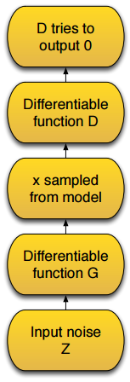
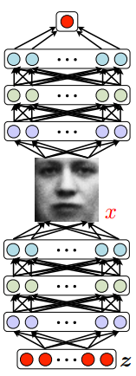
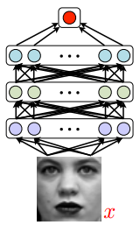
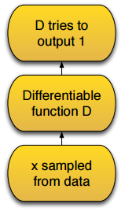
Adversarial nets Framework
Reference : Generative Adversarial Nets. Ian Goodfellow et al. NIPS 2014

Slide 11
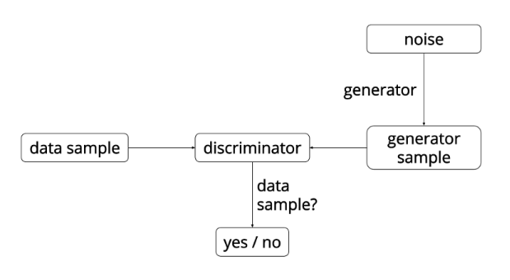
Training GANs

Slide 12
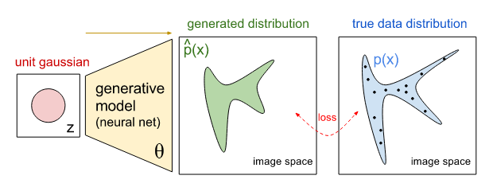
Training GANs
Source: https://openai.com/blog/generative-models/
Green distribution starting out random and then the training process iteratively changes the parameters θ to stretch and squeeze it to better match the blue distribution.

Slide 13
DATASET

Slide 14
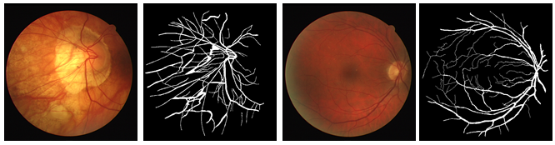
DRIVE: Digital Retinal Images for Vessel Extraction
The dataset contains 20 images for training and 20 for testing.
Blood vessel in each image is manually marked by human observers trained by an experienced ophthalmologist.
Reference: J.J. Staal, M.D. Abramoff, M. Niemeijer, M.A. Viergever, B. van Ginneken, “Ridge-based vessel segmentation in color images of the retina”, IEEE Transactions on Medical Imaging, 2004 Apr.

Slide 15
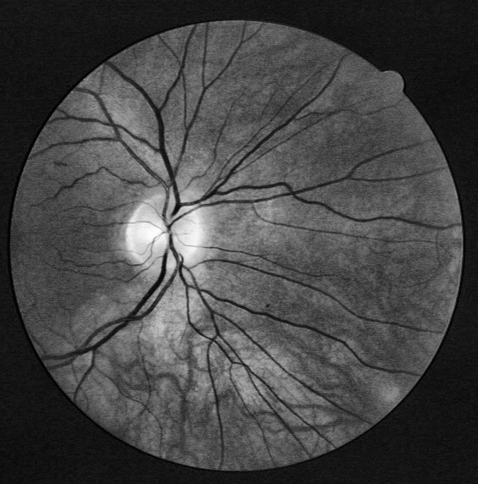
Preprocessing & Patch Creation
Vascular structures manifest best contrast in green channel.

Slide 16
Preprocessing & Patch Creation
Vascular structures manifest best contrast in green channel.
Contrast Limited Adaptive Histogram Equalization (CLAHE) is used for compensating irregular illuminations.

Slide 17
Preprocessing & Patch Creation
Vascular structures manifest best contrast in green channel.
Contrast Limited Adaptive Histogram Equalization (CLAHE) is used for compensating irregular illuminations.
64X64 dimensional patches were extracted and label of central pixel is assigned as the class label of the entire patch.

Slide 18


Preprocessing & Patch Creation
Vessel Patches
Ground Truth Binary Image
$$I_{gr}$$
Ground Truth Binary Image
𝐼_𝑔𝑟
Skeletonization
$$I_{gr}^{s}$$
Skeletonization
𝐼_𝑔𝑟^𝑠
Vessel Patches from green channel image at pixels where
$$I_{gr}^{s}=1$$
Vessel Patches from green channel image at pixels where
𝐼_𝑔𝑟^𝑠=1

Slide 19


Preprocessing & Patch Creation
Background Patches
Ground Truth Binary Image
$$I_{gr}$$
Ground Truth Binary Image
𝐼_𝑔𝑟
Morphological Dilation
$$I_{gr}^{d}$$
Morphological Dilation
𝐼_𝑔𝑟^𝑑
Background Patches from green channel image at pixels where
$$I_{gr}^{d}=0$$
Background Patches from green channel image at pixels where
𝐼_𝑔𝑟^𝑑=0

Slide 20
Network Architecture

Slide 21
Semi-Supervised Learning with GAN
The original version of GAN can be implemented with 2-way softmax output from discriminator network to find a distribution over [REAL, FAKE].

Slide 22
Semi-Supervised Learning with GAN
The original version of GAN can be implemented with 2-way softmax output from discriminator network to find a distribution over [REAL, FAKE].
We incorporate a K+1-way softmax layer at output of discriminator, where now the prediction labels will be [Class 1, Class, 2,.., Class K, FAKE].

Slide 23
Semi-Supervised Learning with GAN
The original version of GAN can be implemented with 2-way softmax output from discriminator network to find a distribution over [REAL, FAKE].
We incorporate a K+1-way softmax layer at output of discriminator, where now the prediction labels will be [Class 1, Class, 2,.., Class K, FAKE].
The revised Discriminator can be termed as a Discriminator-Classifier network (DC net).

Slide 24

Semi-Supervised Learning with GAN
The original version of GAN can be implemented with 2-way softmax output from discriminator network to find a distribution over [REAL, FAKE].
We incorporate a K+1-way softmax layer at output of discriminator, where now the prediction labels will be [Class 1, Class, 2,.., Class K, FAKE].
The revised Discriminator can be termed as a Discriminator-Classifier network (DC net).
The DC net now has to minimize two types of losses, viz.
a) classification loss ($L_{c}$)
b) adversarial loss ($L_{adv}$)

Slide 25
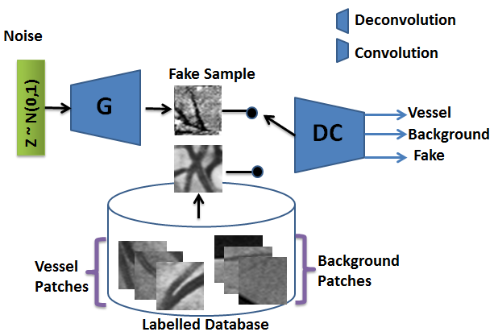
Proposed Model of GAN
G takes in a 300-D standard normal noise vector to create a fake example, G(z) via a series of deconvolution operations.

Slide 26
Proposed Model of GAN
G takes in a 300-D standard normal noise vector to create a fake example, G(z) via a series of deconvolution operations.
DC net is to assign correct class label (vessel or background) to real examples coming from stored training database while assigning G(z) to Fake class.

Slide 27
Proposed Model of GAN
G takes in a 300-D standard normal noise vector to create a fake example, G(z) via a series of deconvolution operations.
DC net is to assign correct class label (vessel or background) to real examples coming from stored training database while assigning G(z) to Fake class.
Goal of G is to fool DC in assigning G(z) to any one of the training labels.

Slide 28
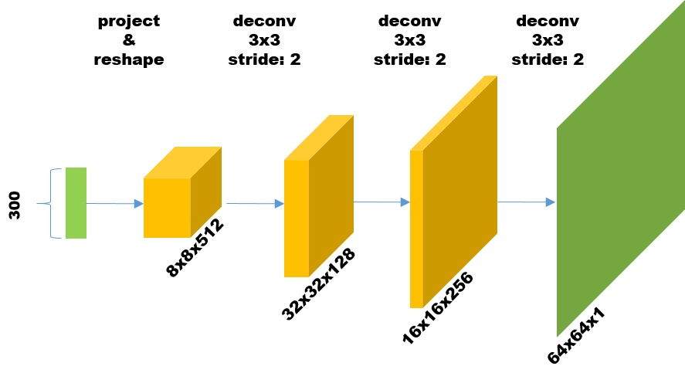
Generator Architecture
We apply instance normalization after every deconvolution followed by Rectified linear unit (ReLU) as non linear activation.

Slide 29
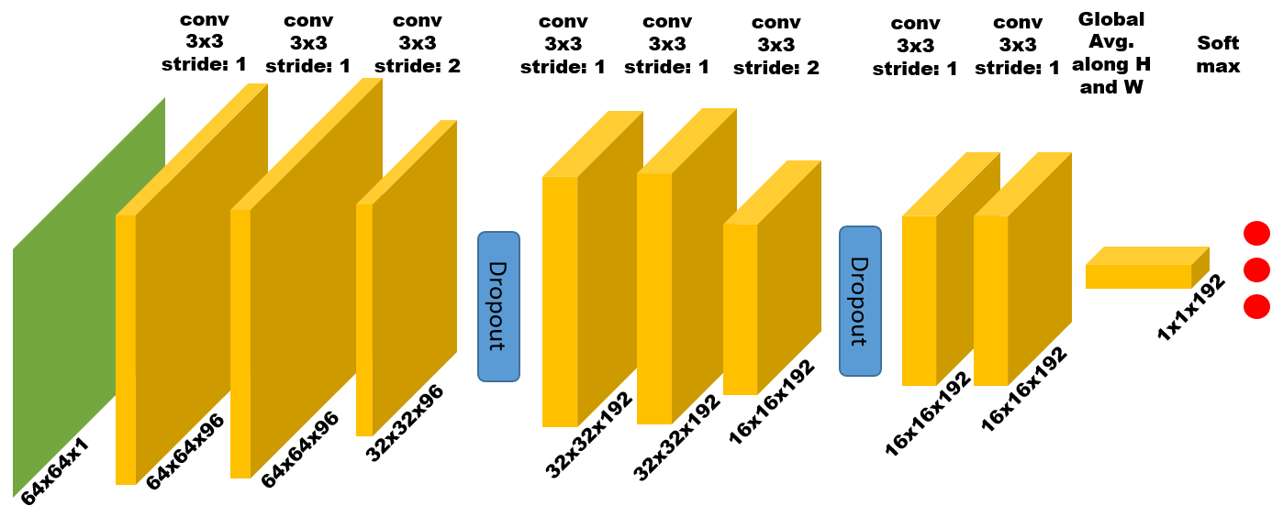
Discriminator/Classifier Architecture
We apply instance normalization after every convolution followed by Leaky Rectified linear unit (LReLU) as non linear activation.

Slide 30

Semi-Supervised Learning with GAN
The DC net is optimized to minimize both classification loss and adversarial loss.

Slide 31
Semi-Supervised Learning with GAN
The DC net is optimized to minimize both classification loss and adversarial loss.
Multi Task Learning
Assign correct class label to a real training sample
Assign high probability to FAKE class when fed with synthetic example

Slide 32
Semi-Supervised Learning with GAN
The generator is updated in such a way so that the DC net places minimum probability over class k = K+1.

Slide 33

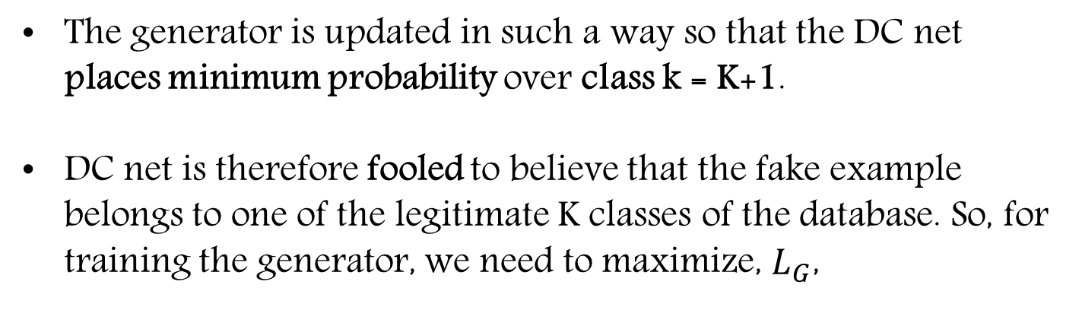
Semi-Supervised Learning with GAN
The generator is updated in such a way so that the DC net places minimum probability over class k = K+1.
DC net is therefore fooled to believe that the fake example belongs to one of the legitimate K classes of the database. So, for training the generator, we need to maximize, $L_{G}$,

Slide 34

Semi-Supervised Learning with GAN
But trying to optimize the generator network with
is practically not advisable because in the early phase of training, magnitudes of gradients propagated to generator are small. Thus, we instead minimize,
Reference : Generative Adversarial Nets. Ian Goodfellow et al. NIPS 2014

Slide 35
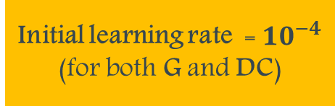
Training Details
Dataset
On each dataset, we train the simple CNN and GAN-CNN from scratch.
150K
15K
30K
ADAM optimizer for both the G and DC net
Slope of leaky ReLU = 0.1
Initial learning rate = ${10}^{−4}$ (for both G and DC)
Decay factor of 0.8 after every 20 epochs
Mini-batch size of 64

Slide 36

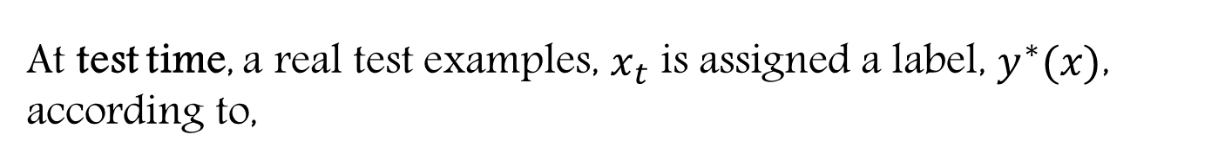
Testing Details
20 Test images
At test time, a real test examples, $x_{t}$ is assigned a label, $y^{∗}(x)$, according to,

Slide 37
Results
In retinal vessel segmentation literature, area under the Receiver Operation Curve, i.e., AUC is taken as a standard metric of comparison. A larger AUC signifies a better segmenter.
Dataset Size | GAN-CNN | CNN | p-value
150K | 0.962 | 0.960 | 0.1
30K | 0.945 | 0.921 | 10⁻³
15K | 0.931 | 0.916 | 10⁻⁵

Slide 38
Results
In retinal vessel segmentation literature, area under the Receiver Operation Curve, i.e., AUC is taken as a standard metric of comparison. A larger AUC signifies a better segmenter.
Dataset Size | GAN-CNN | CNN | p-value
150K | 0.962 | 0.960 | 0.1
30K | 0.945 | 0.921 | 10⁻³
15K | 0.931 | 0.916 | 10⁻⁵
Conclusion: p-value (Welch’s t-test) indicates that there is significant difference between the mean AUCs of the proposed method and simple CNN, specially when trained on smaller training sets. The null hypothesis in this case is that the mean AUCs of both paradigms of segmenters are same.

Slide 39
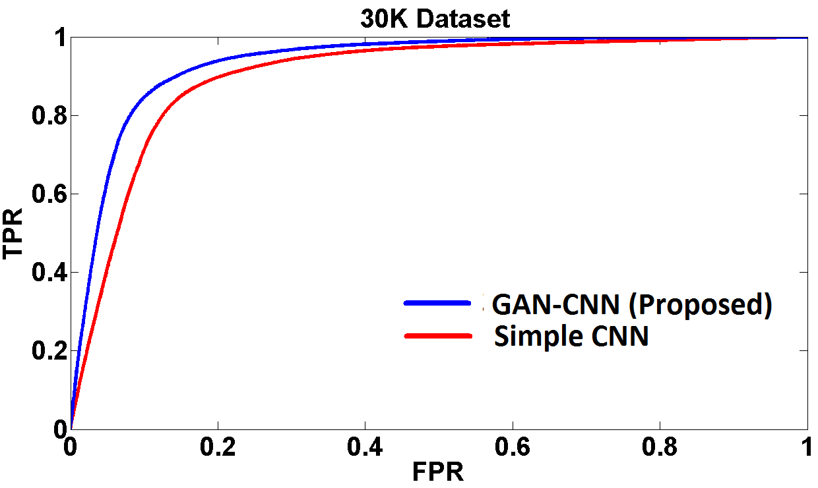
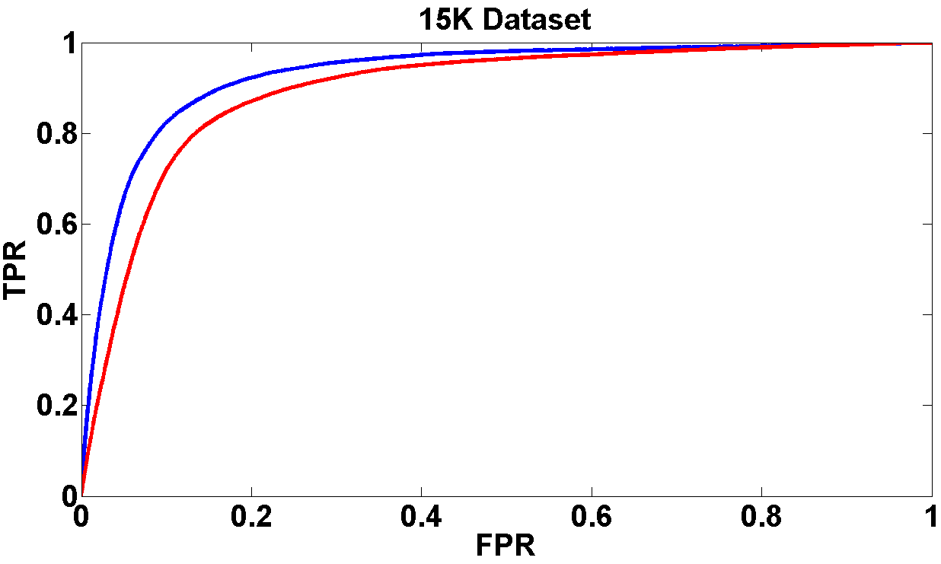
Results
ROC curves of proposed GAN-CNN and simple CNN on the combined 20 test images of DRIVE retina dataset.
Curves of GAN-CNN always tends to be higher on the ROC plots compared to simple CNN based segmenter. The visualization bolsters our claim that training a GAN based CNN for semantic segmentation is data efficient.

Slide 40
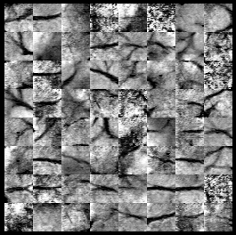
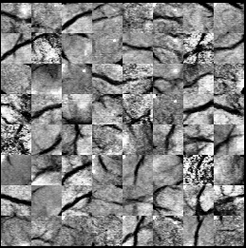
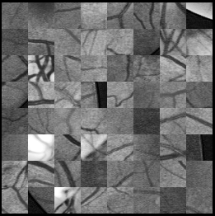
Results
Samples generated during
training on 30K dataset
Samples generated during
training on 15K dataset
Real samples

Slide 41
Results
Comparison of mean AUC of some of the contemporary deep learning based retinal vessel segmentation algorithm.
Method | Dataset Size | Mean AUC
Maji et al. | 60K | 0.928
Lahiri et al. | 120K | 0.950
Fu et al. | 330K | 0.947
Liskowski et al. | 3857K | 0.963
GAN-CNN (Proposed) | 30K | 0.945
GAN-CNN (Proposed) | 15K | 0.931

Slide 42
Results
Comparison of mean AUC of some of the contemporary deep learning based retinal vessel segmentation algorithm.
Method | Dataset Size | Mean AUC
Maji et al. | 60K | 0.928
Lahiri et al. | 120K | 0.950
Fu et al. | 330K | 0.947
Liskowski et al. | 3857K | 0.963
GAN-CNN (Proposed) | 30K | 0.945
GAN-CNN (Proposed) | 15K | 0.931
Conclusion:. Even with smaller dataset size, our proposed method performs comparable (sometimes even better) than the competing techniques trained with 2X-10X times more training data.

Slide 43
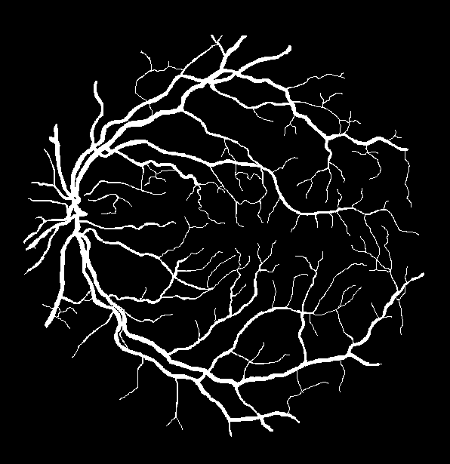
Results
Sample Fundus Image
Ground Truth

Slide 44
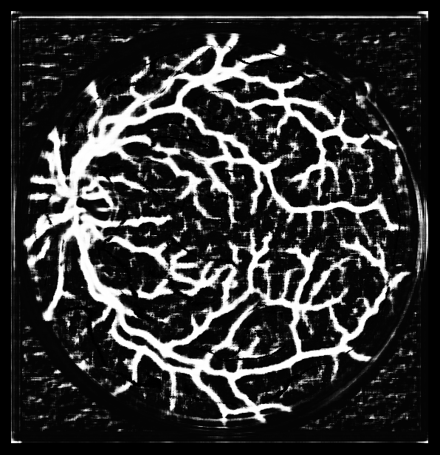
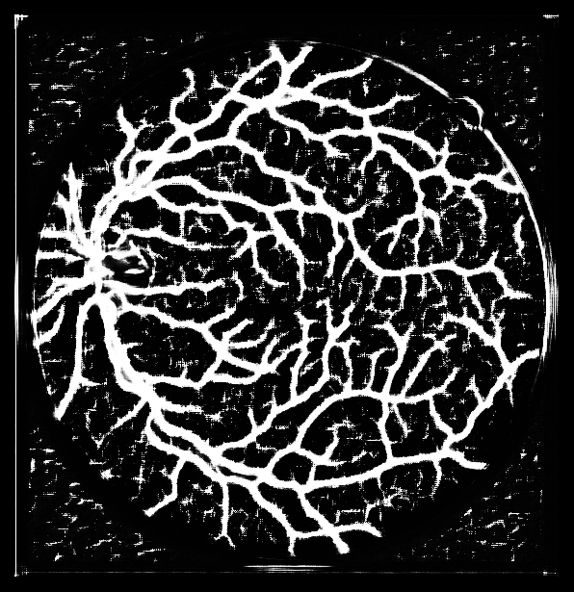
Results
CNN trained on 15K
GAN-CNN trained on 15K

Slide 45
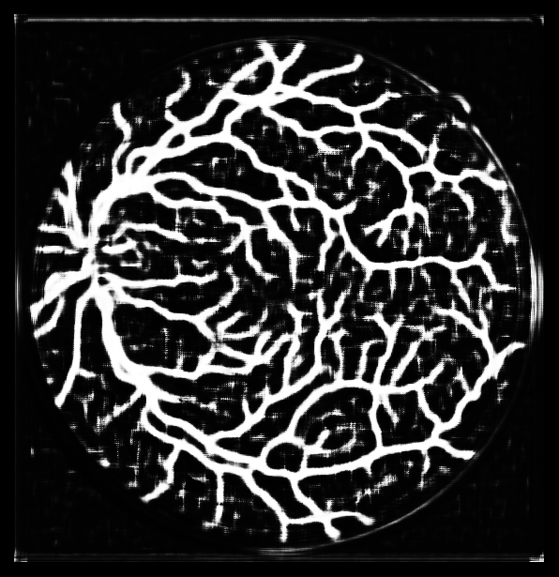
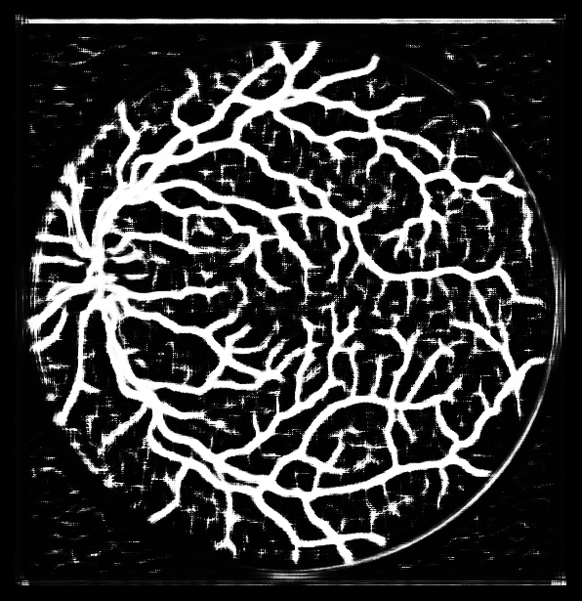
Results
CNN trained on 30K
GAN-CNN trained on 30K

Slide 46
Contributions
To our best knowledge, this is the first work which leverages GAN for semi-supervised learning on large scale fundus imaging modality for automated blood vessel segmentation.

Slide 47
Contributions
To our best knowledge, this is the first work which leverages GAN for semi-supervised learning on large scale fundus imaging modality for automated blood vessel segmentation.
We achieve comparable performance (sometimes even better) with recent CNN based segmentation techniques while using upto 9X times less training data.

Slide 48
Contributions
To our best knowledge, this is the first work which leverages GAN for semi-supervised learning on large scale fundus imaging modality for automated blood vessel segmentation.
We achieve comparable performance (sometimes even better) with recent CNN based segmentation techniques while using upto 9X times less training data.
We show that performance of simple CNN based segmenter starts deteriorating faster on smaller datasets compared to GAN-CNN.

Slide 49
Contributions
To our best knowledge, this is the first work which leverages GAN for semi-supervised learning on large scale fundus imaging modality for automated blood vessel segmentation.
We achieve comparable performance (sometimes even better) with recent CNN based segmentation techniques while using upto 9X times less training data.
We show that performance of simple CNN based segmenter starts deteriorating faster on smaller datasets compared to GAN-CNN.
We show that the difference of performances between simple CNN and GAN-CNN is statistically significant when trained on smaller training sets.

Slide 50
Impact
We applied the proposed model to the challenging task of vessel segmentation in fundus images, but our concept is generic.
Fundus Images have:
- Intricate Branching Pattern
- Noisy Background
- Irregular Illumination
Therefore, pixel level manual annotation is much more tedious
than image tagging, thus bolstering the importance of our
contribution.

Slide 51
Future Work

Slide 52
Future Work
One possibility is to make use of large amount of unlabeled data by forcing the DC-net to place low likelihood for fake class to these examples
Another possibility is to use class conditional generator network to force it to generate class specific
fake examples and forcing the DC-net to classify these fake examples.
Both of these methods are further steps towards
improving the performance of the combined DC-net.

Slide 53
Thank You!

