Slide 1
A GROUP PRESENTATION ON Evaluating the Effects of Treatment Type and Age Group on Blood Glucose Levels in Patients with Diabetes: A 2 by 3 Factorial Experimental Design Study BY HAKEEM ADEKUNLE OLADIMEJI ADEWUYI KAYODE OKUNOLA
FINAL PROJECT PRESENTATION, EXPERIMENTAL DESIGN
GEORGIA STATE UNIVERSITY

Slide 2

INTRODUCTION
Diabetes management remains a global health challenge, requiring personalized treatment strategies to optimize patient outcomes. Blood glucose control, a key indicator of diabetes management, is influenced by various factors, including treatment methods and demographic characteristics such as age. However, the interaction between these factors is not well understood, making it difficult to determine the most effective treatment for specific patient groups.

Slide 3
AIM
This study aims to evaluate the main effects of Treatment Type (oral medication, insulin therapy, and combined therapy) and Patient Age Group (18–30 years, 31–50 years, and 51–70 years) on blood glucose levels. Additionally, the study investigates whether the effectiveness of different treatment types varies across age groups. Understanding these interactions can provide valuable insights into tailoring treatment plans to improve diabetes outcomes.

Slide 4
RESEARCH QUESTION
Does treatment type significantly affect blood glucose levels?
Does age group significantly affect blood glucose levels?
Is there a significant interaction between treatment type and age group in influencing blood glucose levels?

Slide 5
EXPERIMENTAL DESIGN
We used a 2 by 3 repeated measure factorial design. Blood glucose levels were measured post-treatment, with 5 patients sampled per treatment-age combination, yielding 45 observations.
Overview of the design methodology
Factors | Level
Treatment Type | Oral Medication
 | Insulin Therapy
 | Combined Therapy
Patient Age Group | 18–30 years
 | 31–50 years
 | 51–70 years

Slide 6
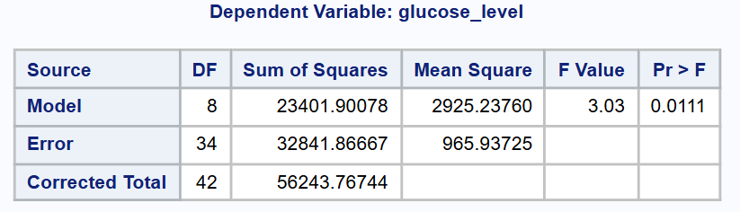
RESULT

Slide 7
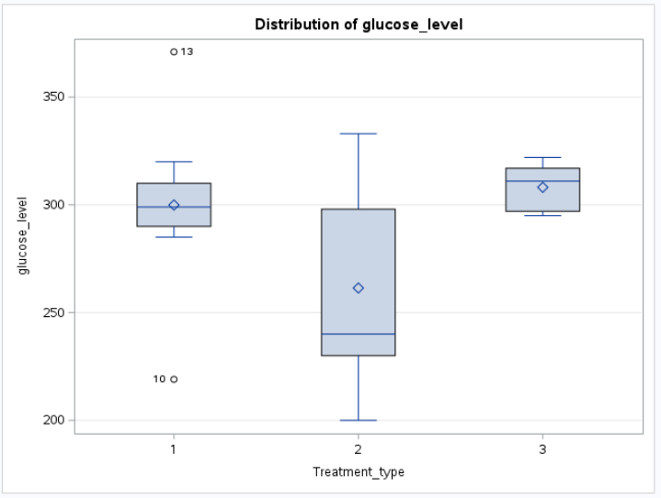
CONT.

Slide 8
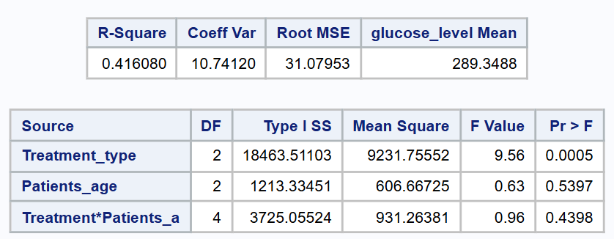
CONT.

Slide 9
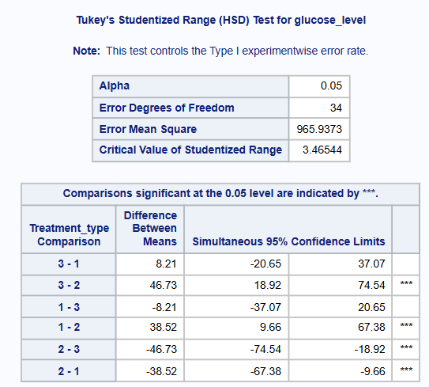
Post Hoc Test

Slide 10
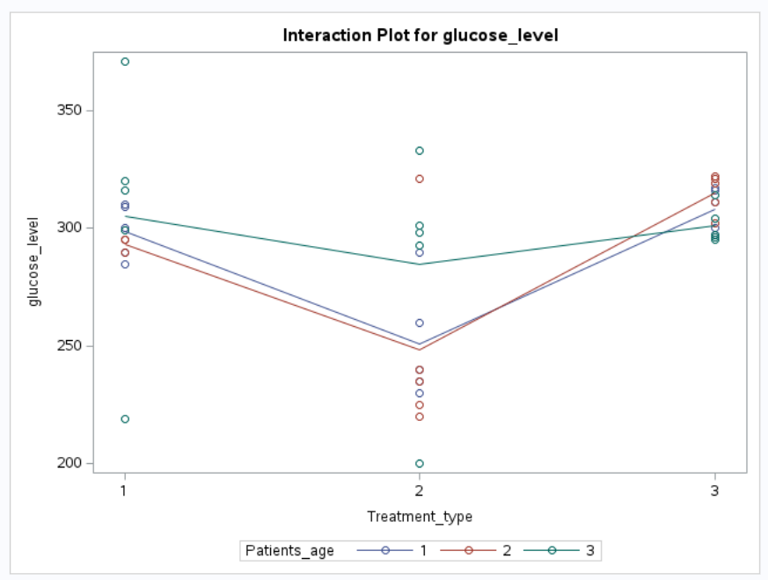
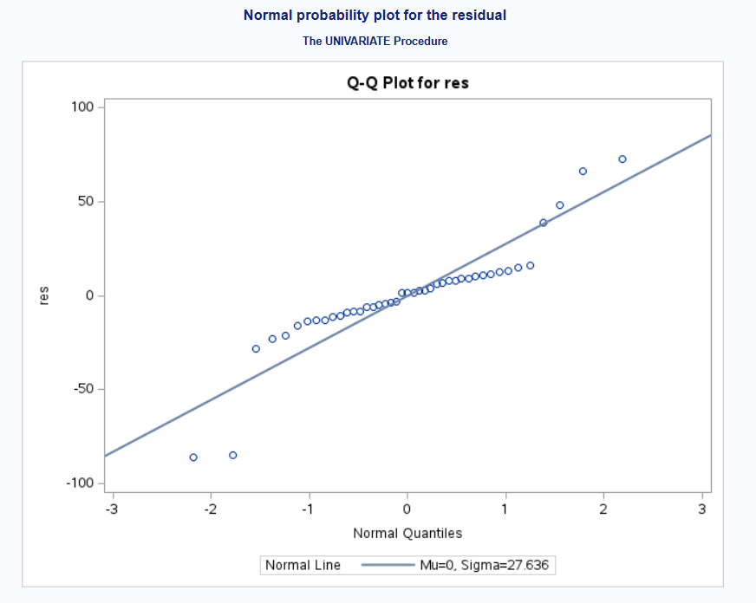
MODEL DIAGNOSTIC

Slide 11
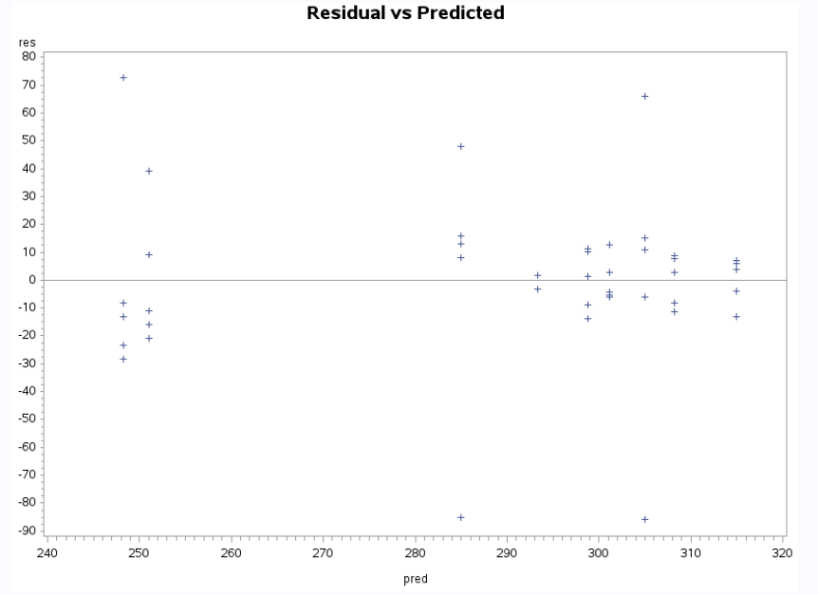
CONT.

Slide 12
CONCLUSION
The results indicate that the study successfully examined the impact of different treatments on glucose levels, achieving its objective of determining whether significant differences exist between treatment groups. The ANOVA analysis confirms that the treatment groups influence glucose levels, as the model is statistically significant. Post-hoc comparisons using Tukey’s HSD further reveal specific significant differences between treatment groups, highlighting notable variations in their effects on glucose levels.

Slide 13
THANK YOU

