Slide 1
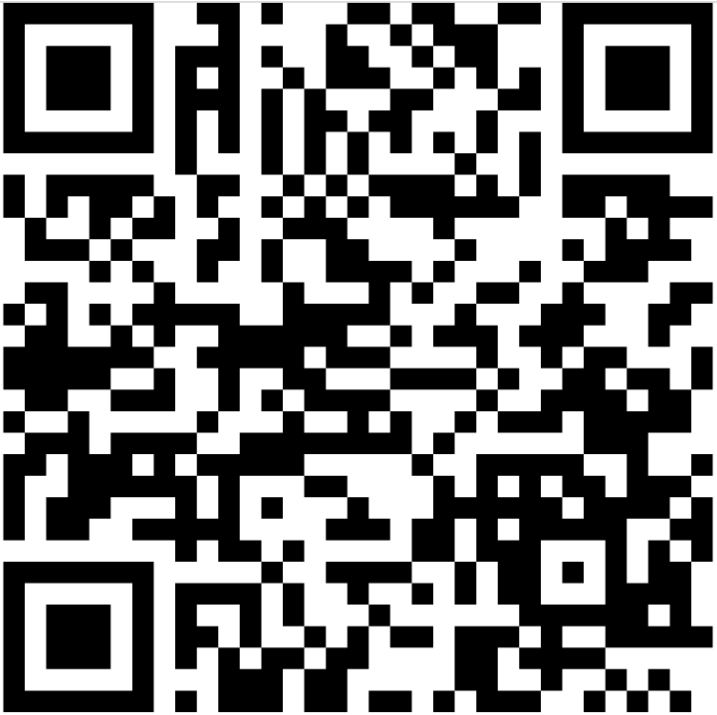
T1 – Assisto Generic
Message 1: WELCOME TO THE DEMO
Message 2: Please flip the card to learn more 👉
Message 3: N/A
If not clicked = PAGE VIEW
T1 – Assisto Generic
Message 1: 🔔 REMINDER 🔔
Message 2: Flip the card to personalize it
Message 3: NO CHANGE 😒
If not FORM SUBMIT
T1 – Assisto Generic
Message 1: 🔔❗❗ REMINDER ❗❗🔔
Message 2: 🙏 Please complete and submit the form.
Message 3: Form Not Complete
MICROSITE
Name, Surname, Theme ?
T2 – Insurance
Message 1: Welcome to AXA 🏖️
Message 2: Please flip the card for all important links %%Name%% 👉
Message 3: 2022/07/28
T3 – Insurance
Message 1: Have a SAFE TRIP!
Message 2: ✈️ %%Name%% , your Insurance policy is active now.
Message 3: N/A
T2 – Travel Agency
Message 1: Welcome to Albatros Palace !
Message 2: %%Name%% Please flip the card for more information
Message 3: Drink Time
T3 – Travel Agency
Message 1: Are You READY ?
Message 2: 🥽 Your diving trip starts in one hour %%Name%%
Message 3: Adventure Time

