Slide 1
Digital Portfolio
STUDENT NAME: P.Kayathri
REGISTER NO :2422K2181
NMID : AEFA0CC901B90DDA7D34DE2451A9A041
DEPARTMENT : COMPUTER SCIENCE
COLLEGE : PTA Govt Arts and Science College
UNIVERSITY :BHARATHIAR UNIVERSITY

Slide 2
PROJECT TITLE
PERSONAL
PORTFOLIO

Slide 3


AGENDA
Problem Statement
Project Overview
End Users
Tools and Technologies
Portfolio design and Layout
Features and Functionality
Results and Screenshots
Conclusion
3/21/2024 Annual Review

Slide 4

PROBLEM STATEMENT
Many developers lack a centralized platform to showcase their work.
Recruiters/clients find it hard to assess skills without a portfolio.
Need for a responsive, fast, and modern portfolio website.

Slide 5

PROJECT OVERVIEW
A personal portfolio website designed and developed from scratch.
Showcases projects, skills, and contact info.
Built with responsive design to work on all devices.
Goals:
Professional online presence
Highlight technical expertise
Attract job opportunities or freelance clients

Slide 6

WHO ARE THE END USERS?
Recruiters: Looking to assess your technical & UI/UX skills
Peers/Collaborators: Developers or designers exploring your work
Yourself: As a platform to manage and update your project showcase

Slide 7

TOOLS AND TECHNIQUES
Frontend:
HTML5
CSS3
JavaScript
Responsive design with Flexbox
Other Tools:
Git & GitHub for version control
VS Code

Slide 8
POTFOLIO DESIGN AND LAYOUT
Color scheme & theme used in my project
Navigation flow / structure
8

Slide 9
FEATURES AND FUNCTIONALITY
Homepage: Welcome, brief intro & navigation
About Me:Studying Details
Skills: Tech stack visually represented
Contact: Form + links to email and social profiles
Responsive Design: Mobile-friendly layout

Slide 10
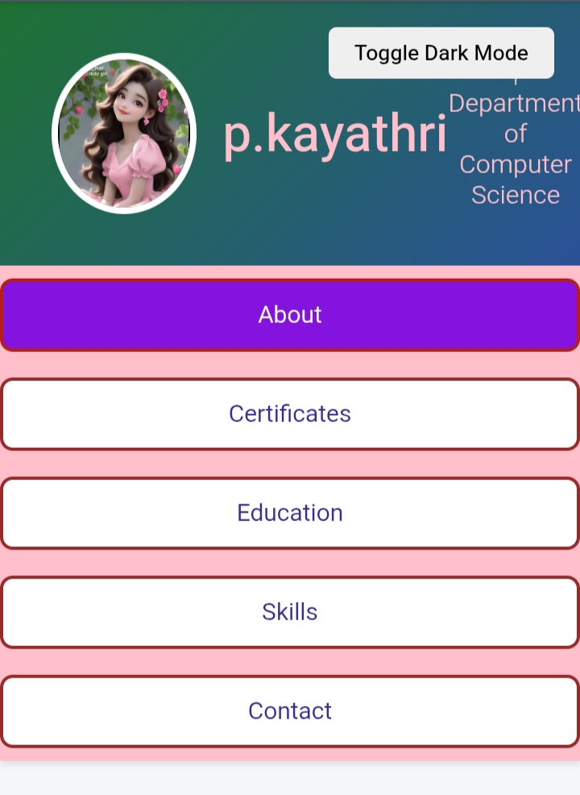

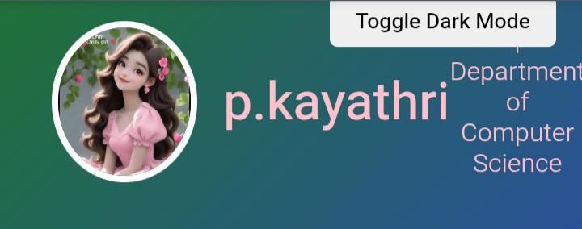
RESULTS AND SCREENSHOTS
3/21/2024 Annual Review
10

Slide 11
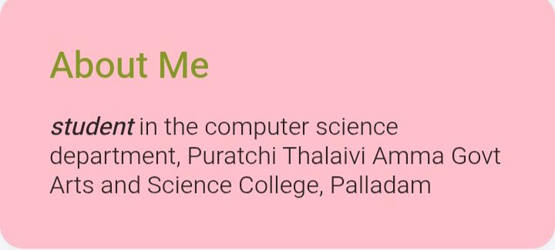
RESULTS AND SCREENSHOTS
3/21/2024 Annual Review
11

Slide 12
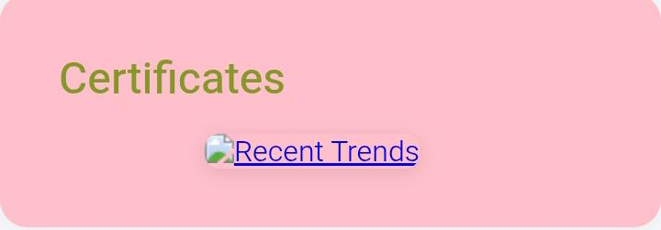
RESULTS AND SCREENSHOTS
3/21/2024 Annual Review
12

Slide 13
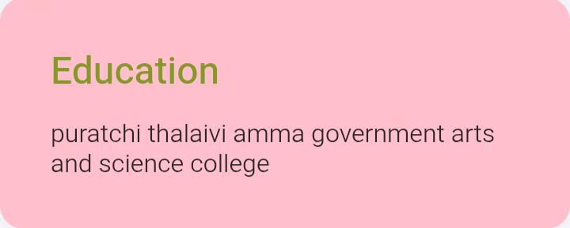
RESULTS AND SCREENSHOTS
3/21/2024 Annual Review
13

Slide 14
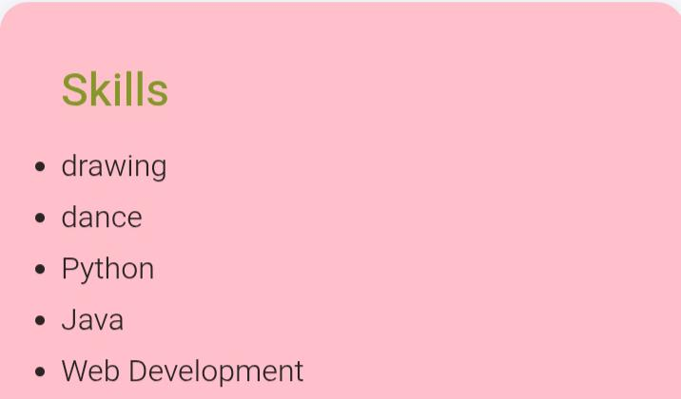
RESULTS AND SCREENSHOTS
3/21/2024 Annual Review
14

Slide 15
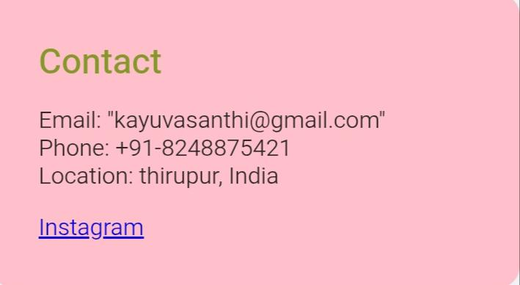
RESULTS AND SCREENSHOTS
3/21/2024 Annual Review
15

Slide 16
CONCLUSION
Created a fully functional, modern portfolio site
Improved UI/UX, frontend and responsive design skills
Helps stand out in job applications and freelance work
Future Plans:
Add blog or CMS
Improve accessibility (a11y)
Integrate admin dashboard for project updates
16

