Slide 1

Presentation on
Technical Support
OF
BACHELOR OF TECHNOLOGY
IN
COMPUATER SCIENCE AND ENGINEERING
By
ABDUL KAYYUM
Under the Guidance of
MR. KAMLESH KUMAR
DEPARTMENT OF COMPUTER SCIENCE AND ENGINEERING BANSAL INSTITUTE OF ENGINEERING & TECHNOLOGY, LUCKNOW

Slide 2

TECHNICAL SUPPORT
Technical support is a concept business that provides digital services like Web Development, Android Application, Graphic design, and more services. Which helps a business person to do their business online.

Slide 3
OBJECTIVE
Do business across the world
Build a brand
Increase revenue
Manage online reputation
Providing a unique customer experience
Decrease the paper waste
Opportunities to manage your business from anywhere in the world

Slide 4
OUR SERVICES
WEB DEVELOPMENT
NETWORK SECURITY
WEBSITE SEO
ANDROID APPLICATION
GRAPHIC DESIGN
BUSINESS RESEARCH

Slide 5

WEB DEVELOPMENT
We design and develop 6 different types of websites…
Magazine websites
E-commerce websites
Blogs
Portfolio websites
Landing pages
Social media websites

Slide 6

NETWORK SECURITY
Network security is the security provided to a network from unauthorized access and risks.

Slide 7
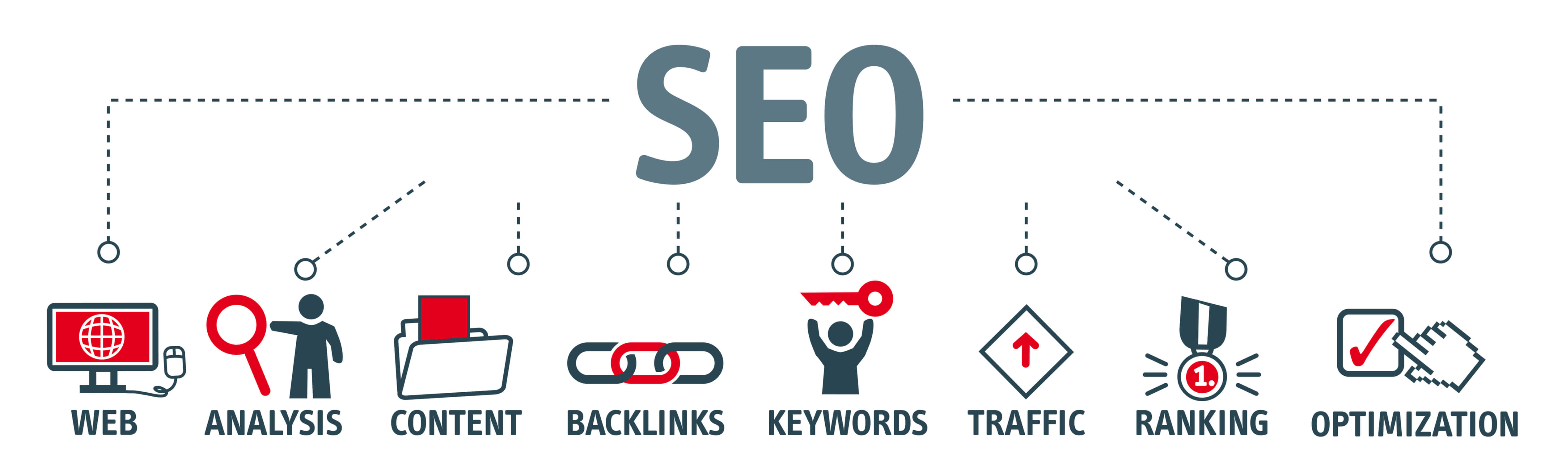
WEBSITE SEO
SEO stands for Search Engine Optimization, which is the practice of increasing the quantity and quality of traffic to your website through organic search engine results.
It depends on different aspects such as,
Organic search
Bounce rate
SSL certificate
Page loading speed and responsiveness
Alt tags

Slide 8

ANDROID APPLICATION
Android App is a software designed to run on an Android device or emulator. The term also refers to an APK file which stands for Android package.
We create only Native Application
Native apps are created for one specific platform or operating system.

Slide 9

BUSINESS RESEARCH
Business research is a process of acquiring detailed information of all the areas of business and using such information in maximizing the sales and profit of the business.

Slide 10
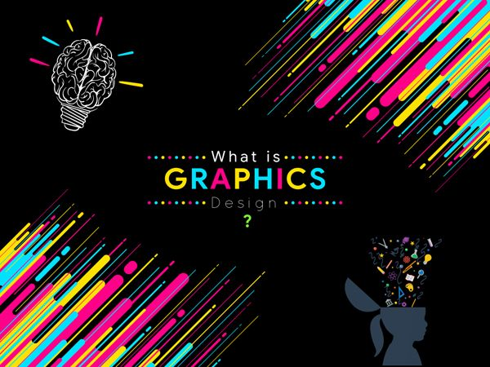
GRAPHIC DESIGN
Graphic design is the process of visual communication through the use of typography, photography, iconography and illustration.
We offer these graphic design services such as,
Logo Design
UI Design
Publication Graphic Design

Slide 11
REQUIRMENTS
SOFTWARE
HTML
CSS
HARDWARE
COMPUTER/PC
WINDOWS 7/8/10/XP

Slide 12


