Slide 1
Forgotten
Developed by:
Abdulmajeed Kakar, Eva Adejor, Gregory Denis, Rachel Herron, and Sabrina Robinson

Slide 2
Game Overview
Enter the realm of Everwilde
Components | Description
Title | Forgotten
Tagline | Whispers of the forest
Genre | Platformer, Puzzle, Adventure
Target | E for Everyone 10+
Goal | Gather gemstones to help you navigate the forest
Navigate through the enchanted forest
Move quickly from platform to platform
Collect various gemstones to gain certain abilities
Unlock new areas of the forest
Plays like Celeste, with the aesthetic of Hollow Knight

Slide 3
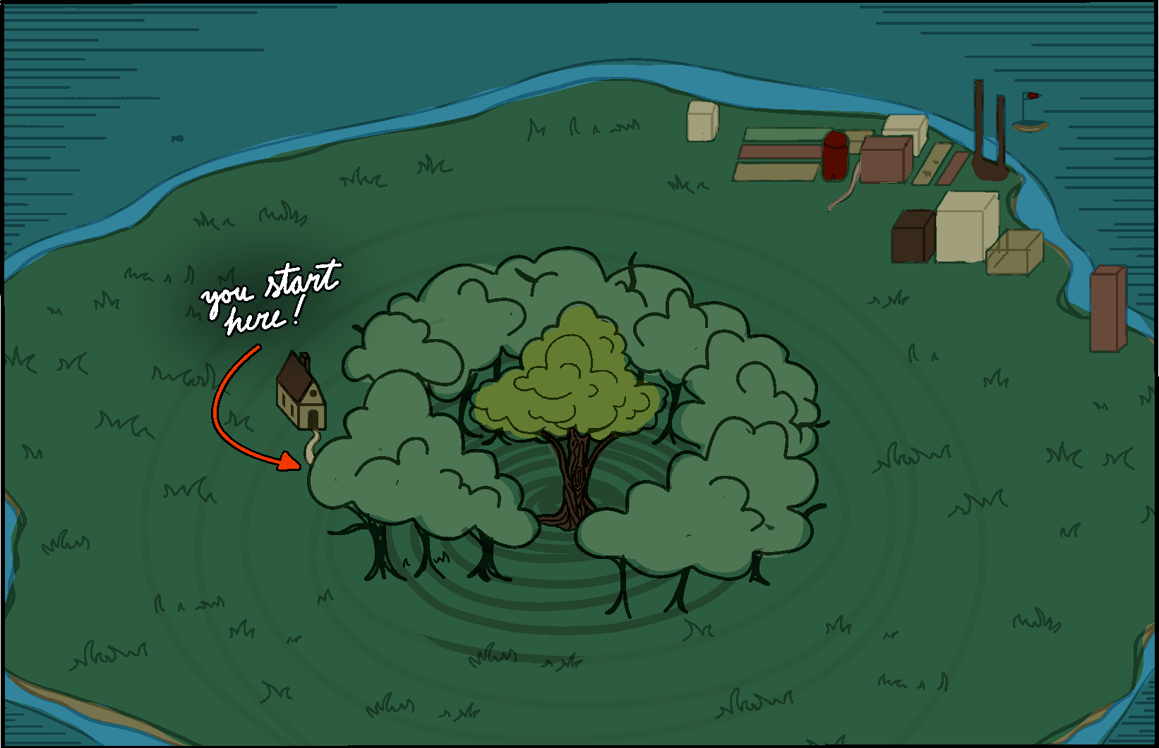
Game World
Everwilde is the only land in the realm
It is a large island surrounded by the ocean
It is full of lush green plains
At its center lies a massively overgrown
forest
The forest is rumoured to be overrun by spirits
The most powerful controls the foliage
within the forest.

Slide 4
Game Progression
You must make your way to the center of the forest
01
02
03
press start to enter the level
move and jump to collect gems and avoid obstacles
unlock the portal to the next level

Slide 5
Art Direction
Art assets designed at a pixel level
Restricted to 32 colors
Inspired by Celeste and Hollow Knight
Colors were chosen to make the atmosphere feel dark and gloomy
Colors are desaturated, and cooler in tonal value
Theme of art/world is whimsical and fantastical
Characters are drawn in a cartoon style
Taking inspirations from the character designs found in the Sonic franchise
Characters heads and hands are proportionally much larger than the rest of the body

