Slide 1

Unix Final Project
Team_Composition {
“TeamMember1” {
name: “Rachel Herron”
},
“TeamMember2” {
name: “Helene Rousseau”
},
“TeamMember3” {
name: “Sabrina Robinson”
},
Build project.host.website ↵
Run Presentation.exe ↵

Slide 2
TABLE OF CONTENTS
01
INTRODUCTION
02
Demo
03
GitHub

Slide 3

Project Description
& Motivation
Description
We created a web-hosting service using a GNU/Linux web server with auto-deployment.
Motivation
To create a service for people like us who have simple static projects that we would like to have hosted online. This service facilitates this process and simplify the complexity.

Slide 4
Infrastructure:
- Containerization:
- Hosting:
- Backup:
Major Technical Solutions.1
Infrastructure_Hosting {
Solution: “Digital Ocean”,
Explanation: [
“Supports fully configurable
GNU/Linux web server”,
“Allows root access”,
“Beginner friendly interface”,
“Extensive documentation”,
“Predictable pricing model”,
“Reasonably priced”,
“Compatible with docker”,
“Provides SSH access with
key-based authentication”
]
};
Infrastructure_Containerization {
Solution: “Docker”,
Explanation: [
“Simplifies deployment”, “Simplifies testing”,
“Ensures consistency”, “Facilitates dependency
management”, “Facilitates project versioning”,
“Large community”, “Well detailed documentation”
]
};
Infrastructure_Backup {
Solution: “Cron Jobs”,
Explanation: [ “Archives apps and web directories”,
“Runs on host system”, “recoverable”
]
};

Slide 5
Major Technical Solutions.2
Backend_Server {
Backend_Database{
Solution: “Ubuntu VPS”,
Explanation: [
“Allows docker containers”,
“Simplifies Configuration”,
“Removes the need fora separate reverse proxy.”,
]
};
Solution: “N/A”,
Explanation: “To be added in the future”
};

Slide 6
Run Demo.exe ↵
loading Demo.VPS.exe . . .
loading Demo.DOCKER.exe . . .
loading Demo.BASH.SCRIPS.exe . . .

Slide 7
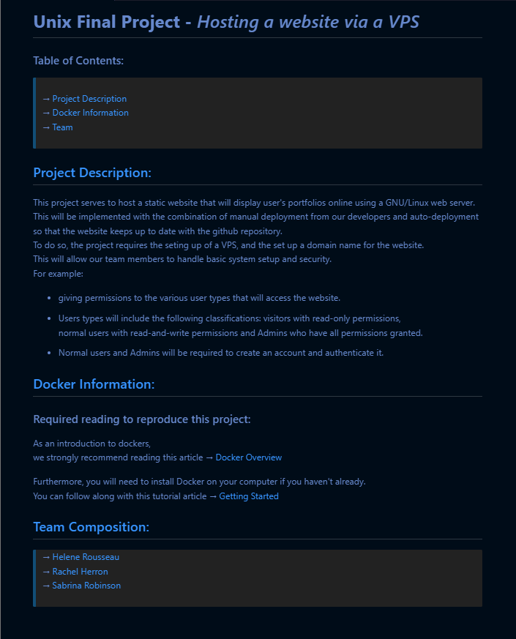
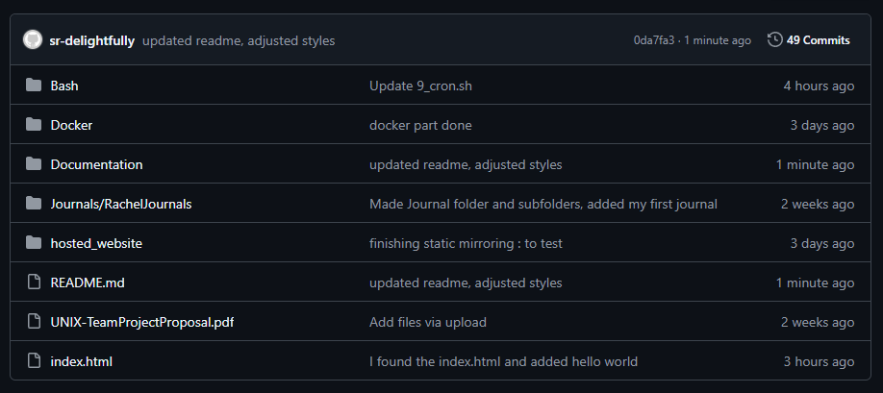
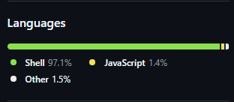

README.MD
GitHub tour
GitHub Files

Slide 8
Dev Journey
Planning
Expectation
Reality
Focus:
Researching & Gaining a
greater understanding for
the project at hand
Hosting Mirrored Website:
Our original concept consisted of mirroring websites and portfolios that have static webpages
Hosting Custom Website:
Our project in reality allows you to create & host your own website. See live updates when you push a new commit!

Slide 9
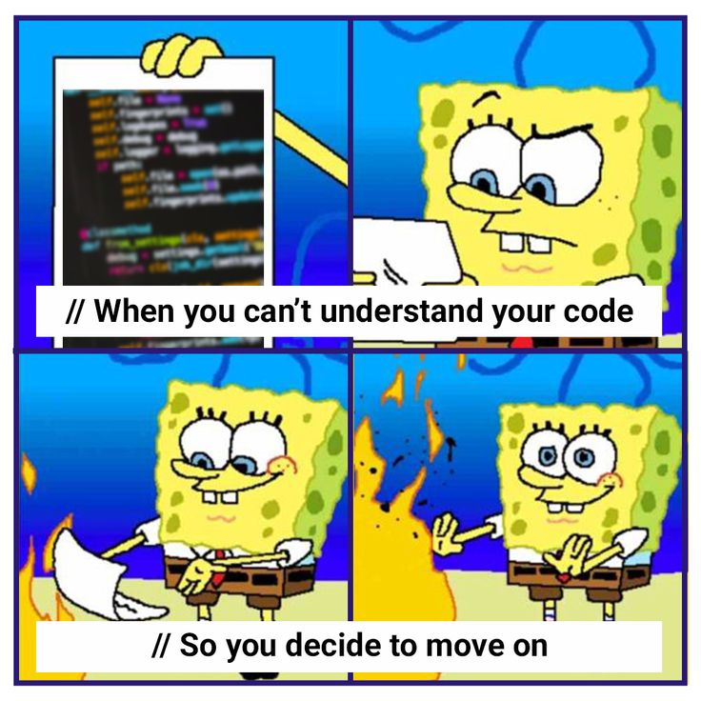
Major Challenges
Challenges {
Communication: [
“Unclear who was doing what”,
“Unclear what needed to be done”
],
TeamWork: [
“Working alone rather than together”,
“Working on the same tasks”
],
Completion: [
“Issues with combining work from
different team members”,
“Issues getting website to load”
]
}

Slide 10
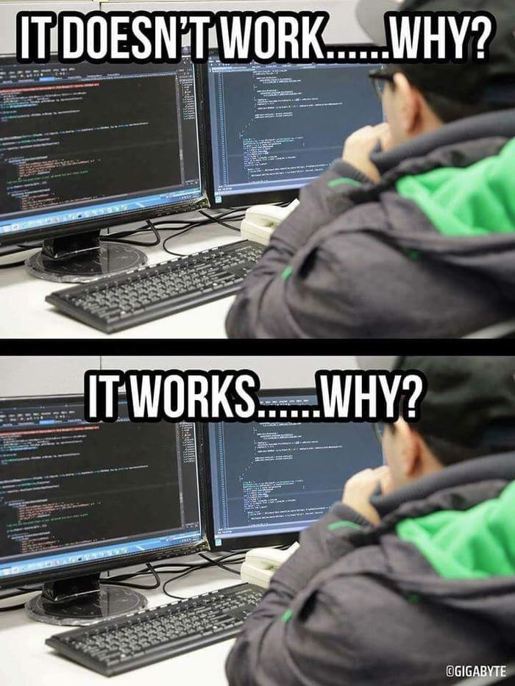
Major Accomplishments
Accomplishments {
VPS: [
“First step in progress”,
“Long and complicated setup”,
“Works flawlessly!”
],
Docker: [
“Confusing documentation”,
“Works well and is compatible with VPS”
],
Bash: [
“Writing scripts Blindly”,
“Testing proved that the scripts work!”
]
}

Slide 11

Plans for the future
If we were to continue this project in the future, we might try to facilitate the process even more by connecting the bash scripts in order to decrease the need for any manual inputs from the user.
As well as provide additional scripts that will quickly render a static html page for the user to edit

Slide 12
Outro
Why should you buy
Our product?

