Slide 1
Spresense OpenPLC
Next Step LLC

Slide 2
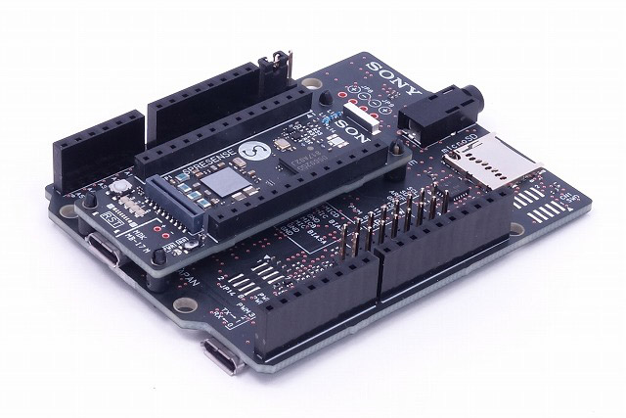
Spresense + Extension board
Spresense Arduino setup こちらを参照(日本語)
See here(EN)

Slide 3
Arduino UNO
Spresense Extension board
Digital Inputs
Digital Inputs
Pin | OpenPLC I/O
2 | %IX0.0
3 | %IX0.1
4 | %IX0.2
5 | %IX0.3
6 | %IX0.4
Pin | OpenPLC I/O
0 | %IX0.0
1 | %IX0.1
2 | %IX0.2
4 | %IX0.3
7 | %IX0.4
Digital Outputs
Digital Outputs
Pin | OpenPLC I/O
7 | %QX0.0
8 | %QX0.1
12 | %QX0.2
13 | %QX0.3
Pin | OpenPLC I/O
8 | %QX0.0
10 | %QX0.1
11 | %QX0.2
12 | %QX0.3
13 | %QX0.4
Analog Inputs
Analog Inputs
Pin | OpenPLC I/O
A0 | %IW0
A1 | %IW1
A2 | %IW2
A3 | %IW3
A4 | %IW4
A5 | %IW5
Pin | OpenPLC I/O
A0 | %IW0
A1 | %IW1
A2 | %IW2
A3 | %IW3
A4 | %IW4
A5 | %IW5
Analog Outputs
Analog Outputs
Pin | OpenPLC I/O
9 | %QW0
10 | %QW1
11 | %QW2
Pin | OpenPLC I/O
3 | %QW0
5 | %QW1
6 | %QW2
9 | %QW3

