Slide 1
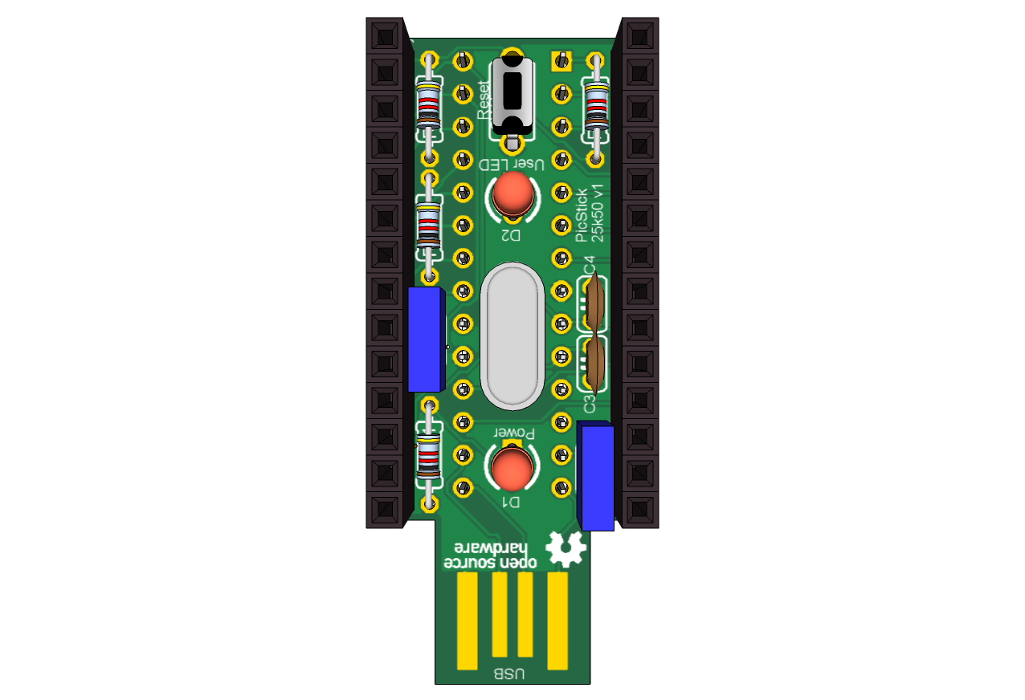
JP2
JP1
Reset Switch
1
1
GND
RB7
2
2
RA0
A/D
RB6
3
3
RA1
A/D
RB5
4
4
RA2
RB4
5
5
RA3
SPI Dout
RB3
6
6
RA4
RB2
7
7
RA5
A/D
SPI Select
I2C
RB1
8
8
RA6
SPI Din
RB0
9
9
RA7
ICSP
MCLR
10
10
RC7
A/D
RX1
5V
11
11
RC6
TX1
GND
12
12
RC2
User LED
PGD
13
13
RC1
PGC
14
14
RC0
Pinout - picstick_25K50_v1

