Slide 1
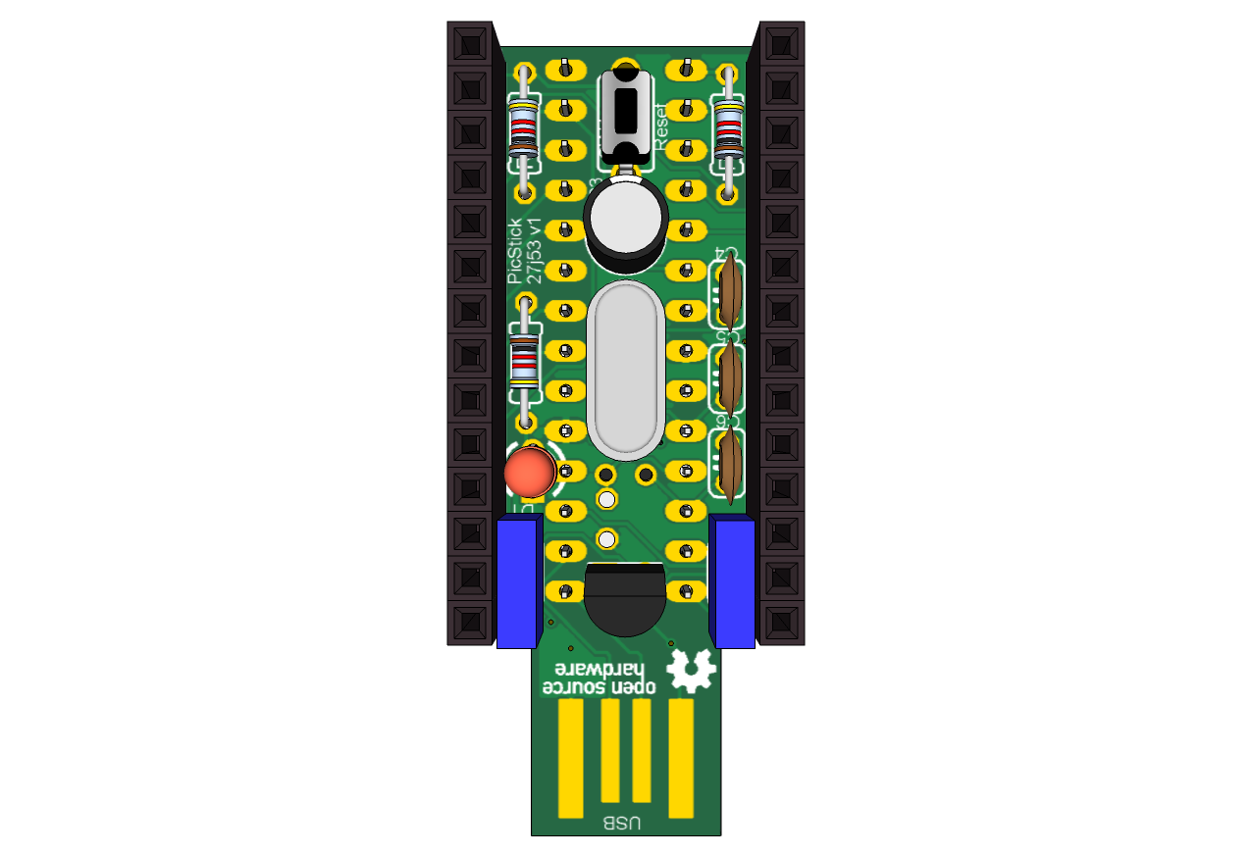
JP2
JP1
Reset Switch
1
1
GND
RB7
2
2
RA0
12bit A/D
RB6
3
3
RA1
SPI Din
I2C
RB5
4
4
RA2
RB4
5
5
RA3
CTMU
12bit A/D
RB3
6
6
RA5
SPI Select
RB2
7
7
5V
RTCC
RB1
8
8
3.3V
RB0
9
9
3.3V
ICSP
MCLR
10
10
GND
3.3V
11
11
GND
GND
12
12
RC2
User LED
PGD
13
13
RC6
TX1
PGC
14
14
RC7
RX1
SPI Dout
Pinout - picstick_27j53_v1

