Slide 1

Daniel Choi
Sean Kelley
Robert Hromada
David Su
Mike Turley
Colby Stone
Yue Shing

Slide 2
Team Roles
Colby Stone
Sean Kelley
David Su
Yue Shing
Mike Turley
Daniel Choi
Robert Hromada
Project Manager
Creative Director
FrontEnd Programmer
FrontEnd Programmer
BackEnd Programmer
BackEnd Programmer
Documentation Scribe

Slide 3
Project Idea
This project is an interactive multi-player on-line competitive
madlib web service. The game is centered around filling in an
incomplete story. The players submit words to the "card czar”
who chooses which word given is used to fill in the story. The
card czar is a role which changes every turn, so every player
gets a chance to create the story, using their favorite
submitted word given by the others.
The application presents a user friendly gui, a playing area
with real-time updates, personal profile page with a fiends list,
search functionality for other players profiles and an in-game
chat room. Our back end development uses MongoDB to
store user data, game state and structured story data, and
shares this data with the client via AJAX and Socket.IO
implementations.

Slide 4
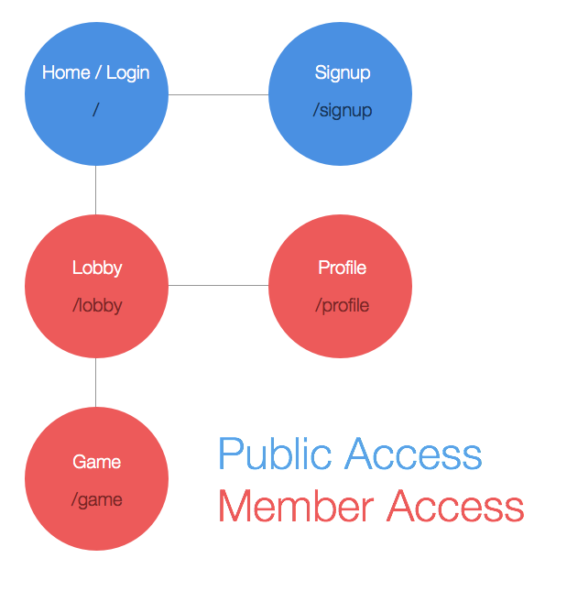
Birds Eye View

Slide 5
Components
Overview
The application is built in Javascript on top of a Node.js server environment customized with the ExpressJS
web framework for Node. The server uses EJS to render static pages and initial page templates, and some
of the client-side pages use dynamic reactive template updates powered by Blaze. CSS styles based on
Foundation with some customizations are used across all pages of the application for the look and feel. The
website contains features from the individual aspect, such as personal profile, to the community aspect (ie.
lobby and chat room). The remaining components are focused on the game aspect of the app. Certain
components, like stories, are necessary for the game to run properly, while others simply enhance the
players' experience.
Login
For the player login we used a library called Passport. We set it up to allow users to sign into their account
by filling in two fields: Email and Password. We used HTML5 fields to deal with simple validation. Once
authentication is completed, the user successfully log in and redirected to the lobby page. If authentication
fails, an error message will appear, and user will be asked to re-enter information into the two fields. There is
a link to the sign-up page, in case the user trying to log in does not have an account.
Signup
Passport also deals with the sign up. The account creation requires an email address, a nickname, a
password and a password confirmation. The feature checks the database and makes sure the nickname has
not been taken already. Once the account is created the user will be re-directed to the lobby page.

Slide 6
Components
Lobby
The lobby function is is an essential feature of the web app that allows all users to see the games in
progress, games being created, and games being filled up. Players not in a game will spend most of
their time here. There will be a list of players currently in the lobby, in which a player can click and
view their profiles. Moreover, in the lobby, players will be able to chat with other players in the lobby,
create a game, and join a game.
Story
All Madlib stories will be stored in a JSON object. These objects will contain information about the
story like it's name, search tags, and length, as well as the story itself. The stories will be broken into
"story chunks", which will provide the pieces of data that the different player views, either submitter or
voter, will use inside the game. This object will be updated as the game progresses to store game
state, and can be queried for any game information for rendering or other purposes.
Game
This is our main game view for when the mad-lib game is running. Users enter this view when they
join a game room from the lobby. This page implements Blaze to render the current state of a game in
real time based on data coming in from socket.io connections and ajax. The game will support the
chat features and contain likes to players profiles through their names or Gravatar. The game views
also contain the progressbar.js library for use during the game's timed turns.

Slide 7
Components
Chat
Our chat is built using socket.io. Anyone participating in that particular game will be able to use the
chat feature. We also set up a global variable to hold the current users nickname and gravatar and
display them when a user is sending a message in chat. This feature is meant to enhance players’
game experience by increasing their interaction with each other.
Profile
Profile will hold all the information about the account creator. The information shown includes a
Gravatar picture, total number of games won, the players friends and a search for friends area. This
feature allows players to distinguish themselves from other players and give their personal profile a
unique feel. Furthermore, profiles enables players to view any other player's basic information.
Search
User search functionality is available within the profile page. This functionality allows searching for
friends dynamically amongst the database of PhraseCards users. This feature uses jQuery's AJAX
functionality to fetch data from the back-end API.
Friends
Friends consists of a list of a persons friends. It is part of the profile functionality and is used in
conjunction with search.

Slide 8
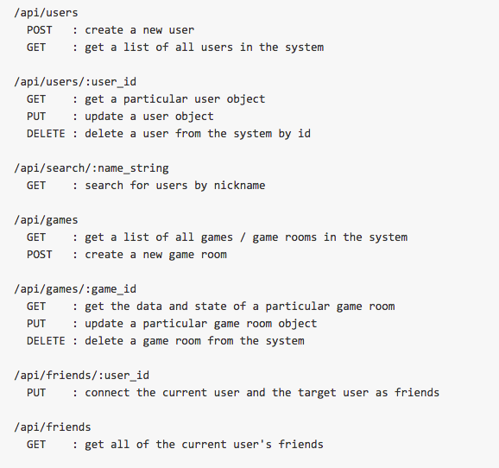
API

Slide 9
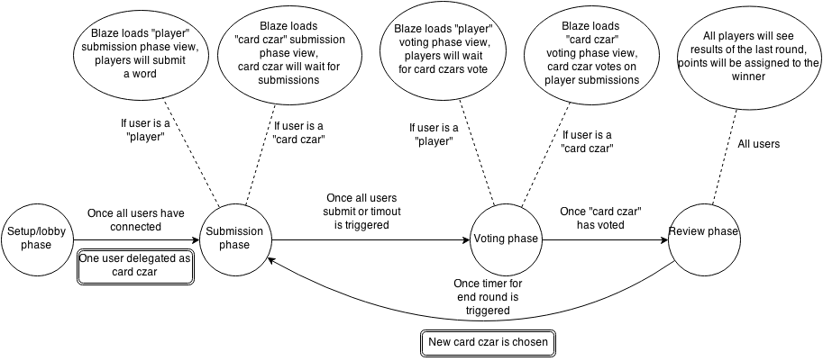
In-Game Data Flow and State Transitions

Slide 10
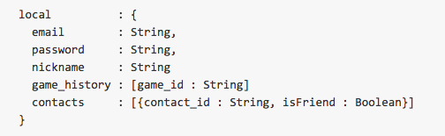
Database Design User

Slide 11
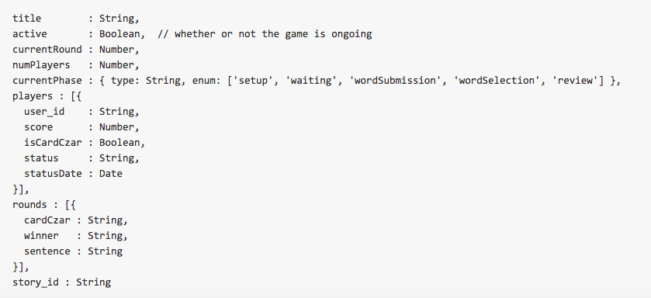
Database Design Game

Slide 12
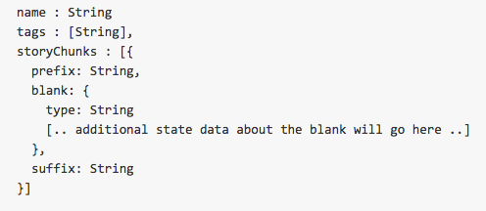
Database Design Story

Slide 13
External Libraries
CSS:
Foundation: bootstrap our css
Font-Awesome: icons
Animate.css: animations

Slide 14
External Libraries
Javascripts:
Jquery: for some basic DOM manipulation and event handling
Blaze: for reactive DOM templating
Foundation: bootstrap our js
progressbar.js: for pretty-looking timers

Slide 15
External Libraries
Notable node libraries:
Express: General backend framework for our web application
Passport: Used for user authentication (registration, login, logout)
Mongodb: Framework for database design
Ejs: Javascript template that cleans html code
Gravatar: Display profile pictures
Socket.io: Used to create Chat and Rooms

