Slide 1
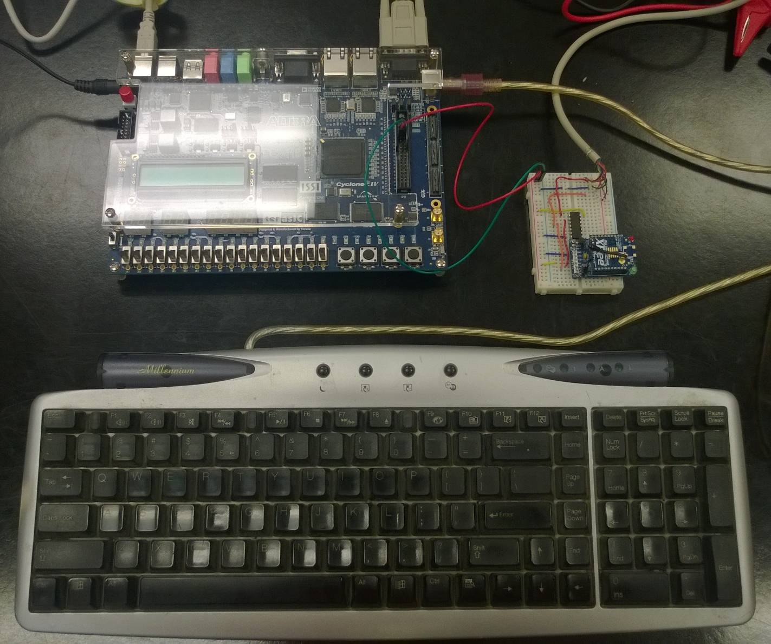
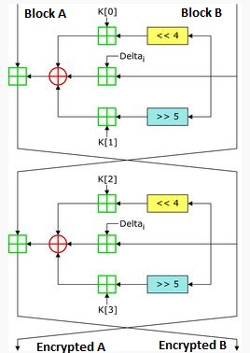
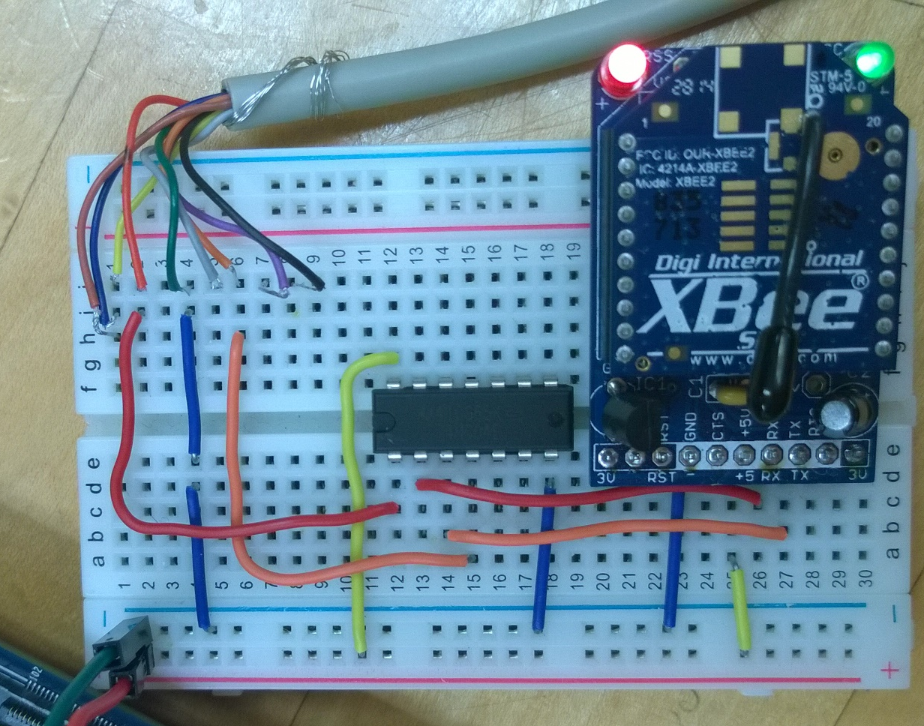

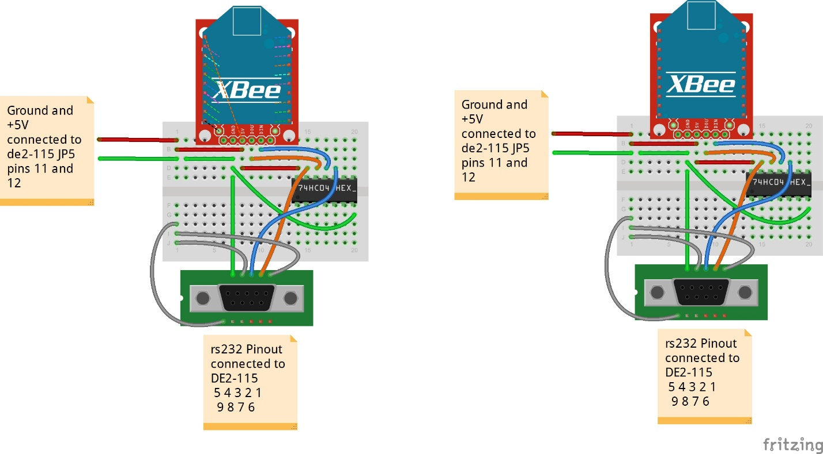
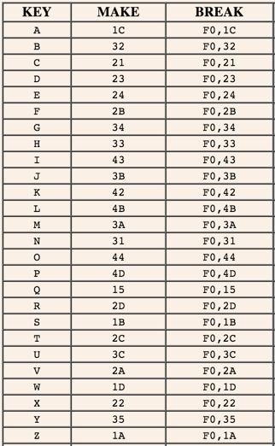
Encrypted Mobile Radio Communication
Electrical & Computer Engineering
Students: Chris Hays, Sean Rall, Shon Saevang
Advisors:Dr. Reza Raeisi, Dr. Woonki Na
Abstract
Encryption
Experimental Hardware Design
The idea for the project is to design hardware embedded systems to communicate with one another, creating a private, encrypted peer-to-peer (P2P) network. The implementation will consist of designing a custom system and programming it into an FPGA board, interfacing with the systems through Xbee RF modules, and developing a user interface using the PS/2 Keyboard and JTAG console. These systems will be able to transmit data bi-directionally providing various applications. Practical applications include communications and point-of-sale systems, or any situation that requires private, local transmission. Applications can be developed that have the same foundational components and only require minor adjustments to the hardware system and user interface.
The Tiny Encryption Algorithm (TEA) is a block cypher that operates on two 32-bit data blocks. It uses a 128-bit key and the key data is mixed in 32 symmetrical rounds. Multiples of a constant (Delta) are used to prevent simple attacks based on symmetry, though the algorithm may be susceptible to related-key attacks with a 2³² time complexity.
Figure 2 below shows the overall system showing the FPGA, XBee, and PS/2 Keyboard. Figure 4 shows a close up on the Xbee wiring that connect to the RS232 chip.
DE2-115 Dev Board
XBee Circuit
The algorithm was implemented in hardware on the FPGA using the Verilog hardware definition language. The encryption module has 64-bit input and output busses, a 2-bit control input and a 2-bit status output. The main C program calls encryption and decryption functions when needed; these functions send the data out to the hardware as well as control signals to choose between encrypting or decrypting the data on the bus.
PS/2 Keyboard
Design
Figure 1 below shows the overall system block diagram of the Encrypted Mobile Radio Communication program and figure 2 shows the hardware aspect of the project.
Figure 3 System Overview
XBee S2 With Adapter
RS232 Breakout
+5V and Ground From FPGA GPIO
74HC04E Inverter
PS/2 Communication
The PS/2 controller on the development allowed us to use is as a memory mapped device, which means that we can interact with it using read and write commands at it’s specified memory address. Table 1 shows it’s register map.
Figure 4 XBee System Overview
Table 1: PS/2 Controller Register Map
Conclusion
Figure 1 Software Overview
This project allowed us to design a custom system that is used for wireless communication. We were also able to design custom hardware components to be used with the custom embedded system. The system combined to form a private network that was also encrypted. This project is a platform that can be used for many different applications that requires a small network for transmitting data. Since the systems can be easily customized, they provide the ability for rapid prototyping. This allows the systems to adapt to any new features that may needed for a particular application.
The keyboard sends a scan code whenever a key is pressed. It consist of a make code and a break code. The make code is a byte of data that is sent when the key is pressed; the break code is two bytes that are sent separately. The first byte of the break code is always 0xF0, while the second byte is a repeat of the make code. This gives the ability to know when a particular key is released.
Table 2: Scan Codes
Figure 2 Hardware Overview

