Slide 1
Fix potential implementation

Slide 2
Grand picture
Implementation of point charge update
Test cases and Optimization
Implementation of Gaussian distributed charge update
Test cases
Self discharge study

Slide 3
Data flow chart

Slide 4
Main Functions
pre_force()
prepare k, call coeffs() to get cosine, sine, and call the following functions to realize charge update.
init_matvec()
Call compute_ewald()
Fill H matrix, under the name AM[][], by short-range via reading mappingfiles; and long-range, by filling derived terms
Fill b matrix, by name b_s[]
gaussian()
Shrink the H and b matrix to be named A[][] and b[] respectively
Solve H*q=b by Gauss elimination
backup_Q()
Assign charges to atoms
Forward map charges to corresponding ghost atoms by forward_comm_fix()
Reference: fix_qeq_reax.cpp/h, fix_qeq_sm.cpp/h

Slide 5
Added functions and parameters
For long-range term calculation
Borrow contents from ewald.cpp:
In pre_force(): prepare kxmax, kymax, kzmax, kmax, kmax3d and coefficients of cosine & sine
rms(): for accuracy calculation
compute_self()
Borrow contents from ewald.cpp
Calculate pre-factors and summation of all
compute_cross()
Fill H matrix with long-range term at non-diagonal
compute_b()
Fill b matrix with long-range term by summing up over j atoms
New functions, intermediate parameters such as AM[][], b_s[], cs[][][], sn[][][], of which definition to be found in header file

Slide 6
Short-range terms
forward_comm_fix()
Call pack_comm() and unpack_comm() to form correspondence between unit cell atom and image atom(s)
Reference to be seen in comm.cpp, update.cpp, and fix.cpp
Write out correspondence files: list1.txt and list2.txt for matching summation in compute_ewald() for short-range terms
Alternative choice for mapping by using 1D buffer in reverse_comm_fix()
No self term
Non-diagonal AM(H) terms filled by 1/r*erfc
b_s[] term summing q[j]/r
All AM(H) mapped to [nlocal,nlocal], later shrunk to [n,n]

Slide 7
Damping factor
t = 1/(1+EWALD_P*g_ewald*r)
alpha = (t*A1+t^2*A2+t^3*A3+t^4*A4+t^5*A5)*exp(-g_ewald^2*r^2)
r | t | erfc
0 | 1 | 0.999999999
1 | 0.936534 | 0.769866367
2 | 0.880643 | 0.558480563
3 | 0.831048 | 0.380133816
4 | 0.78674 | 0.241920816
5 | 0.746919 | 0.143536051
6 | 0.710934 | 0.079208049
7 | 0.678257 | 0.040574652
8 | 0.648452 | 0.019263108
9 | 0.621156 | 0.008464788
10 | 0.596065 | 0.003439181
11 | 0.572923 | 0.001290786
12 | 0.551511 | 0.000447186
13 | 0.531641 | 0.000142917
14 | 0.513153 | 4.21125E-05
15 | 0.495908 | 1.14359E-05
16 | 0.479785 | 2.86085E-06
Reference: pair_lj_cut_coul_long.cpp
g_ewald | 0.206864
EWALD_P | 0.3275911
A1 | 0.254829592
A2 | -0.284496736
A3 | 1.421413741
A4 | -1.453152027
A5 | 1.061405429

Slide 8
Damping factor – g_ewald(cont.)
r | erfc(g_ewald*r) | erfc
0 | 1 | 0.999999999
1 | 0.769866233 | 0.769866367
2 | 0.558480648 | 0.558480563
3 | 0.380133891 | 0.380133816
4 | 0.241920695 | 0.241920816
5 | 0.143535971 | 0.143536051
6 | 0.079208135 | 0.079208049
7 | 0.040574786 | 0.040574652
8 | 0.019263148 | 0.019263108
9 | 0.008464709 | 0.008464788
10 | 0.003439046 | 0.003439181
11 | 0.001290659 | 0.001290786
12 | 0.000447099 | 0.000447186
13 | 0.000142869 | 0.000142917
14 | 4.20898E-05 | 4.21125E-05
15 | 1.14267E-05 | 1.14359E-05
16 | 2.8576E-06 | 2.86085E-06
g_ewald = 0.206864
alpha = (t*A1+t^2*A2+t^3*A3+t^4*A4+t^5*A5)*exp(-g_ewald^2*r*2)

Slide 9




Long-range term
Derivation of long-range pre-factors
$$\begin{matrix}A_{ii}=\sum_{k≠0}{\frac{4π}{V}\frac{e^{−{k^{2}}/4α^{2}}}{k^{2}}}−\frac{2α}{\sqrt{π}}−\frac{π}{Vα^{2}} \\ A_{ij}=\sum_{k≠0}{\frac{4π}{V}\frac{e^{−{k^{2}}/4α^{2}}}{k^{2}}}cos\left(θ_{i}−θ_{j}\right)−\frac{π}{Vα^{2}} \\ b_{i}=−\sum_{k≠0}{\frac{4π}{V}\frac{e^{−{k^{2}}/4α^{2}}}{k^{2}}}\sum{q_{j}cos\left(θ_{i}−θ_{j}\right)}+\frac{π}{Vα^{2}}\sum{q_{j}}\end{matrix}$$
Reference:
Naoki, Goddard,
Accelerating of Covergence for lattice sums
J. Phys. Chem. 1989, 93, 7320-7327
$$∈$$
$$\left(i,j\right)$$
$$\left[0,nlocal\right)$$
Summation over all electrolyte atoms (j)

Slide 10
Test case
System setup:
Size 30*30*30 angstroms
6 atoms, 2 of charges to update(5,6)
Cut-off radius 12 angstroms
Interpolation study
Potential calculation

Slide 11
Interpolation study
ecut | decut | dq | decut/dq
-162.71122 | 3.32064 | -0.10000 | -33.206400
-165.69979 | 0.33207 | -0.01000 | -33.207000
-165.99865 | 0.03321 | -0.00100 | -33.210000
-166.02853 | 0.00333 | -0.00010 | -33.300000
-166.03186 | 0.00000 | 0.00000
etot | de | dq | de/dq
-162.711217937800 | 3.320637062200 | -0.100000000000 | -33.206370622000 | -33.206371
-165.699791291458 | 0.332063708542 | -0.010000000000 | -33.206370854200 | -33.206371
-165.998648630000 | 0.033206370000 | -0.001000000000 | -33.206370000016 | -33.206370
-166.028534360000 | 0.003320640000 | -0.000100000000 | -33.206399999983 | -33.206400
-166.031855000000 | 0.000000000000 | 0.000000000000
 |  | qqrd2e | 332.06371
Why so many zeros??
Reference: update.cpp

Slide 12
Interpolation study(cont.)
Two error sources:
Round up issue in log file (may be fixed)
ERFC dependence on total charge (may not be an issue, because it should converge as dq becomes very small)
dq | ecut | de | de/dq | decoul/dq
-0.1 | -162.71122 | 3.32064 | -33.2064 | 0.00240333
-0.01 | -165.69979 | 0.33207 | -33.207 | 0.0030169
-0.001 | -165.99865 | 0.03321 | -33.21 | 0.003076
-0.0001 | -166.02853 | 0.00333 | -33.3 | 0.00308
0 | -166.03186 | 0 | null
decoul | decoul/dq | ecoul | ecoul/ecut | erfc(alpha*r) | alpha
-0.000240333 | 0.00240333 | -0.064846423 | 0.000398537 | 0.000398539 | 0.25039
-3.0169E-05 | 0.0030169 | -0.064636259 | 0.000390081 | 0.000390079 | 0.25079
-3.076E-06 | 0.003076 | -0.064609166 | 0.000389215 | 0.000389222 | 0.250831
-3.08E-07 | 0.00308 | -0.064606398 | 0.000389128 | 0.000389138 | 0.250835
0 |  | -0.06460609 | 0.000389119 | 0.000389117 | 0.250836
dq | de/dq | decoul_t/dq
-0.1 | -33.2064 | -0.012921185
-0.01 | -33.207 | -0.012921419
-0.001 | -33.21 | -0.012922586
-0.0001 | -33.3 | -0.012957607
ecut | erfc | ecoul_test | decoul_test | decoul_t/dq
-162.71122 | 0.000389117 | -0.063313754 | 0.001292119 | -0.012921185
-165.69979 | 0.000389117 | -0.064476659 | 0.000129214 | -0.012921419
-165.99865 | 0.000389117 | -0.06459295 | 1.29226E-05 | -0.012922586
-166.02853 | 0.000389117 | -0.064604577 | 1.29576E-06 | -0.012957607
-166.03186 | 0.000389117 | -0.064605873 | 0
Does this interpolation validation still work for long-range?
Concern: as q changes, the total charge in cell becomes non-zero.
The treatment using background charge may cause difference in different finite difference cases.

Slide 13
Interpolation study(cont.)
alpha | g_ewald | erfc
0.3 | 0.060259 | 0.394111028
0.4 | 0.052569 | 0.457218826
0.5 | 0.045722 | 0.517888027
0.6 | 0.039251 | 0.578834116
0.7 | 0.032798 | 0.642766966
rc | 12
r | 10

Slide 14
Long-range term coupled: Updated charges
Long-range term coupled:
ITEM: ATOMS id type x y z q
4 4 5 5 15 -1
3 3 25 5 15 1
5 5 5 15 15 -5.04091
6 6 25 15 15 5.04091
1 1 5 25 15 1
2 2 25 25 15 -1
Only with short-range term:
ITEM: ATOMS id type x y z q
4 4 5 5 15 -1
3 3 25 5 15 1
5 5 5 15 15 -10
6 6 25 15 15 10
1 1 5 25 15 1
2 2 25 25 15 -1

Slide 15
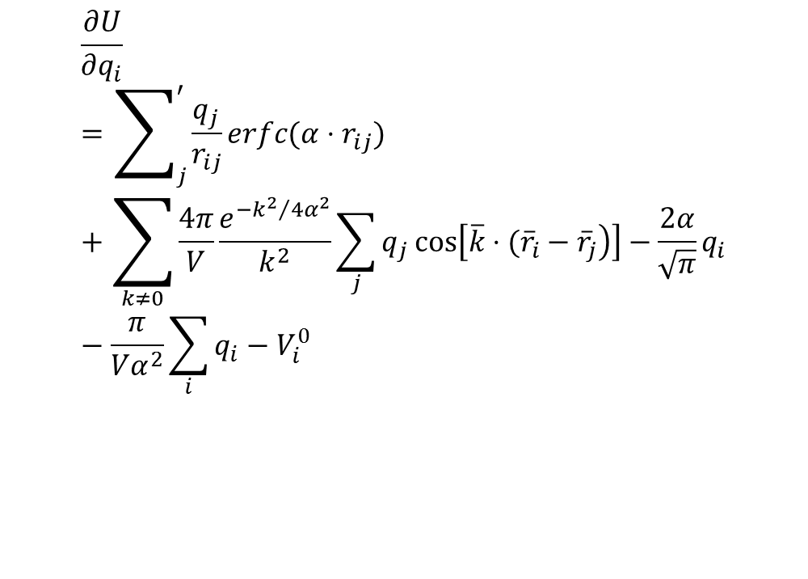
Potential Calculation
A(qe,r)qE=b(qe,r)
qE updated, how to enure system charge is zero?
Needs perfect match!!
potentialcalc.for
short-range term = 2.6523307E-04
long-range term = -0.3310307
self-term = 1.394478
back-ground screening = 0.0
target potential = 1.000000
potential = 1.063713
error = 6.3712955E-02
$$\frac{∂U}{∂q_{i}}=\sum_{j}^{′}{\frac{q_{j}}{r_{ij}}}erfc(α⋅r_{ij})+\sum_{k≠0}{\frac{4π}{V}\frac{e^{−{k^{2}}/4α^{2}}}{k^{2}}}\sum_{j}{q_{j}}cos\left[\left.\overline{k}⋅({\overline{r}}_{i}−{\overline{r}}_{j}\right)\right]−\frac{2α}{\sqrt{π}}q_{i}−\frac{π}{Vα^{2}}\sum_{i}{q_{i}}−V_{i}^{0}$$

Slide 16
To-do list
1 study on potential calculation
Compare dU/dq in code with theory.
For complex system there theory is complex, use interpolation. But fix round-up issue.
Back-forward validate has been done for CUT. How about LONG-Short? This should work.
For LONG-Long, first fix the matrix calculation – scalar calculation mismatch problem.
For dU/dq test, one worry is the change of system charge as one charge is modified. A potential fix is to modify both a positive charge and a negative charge in a antisymmetric system. Hope is that dU(dq5,dq6)/2 would be the dU(dq5). This needs verification by simple LAMMPS calculation.
Back forward: potential calculation has problem. U1,1 is infinitely large!!! If need to do his, search literature to find out potential calculation in EWALD!
2 optimization:
Soft-coding
Mapping in more efficient style
Long-range calcs
MPI
3 test cases: complex system; French group paper case

