Slide 1
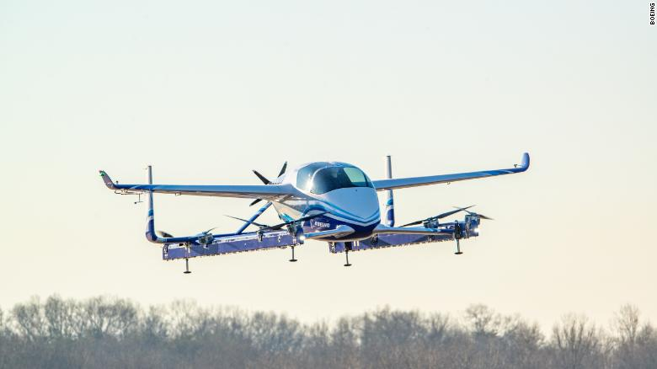
Schedule_verification userguide
PolyHack 2019
Controlled under the Export Administration Regulations as ECCN 9E991. Confirm authorized nationalities prior to disclosure.

Slide 2
Overview
General concept
File diagram
JSON input file example
Example of use (steps)
Example of output (schedule conflict)
Example of output (demand)

Slide 3
General concept
Python script which uses a JSON as an input file
(written in python 2. ‘print’ and ‘execfile("./filename").’ functions need to be changed to ‘print()’ and “exec(open("./filename").read())”
Plots the schedule according to different tests in order to diagnose potential errors in the schedule that is generated

Slide 4
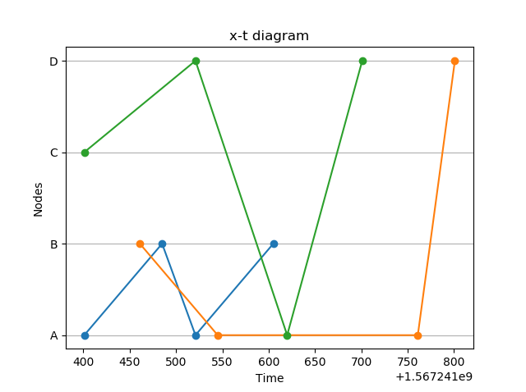
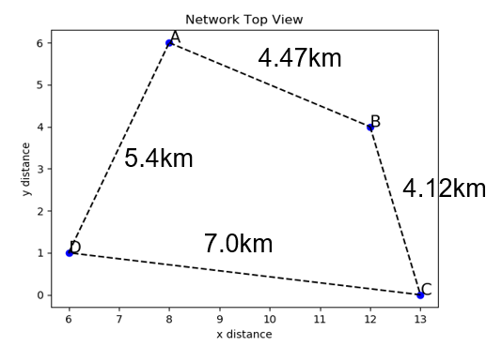
File diagram
checks.py
utilityFunctions.py
Checks.py is a module (contains a list of functions) that all have the same interface so that they can be looped over during verification. Only check that is not included is continuity (needs to be met before other checks may be conducted)
generalFunctions.py is a module containing a few simple functions that are used across the different scripts
Network.py
FleetPath.py
3. Loops through check functions
Network.py defines the network class and its methods.
FleetPath.py (or ScheduleVerifier) is the main script containing the methods.
1.defines network & data structure
2. Calls “evaluate_schedule”
4. Plots output
Input:
Schedule.json
Parameters.py
Input_network.py
Main.py
main.py
Output: figures & score
main.py (or ScheduleVerifier) initializes data strucutres and runs the verifier.

Slide 5

Json schedule input format (single line= single flight)
Number of passengers on the flight
End point of flight (node in network)
Start point of flight (node in network)
Number of flight (irrelevant in this case)
FATO (set to 1)
FATO (set to 1)
Vehicle name
TakeOff Time of flight (use this format).
If not possible, another format can be set in the parameters.py file
LanDing Time of flight (use this format).
If not possible, another format can be set in the parameters.py file
Number of mission (irrelevant in this case)

Slide 6

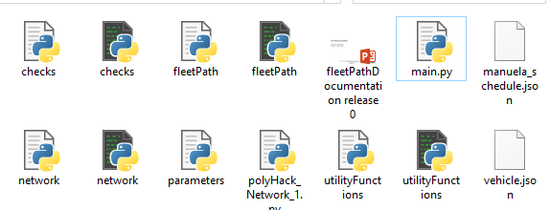
Example of use (steps):
Install the proper python dependencies (anaconda covers all). See requirements file
Create your schedule (as json seen above)
Place file in the appropriate folder (level1, 2 or 3)
Challenge

Slide 7

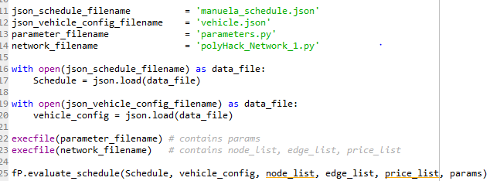

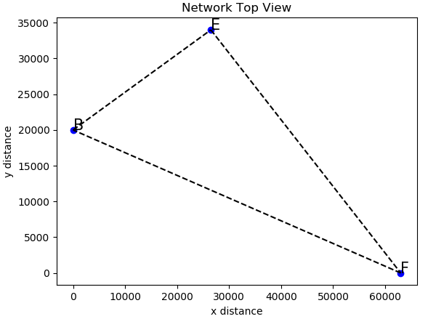
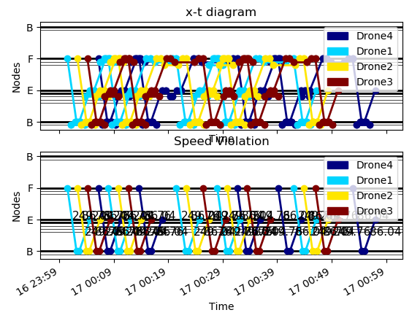
Example of use (steps):
4. Open the ‘main.py’ file in a text editor or python IDE in order to specify the input files (schedule, vehicles, schedule, parameters)
5. Run the ‘main.py’ in a python console. This will do the usual diagnostics. If others are needed, other plots may be coded
6. Using the graphs and prints in the command prompt, evaluate the schedule (inconsistencies, constraints, objective function).

Slide 8
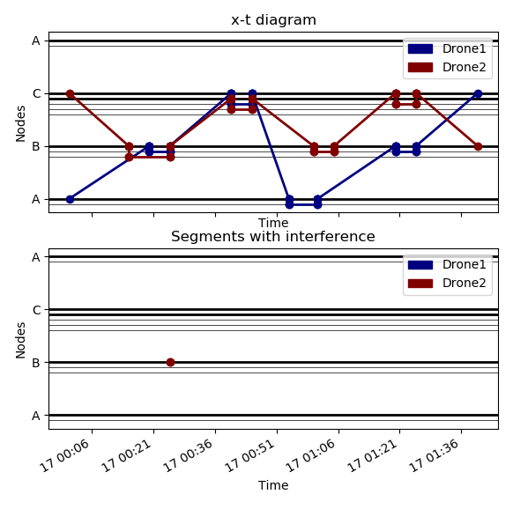
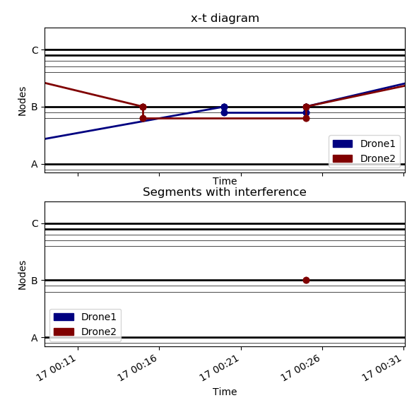
Example of output (schedule conflict):
Two vehicles would collide on the FATO

Slide 9
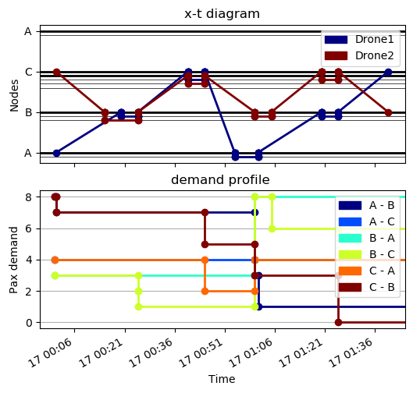
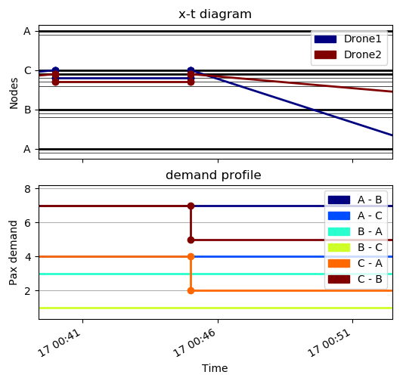
Example of output (demand):
Passengers are flown away, reducing the demand
In a proper schedule, demand should not go below 0!

