Slide 1
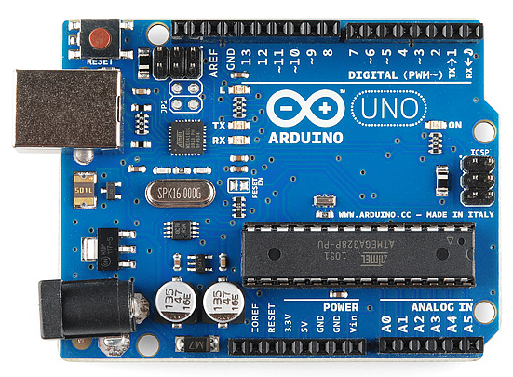
Introduction to Arduino CSE360-Computer Interfacing BRAC University

Slide 2
What is Arduino
An Arduino is an open-source microcontroller development board.
Arduino boards are able to read inputs – from sensors and control things like motors and lights.
This allows you to upload programs to this board which can then interact with things in the real world.
Example: Automatic watering system by humidity sensor Stand-alone chat server Set up a motion sensor to a door Alarm to perform any defined tasks

Slide 3
Arduino
Programming Language:
The Arduino IDE supports the languages C and C++ using special rules of code structuring.
Why Arduino?
The Arduino software is easy-to-use for beginners, yet flexible enough for advanced users.
It runs on Mac, Windows, and Linux.
Inexpensive
Open source and extensible software

Slide 4
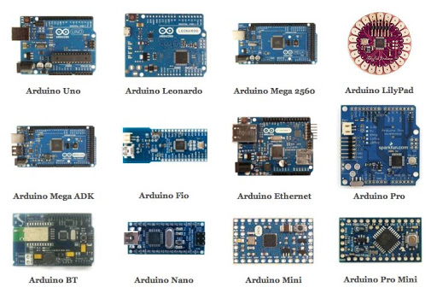
Types of Arduino

Slide 5
Arduino Uno
It is a microcontroller board developed by Arduino.cc and based on Atmega328.
Arduino Uno is a very valuable addition in the electronics that consists of: 1. USB interface, 2. 14 digital I/O pins, 3. Tx and Rx pins 4. 6 analog pins, 5. Atmega328 microcontroller. 6. 13KB of flash memory 7. RAM memory is 32KB

Slide 6
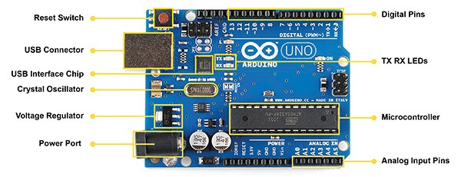
Arduino Uno

Slide 7

Applications of Arduino

Slide 8
.
Thank You For Your Attention

