Slide 1
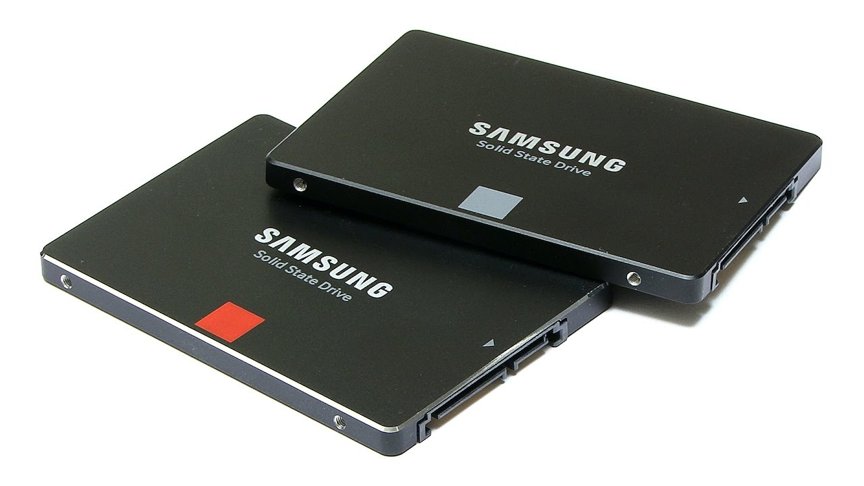
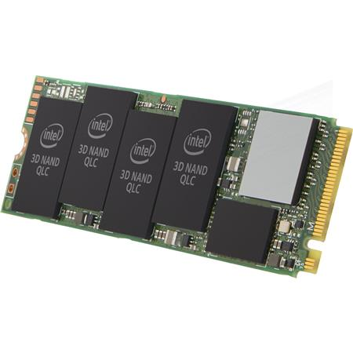
CSE360-Computer Interfacing BRAC University Solid State Drive (SSD)

Slide 2
Solid State Drive
An SSD is a Solid State Drive that is used to store data, files and applications, as well as to run computing devices.
Solid state drives offer significant performance advantages over conventional hard disk drives (HDDs).
SSDs do not have any moving mechanical components, which distinguishes them from traditional magnetic disks such as hard disk drives(HDDs).
SSDs use microchips that retain data in non-volatile memory chips.
SSD uses non volatile NAND Flash Memory , which enables it to retain data when the power is removed.

Slide 3
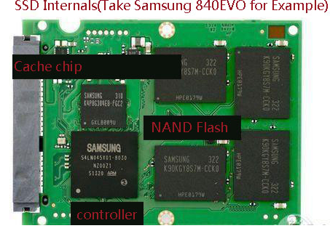
Internal Components and Design
Major Components:
Outer Shell
NAND Flash
Controller
Firmware
DRAM Buffer

Slide 4
Outer Shell
The outer shell could be of metal or plastic and it helps in absorbing most of the heat from inside the flash memory.
Although, SSDs don’t contain any moving parts, they give off very little heat and emit no noise. This particular feature is vital in increased durability of an SSD.
An SSD can withstand 10X more vibration than an HDD and up to 1500G of shock (compared to less than 70Gs for a typical HDD).
SSDs exceed expectations in handling shock, vibration, and temperature extremes as well.

Slide 5
NAND Flash
NAND Flash Memory is the key component of SSD.
It is a specific type of EEPROM chip.
It has a grid of columns and rows with a cell that has two transistors at each intersection as Control gate and Floating gate transistor.
The principle of operation is based on MOSFETs.
NAND flash memory is non-volatile that means it has ability to retain the data without a constant power supply.
Lower cost compared to DRAM.
Flash memory SSDs are slower than DRAM solution.
NAND Flash components have structures called pages and blocks.

Slide 6
NAND Flash
Groups of NAND flash cells are organized into pages and these pages are organized into blocks.
Read and write operations can be performed on pages, but erase operations can only be performed at the block level.
This means that when rewriting a page, the entire block must be erased first. This is because the act of erasing NAND flash requires a high amount of voltage.
• The SSD controller manages this process.

Slide 7
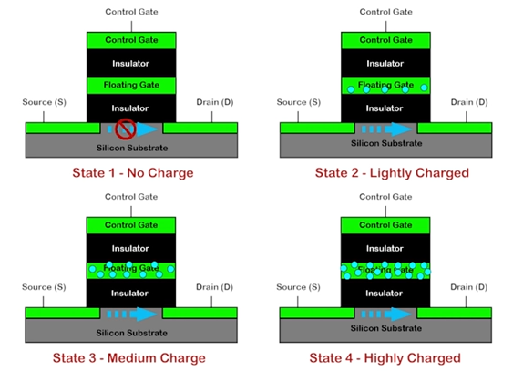
Charge States
PC Builder Bangladesh

Slide 8
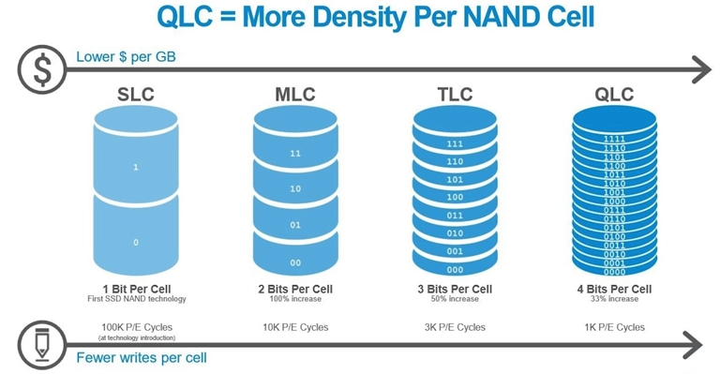
NAND Cell Storage
PC Builder Bangladesh
Notes:
Single Level Cell Multi “ “
Trinary “ “ Quad “ “

Slide 9
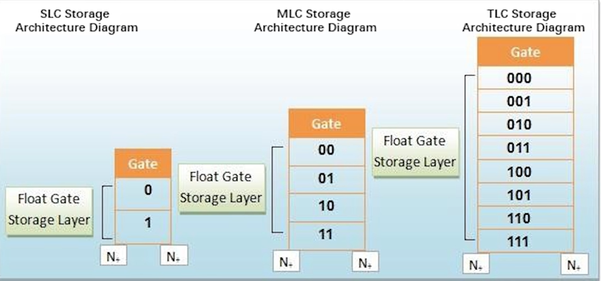
NAND Cell Storage
PC Builder Bangladesh

Slide 10
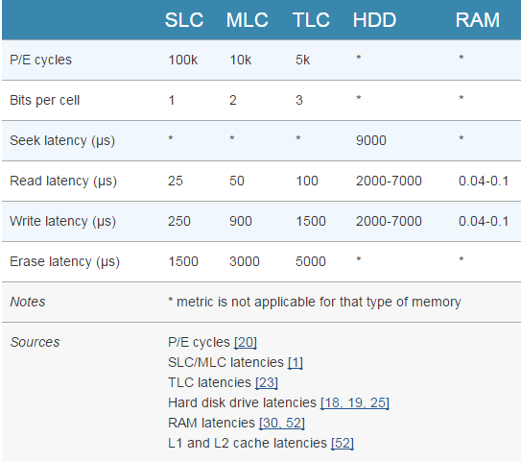
Performance Comparison

Slide 11
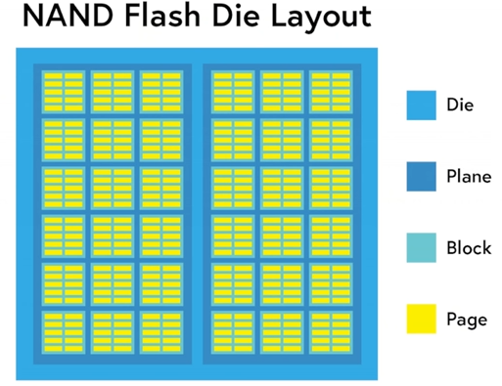
PC Builder Bangladesh

Slide 12
NAND Flash
The only way for an SSD to update an existing page is to copy the contents of the entire block into memory, erase the block, and then write the contents of the old block + the updated page.
If the drive is full and there are no empty pages available, the SSD must first scan for blocks that are marked for deletion but that haven’t been deleted yet, erase them, and then write the data to the now-erased page.
Garbage collection is a background process that allows a drive to mitigate the performance impact of the program/erase cycle by performing certain tasks in the background.

Slide 13
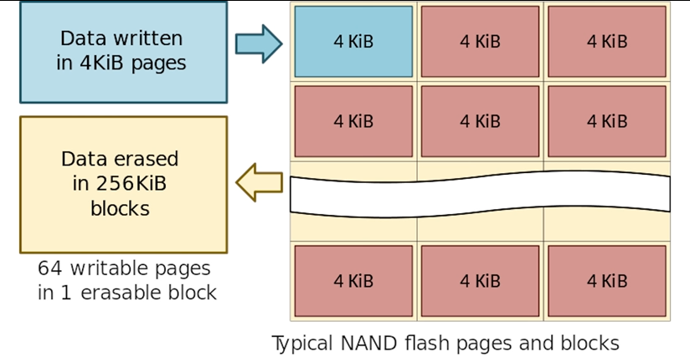
Data Read, Write and Erase

Slide 14
Some Important Concepts
Garbage Collection
TRIM Command
Wear Leveling
Write Amplification
Over-Provisioning

Slide 15
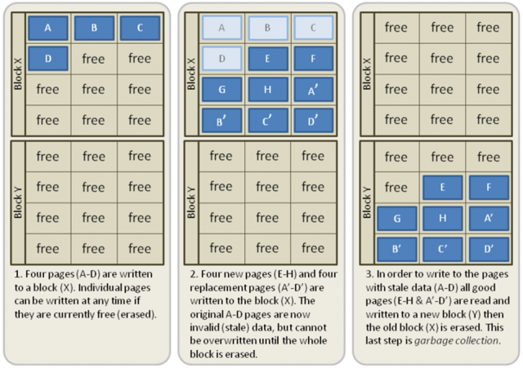
Garbage Collection
www.extremetech.com

Slide 16
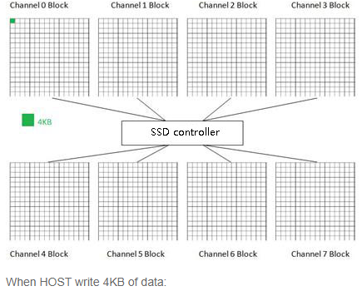
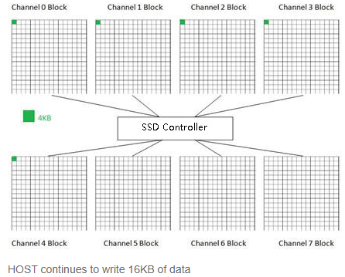
Wear Leveling
www.elinfor.com

Slide 17
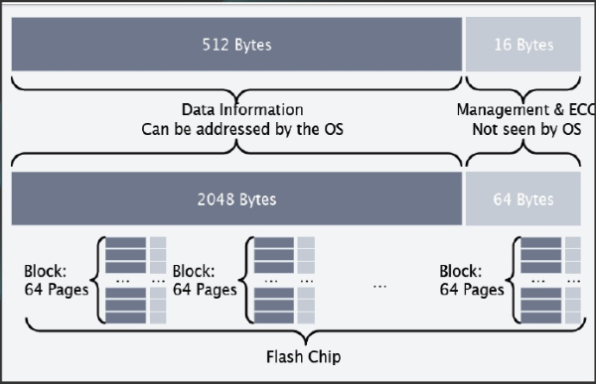
Over-Provisioning

Slide 18
SSD Controller
Flash controller includes the electronics that bridge the Flash memory components to the SSD input/output interfaces.
The controller is an embedded processor that executes firmware-level software.
Every SSD includes a controller i.e. an embedded processor that executes firmware-level code and is one of the most important factors of SSD performance.
Functions:
Error Correction(ECC).
Bad block mapping.
Read disturb management.
Read and write caching.
Encryption.

Slide 19
DRAM
A bit of DRAM is included in every SSD for the process of buffering.
Similar to hard drive’s cache, data is stored on it for some time temporarily before it is being written to the device.
It increases SSD performance to some level.

Slide 20
Advantages
High performance-Significantly faster than a standard HDD.
Faster seek time-Up to 60x faster than HDD.
Higher reliability-No moving parts.
Lower power-Lesser power consumption, cooler operation.
Silent Operation-Ideal for post production environments.
Light weight-Perfect for portable devices.
Wider Operating Temp.

Slide 21
Disadvantage
They are more expensive than traditional hard drives.
They currently offer less storage space then traditional hard drives.
Flash memory SSDs are slower than DRAM solution.

Slide 22
Applications
Desktop Computers
Laptops
Ultra books
HD Camcorder, CCTV Digital Video Recorder (DVR)
Smart TV
Set Top Boxes
Mobile Phones
Servers - SSD are used as cache at server side of Enterprises.

Slide 23
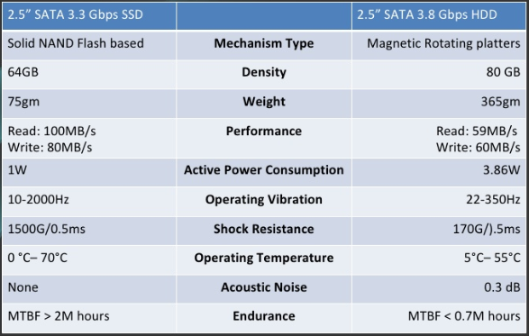
SSD vs HDD

Slide 24
.
Thank You For Your Attention

