Slide 1
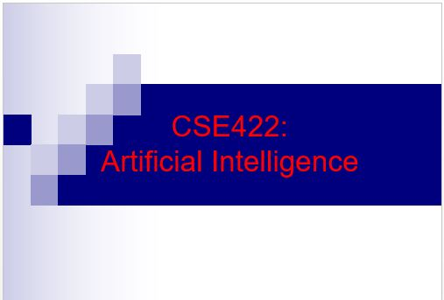
‹#›

Slide 2
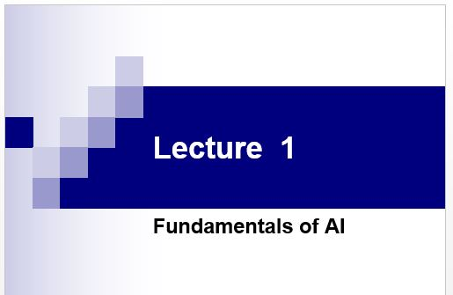
‹#›

Slide 3
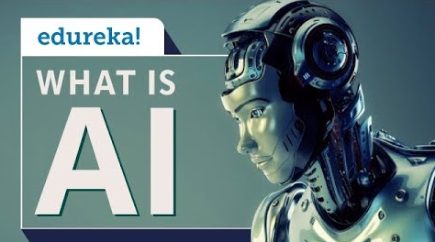
What is AI??
Artificial intelligence (AI) is the simulation of human intelligence processes by machines, especially computer systems.
These processes include learning (the acquisition of information and rules for using the information), reasoning (using rules to reach approximate or definite conclusions) and self-correction.

Slide 4







AI: A Vision
Could an intelligent agent living on your home computer manage your email, coordinate your work and social activities, help plan your vacations…… even watch your house while you take those well planned vacations?

Slide 5
Main Goals of AI
Represent and store knowledge
Retrieve and reason about knowledge
Behave intelligently in complex environments
Develop interesting and useful applications
Interact with people, agents, and the environment

Slide 6
Why AI?
Engineering: To get machines to do a wider variety of useful things
e.g., understand spoken natural language, recognize individual people in visual scenes, find the best travel plan for your vacation, etc.
Cognitive Science: As a way to understand how natural minds and mental phenomena work
e.g., visual perception, memory, learning, language, etc.
Philosophy: As a way to explore some basic and interesting (and important) philosophical questions
e.g., the mind body problem, what is consciousness, etc.

Slide 7
Foundations of AI
Computer
Science &
Engineering
Mathematics
Philosophy
AI
Economics
Biology
Psychology
Linguistics
Cognitive
Science

Slide 8
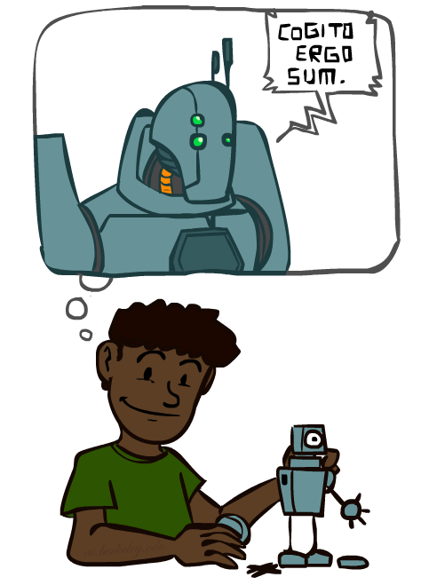
A (Short) History of AI
1940-1950: Early days
1943: McCulloch & Pitts: Boolean circuit model of brain
1950: Turing's “Computing Machinery and Intelligence”
1950—70: Excitement: Look, Ma, no hands!
1950s: Early AI programs, including Samuel's checkers program, Newell & Simon's Logic Theorist, Gelernter's Geometry Engine
1956: Dartmouth meeting: “Artificial Intelligence” adopted
1965: Robinson's complete algorithm for logical reasoning
1970—90: Knowledge-based approaches
1969—79: Early development of knowledge-based systems
1980—88: Expert systems industry booms
1988—93: Expert systems industry busts: “AI Winter”
1990—: Statistical approaches
Resurgence of probability, focus on uncertainty
General increase in technical depth
Agents and learning systems… “AI Spring”?
2000—: Where are we now?
Notes:
Million dollar computer with less computation than your phone
MT was
‹#›

Slide 9
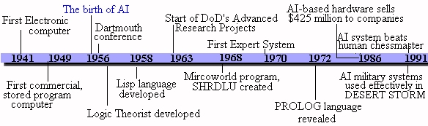
History
1997: Deep Blue beats Garry Kasparov (world champion)
1998: Founding of Google
2000: Interactive robot pets
2004: First DARPA Grand Challenge robot race
2004: Commercial recommender systems (TIVO, amazon.com)
2007: Checkers is solved!
2011: An AI named Watson beats the top Jeopardy! champions
2010: Google self-driving cars reach their 1000th mile

Slide 10

What Can AI Do?
Quiz: Which of the following can be done at present?
Play a decent game of table tennis?
Play a decent game of Jeopardy?
Drive safely along a curving mountain road?
Drive safely along Telegraph Avenue?
Buy a week's worth of groceries on the web?
Buy a week's worth of groceries at Berkeley Bowl?
Discover and prove a new mathematical theorem?
Converse successfully with another person for an hour?
Perform a surgical operation?
Put away the dishes and fold the laundry?
Translate spoken Chinese into spoken English in real time?
Write an intentionally funny story?

Slide 11
Eliza
ELIZA: A program that simulated a psychotherapist interacting with a patient and successfully passed the Turing Test.
Coded at MIT during 1964-1966 by Joel Weizenbaum.
First script was DOCTOR.
The script was a simple collection of syntactic patterns not unlike regular expressions
Each pattern had an associated reply which might include bits of the input (after simple transformations (my → your)
Weizenbaum was shocked at reactions:
Psychiatrists thought it had potential.
People unequivocally anthropomorphized.
Many thought it solved the NL problem.

Slide 12
Eliza
I am the psychotherapist. Please, describe your problems. Each time you are finished talking, type RET twice.
i'm having a hard time with my students
Why do you say that?
well, they keep asking me for money
Maybe your plans have something to do with this.
what plans?
Is it because of your life that you say what plans?
No, it's because I didn't know what you were talking about
Is it because you didn't know what I was talking about that you came to me?
no, it's because i wanted to see if you could pass the turing test
Does it bother you that you wanted to see if I could really pass the turing test?
…..
How do you reconcile problems at school?
This is a waste of time. Good bye
My secretary will send you a bill.
This is a transcript of a conversation with an Eliza-like program found in Emacs
Try typing
Meta-x doctor
in your favorite Emacs.

Slide 13
Colby’s PARRY
H: Good afternoon. My name is Doctor Jones.
P: Pleased to meet you.
H: How are you?
P: All right I guess.
H: Could you tell me your name?
P: Pat Smith.
H: I though you might have some problems.
P: I've been upset lately.
H: By what?
P: People get on my nerves sometimes.
H: Tell me more.
P: Do you know anything about bookies?
...
Kenneth Colby modeled a paranoid using the same techniques circa 1968.
PARRY has basic emotions. If it gets angry, its replies become more hostile.
In a Turing test, expert psychiatrists were unable to distinguish PARRY’s ramblings from those of real paranoids.

Slide 14
Parry Meets Eliza
Please tell me *this* isn't AI!
P: I don't understand your motives.
E: Why don't you understand my motives?
P: Shouldn't I be?
E: Why do you say that just now?
P: That's just the way it is.
E: Suppose that's the way it were not.
P: So?
E: I am not sure I understand you fully.
P: You harp on the same questions too much.
E: What does that similarity suggest to you?
P: I don't get you.
E: Do you wish that you did get I?

Slide 15
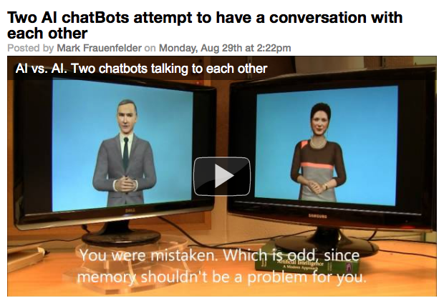
We’ve Come a Long Way (or have we?...)

Slide 16
Big Questions
Can machines think?
If so, how?
If not, why not?
What does this say about human beings?
What does this say about the mind?

Slide 17
What’s Easy and What’s Hard?
It’s been easier to mechanize many of the high-level tasks we usually associate with “intelligence” in people
e.g., symbolic integration, proving theorems, playing chess, medical diagnosis
It’s been very hard to mechanize tasks that lots of animals can do
walking around without running into things
catching prey and avoiding predators
interpreting complex sensory information (e.g., visual, aural, …)
modeling the internal states of other animals from their behavior
working as a team (e.g., with pack animals)
Is there a fundamental difference between the two categories?

Slide 18
Turing Test
Three rooms contain a person, a computer, and an interrogator.
The interrogator can communicate with the other two by teleprinter.
The interrogator tries to determine which is the person and which is the machine.
The machine tries to fool the interrogator into believing that it is the person.
If the machine succeeds, then we conclude that the machine can think.

Slide 19
The Loebner Contest
A modern version of the Turing Test, held annually, with a $100,000 cash prize.
Hugh Loebner was once director of UMBC’s Academic Computing Services (née UCS)
http://www.loebner.net/Prizef/loebner-prize.html
Restricted topic (removed in 1995) and limited time.
Participants include a set of humans and a set of computers and a set of judges.
Scoring
Rank from least human to most human.
Highest median rank wins $2000.
If better than a human, win $100,000. (Nobody yet…)

Slide 20
What Can AI Systems Do?
Here are some example applications
Computer vision: face recognition from a large set
Robotics: autonomous (mostly) automobile
Natural language processing: simple machine translation
Expert systems: medical diagnosis in a narrow domain
Spoken language systems: ~1000 word continuous speech
Planning and scheduling: Hubble Telescope experiments
Learning: text categorization into ~1000 topics
User modeling: Bayesian reasoning in Windows help (the infamous paper clip…)
Games: Grand Master level in chess (world champion), perfect play in checkers, professional-level Go players

Slide 21
What Can’t AI Systems Do Yet?
Understand natural language robustly (e.g., read and understand articles in a newspaper)
Surf the web
Interpret an arbitrary visual scene
Learn a natural language
Play Go as well as the best human players
Construct plans in dynamic real-time domains
Refocus attention in complex environments
Perform life-long learning
Exhibit true autonomy and intelligence!

Slide 22











Who Does AI?
Academic researchers (perhaps the most Ph.D.-generating area of computer science in recent years)
Some of the top AI schools: CMU, Stanford, Berkeley, MIT, UIUC, UMd, U Alberta, UT Austin, ... (and, of course, UMBC!)
Government and private research labs
NASA, NRL, NIST, IBM, AT&T, SRI, ISI, MERL, ...
Lots of companies!
Google, Microsoft, Honeywell, Teknowledge, SAIC, MITRE, Fujitsu, Global InfoTek, BodyMedia, ...

Slide 23
Representation
Causality
Constraints
Description Logics
Knowledge Representation
Ontologies and Foundations

Slide 24
Reasoning
Automated Reasoning
Belief Revision and Update
Diagnosis
Nonmonotonic Reasoning
Probabilistic Inference
Qualitative Reasoning
Reasoning about Actions and Change
Resource-Bounded Reasoning
Satisfiability
Spatial Reasoning
Temporal Reasoning

Slide 25
Behavior
Case-Based Reasoning
Cognitive Modeling
Decision Theory
Learning
Planning
Probabilistic Planning
Scheduling
Search

Slide 26
Interaction
Cognitive Robotics
Multi-agent Systems
Natural Language
Perception
Robotics
User Modeling
Vision

Slide 27
Robotics
SRI: Shakey / planning ..\movies\sri-Shakey.ram
SRI: Flakey / planning & control ..\..\movies\sri-Flakey.ram
UMass: Thing / learning & control ..\movies\..\movies\umass_thing_irreg.mpeg ..\movies\..\movies\umass_thing_quest.mpeg ..\..\movies\umass-can-roll.mpeg
MIT: Cog / reactive behavior ..\movies\mit-cog-saw-30.mov ..\movies\mit-cog-drum-close-15.mov
MIT: Kismet / affect & interaction ..\..\movies\mit-kismet.mov ..\..\movies\mit-kismet-expressions-dl.mov
CMU: RoboCup Soccer / teamwork & coordination ..\movies\cmu_vs_gatech.mpeg

Slide 28
Applications
AI and Data Integration
AI and the Internet
Art and Creativity
Information Extraction
A sample from IAAI-03:
Scheduling train crews
Automated student essay evaluation
Packet scheduling in network routers
Broadcast news understanding
Vehicle diagnosis
Robot photography
Relational pattern matching

Slide 29
Other Topics/Paradigms
Intelligent tutoring systems
Agent architectures
Mixed-initiative systems
Embedded systems / mobile autonomous agents
Machine translation
Statistical natural language processing
Object-oriented software engineering / software reuse

Slide 30
Applications

Slide 31
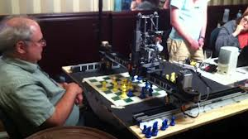
Game Playing
‹#›

Slide 32
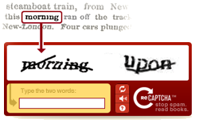
Text/Sketch Recognition
‹#›

Slide 33

User Modeling/Recommender Systems
mission to make language education free and accessible to everyone.
‹#›

Slide 34

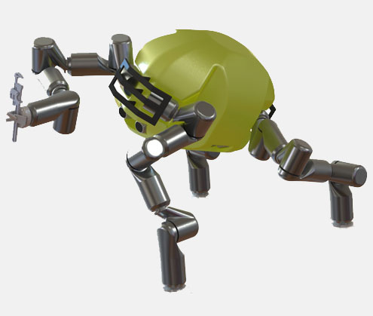
Robotics
‹#›

Slide 35

Knowledge Representation
Watson
Watson is a highly intelligent question answering computer system capable of processing questions posed in natural language.
‹#›
‹#›

Slide 36


Evolutionary Art
Evolutionary art is a branch of generative art, in which the artist does not do the work of constructing the art work, but rather lets a system do the construction
Electric Sheep is a distributed computingElectric Sheep is a distributed computing project for animating and evolving fractal flames
‹#›

Slide 37
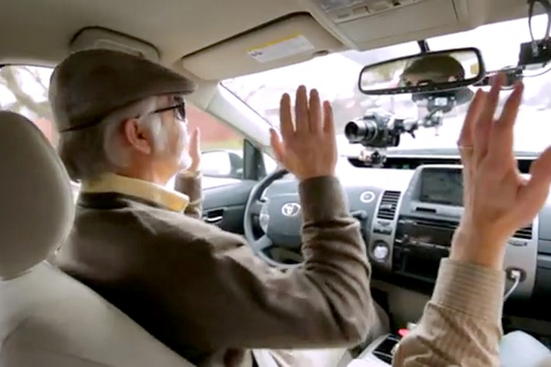
Computer Vision
‹#›

Slide 38
Possible Approaches
Like humans
Well
Rational
agents
Think
GPS
AI tends to work mostly in this area
Act
Heuristic
systems
Eliza

Slide 39
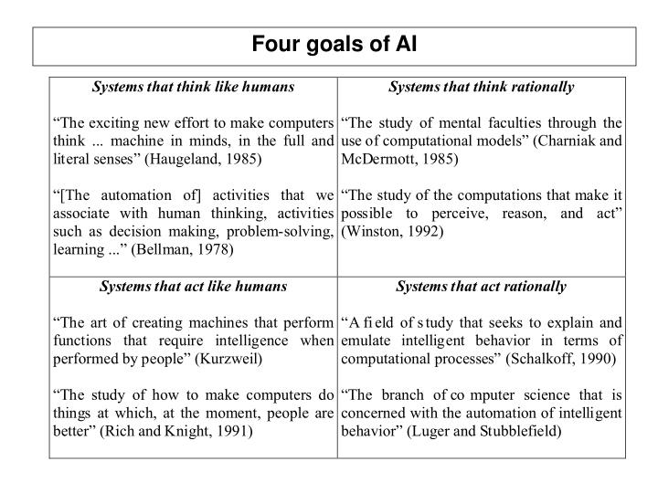

Slide 40
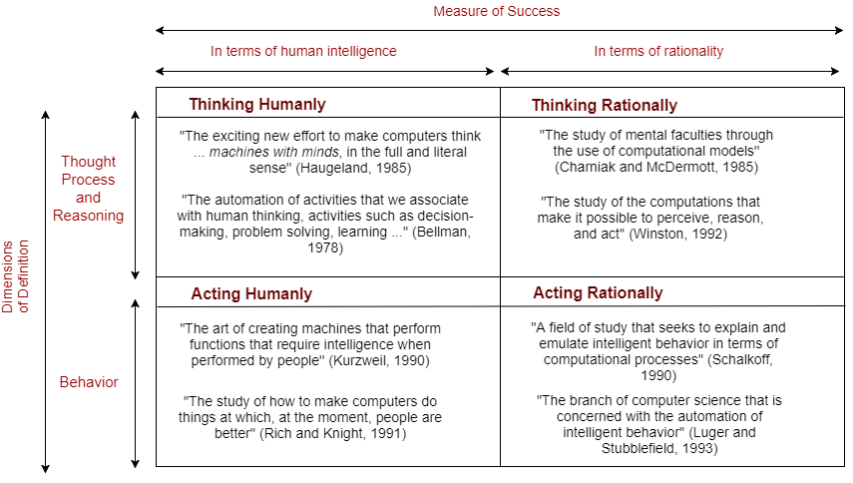

Slide 41
Think Well
Like humans
Well
Think
GPS
Rational
agents
Develop formal models of knowledge representation, reasoning, learning, memory, and problem solving, that can be rendered in algorithms.
There is often an emphasis on systems that are provably correct, and guarantee finding an optimal solution.
Act
Eliza
Heuristic
systems

Slide 42
Act Well
Like humans
Well
Think
GPS
Rational
agents
For a given set of inputs, generate an appropriate output that is not necessarily correct but gets the job done.
A heuristic (heuristic rule, heuristic method) is a rule of thumb, strategy, trick, simplification, or any other kind of device which drastically limits search for solutions in large problem spaces.
Heuristics do not guarantee optimal solutions; in fact, they do not guarantee any solution at all: all that can be said for a useful heuristic is that it offers solutions which are good enough most of the time. – Feigenbaum and Feldman, 1963, p. 6
Act
Eliza
Heuristic
systems

Slide 43
Think Like Humans
Like humans
Well
Think
GPS
Rational
agents
Cognitive science approach
Focus not just on behavior and I/O but also look at reasoning process.
Computational model should reflect “how” results were obtained.
Provide a new language for expressing cognitive theories and new mechanisms for evaluating them
GPS (General Problem Solver): Goal not just to produce humanlike behavior (like ELIZA), but to produce a sequence of steps of the reasoning process that was similar to the steps followed by a person in solving the same task.
Act
Eliza
Heuristic
systems

Slide 44
Act Like Humans
Like humans
Well
Think
GPS
Rational
agents
Behaviorist approach.
Not interested in how you get results, just the similarity to what human results are.
Exemplified by the Turing Test (Alan Turing, 1950).
Act
Eliza
Heuristic
systems

Slide 45
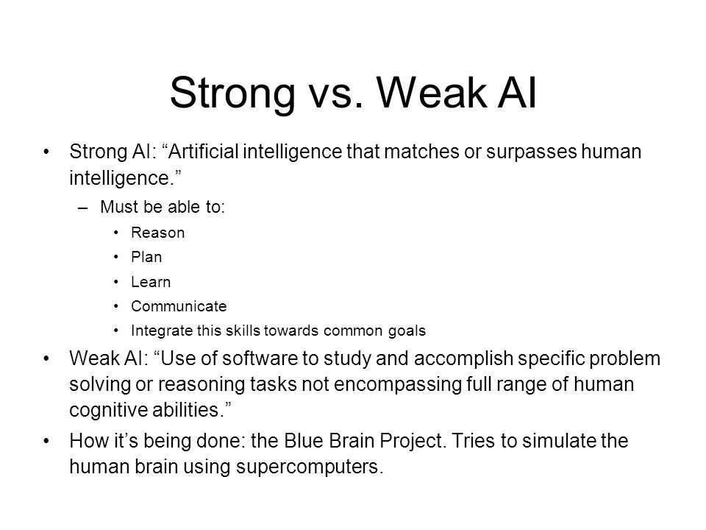

Slide 46
Possible Questions
Purpose of Turing Test, Lubner test
Heuristic System
Act well
What AI can do/cant do yet
What are reasoning areas in which AI are used?
Strong vs Weak AI
So on ….

Slide 47
Thanks!

