Slide 1
AMERICAN BARBER INSTITUTE · TEN VISIONS
One brand. Ten distinct websites.
Ten production-ready website concepts for ABI — NYC's only dedicated barber school. Each with its own visual identity. Built on the same real content. Deployed independently.
Mobile-first · SEO + JSON-LD · Multi-page · abi-app-1 → abi-app-10.vercel.app

Slide 2
AT A GLANCE
Ten unique deployments
01
02
03
04
05
Neon Blade
Chrome Culture
Aurora Fade
Midnight HUD
Barber Prime
Cyberpunk · Neon Blade
Liquid Metal · Brutalism
Light Holographic Shader
Tactical Sci-Fi Interface
Black + Gold · 3D Pole
abi-app-1.vercel.app
abi-app-2.vercel.app
abi-app-3.vercel.app
abi-app-4.vercel.app
abi-app-5.vercel.app
06
07
08
09
10
Neon Grid
Chrome Liquid
Holographic
Noir Gold
Vapor Retro
Particle Network · Glitch
Brutalist · Chrome Orb
Iridescent Glass · Ring
Cinematic Luxe · Spotlight
Synthwave · 3D Grid Sun
abi-app-6.vercel.app
abi-app-7.vercel.app
abi-app-8.vercel.app
abi-app-9.vercel.app
abi-app-10.vercel.app

Slide 3
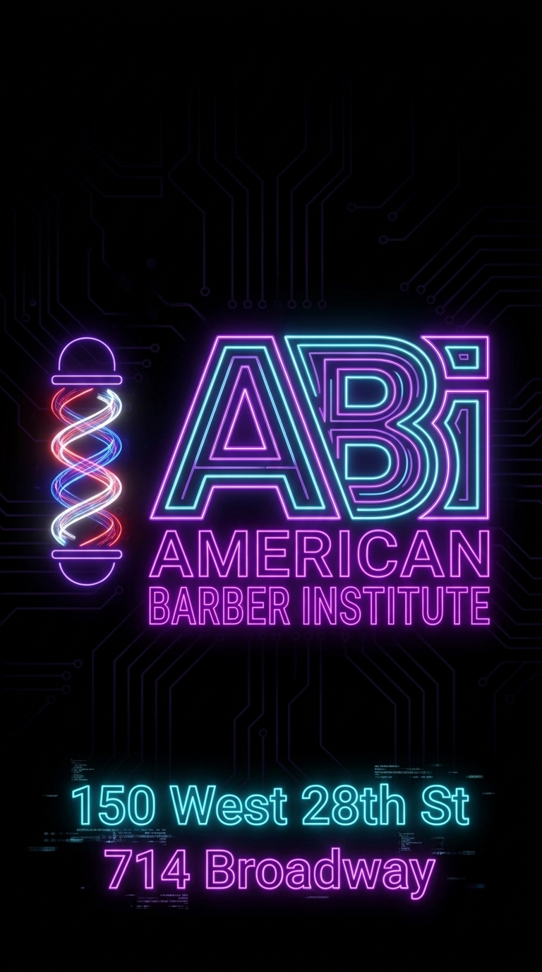
CONCEPT 01/10
Concept signature
Cyberpunk WebGL training experience for the future of barbering.
Tagline variant
"Cut Bold. Cut Brave. Cut Now."
Pages
Neon Blade
• Home — hero, programs, careers, reviews, tuition, locations, FAQ • Programs — every program, schedule, tuition plan • Gallery — 30+ photos from the clinic floor • FAQ — 15 questions with full answers (JSON-LD) • Contact — both campuses + lead form
Cyberpunk · Neon Blade
abi-app-1.vercel.app
Mobile-first • Hamburger nav • SEO meta + OpenGraph • Sitemap + robots • CDN-backed assets

Slide 4
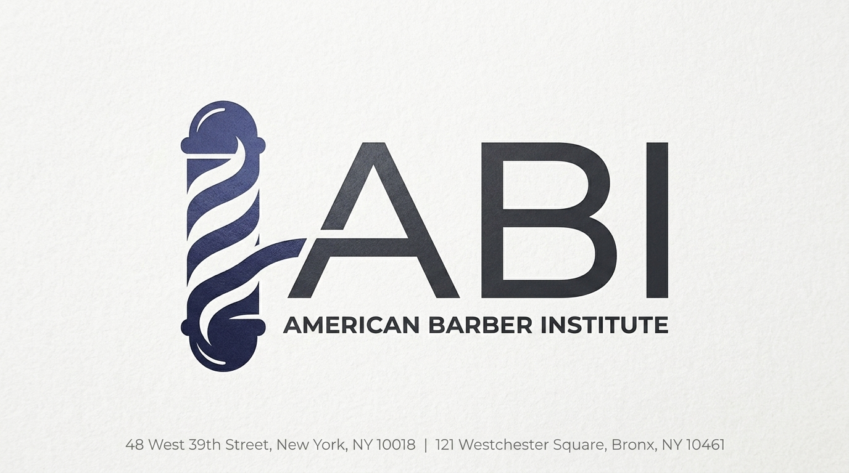
CONCEPT 02/10
Concept signature
Liquid-metal brutalism for the next generation of master barbers.
Tagline variant
"Forge Your Craft. Polish Your Future."
Pages
Chrome Culture
• Home — hero, programs, careers, reviews, tuition, locations, FAQ • Programs — every program, schedule, tuition plan • Gallery — 30+ photos from the clinic floor • FAQ — 15 questions with full answers (JSON-LD) • Contact — both campuses + lead form
Liquid Metal · Brutalism
abi-app-2.vercel.app
Mobile-first • Hamburger nav • SEO meta + OpenGraph • Sitemap + robots • CDN-backed assets

Slide 5

CONCEPT 03/10
Concept signature
Light, holographic experience for an inspired new barbering career.
Tagline variant
"Where Light Meets Skill."
Pages
Aurora Fade
• Home — hero, programs, careers, reviews, tuition, locations, FAQ • Programs — every program, schedule, tuition plan • Gallery — 30+ photos from the clinic floor • FAQ — 15 questions with full answers (JSON-LD) • Contact — both campuses + lead form
Light Holographic Shader
abi-app-3.vercel.app
Mobile-first • Hamburger nav • SEO meta + OpenGraph • Sitemap + robots • CDN-backed assets

Slide 6
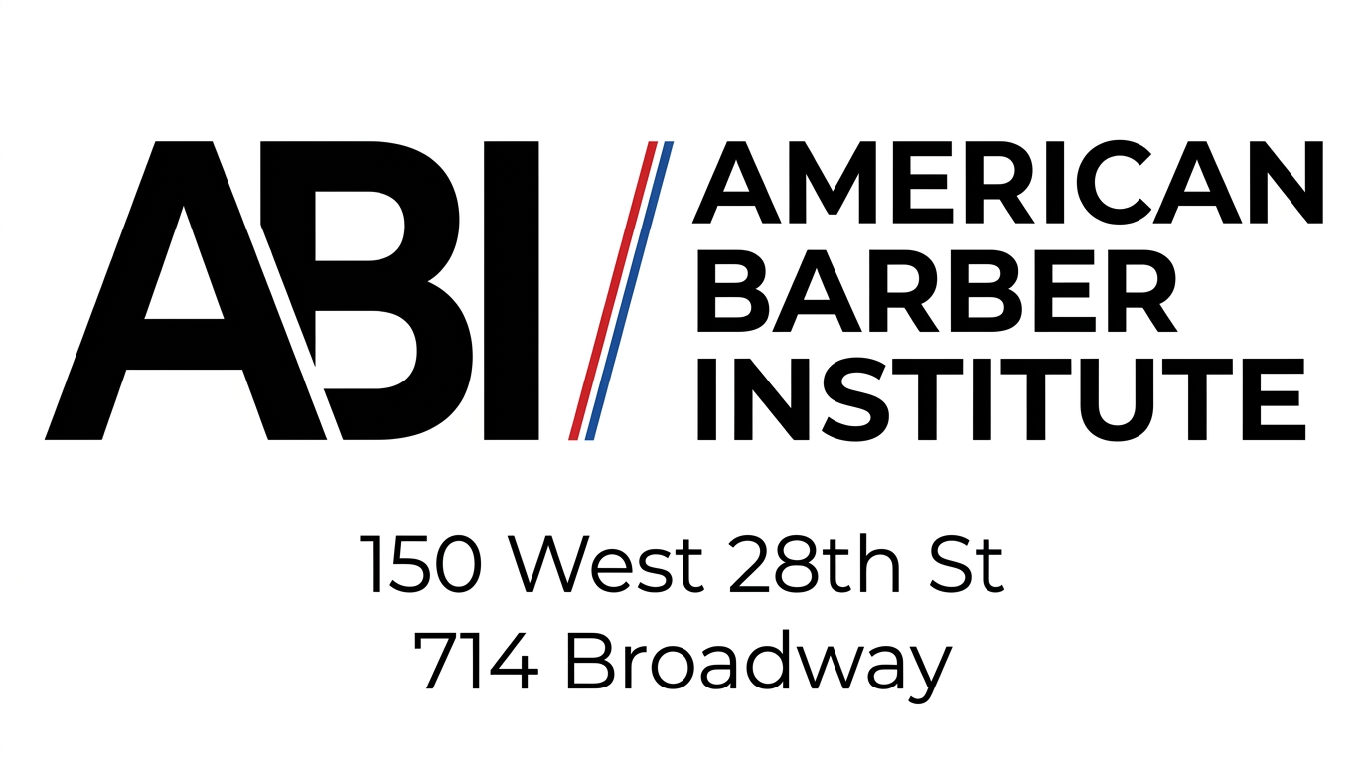
CONCEPT 04/10
Concept signature
Tactical sci-fi HUD experience — train like the operator you are.
Tagline variant
"Lock In. Train Sharp. Operate."
Pages
Midnight HUD
• Home — hero, programs, careers, reviews, tuition, locations, FAQ • Programs — every program, schedule, tuition plan • Gallery — 30+ photos from the clinic floor • FAQ — 15 questions with full answers (JSON-LD) • Contact — both campuses + lead form
Tactical Sci-Fi Interface
abi-app-4.vercel.app
Mobile-first • Hamburger nav • SEO meta + OpenGraph • Sitemap + robots • CDN-backed assets

Slide 7
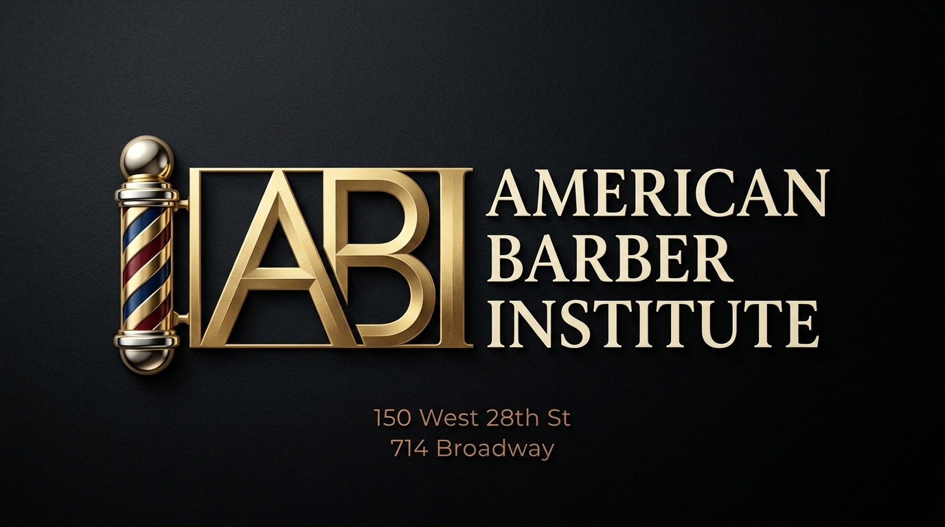
CONCEPT 05/10
Concept signature
Black and gold luxury barbering — the prime cut of barber schools in NYC.
Tagline variant
"Prime Craft. Prime Career."
Pages
Barber Prime
• Home — hero, programs, careers, reviews, tuition, locations, FAQ • Programs — every program, schedule, tuition plan • Gallery — 30+ photos from the clinic floor • FAQ — 15 questions with full answers (JSON-LD) • Contact — both campuses + lead form
Black + Gold · 3D Pole
abi-app-5.vercel.app
Mobile-first • Hamburger nav • SEO meta + OpenGraph • Sitemap + robots • CDN-backed assets

Slide 8

CONCEPT 06/10
Concept signature
Particle-network barbering education — learn the craft on a digital floor.
Tagline variant
"On The Grid. On Your Grind."
Pages
Neon Grid
• Home — hero, programs, careers, reviews, tuition, locations, FAQ • Programs — every program, schedule, tuition plan • Gallery — 30+ photos from the clinic floor • FAQ — 15 questions with full answers (JSON-LD) • Contact — both campuses + lead form
Particle Network · Glitch
abi-app-6.vercel.app
Mobile-first • Hamburger nav • SEO meta + OpenGraph • Sitemap + robots • CDN-backed assets

Slide 9
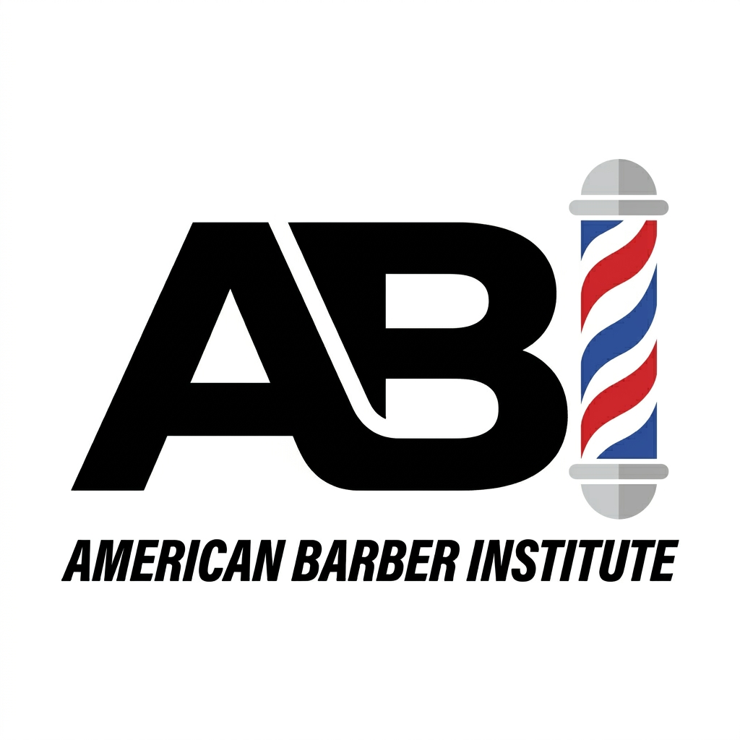
CONCEPT 07/10
Concept signature
Brutalist chrome experience for the bold barber-in-training.
Tagline variant
"Pure Form. Pure Skill."
Pages
Chrome Liquid
• Home — hero, programs, careers, reviews, tuition, locations, FAQ • Programs — every program, schedule, tuition plan • Gallery — 30+ photos from the clinic floor • FAQ — 15 questions with full answers (JSON-LD) • Contact — both campuses + lead form
Brutalist · Chrome Orb
abi-app-7.vercel.app
Mobile-first • Hamburger nav • SEO meta + OpenGraph • Sitemap + robots • CDN-backed assets

Slide 10

CONCEPT 08/10
Concept signature
Iridescent, holographic barber experience — see your future through every fade.
Tagline variant
"Iridescent. Inspired. In Demand."
Pages
Holographic
• Home — hero, programs, careers, reviews, tuition, locations, FAQ • Programs — every program, schedule, tuition plan • Gallery — 30+ photos from the clinic floor • FAQ — 15 questions with full answers (JSON-LD) • Contact — both campuses + lead form
Iridescent Glass · Ring
abi-app-8.vercel.app
Mobile-first • Hamburger nav • SEO meta + OpenGraph • Sitemap + robots • CDN-backed assets

Slide 11
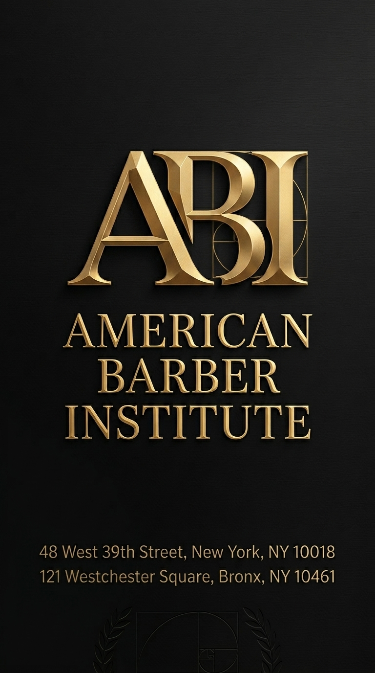
CONCEPT 09/10
Concept signature
Cinematic noir + gold luxe experience — barbering as cinema.
Tagline variant
"Cinematic. Confident. Cut."
Pages
Noir Gold
• Home — hero, programs, careers, reviews, tuition, locations, FAQ • Programs — every program, schedule, tuition plan • Gallery — 30+ photos from the clinic floor • FAQ — 15 questions with full answers (JSON-LD) • Contact — both campuses + lead form
Cinematic Luxe · Spotlight
abi-app-9.vercel.app
Mobile-first • Hamburger nav • SEO meta + OpenGraph • Sitemap + robots • CDN-backed assets

Slide 12
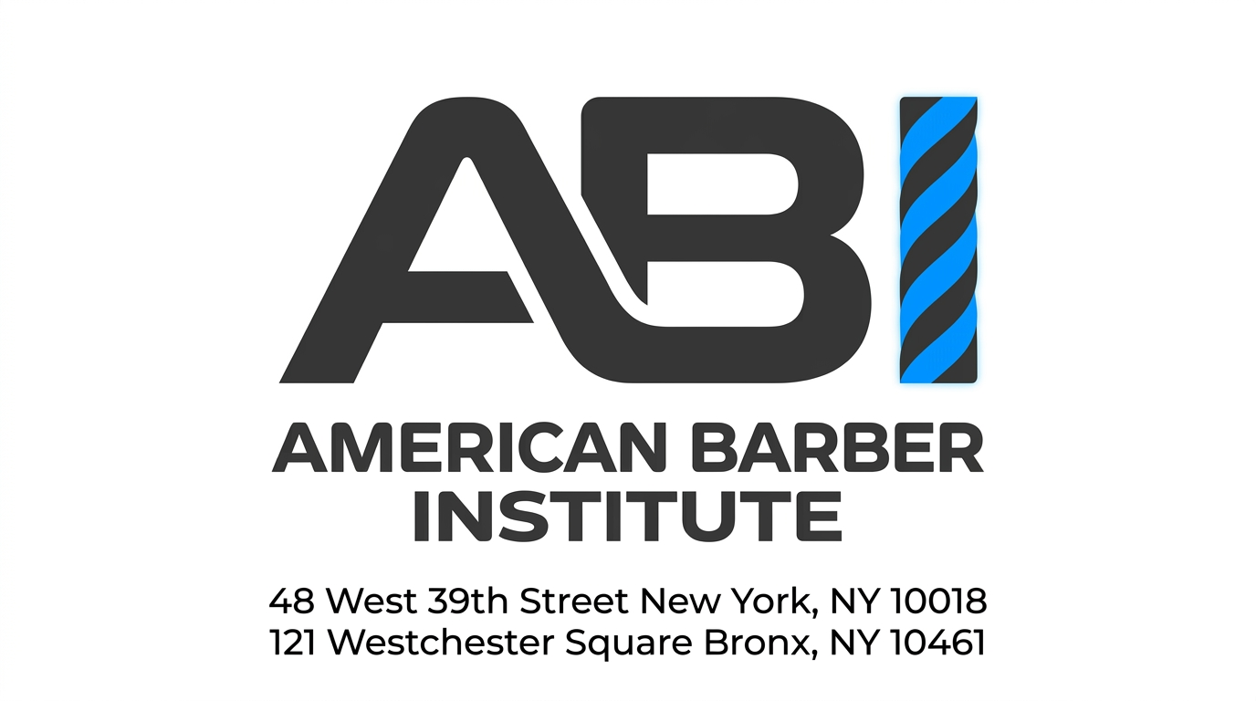
CONCEPT 10/10
Concept signature
Synthwave retro experience for the barber who wants to stand out.
Tagline variant
"Old-School Soul. New-Wave Cuts."
Pages
Vapor Retro
• Home — hero, programs, careers, reviews, tuition, locations, FAQ • Programs — every program, schedule, tuition plan • Gallery — 30+ photos from the clinic floor • FAQ — 15 questions with full answers (JSON-LD) • Contact — both campuses + lead form
Synthwave · 3D Grid Sun
abi-app-10.vercel.app
Mobile-first • Hamburger nav • SEO meta + OpenGraph • Sitemap + robots • CDN-backed assets

Slide 13
ALL LIVE URLS
Ten sites. One naming pattern.
abi-app-N.vercel.app — change N from 1 to 10.
01.
Neon Blade
06.
Neon Grid
https://abi-app-1.vercel.app
https://abi-app-6.vercel.app
02.
Chrome Culture
07.
Chrome Liquid
https://abi-app-2.vercel.app
https://abi-app-7.vercel.app
03.
Aurora Fade
08.
Holographic
https://abi-app-3.vercel.app
https://abi-app-8.vercel.app
04.
Midnight HUD
09.
Noir Gold
https://abi-app-4.vercel.app
https://abi-app-9.vercel.app
05.
Barber Prime
10.
Vapor Retro
https://abi-app-5.vercel.app
https://abi-app-10.vercel.app
Repo: github.com/kazi-reprime/ABI-10-Websites · Assets CDN: abi-assets.vercel.app

