Slide 1

Network Layer:
Internet Protocol

Slide 2
INTERNETWORKING
Here we discuss internetworking, connecting networks together to make an internetwork or an internet.
Topics :
Need for Network Layer
Internet as a Datagram Network
Internet as a Connectionless Network

Slide 3
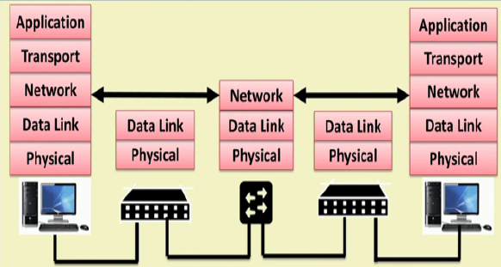
Layers and Links between two hosts

Slide 4

Figure Links between two hosts

Slide 5

Figure Network layer in an internetwork

Slide 6

Figure Network layer at the source, router, and destination

Slide 7

Figure Network layer at the source, router, and destination (continued)

Slide 8
Switching at the network layer in the Internet uses the datagram approach to packet switching.

Slide 9
Communication at the network layer in the Internet is connectionless.

Slide 10
IPv4
The Internet Protocol version 4 (IPv4) is the delivery mechanism used by the TCP/IP protocols.
Topics :
Datagram
Fragmentation
Checksum
Options

Slide 11
The Internet has chosen the datagram approach to switching in the network layer. It uses the universal addresses defined in the network layer to route packets from the source to the destination.

Slide 12
Datagram
Packets in the IPv4 layer are called datagrams. Figure shows the IPv4 datagram format.

Slide 13

Figure Position of IPv4 in TCP/IP protocol suite

Slide 14

Figure IPv4 datagram format

Slide 15
Figure Service type or differentiated services
Version (VER). This 4-bit field defines the version of the IPv4 protocol. Currently the version is 4. However, version 6 (or IPng) may totally replace version 4 in the future.
Header length (HLEN). This 4-bit field defines the total length of the datagram header in 4-byte words. This field is needed because the length of the header is variable (between 20 and 60 bytes).
Services. IETF has changed the interpretation and name of this 8-bit field. This field, previously called service type, is now called differentiated services.

Slide 16
Services
1. Service Type. In this interpretation, the first 3 bits are called precedence bits. The next 4 bits are called type of service (TOS) bits, and the last bit is not used.

Slide 17
Service type
Precedence is a 3-bit subfield ranging from 0 (000 in binary) to 7 (111 in binary). The precedence defines the priority of the datagram in issues such as congestion. If a router is congested and needs to discard some datagrams, those datagrams with lowest precedence are discarded first.
TOS bits is a 4-bit subfield with each bit having a special meaning. Although a bit can be either 0 or 1, one and only one of the bits can have the value of 1 in each datagram. The bit patterns and their interpretations are given in Table.

Slide 18
The precedence subfield was part of version 4, but never used.

Slide 19

Figure Service type or differentiated services

Slide 20
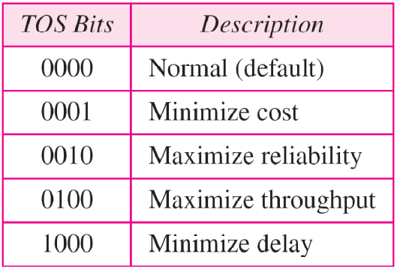
Table Types of service
Application programs can request a specific type of service. The defaults for some applications are shown in Table next

Slide 21

Table Default types of service

Slide 22
Services
Differentiated Services: In this interpretation, the first 6 bits make up the codepoint subfield, and the last 2 bits are not used. The codepoint subfield can be used in two different ways.
  When the 3 rightmost bits are 0s, the 3 leftmost bits are interpreted the same as the precedence bits in the service type interpretation. In other words, it is compatible with the old interpretation.
  When the 3 rightmost bits are not all 0s, the 6 bits define 64 services based on the priority assignment by the Internet or local authorities according to Table . The first category contains 32 service types; the second and the third each contain 16. (cont. to nex slide)

Slide 23
Differentiated Services
b. (cont. prev slide) The first category (numbers 0, 2, 4, ... ,62) is assigned by the Internet authorities (IETF). The second category (3, 7, 11, 15, , 63) can be used by local authorities (organizations). The third category (1, 5, 9, ,61) is temporary and can be used for experimental purposes.

Slide 24
Figure IPv4 datagram format

Slide 25
Total length. This is a In-bit field that defines the total length (header plus data) of the IPv4 datagram in bytes.
The total length field defines the total length of the datagram including the header.

Slide 26

Figure Encapsulation of a small datagram in an Ethernet frame
23

Slide 27

Protocol. This 8-bit field defines the higher-level protocol that uses the services of the IPv4 layer. An IPv4 datagram can encapsulate data from several higher-level protocols such as TCP, UDP, ICMP, and IGMP.
Figure Protocol field and encapsulated data

Slide 28

Table Protocol values

Slide 29
Example
An IPv4 packet has arrived with the first 8 bits as shown:
01000010
The receiver discards the packet. Why?
Solution
There is an error in this packet. The 4 leftmost bits (0100) show the version, which is correct. The next 4 bits (0010) show an invalid header length (2 × 4 = 8). The minimum number of bytes in the header must be 20. The packet has been corrupted in transmission.

Slide 30
Example
In an IPv4 packet, the value of HLEN is 1000 in binary. How many bytes of options are being carried by this packet?
Solution
The HLEN value is 8, which means the total number of bytes in the header is 8 × 4, or 32 bytes. The first 20 bytes are the base header, the next 12 bytes are the options.

Slide 31
Example
In an IPv4 packet, the value of HLEN is 5, and the value of the total length field is 0x0028. How many bytes of data are being carried by this packet?
Solution
The HLEN value is 5, which means the total number of bytes in the header is 5 × 4, or 20 bytes (no options). The total length is 40 bytes, which means the packet is carrying 20 bytes of data (40 − 20).

Slide 32
Cont.
Checksum. The checksum concept and its calculation.
Source address. This 32-bit field defines the IPv4 address of the source. This field must remain unchanged during the time the IPv4 datagram travels from the source host to the destination host.
Destination address. This 32-bit field defines the IPv4 address of the destination. This field must remain unchanged during the time the IPv4 datagram travels from the source host to the destination host.

Slide 33
Example
An IPv4 packet has arrived with the first few hexadecimal digits as shown.
0x45000028000100000102 . . .
How many hops can this packet travel before being dropped? The data belong to what upper-layer protocol?
Solution
To find the time-to-live field, we skip 8 bytes. The time-to-live field is the ninth byte, which is 01. This means the packet can travel only one hop. The protocol field is the next byte (02), which means that the upper-layer protocol is IGMP.

Slide 34
Figure IPv4 datagram format

Slide 35
Identification. This 16-bit field identifies a datagram originating from the source host. The combination of the identification and source IPv4 address must uniquely define a datagram as it leaves the source host.

Slide 36

Flags. This is a 3-bit field.
The first bit is reserved.
The second bit is called the do notfragment bit. If its value is 1, the machine must not fragment the datagram. If it cannot pass the datagram through any available physical network, it discards the datagram and sends an ICMP error message to the source host .
If its value is 0, the datagram can be fragmented if necessary.
The third bit is called the more fragment bit. If its value is 1, it means the datagram is not the last fragment; there are more fragments after this one. If its value is 0, it means this is the last or only fragment.

Slide 37
Fragmentation offset. This 13-bit field shows the relative position of this fragment with respect to the whole datagram. It is the offset of the data in the original datagram measured in units of 8 bytes.

Slide 38
Fragmentation
A datagram can travel through different networks. Each router decapsulates the IPv4 datagram from the frame it receives, processes it, and then encapsulates it in another frame.
Maximum Transfer Unit (MTU)
Each data link layer protocol has its own frame format in most protocols. One of the fields defined in the format is the maximum size of the data field.
To make the IPv4 protocol independent of the physical network, the designers decided to make the maximum length of the IPv4 datagram equal to 65,535 bytes.

Slide 39

Figure Maximum transfer unit (MTU)

Slide 40

Table MTUs for some networks
20.<number>

Slide 41
Figure Flags used in fragmentation

Slide 42

Figure Fragmentation example
Original datagram are numbered 0 to 3999.

Slide 43

Figure Detailed fragmentation example

Slide 44
Example
A packet has arrived with an M bit value of 0. Is this the first fragment, the last fragment, or a middle fragment? Do we know if the packet was fragmented?
Solution
If the M bit is 0, it means that there are no more fragments; the fragment is the last one. However, we cannot say if the original packet was fragmented or not. A non-fragmented packet is considered the last fragment.

Slide 45
Example
A packet has arrived with an M bit value of 1. Is this the first fragment, the last fragment, or a middle fragment? Do we know if the packet was fragmented?
Solution
If the M bit is 1, it means that there is at least one more fragment. This fragment can be the first one or a middle one, but not the last one. We don’t know if it is the first one or a middle one; we need more information (the value of the fragmentation offset).

Slide 46
Example
A packet has arrived with an M bit value of 1 and a fragmentation offset value of 0. Is this the first fragment, the last fragment, or a middle fragment?
Solution
Because the M bit is 1, it is either the first fragment or a middle one. Because the offset value is 0, it is the first fragment.
20.<number>

Slide 47
Example
A packet has arrived in which the offset value is 100. What is the number of the first byte? Do we know the number of the last byte?
Solution
To find the number of the first byte, we multiply the offset value by 8. This means that the first byte number is 800. We cannot determine the number of the last byte unless we know the length.

Slide 48
Example
A packet has arrived in which the offset value is 100, the value of HLEN is 5, and the value of the total length field is 100. What are the numbers of the first byte and the last byte?
Solution
The first byte number is 100 × 8 = 800. The total length is 100 bytes, and the header length is 20 bytes (5 × 4), which means that there are 80 bytes in this datagram. If the first byte number is 800, the last byte number must be 879.

Slide 49
Checksum. Then the entire header is divided into 16-bit sections and added together. The result (sum) is complemented and inserted into the
checksum field. The checksum in the IPv4 packet covers only the header, not the data.
Options. The header of the IPv4 datagram is made of two parts: a fixed part and a variable part. The fixed part is 20 bytes long and was discussed in the previously. The variable part comprises the options that can be a maximum of 40 bytes.
Options, as the name implies, are not required for a datagram. They can be used for network testing and debugging.
No Operation. A no-operation option is a 1-byte option used as a filler between options.

Slide 50
End of Option. An end-of-option option is a 1-byte option used for padding at the end of the option field. It, however, can only be used as the last option.
Record Route. A record route option is used to record the Internet routers that handle the datagram. It can list up to nine router addresses. It can be used for debugging and management purposes.
Strict Source Route. A strict source route option is used by the source to predetermine a route for the datagram as it travels through the Internet.
Loose Source Route. A loose source route option is similar to the strict source route, but it is less rigid.
Timestamp. A timestamp option is used to record the time of datagram processing by a router. The time is expressed in milliseconds from midnight, Universal time or Greenwich mean time. Knowing the time a datagram is processed can help users and managers track the behavior of the routers in the Internet.

Slide 51
Example
Figure shows an example of a checksum calculation for an IPv4 header without options. The header is divided into 16-bit sections. All the sections are added and the sum is complemented. The result is inserted in the checksum field.

Slide 52

Figure Example of checksum calculation in IPv4

Slide 53

Figure Taxonomy of options in IPv4

Slide 54
IPv6
The network layer protocol in the TCP/IP protocol suite is currently IPv4. Although IPv4 is well designed, data communication has evolved since the inception of IPv4 in the 1970s. IPv4 has some deficiencies that make it unsuitable for the fast-growing Internet.
Topics:
Advantages
Packet Format
Extension Headers

Slide 55
IPv6
Despite all short-term solutions, such as subnetting, classless addressing, and NAT, address depletion is still a long-term problem in the Internet.
The Internet must accommodate real-time audio and video transmission. This type of transmission requires minimum delay strategies and reservation of resources not provided in the IPv4 design.
The Internet must accommodate encryption and authentication of data for some applications. No encryption or authentication is provided by IPv4.
Topics:
Advantages
Packet Format
Extension Headers

Slide 56

Figure IPv6 datagram header and payload

Slide 57

Figure Format of an IPv6 datagram

Slide 58
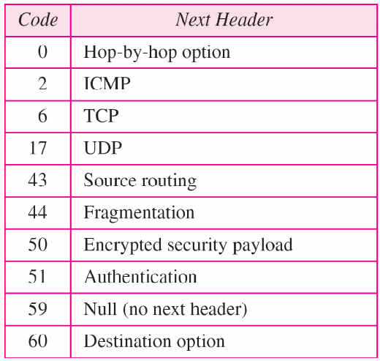
Table Next header codes for IPv6

Slide 59
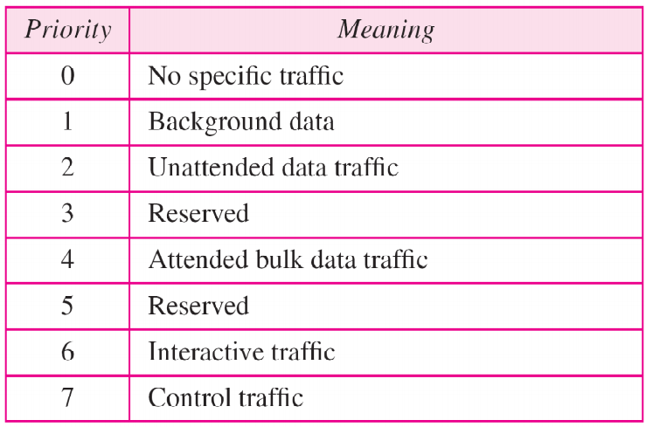
Table Priorities for congestion-controlled traffic

Slide 60
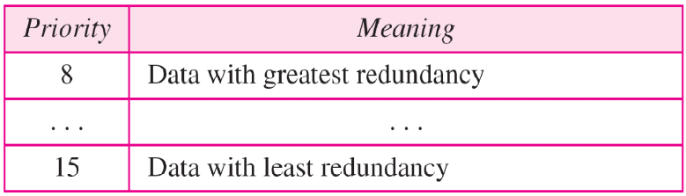
Table Priorities for noncongestion-controlled traffic

Slide 61

Table Comparison between IPv4 and IPv6 packet headers

Slide 62

Figure Extension header types

Slide 63
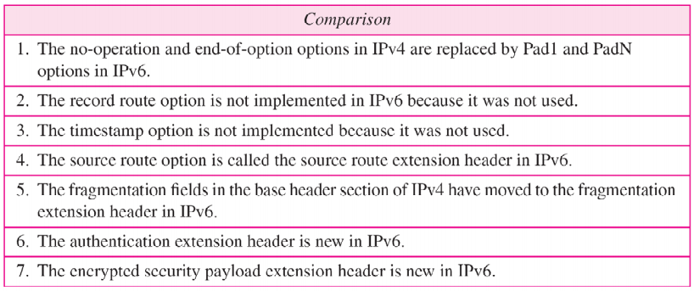
Table Comparison between IPv4 options and IPv6 extension headers

Slide 64
TRANSITION FROM IPv4 TO IPv6
Because of the huge number of systems on the Internet, the transition from IPv4 to IPv6 cannot happen suddenly. It takes a considerable amount of time before every system in the Internet can move from IPv4 to IPv6. The transition must be smooth to prevent any problems between IPv4 and IPv6 systems.
Topics
Dual Stack
Tunneling
Header Translation

Slide 65

Figure Three transition strategies

Slide 66

Figure Dual stack

Slide 67

Figure Tunneling strategy

Slide 68

Figure Header translation strategy

Slide 69
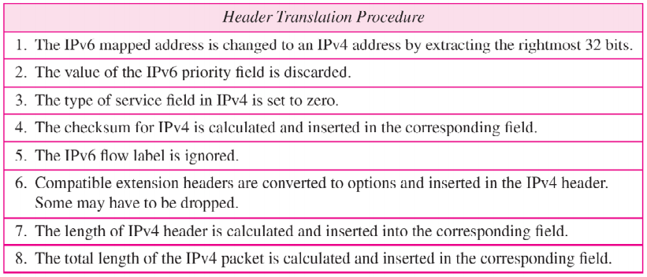
Table Header translation

