Slide 1
IP Addresses vs Net Address
IP address uniquely identify a device on an IP network.
Net address uniquely identify an IP network
192.168.1.10

Slide 2
Network Masks/ Subnet Mask
32 bit long address that distinguishes which portion of the address identifies the network and which portion of the address identifies the hosts
255.255.255.0

Slide 3
Network Masks/ Subnet Mask
In binary notation
• In binary notation subnet mask ON bit [ 1] represent
network address while OFF bit[0] represent host
address.
IP address
11000000.10101000.00000001.00001010
Subnet mask
11111111.11111111.11111111.00000000
• Network address is 11000000.10101000.00000001
and host address is 00001010

Slide 4
Network Masks/ Subnet Mask
In decimal notation
IP address 192.168.1.10
Subnet mask 255.255.255.0
• Network address is 192.168.1 and host address
is 10.
Default masks:
Class A: 255.0.0.0
Class B: 255.255.0.0
Class C: 255.255.255.0

Slide 5
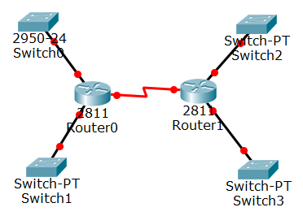
Subneting Scenario
Net-C
(29)
Net-A
(14)
192.168.10.0/24
Net-B
(55)
Net-D
(3)
You have 4 subnets with the following numbers of hosts: 58, 29, 14, 3 and the address is 192.168.10.0/24

Slide 6
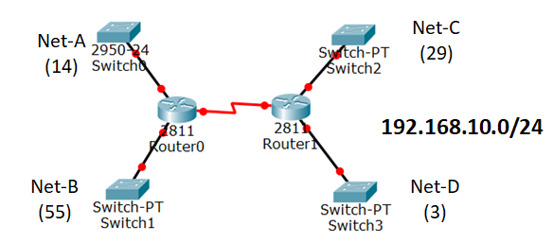
Subneting Scenario (FLSM)
Networks:
Net-A: 192.168.10.0/26 host address range 0 to 63 (64)
Net-B: 192.168.10.64/26 host address range 64 to 127(64)
Net-C: 192.168.10.128/26 host address range 1 to 191(64)
Net-D: 192.168.10.192/26 host address range 1 to 255(64)
Subnet mask
11111111.11111111.11111111.11000000
255 . 255 . 255 . 192

Slide 7
Subneting Scenario(VLSM)
Bits taken as net | 1 | 2 | 3 | 4 | 5 | 6 | 7 | 8
No of Host | 128 | 64 | 32 | 16 | 8 | 4 | 2 | 1
Subnet(4th Octet) | 128 | 192 | 224 | 240 | 248 | 252
We have 58, 29, 14, 3 Hosts
Net with max no of host 58. Smallest number larger than (58+2) is 64. So, 2 bits taken to net.
Add 2 bit with 24 bits of prefix
Net B is 192.168.10.0/26. Subnet is 255.255.255.192
Host range: 192.168.10.0-192.168.10.63

Slide 8
Subneting Scenario(VLSM)
Bits taken as net | 1 | 2 | 3 | 4 | 5 | 6 | 7 | 8
No of Host | 128 | 64 | 32 | 16 | 8 | 4 | 2 | 1
Subnet(4th Octet) | 128 | 192 | 224 | 240 | 248 | 252
We start the next net at 192.168.10.64
Now this block has 29 hosts and smallest number larger than (29+2) is 32. 3 bits taken to net
Add 3 bit with 24 bits of prefix
Net-C is 192.168.10.64/27 Subnet is 255.255.255.224
Host range: 192.168.10.64 -192.168.10.95

Slide 9
Subneting Scenario(VLSM)
Bits taken as net | 1 | 2 | 3 | 4 | 5 | 6 | 7 | 8
No of Host | 128 | 64 | 32 | 16 | 8 | 4 | 2 | 1
Subnet(4th Octet) | 128 | 192 | 224 | 240 | 248 | 252
We start the next net at 192.168.10.96
Now this block has 14 hosts and smallest number larger than (14+2) is 16. So, 4 bits taken to net
Add 4 bit with 24 bits of prefix
Net-A is 192.168.10.96/28, Subnet is 255.255.255.240
Host range: 192.168.10.96 -192.168.10.111

Slide 10
Subneting Scenario(VLSM)
Bits taken as net | 1 | 2 | 3 | 4 | 5 | 6 | 7 | 8
No of Host | 128 | 64 | 32 | 16 | 8 | 4 | 2 | 1
Subnet(4th Octet) | 128 | 192 | 224 | 240 | 248 | 252
We start the next net at 192.168.10.112
Now this block has 3 hosts and smallest number larger than (3+2) is 8. So, 5 bits taken to net
Add 5 bit with 24 bits of prefix
Net-D is 192.168.10.96/29, Subnet is 255.255.255.248
Host range: 192.168.10.112 -192.168.10.119

Slide 11
Subneting Scenario(VLSM)
Net | Address/ Prefix | Range | Subnet Mask
Net-B(55) | 192.168.10.0/26 | 192.168.10.0-192.168.10.63 | 255.255.255.192
Net-C(29) | 192.168.10.64/27 | 192.168.10.64-192.168.10.95 | 255.255.255.224
Net-A(14) | 192.168.10.96/28 | 192.168.10.96-192.168.10.111 | 255.255.255.240
Net-D (3) | 192.168.10.0/29 | 192.168.10.112-192.168.10.119 | 255.255.255.248

Slide 12
Subneting Scenario(VLSM)
Net | Address/ Prefix | Range | Subnet Mask
Net-B(55) | 192.168.10.0/26 | 192.168.10.0-192.168.10.63 | 255.255.255.192
Net-C(29) | 192.168.10.64/27 | 192.168.10.64-192.168.10.95 | 255.255.255.224
Net-A(14) | 192.168.10.96/28 | 192.168.10.96-192.168.10.111 | 255.255.255.240
Net-D (3) | 192.168.10.0/29 | 192.168.10.112-192.168.10.119 | 255.255.255.248
Only 120 address are used and rest are reserve for future use

Slide 13
VLSM Summary
Select block size for each segment. Block size must be greater than or equal to total host addresses + 2 (network address and broadcast address).
Based on block size arrange all network in descending order.
Find the prefix (\n) and assign subnet mask depending on the block size
Find the address range chronologically

