Slide 1
Data Analysis for Education Consultants
Emdadul Alam Kazi, June 1, 2020

Slide 2
Background
Education consultancy is one of the major industry which has been in operation for a quite a some time now, generally their success is measured based on the parameter that how well the student manage to earn after following their advice on the choice of college and the course.

Slide 3
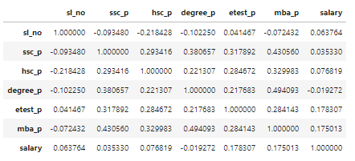
Exploratory Data Analysis
Correlation between non categorical factors

Slide 4
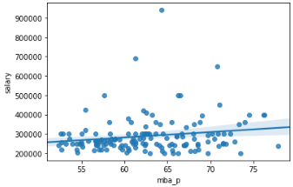
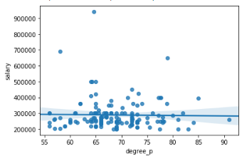
Correlation between Different factors and salary
Yhat= 114715.29018899679 + [2779.51111313] mba_p
The R-square is: 0.030629529410807547
The mean square error of price and predicted value is: 8409560162.271541
Yhat= 307650.38245922566 + [-276.32859597] degree_p
The R-square is: 0.0003714190255738048
The mean square error of price and predicted value is: 8672057739.205791

Slide 5
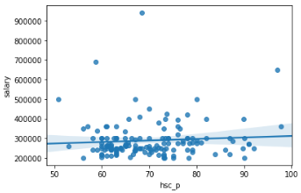
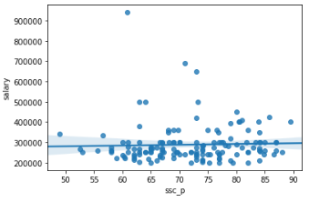
Correlation between Different factors and salary
Yhat= 234843.62750858403 + [769.54711447] hsc_p
The R-square is: 0.005901163822659261
The mean square error of price and predicted value is: 8624085655.297733
Yhat= 261483.4135696075 + [378.85427599] ssc_p
The R-square is: 0.0012482330170948686
The mean square error of price and predicted value is: 8664451132.406292

Slide 6
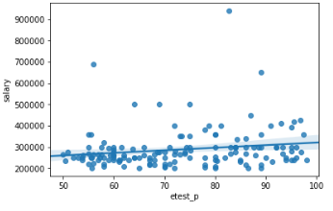
Correlation between Different factors and salary
Yhat= 199761.83197581192 + [1213.76231223] etest_p
The R-square is: 0.03179349643438667
The mean square error of price and predicted value is: 8399462422.543881

Slide 7
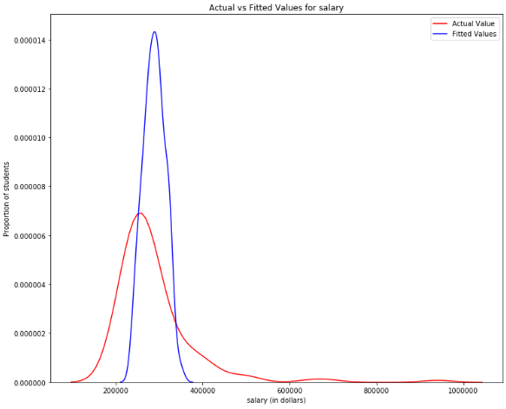
MODEL FIT
Independent variable used in Multiple linear regression are MBA, Undergrad, Higher secondary, Secondary and aptitude test percentage. The predicted value curve is fitted on actual value curve to know the efficiency of model. If we remove outliers from our dataset then efficiency of model will improve drastically.

Slide 8
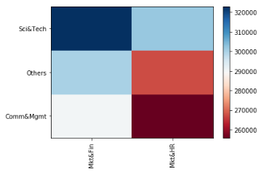
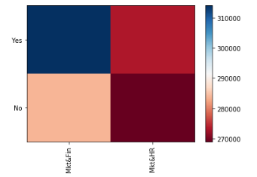
Categorical factors
Following matrix helps us summarize the impact of different choices on salary offered to students after post-graduation. From the below two matrix, it can be safely concluded that student with Science and Technology background, having some amount of work experience and Completed MBA with Marketing and Finance specialization are generally offered the highest salaries.

Slide 9
CONCLUSION
It can be safely concluded that student with Science and Technology background, having some amount of work experience and Completed MBA with Marketing and Finance specialization are generally offered the highest salaries.

Slide 10

THANK YOU

