Slide 1
Presented By
PRESENTATION ON DISINFECTION Course Name: Waste and Effluent Management
Course code: ESRM 3203
Kazi Jannat
Student Id: ER-21055
Department of Environmental Science and Resource Management
Mawlana Bhashani Science and Technology University

Slide 2

Disinfection
Disinfection is the process of eliminating or inactivating harmful microorganisms, such as bacteria, viruses, and fungi, from surfaces, water, air, or objects to prevent infection and contamination.
This is a crucial aspect of public health, environmental safety, and hygiene, especially in settings like hospitals, food processing industries, and water treatment plants.

Slide 3
Objectives of disinfection
Prevent Disease Spread
Ensure Safe Drinking Water
Maintain Hygiene in Healthcare Settings
Protect Vulnerable Populations
Improve Food Safety
Reduce Environmental Contamination

Slide 4
Level of Disinfection
Low-Level Disinfection
To kill most vegetative bacteria.
But not resistant organisms like bacterial spores.
Intermediate-Level Disinfection
To kill a broader range of pathogens, including vegetative bacteria, most viruses, fungi, and Mycobacterium tuberculosis.
It does not eliminate bacterial spores.
High-Level Disinfection
To kill all microorganisms, Including viruses, fungi, and bacterial spores.

Slide 5
Types of Disinfection
1. Chemical Disinfection
Chlorine, alcohol, hydrogen peroxide, Iodine Compounds.
2. Physical Disinfection
Heat (boiling, pasteurization), UV light.
3. Biological Disinfection
Use of bacteriophages or other natural agents.

Slide 6
Applications of Disinfection
Water Treatment
Healthcare (Hospitals and Clinics)
Food Industry
Surface Disinfection in Public and Private Spaces
Air Disinfection
Agricultural Disinfection

Slide 7
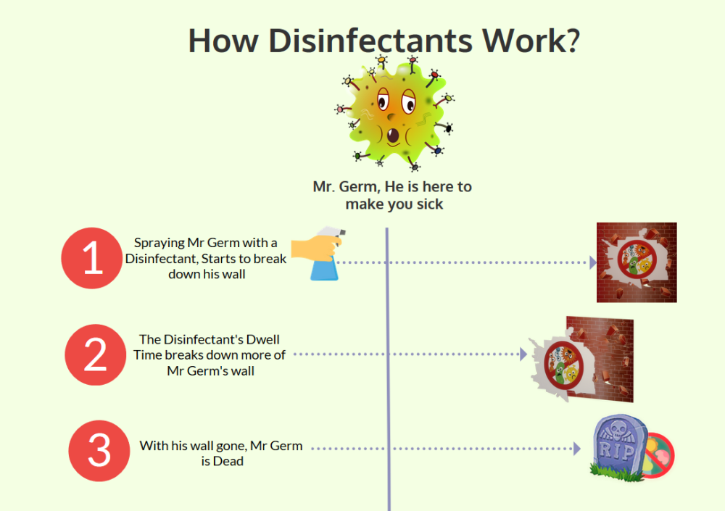
How Disinfection Works
Breaking down cell walls or membranes of microorganisms.
Inactivating proteins or enzymes essential for the microorganism's survival.
Destroying nucleic acids, preventing the replication of pathogens.

Slide 8
Factors Influencing Disinfection
Concentration of the Disinfectant
Contact Time
Temperature
pH Level
Hardness of Water
Type of Microorganism
Hardness of Water

Slide 9
Challenges of Disinfection
Resistance Development: Pathogens can develop resistance to disinfectants, similar to antibiotic resistance.
Toxicity: Some disinfectants can be harmful to health and the environment.
Inconsistent Coverage: Hard-to-reach areas may not be disinfected properly.
Environmental Impact: Disinfectants can cause water and soil contamination.
Cost and Accessibility: High costs for equipment and chemicals can limit access in certain settings.
Chemical Interference: Organic matter can reduce the efficacy of disinfectants.
Incompatibility with Certain Materials: Some disinfectants can damage or degrade certain materials.

Slide 10
Thank You

