Slide 1
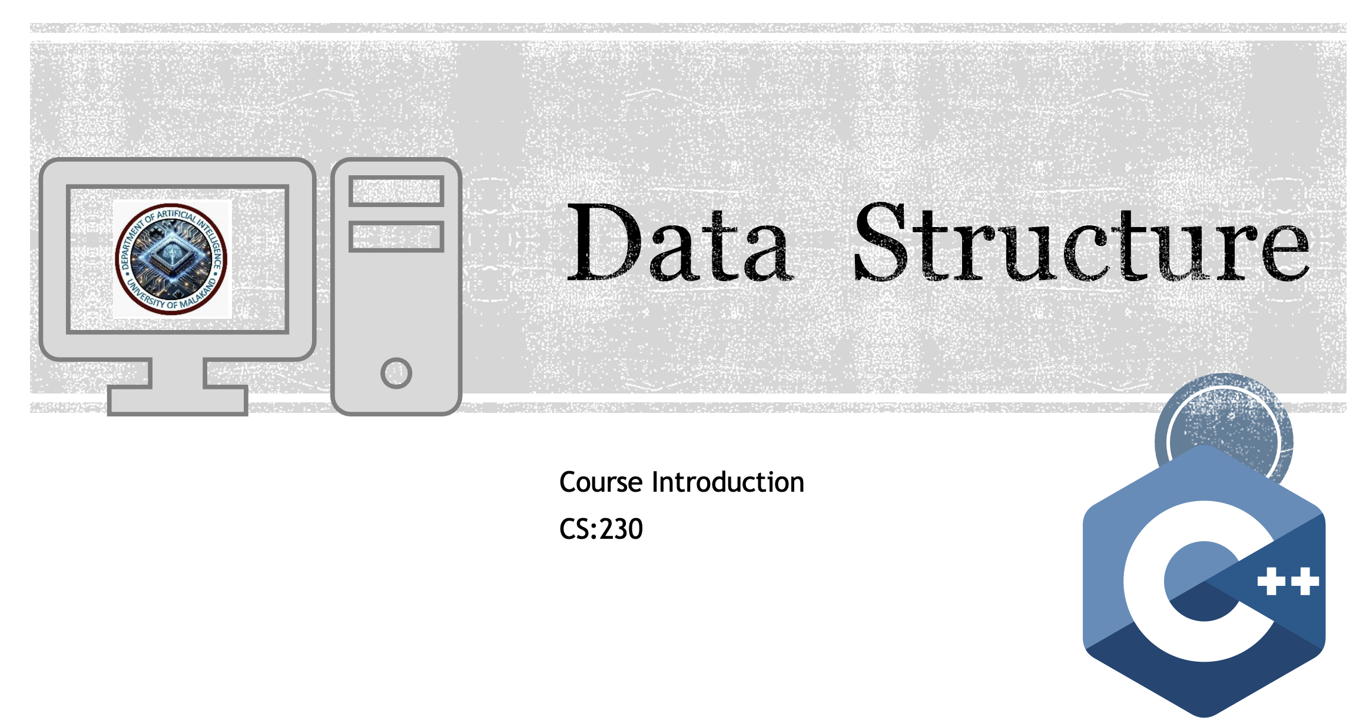

Slide 2
About your Instructor
Dr. Muhammad Kazim
Ph.D. North Dakota State University, United States
MS Abasyn University, Peshawar
M.Sc. University of Malakand, Gold Medalist

Slide 3

Ice Breaking Session
Name
Last Degree
Programming Knowledge (Beginner, Intermediate / What are you talking about.)
Fun things in life
WHY Artificial Intelligence. What do you expect from this course?

Slide 4
Course Material
Textbook:
Data Structures and Algorithms in C++ by Adam Drozdek,
Reference Books:
Data Structures and Algorithms Shaums Outline Series by Lipchautz, Latest Edition
Data Structures and Algorithm Analysis in C++ by Mark Allen Weiss, Latest Edition

Slide 5
Assessment (3 + 1)
Assessment | Weightage (100)
Quizzes 3 - 4 Announced only. | 10%
Assignment 3 – 4 | 10%
Lab | 20%
Midterm exam | 20%
Final Exam | 40%

Slide 6

Misc
Late submission: -10% per day
Familiarize yourself with policies on
– Plagiarism
clipartsheep.com
Missing quizzes, assignments, Mid-Final exams, etc.
Attendance

Slide 7
Communication
Slack
Assignment Submission:
Google Classroom

Slide 8
Questions?

Slide 9
Data Structures - Lecture 1
Introduction to Data Structures and Algorithms

Slide 10
Course Introduction
Why study Data Structures?
Efficiency in storing, retrieving, and manipulating data
Foundation for advanced computing courses
Real-world applications: Databases, AI, Operating Systems

Slide 11
What is a Data Structure?
Definition: Organizing and storing data for efficient access and modification
Examples: Arrays, Linked Lists, Stacks, Queues, Trees, Graphs, Hash Tables
Classification: Linear vs Non-linear Data Structures

Slide 12
What is an Algorithm?
Definition: Finite sequence of steps to solve a problem
Characteristics: Input & Output, Definiteness, Finiteness, Effectiveness
Example: Search for an element in an array

Slide 13
Basic Terminology
Abstract Data Type (ADT)
Operations: Insertion, Deletion, Traversal, Searching, Sorting
Data Types: Primitive vs Non-primitive
Space & Time Complexity

Slide 14
Algorithm Writing & Notation
Pseudocode: Language-independent description
Flowcharts: Visual representation
Mathematical Notation: Big-O for complexity

Slide 15
Complexity Analysis
Why analyze algorithms? Efficiency matters!
Time Complexity: Speed of execution
Space Complexity: Memory usage
Big-O Notation: O(n), O(log n), O(n²)

Slide 16
Example: Linear Search
Step-by-step pseudocode for linear search
Time Complexity: O(n)
Best vs Worst Case

Slide 17
Example: Binary Search
Requires sorted array
Divide and Conquer approach
Time Complexity: O(log n)

Slide 18
Summary
Data Structures = Organization of Data
Algorithms = Steps to manipulate Data
Efficiency measured via Complexity (Big-O)
Next Lecture: Arrays & Memory Representation

Slide 19
In-Class Activity / Q&A
Write pseudocode to find max of 3 numbers
Discuss efficiency: Linear vs Binary Search

