Slide 1
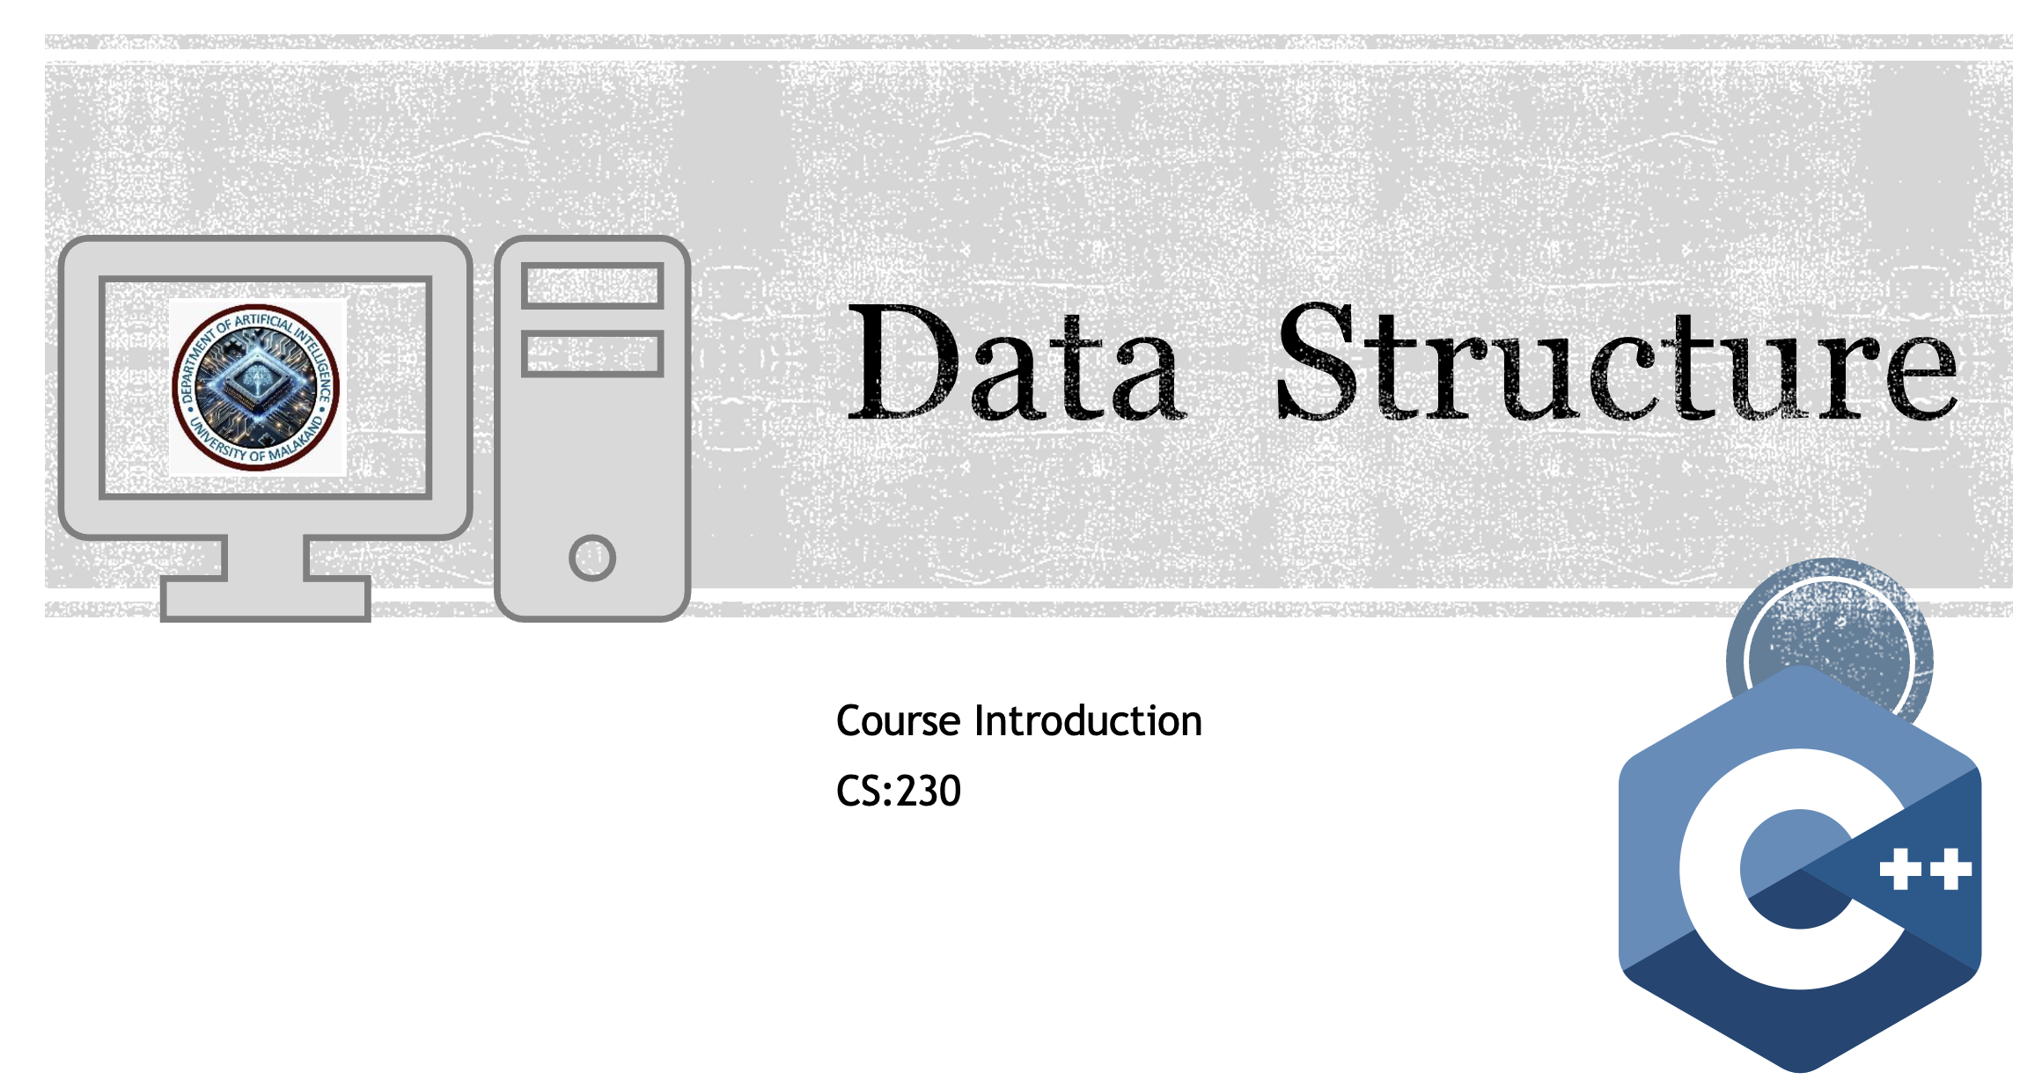

Slide 2
Week 1, Class 3
Today's Topics:
Algorithm Writing Notation,
Data Structure Operations,
Complexity Analysis

Slide 3
Learning Objectives
By the end of this class, you will be able to:
Compare and contrast different algorithm writing notations (Pseudocode vs. Flowcharts).
Identify and describe the fundamental operations performed on data structures (CRUD + more).
Define time and space complexity.
Explain the purpose of Big O notation for analyzing algorithm efficiency.

Slide 4
Recap & Look Back
What is a Data Structure?
A way to organize, manage, and store data for efficient access and modification.
Examples: Array, Linked List, Stack.
What is an Algorithm?
A step-by-step procedure or formula for solving a problem.
Example: A recipe for baking a cake.
Think-Pair-Share (1 min): Turn to your neighbor and name one real-world example of a data structure and an algorithm you used today. (e.g., A playlist (data structure) and the shuffle function (algorithm))

Slide 5
Part 1: Describing Algorithms - How do we write them?
We need a clear, language-agnostic way to communicate the steps of an algorithm before we write code.

Slide 6
Algorithm Notation: Pseudocode
What is it? A high-level description of an algorithm that uses the structural conventions of a programming language but is intended for human reading.
It is NOT code. It ignores syntax details like semicolons or variable declarations.
Focuses on logic, control structures (if, while, for), and operations.

Slide 7
Example: Find the largest number in an array.
BEGIN
SET max TO the first element in the array
FOR each subsequent element IN the array
IF element > max THEN
SET max TO element
END IF
END FOR
RETURN max
END

Slide 8
Algorithm Notation: Flowcharts
What is it? A visual representation of an algorithm's workflow using standardized symbols.
Good for understanding the flow of control and decision points.

Slide 9
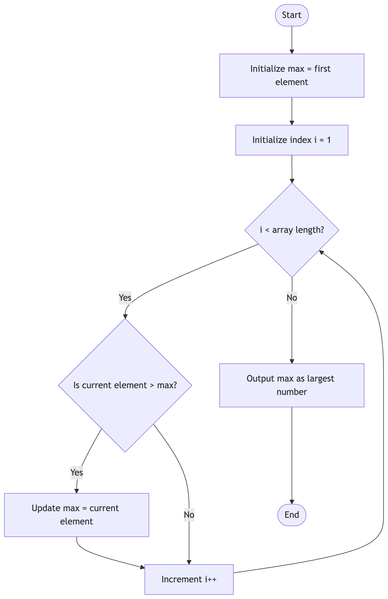
Show a simple flowchart for the " Find the largest number in an array " algorithm:

Slide 10
Pseudocode vs. Flowchart
Feature | Pseudocode | Flowchart
Form | Text-based | Visual / Graphical
Detail | Can be more detailed | Shows overall flow clearly
Best for | Complex algorithms, easy to translate to code | Understanding logic flow, simpler processes

Slide 11
Part 2: What can we DO with Data Structures?
Transition to operations
Data structures are useless if we can't interact with them. These interactions are called Operations.

Slide 12
Core Data Structure Operations
Traversal (R): Access each data element exactly once.
Example: Printing every name on the list.
Insertion (C): Add a new data element.
Example: Adding a new friend's name to the list.
Deletion (D): Remove a data element.
Example: Removing a name from the list.
Searching (R): Find the location of a given element.
Example: Is "Ali" on the list? At what position?
Sorting: Arrange elements in a specific order (ascending/descending).
Example: Ordering the names alphabetically.
Merging: Combine two similar structures into one.
Example: Combining two lists of names into one big list.
CRUD Analogy: Create (Insert), Read (Traverse, Search), Update (often involves search+insert), Delete.

Slide 13
Part 3: How do we MEASORE algorithms? Complexity Analysis
Two algorithms can solve the same problem. How do we know which one is better?
Is it the one that uses fewer lines of code?
Is it the one that runs the fastest?
Is it the one that uses the least memory?
Answer: We analyze their Complexity.

Slide 14
What is Complexity?
Time Complexity: A measure of the amount of time an algorithm takes to run as a function of the input size (n).
"How fast does it run?"
Space Complexity: A measure of the amount of memory an algorithm uses as a function of the input size (n).
"How much memory does it need?"
Why does input size (n) matter?
Sorting 10 numbers is easy. Sorting 10 million numbers is hard. We care about how performance scales.

Slide 15
Introducing Big O Notation
O(1) - Constant Time: Amazing! (e.g., accessing an array element by index).
O(log n) - Logarithmic Time: Excellent! (e.g., binary search).
O(n) - Linear Time: Good! (e.g., simple search, traversing an array).
O(n log n) - Linearithmic Time: Decent. (e.g., efficient sorting algorithms like Merge Sort).
O(n²) - Quadratic Time: Bad. (e.g., simple sorting with two nested loops, like Bubble Sort).
O(2^n) - Exponential Time: Terrible! (e.g., naive Fibonacci calculation).

Slide 16
Big O in Practice: An Example
Problem: Find a number in a list (array).
Algorithm 1: Linear Search. Check each element one by one.
Worst Case: The number is last. We check all n elements.
Time Complexity: O(n)
Algorithm 2: Binary Search. (Requires a sorted list). Repeatedly check the middle and discard half the list.
Worst Case: We halve the list until it has one item. Steps = log₂(n).
Time Complexity: O(log n)
Conclusion: For large n, O(log n) is dramatically faster than O(n).

Slide 17
Key Takeaways
We use Pseudocode (text) and Flowcharts (visuals) to design algorithms unambiguously.
Data Structures support core Operations like Traversal, Insertion, Deletion, and Search.
We measure algorithm efficiency using Complexity Analysis (Time & Space).
Big O Notation tells us how an algorithm's resource needs scale with input size, helping us choose the best tool for the job.

Slide 18


