Slide 1
Early Detection of Diabetic Retinopathy
Early DR (grades 1–2) on DDR, EyePACS and APTOS fundus images
Advisor: Navid Amini, PhD
Department of Computer Science
1

Slide 2

About Diabetic Retinopathy
151M
The clinical burden is growing
Observed growth over time
Diabetes has expanded rapidly worldwide, increasing the number of people who need retinal screening for diabetic retinopathy.
More patients means more fundus images to grade - and more pressure for fast triage.
adults living with diabetes
in 2000
589M
adults living with diabetes
in 2024
+290%
observed increase in
screening population
2

Slide 3
Research Aim
Catch early DR (grades 1–2)
Many studies target referable DR (moderate or worse). This thesis targets the earliest grades.
Fundus
photo
Deep
learning
Early-DR
flag (1–2)
Referral /
review
Primary
Sensitivity for grades 1–2 vs No DR at a fixed specificity.
Secondary
Separate early (1–2) from late (3–4) DR for triage.
Robustness
Held-out EyePACS patients, then APTOS, never used in training.
Goal: high sensitivity at fixed specificity, with calibrated probabilities.
3

Slide 4
PROGRESS · MEASURED ON THE REAL DDR + EYEPACS LABELS
The EyePACS merge has a measurable cost
Topping up only the short grades links “which dataset” to “how severe”. Measured from the label files alone — no images, no GPU, no training.
SHARE OF EACH GRADE TAKEN FROM EYEPACS
0.512 bits
of the severity label is recoverable from the dataset name alone — 24.6% of its information
Grade 0
0.0%
Grade 1
79.0%
100%
Grade 2
0.0%
of merged EyePACS images carry disease, so 38.7% of all disease cases are identifiable purely by recognising the camera
Grade 3
78.7%
Grade 4
43.7%
0.167 → 0.000
score of a dataset-name-only predictor: under a random split, versus in a single-clinic test
The shortcut is specific to the earliest decision — any disease versus none (AUC 0.694), and useless for referable disease (0.482).
That is exactly the decision this thesis targets, so the merge must be audited rather than assumed safe.
A classifier also tells DDR from EyePACS images with AUROC 0.996. Design consequence: three arms (A DDR only, B source-balanced, C this merge as a negative control), with every result reported per source.
4
Notes:
This is what I have measured so far, and it changed the design of the project. Because the top-up is applied only to the short grades, grades 0 and 2 contain no EyePACS images while grades 1 and 3 are nearly 80 percent EyePACS. A quarter of the severity label is recoverable from the dataset name alone. Every merged EyePACS image carries disease, so a model that learns only to recognise the camera gets 38.7 percent of disease cases right with no false alarms — and only for the earliest decision, which is the one I am targeting. So the merge is not just an imbalance fix; it has a cost, and the thesis now measures it.

Slide 5
Proposed Methods
Three data arms, one change at a time
Same model, image size and epochs; frozen patient-level splits; test sets opened once.
Data
DDR, EyePACS, APTOS
Prepare
Crop, pad, 512 px
Merge arms
A, B, C
Model
EfficientNet-B0
Output
Calibrated, 95% CI
Imbalance methods tested
The three arms
Weighted sampler
Class-balanced loss
Focal loss
• A: DDR only (clean baseline)
• B: DDR + EyePACS, source-balanced
• C: version 1 merge (negative control)
• C wins on its own test but not on APTOS = it learned the source
Strong augmentation
Augmentation control
Not a new network: the value is the design, the controls and the evidence.
5

Slide 6
Complete Model Architecture
From fundus image to a calibrated early-DR flag
TRAIN: one model per arm, task and seed
Fundus image
DDR, EyePACS, APTOS; frozen patient-level splits
Preprocess
Crop border, pad to square, resize to 512 px (colour norm optional)
Sampler + augment
Arm B: source-balanced. Weighted, class-aware or repeat-factor. Mild or strong
Backbone
EfficientNet-B0, ImageNet weights (ViT + RETFound as extension)
Head (1 per run)
0 vs 1-4, early vs late, 3-class or 5-grade
Loss
Cross-entropy, class-balanced CE, or focal (gamma 1-3)
VALIDATE AND FREEZE, THEN TEST
Outputs
Calibrated probability, early-DR flag, per-source metrics with 95% CI
Frozen threshold
Set at the declared specificity (0.90) on validation
Prior-shift correction
Training class mix back to natural prevalence
Temperature scaling
One number T, fitted on validation
Best epoch
Chosen on validation score only
Test sets opened once: DDR + held-out EyePACS, then APTOS last. Grad-CAM with a randomised-weights check.
6

Slide 7
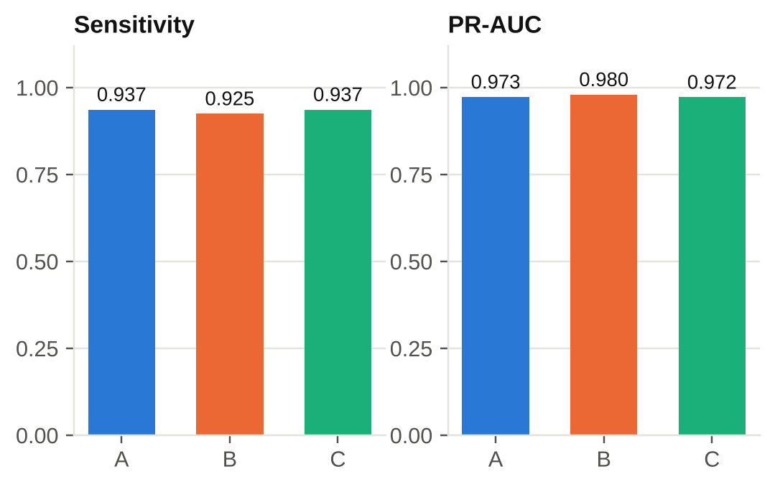
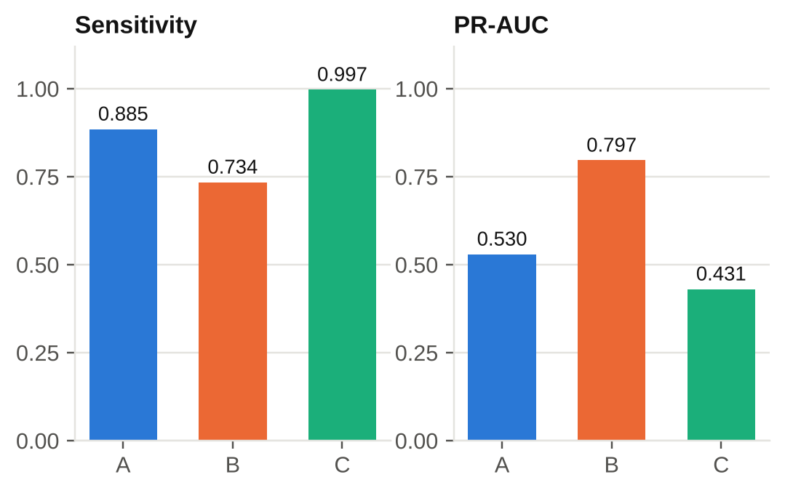
Key Results
Early DR (grades 1-2) vs No DR, mean of 3 seeds, threshold frozen on validation
DDR test set
Held-out EyePACS patients
Sensitivity 0.937 / 0.925 / 0.937 (A / B / C): adding EyePACS did not help.
Arm C: sensitivity 0.997 but PR-AUC 0.43 (A: 0.53): it learned the source. B: PR-AUC 0.80.
Preliminary: random DDR split, duplicates unchecked; APTOS (AUROC 0.994) not claimed yet.
7

Slide 8
What These Results Do Not Show
Read before quoting any number
DDR split is random
No patient IDs and no official split in this copy: images from one patient can sit in both train and test.
Duplicate candidates
834 candidate groups: 375 cross splits, 39 cross datasets. Under review; DDR and APTOS numbers may be inflated.
APTOS looks too good
Not claimed as robustness until the overlap check is done.
Not yet reported here
Specificity reached, grade-1-only sensitivity, ECE, Brier and 95% intervals (saved in the results files).
The arm C pattern matches the label audit, but it is also unchecked for duplicates.
8

Slide 9
Conclusions and Next Steps
What the evidence supports so far
The merge as written teaches the source
Arm C is best on its own validation set (0.982) and worst on EyePACS PR-AUC (0.43).
Next steps
1. Run the duplicate check and look at the pairs
2. Official or patient-level DDR split; retrain
3. Diagnose strong augmentation; rerun ablations with 3 seeds
4. Report specificity, grade-1 sensitivity, ECE, intervals
5. Re-evaluate APTOS after de-duplication; write up
Source-balancing helps EyePACS, not DDR
B lifts EyePACS PR-AUC by 0.27; DDR sensitivity does not improve.
Imbalance methods: no clear gain
All within noise of plain cross-entropy on the primary metric.
9

Slide 10
References
• International Diabetes Federation. IDF Diabetes Atlas, 11th ed., 2025.
• Ting, D. S. W., et al. 'Artificial intelligence-assisted diabetic retinopathy screening.' Ophthalmology, 2021.
• Shah, P., et al. 'Progression of DR and screening demand.' JAMA Ophthalmology, 2024.
• WHO. Guidelines on diabetic retinopathy screening, 2023.
• CDC. Eye-health guidance for people with diabetes, 2024.
• Li, T., et al. Diagnostic assessment of deep learning algorithms for DR screening (DDR). Information Sciences, 2019.
• Kaggle. Diabetic Retinopathy Detection (EyePACS), 2015; APTOS 2019 Blindness Detection.
• Guo, C., et al. On calibration of modern neural networks. ICML, 2017.
• Sipka, T., et al. The hitchhiker’s guide to prior-shift adaptation. WACV, 2022.
10

Slide 11
THANK YOU
Questions? We’d love to discuss!

