Slide 1
Early Detection of Diabetic Retinopathy
Early DR (grades 1–2) on DDR, EyePACS and APTOS fundus images
Advisor: Navid Amini, PhD
Department of Computer Science
1

Slide 2

About Diabetic Retinopathy
151M
The clinical burden is growing
Observed growth over time
Diabetes has expanded rapidly worldwide, increasing the number of people who need retinal screening for diabetic retinopathy.
More patients means more fundus images to grade - and more pressure for fast triage.
adults living with diabetes
in 2000
589M
adults living with diabetes
in 2024
+290%
observed increase in
screening population
2

Slide 3
Research Aim
Catch early DR (grades 1–2)
Many studies target referable DR (moderate or worse). This thesis targets the earliest grades.
Fundus
photo
Deep
learning
Early-DR
flag (1–2)
Referral /
review
Primary
Sensitivity for grades 1–2 vs No DR at a fixed specificity.
Secondary
Separate early (1–2) from late (3–4) DR for triage.
Robustness
Held-out EyePACS patients, then APTOS, never used in training.
Goal: high sensitivity at fixed specificity, with calibrated probabilities.
3

Slide 4

Data: Three Fundus Datasets
Different sizes, grade mixes and cameras
DDR
12,522 gradable images. Random 60/20/20 split (7,454 / 2,552 / 2,516): this copy has no official split or patient IDs.
EyePACS
35,108 images. Split by patient: 24,572 train, 5,266 validation, 5,270 test.
APTOS
3,662 images. External test only: never used for training or model selection.
Early DR (grades 1-2) is 41% of DDR, 22% of EyePACS and 37% of APTOS.
4

Slide 5
PROGRESS · MEASURED ON THE REAL DDR + EYEPACS LABELS
The EyePACS merge has a measurable cost
Topping up only the short grades links “which dataset” to “how severe”. Measured from the label files alone — no images, no GPU, no training.
SHARE OF EACH GRADE TAKEN FROM EYEPACS
0.512 bits
of the severity label is recoverable from the dataset name alone — 24.6% of its information
Grade 0
0.0%
Grade 1
79.0%
100%
Grade 2
0.0%
of merged EyePACS images carry disease, so 38.7% of all disease cases are identifiable purely by recognising the camera
Grade 3
78.7%
Grade 4
43.7%
0.167 → 0.000
score of a dataset-name-only predictor: under a random split, versus in a single-clinic test
The shortcut is specific to the earliest decision — any disease versus none (AUC 0.694), and useless for referable disease (0.482).
That is exactly the decision this thesis targets, so the merge must be audited rather than assumed safe.
A classifier also tells DDR from EyePACS images with AUROC 0.996. Design consequence: three arms (A DDR only, B source-balanced, C this merge as a negative control), with every result reported per source.
5
Notes:
This is what I have measured so far, and it changed the design of the project. Because the top-up is applied only to the short grades, grades 0 and 2 contain no EyePACS images while grades 1 and 3 are nearly 80 percent EyePACS. A quarter of the severity label is recoverable from the dataset name alone. Every merged EyePACS image carries disease, so a model that learns only to recognise the camera gets 38.7 percent of disease cases right with no false alarms — and only for the earliest decision, which is the one I am targeting. So the merge is not just an imbalance fix; it has a cost, and the thesis now measures it.

Slide 6
Proposed Methods
Three data arms, one change at a time
Same model, image size and epochs; frozen patient-level splits; test sets opened once.
Data
DDR, EyePACS, APTOS
Prepare
Crop, pad, 512 px
Merge arms
A, B, C
Model
EfficientNet-B0
Output
Calibrated, 95% CI
Imbalance methods tested
The three arms
Weighted sampler
Class-balanced loss
Focal loss
• A: DDR only (clean baseline)
• B: DDR + all EyePACS grades, source-balanced
• C (control): DDR + EyePACS grades 1, 3, 4 only
• C does well on its own test, not on unseen sources
Strong augmentation
Augmentation control
Not a new network: the value is the design, the controls and the evidence.
6

Slide 7
The Three Data Arms
Exactly what each arm trains on
A: DDR only
Trained on DDR alone. The clean baseline: it never sees EyePACS.
Role: baseline
B: DDR + all EyePACS, source-balanced
All EyePACS grades are added. The sampler makes each source equally likely within every grade, so grade frequencies stay natural.
Role: does more data help without teaching the source?
C: the old merge (negative control)
DDR plus only EyePACS grades 1, 3 and 4: no EyePACS No DR and no grade 2. EyePACS then supplies mostly disease images, so the dataset name predicts disease.
Role: a deliberately flawed control
Everything else is identical: model, image size, epochs, frozen splits and seeds.
7

Slide 8
Complete Model Architecture
From fundus image to a calibrated early-DR flag
TRAIN: one model per arm, task and seed
Fundus image
DDR, EyePACS, APTOS; frozen patient-level splits
Preprocess
Crop border, pad to square, resize to 512 px (colour norm optional)
Sampler + augment
Arm B: source-balanced. Weighted, class-aware or repeat-factor. Mild or strong
Backbone
EfficientNet-B0, ImageNet weights (ViT + RETFound as extension)
Head (1 per run)
0 vs 1-4, early vs late, 3-class or 5-grade
Loss
Cross-entropy, class-balanced CE, or focal (gamma 1-3)
VALIDATE AND FREEZE, THEN TEST
Outputs
Calibrated probability, early-DR flag, per-source metrics with 95% CI
Frozen threshold
Set at the declared specificity (0.90) on validation
Prior-shift correction
Training class mix back to natural prevalence
Temperature scaling
One number T, fitted on validation
Best epoch
Chosen on validation score only
Test sets opened once: DDR + held-out EyePACS, then APTOS last. Grad-CAM with a randomised-weights check.
8

Slide 9

Training Setup and Curves
EfficientNet-B0, 512 px, 10 epochs, 3 seeds per arm
Same recipe for every arm
AdamW, learning rate 3e-4, mixed precision. Best epoch chosen on validation only.
Cost on a Kaggle GPU
About 110 s per epoch (A), 450 s (B), 150 s (C): roughly 6 hours for the nine runs.
Raw outputs are overconfident
Fitted temperature T = 1.6 to 2.4 across the nine runs; calibration is fitted on validation.
Validation sets differ by arm, so these curves show convergence, not which arm is better.
9

Slide 10

Result 1: DDR Test Set (In-Domain)
A: DDR only. B: DDR + EyePACS, source-balanced. C: old merge. 3 seeds, threshold frozen on validation
The operating point works here
Specificity 0.91, 0.94, 0.91 (target 0.90); sensitivity 0.937, 0.925, 0.937 for A, B, C.
B vs A
Sensitivity -0.012 (Holm p = 0.084, not significant); PR-AUC +0.007 (p = 0.002).
Caution
The split is random with no patient IDs: the other eye of a patient can sit in train. Near-duplicate leakage is small (4%).
Adding EyePACS did not improve DDR sensitivity. In-domain numbers are optimistic.
10

Slide 11

Result 2: Held-Out EyePACS Patients
Same frozen threshold, unseen patients. A: DDR only, B: DDR + EyePACS balanced, C: old merge
Arm C: the source shortcut
Specificity 0.013: 99% of healthy EyePACS images flagged as DR. PR-AUC 0.43.
Arm A: threshold does not transfer
Never saw EyePACS: specificity 0.39, sensitivity 0.885, PR-AUC 0.53.
Arm B: source-balanced
Specificity 0.89, sensitivity 0.73, PR-AUC 0.80, AUROC 0.88.
Arm C is the source shortcut, measured directly.
11

Slide 12
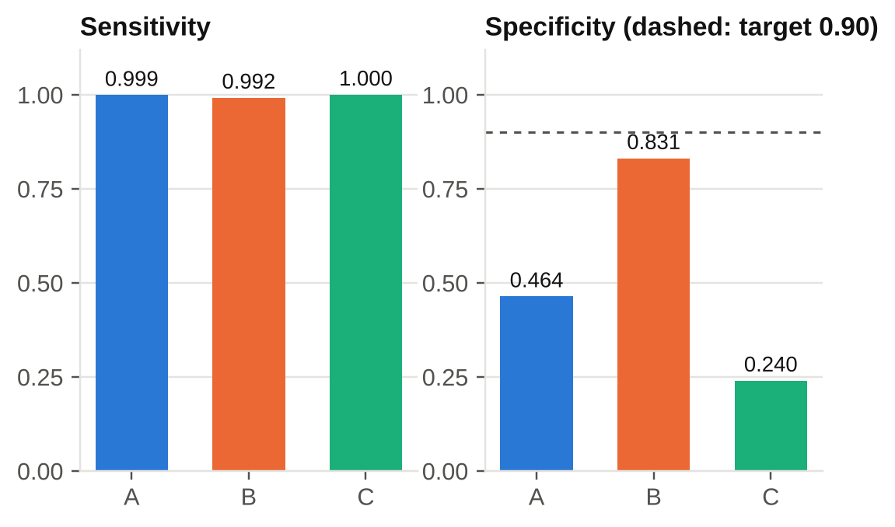
Result 3: APTOS External Set
3,662 images, never trained on. A: DDR only, B: DDR + EyePACS balanced, C: old merge
Ranking is excellent
AUROC 0.994 to 0.995 for all arms, even grade 1 vs No DR (0.98).
The threshold does not transfer
Sensitivity near 1.0 comes with specificity 0.46 (A), 0.83 (B), 0.24 (C).
Label tied to capture
Image size alone predicts APTOS early DR (AUROC 0.96): not clean evidence of robustness.
Report AUROC for APTOS. Do not quote its sensitivity.
12

Slide 13
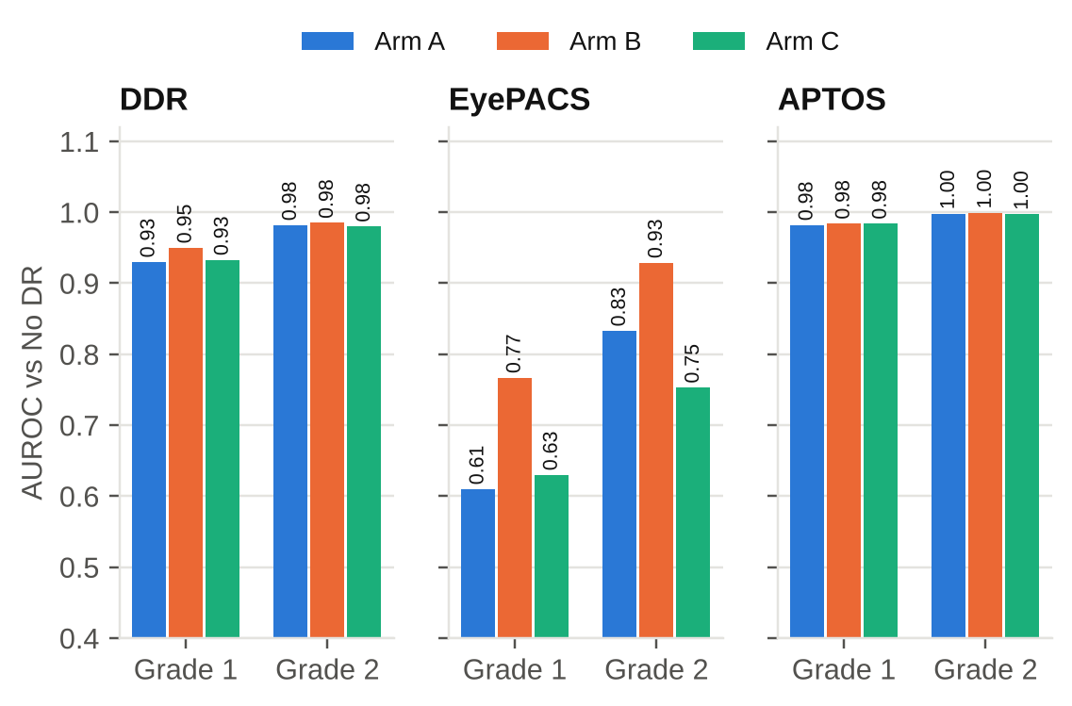
Grade by Grade: Grade 1 Is the Hard One
AUROC against No DR, per grade and per source (post-hoc analysis)
Grade 2 is easy
AUROC 0.98 to 0.999 on DDR and APTOS for every arm.
Grade 1 is harder off-domain
EyePACS grade 1 vs No DR: 0.61 (A), 0.77 (B), 0.63 (C).
Why it matters
"Early DR" in DDR is mostly grade 2, which flatters the headline numbers.
Report grade 1 on its own: it is the earliest disease.
13

Slide 14
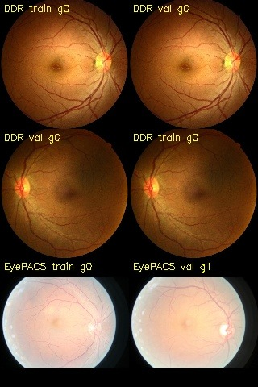
Check 1: Duplicate Images
Hash-matched candidates across train, validation, test and APTOS
834 candidate groups
Only 480 share the same grade; the rest are mostly hash collisions.
Metrics barely move without them
DDR sensitivity 0.937 to 0.936; EyePACS and APTOS unchanged.
What it cannot see
The same patient photographed twice: patient-level leakage in the random DDR split is untested.
Exact duplicates do not explain the high scores.
14

Slide 15
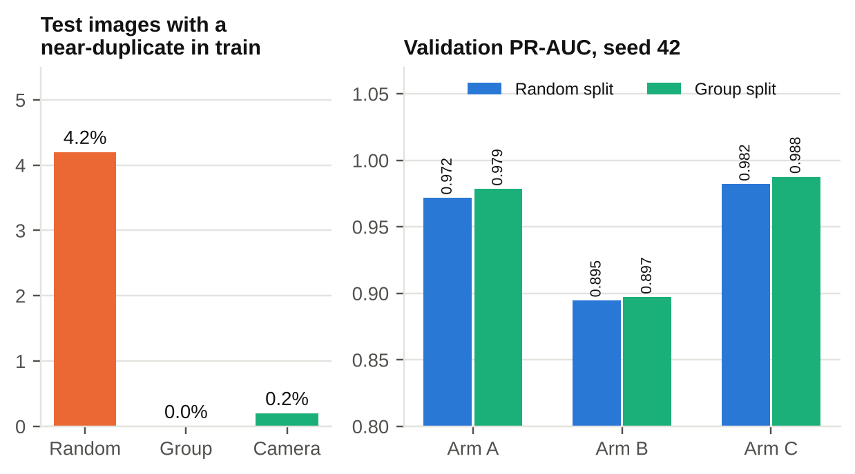
Check 3: A Group-Aware DDR Split
Near-duplicate images kept together; arms retrained and evaluated (3 seeds)
Leakage was small
4.2% of test images had a near-duplicate in train under the random split; 0% under the group split.
Test results changed little
Over 3 seeds, AUROC changed by at most 0.003 on DDR and APTOS. EyePACS AUROC rose 0.019 (A), 0.007 (B), 0.004 (C).
What it cannot fix
Fellow eyes of one patient (similarity 0.92 to 0.96) stay on both sides. APTOS specificity moved by up to 0.03 at the frozen threshold.
Near-duplicate leakage does not explain the high DDR scores.
15

Slide 16
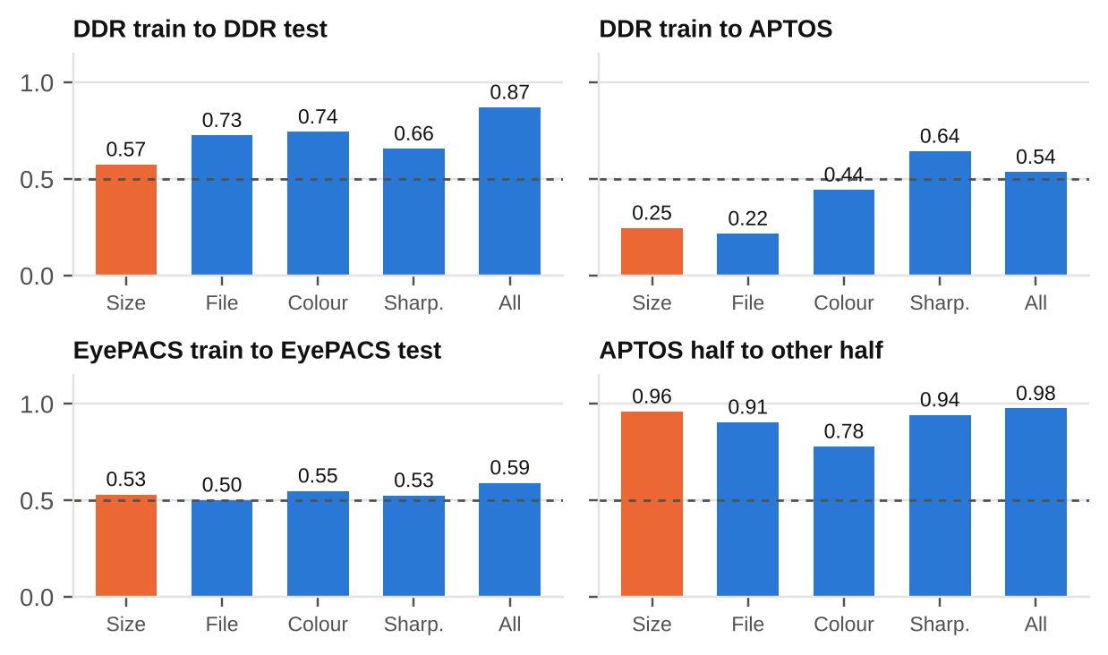
Check 2: Which Image Properties Predict the Label?
AUROC for early DR vs No DR from image properties only
DDR: size alone 0.58
Image size barely predicts early DR. Colour (0.74) and file size (0.73) do: likely lesion content, not camera.
APTOS: size alone 0.96
Within APTOS, image size almost fully predicts the label: a real camera or hospital confound.
EyePACS: 0.50 to 0.59
No property predicts the label: the cleanest benchmark.
Orange = image size. APTOS is camera-confounded; EyePACS is clean; DDR is mixed.
16

Slide 17

Result 4: Imbalance Methods
Sampler, loss and augmentation, one change at a time (single seed, 14 runs)
No method beat baseline
Best 0.9772 (geometric aug, all classes) vs baseline 0.9761: inside seed noise.
Augmentation leaked the label
Geometric aug on all classes: 0.977. On minority classes only: 0.834. Strong aug failed for another reason: next slide.
Limit of the test
The score is early-vs-none PR-AUC; rare grades 1, 3 and 4 are not scored separately.
On this metric, plain cross-entropy is as good as every imbalance method.
17

Slide 18
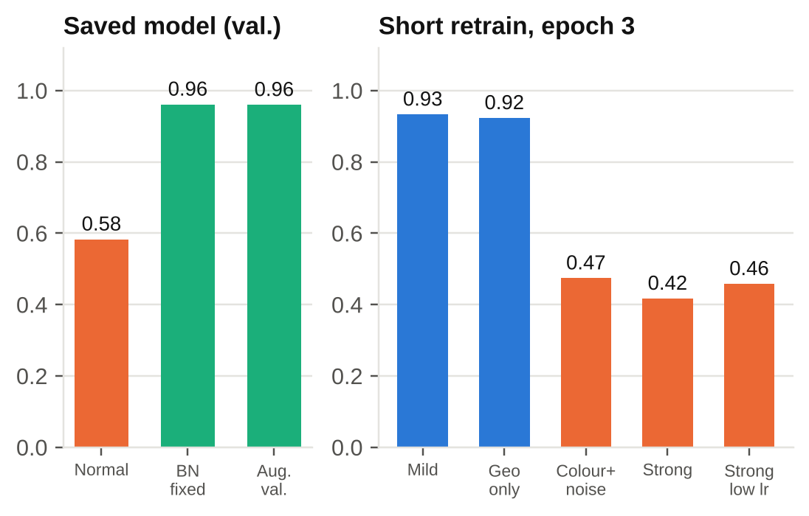
Why Strong Augmentation Failed
Diagnosed with the saved models and a short retrain (train and validation only)
The images are fine
Rotations and crops only: no blank or non-finite images.
BatchNorm mismatch
The strong-all model scores 0.58 normally but 0.96 once BatchNorm is re-estimated.
Confirmed by rerunning
Geometric aug on all classes trains fine (0.977). Colour/blur/noise breaks it. On minority classes only it drops to 0.834: a label cue.
Geometric-only on all classes fixes it, and gives the best raw calibration (T 1.65 vs 2.39).
18

Slide 19
Extensions and Sanity Checks
Single-seed runs on DDR, scored on validation
Early vs late (stage 2)
Validation AUROC 0.951 at the best epoch: early and late DR separate well on DDR.
Three-class label
Validation PR-AUC 0.974 vs 0.972 for the two-class head (arm A): no meaningful difference.
Colour normalisation
0.973 vs 0.972: no gain, and 3.4 times slower to train (about 380 s per epoch).
Grad-CAM sanity check
Trained vs randomised-weights maps correlate 0.12 and −0.27 in two runs: the maps depend on the model.
Test-set metrics for these runs are not analysed here.
19

Slide 20
What These Results Do Not Show
Read before quoting any number
The frozen threshold does not transfer
On EyePACS specificity is 0.39 (A) and 0.013 (C): sensitivity alone is misleading off-domain.
APTOS is confounded by capture
Size alone predicts APTOS (0.96), but within same-size groups the models still score 0.984 to 0.989 (post-hoc). Other capture cues remain untested.
DDR: same-patient leakage remains
No patient IDs. Near-duplicates were small (4%) and removed, but a patient's other eye cannot be. Retraining on a group split changed no test result.
Reported and post-hoc
Group-split results have 95% intervals, ECE and Brier over 3 seeds. Per-grade, specificity and size-strata analyses are post-hoc.
EyePACS, with a patient-level split and clean properties, is the most trustworthy benchmark.
20

Slide 21
Conclusions and Next Steps
What the evidence supports so far
The merge as written teaches the source
Arm C flags 99% of healthy EyePACS images as DR, matching the label audit.
Next steps
1. Size check done: APTOS AUROC holds within same-size groups (0.984 to 0.989)
2. Report AUROC, per-grade results and own-source operating points
3. Test capture mitigation: size-matched subsets
4. More seeds only if needed: the spread over 3 seeds is small
5. Use geometric augmentation on all classes; keep minority-only as the cue control
6. Re-evaluate once; label post-hoc analyses
Source-balancing helps off-domain
Arm B: EyePACS AUROC 0.884 (0.870-0.897), specificity 0.90, ECE 0.056 vs 0.326 (A) and 0.717 (C).
EyePACS is the clean benchmark
Properties do not predict its labels (0.50 to 0.59); APTOS is confounded (size 0.96); DDR leakage is small.
21

Slide 22
References
• International Diabetes Federation. IDF Diabetes Atlas, 11th ed., 2025.
• Ting, D. S. W., et al. 'Artificial intelligence-assisted diabetic retinopathy screening.' Ophthalmology, 2021.
• Shah, P., et al. 'Progression of DR and screening demand.' JAMA Ophthalmology, 2024.
• WHO. Guidelines on diabetic retinopathy screening, 2023.
• CDC. Eye-health guidance for people with diabetes, 2024.
• Li, T., et al. Diagnostic assessment of deep learning algorithms for DR screening (DDR). Information Sciences, 2019.
• Kaggle. Diabetic Retinopathy Detection (EyePACS), 2015; APTOS 2019 Blindness Detection.
• Guo, C., et al. On calibration of modern neural networks. ICML, 2017.
• Sipka, T., et al. The hitchhiker’s guide to prior-shift adaptation. WACV, 2022.
22

Slide 23
THANK YOU
Questions? We’d love to discuss!

