Slide 1
Early Detection of Diabetic Retinopathy
Project progress update: DDR, EyePACS and APTOS
Advisor: Navid Amini, PhD
Department of Computer Science
1

Slide 2
Progress at a Glance
Where the project stands
Done
• Data audit: class counts and merge table
• Pipeline on Kaggle: prepare, train, calibrate, evaluate, plot
• Arms A, B, C trained (3 seeds each)
• Internal and APTOS test evaluation
• 12 imbalance runs and 3 extensions
• Checks: duplicates, image-property shortcut, augmentation diagnosis
Prepared, not yet run
• Geometric-only augmentation runs (all classes vs minority only)
To do
• Group-aware DDR split; retrain
• Report AUROC, per-grade results and own-source operating points
• Capture-artifact mitigation
• Five seeds, intervals, ECE, Brier
• Write the thesis chapters
Main findings: the original merge teaches the source; in-domain scores are inflated.
2

Slide 3

Data: Three Fundus Datasets
Different sizes, grade mixes and cameras
DDR
12,522 gradable images. Random 60/20/20 split (7,454 / 2,552 / 2,516): this copy has no official split or patient IDs.
EyePACS
35,108 images. Split by patient: 24,572 train, 5,266 validation, 5,270 test.
APTOS
3,662 images. External test only: never used for training or model selection.
Early DR (grades 1-2) is 41% of DDR, 22% of EyePACS and 37% of APTOS.
3

Slide 4
PROGRESS · MEASURED ON THE REAL DDR + EYEPACS LABELS
The EyePACS merge has a measurable cost
Topping up only the short grades links “which dataset” to “how severe”. Measured from the label files alone — no images, no GPU, no training.
SHARE OF EACH GRADE TAKEN FROM EYEPACS
0.512 bits
of the severity label is recoverable from the dataset name alone — 24.6% of its information
Grade 0
0.0%
Grade 1
79.0%
100%
Grade 2
0.0%
of merged EyePACS images carry disease, so 38.7% of all disease cases are identifiable purely by recognising the camera
Grade 3
78.7%
Grade 4
43.7%
0.167 → 0.000
score of a dataset-name-only predictor: under a random split, versus in a single-clinic test
The shortcut is specific to the earliest decision — any disease versus none (AUC 0.694), and useless for referable disease (0.482).
That is exactly the decision this thesis targets, so the merge must be audited rather than assumed safe.
A classifier also tells DDR from EyePACS images with AUROC 0.996. Design consequence: three arms (A DDR only, B source-balanced, C this merge as a negative control), with every result reported per source.
4
Notes:
This is what I have measured so far, and it changed the design of the project. Because the top-up is applied only to the short grades, grades 0 and 2 contain no EyePACS images while grades 1 and 3 are nearly 80 percent EyePACS. A quarter of the severity label is recoverable from the dataset name alone. Every merged EyePACS image carries disease, so a model that learns only to recognise the camera gets 38.7 percent of disease cases right with no false alarms — and only for the earliest decision, which is the one I am targeting. So the merge is not just an imbalance fix; it has a cost, and the thesis now measures it.

Slide 5
Proposed Methods
Three data arms, one change at a time
Same model, image size and epochs; frozen patient-level splits; test sets opened once.
Data
DDR, EyePACS, APTOS
Prepare
Crop, pad, 512 px
Merge arms
A, B, C
Model
EfficientNet-B0
Output
Calibrated, 95% CI
Imbalance methods tested
The three arms
Weighted sampler
Class-balanced loss
Focal loss
• A: DDR only (clean baseline)
• B: DDR + EyePACS, source-balanced
• C: version 1 merge (negative control)
• C wins on its own test but not on APTOS = it learned the source
Strong augmentation
Augmentation control
Not a new network: the value is the design, the controls and the evidence.
5

Slide 6

Training Setup and Curves
EfficientNet-B0, 512 px, 10 epochs, 3 seeds per arm
Same recipe for every arm
AdamW, learning rate 3e-4, mixed precision. Best epoch chosen on validation only.
Cost on a Kaggle GPU
About 110 s per epoch (A), 450 s (B), 150 s (C): roughly 6 hours for the nine runs.
Raw outputs are overconfident
Fitted temperature T = 1.6 to 2.4 across the nine runs; calibration is fitted on validation.
Validation sets differ by arm, so these curves show convergence, not which arm is better.
6

Slide 7


Key Results So Far
Early DR (grades 1-2) vs No DR, mean of 3 seeds, threshold frozen on validation
DDR test set
Held-out EyePACS patients
Sensitivity 0.93 with specificity 0.91, as designed: all arms alike.
Same threshold: specificity 0.39 (A), 0.89 (B), 0.013 (C): C flags 99% of healthy images.
The frozen threshold does not transfer across datasets: compare AUROC, not sensitivity.
7

Slide 8
What the Checks Found
Three diagnostic checks, using saved files and train/validation data only
Duplicates
834 candidate groups, only 480 same-grade. Removing them changes no metric by more than 0.001.
Capture properties
Image size, file size, colour and sharpness alone predict early DR: DDR 0.87, APTOS 0.976, EyePACS 0.59.
Strong augmentation
Failure is a BatchNorm mismatch from the noise/blur part (0.58 to 0.96 once fixed). Geometric part is fine.
Duplicates are not the problem; capture properties and the threshold are.
8

Slide 9
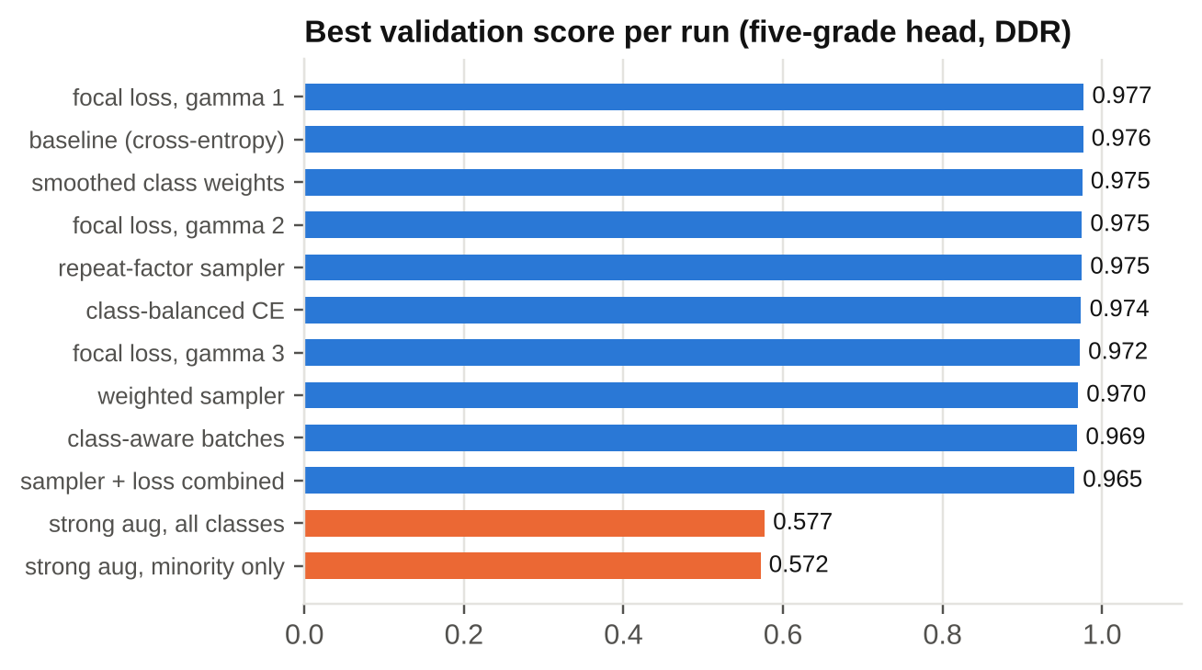
Result 4: Imbalance Methods
Sampler, loss and augmentation, one change at a time (single seed)
No method beat baseline
Best (focal gamma 1) 0.9770 vs baseline 0.9761: inside seed noise.
Strong augmentation failed
Both runs reached only about 0.57. The cause is found: next slide.
Limit of the test
The score is early-vs-none PR-AUC; rare grades 1, 3 and 4 are not scored separately.
On this metric, plain cross-entropy is as good as every imbalance method.
9

Slide 10
What These Results Do Not Show
Read before quoting any number
The frozen threshold does not transfer
On EyePACS specificity is 0.39 (A) and 0.013 (C): sensitivity alone is misleading off-domain.
Capture artifacts in DDR and APTOS
Image properties alone predict the label (AUROC 0.87 and 0.976).
DDR split is random
No patient IDs: same-patient leakage is untested. Exact duplicates are not the issue.
Not yet reported
Confidence intervals, ECE, Brier and five seeds. Per-grade and specificity analyses are post-hoc.
The arm C contrast and the label audit stand; the rest needs a cleaner split and test.
10

Slide 11
Conclusions and Next Steps
What the evidence supports so far
The merge as written teaches the source
Arm C flags 99% of healthy EyePACS images as DR, matching the label audit.
Next steps
1. Rerun augmentation with geometric-only
2. Group-aware DDR split (official split or near-duplicate groups)
3. Report AUROC and per-grade results; own-source operating points
4. Test capture mitigation: size-matched subsets
5. Five seeds, intervals, ECE and Brier
6. Re-evaluate once; label post-hoc analyses
Source-balancing helps off-domain
Arm B: EyePACS specificity 0.89, AUROC 0.88; DDR sensitivity unchanged.
In-domain scores are inflated
Capture properties alone predict DDR (0.87) and APTOS (0.976) labels.
11

Slide 12
THANK YOU
Questions? We’d love to discuss!

