Slide 1
Early Detection of Diabetic Retinopathy
Why it matters, what it can do, and how I will build it
Advisor: Navid Amini, PhD
Department of Computer Science
1

Slide 2

About Diabetic Retinopathy
151M
The clinical burden is growing
Observed growth over time
Diabetes has expanded rapidly worldwide, increasing the number of people who need retinal screening for diabetic retinopathy.
More patients means more fundus images to grade - and more pressure for fast triage.
adults living with diabetes
in 2000
589M
adults living with diabetes
in 2024
+290%
observed increase in
screening population
2

Slide 3
Why Screening Needs Help
The clinical pathway breaks down before an image is graded
Diabetes
patient
Annual eye
exam / photo
Human grading
queue
Referral /
treatment
Coverage gap
60% do not get annual eye exams.
Capacity gap
More images need more grading time and specialist review.
Safety gap
Early disease often has no symptoms; late detection lets preventable vision loss progress.
Need: rapid, consistent triage immediately after fundus image capture.
3

Slide 4
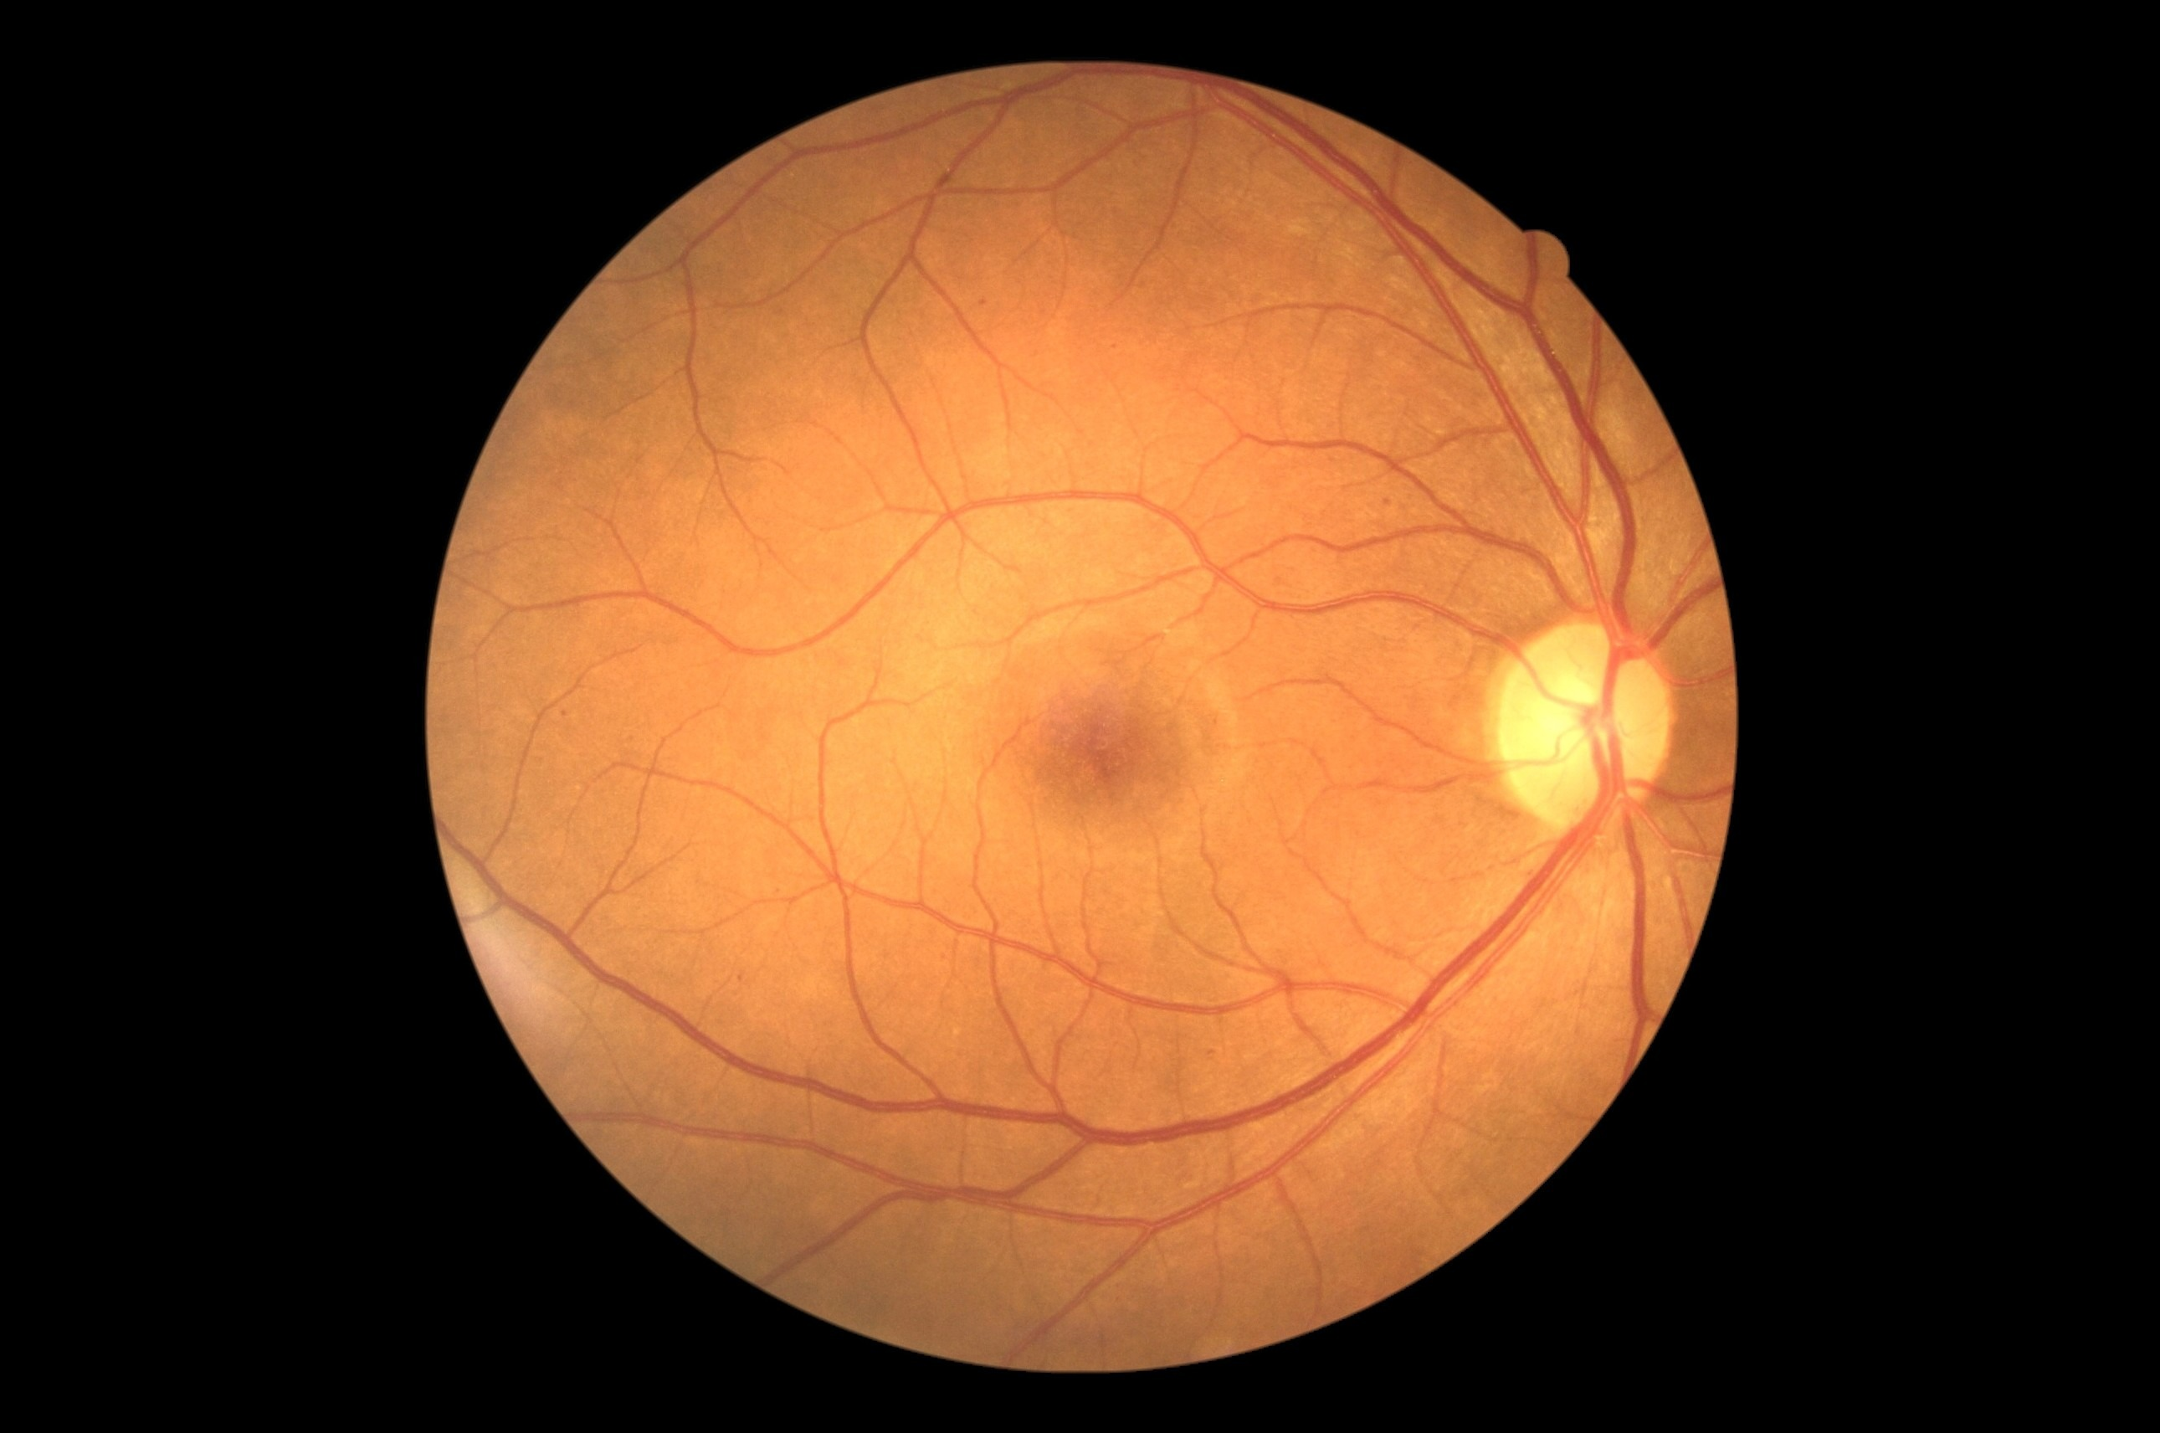
What It Can Do
A triage aid for the ophthalmologist, not a replacement
Early-DR flag
Grades 1-2 vs No DR at a fixed specificity
Early-DR model
EfficientNet-B0 with calibrated probabilities
Early vs late
Separates early from late disease to set priority
Fundus image
Calibrated probability
A score clinicians can trust, tested on unseen datasets
The model supports the ophthalmologist: faster prioritization of high-risk images.
4

Slide 5
How It Is Different
Common practice as I understand it, to be checked in the literature review
Common in existing work (to verify)
This project
Target
Referable DR (moderate or worse)
Early DR (grades 1-2) at a fixed specificity
Data
One dataset, or merged without testing the merge
The merge is tested: DDR only, source-balanced, and the old merge as a control
Imbalance
A new method against a few baselines
Sampler, loss and augmentation one at a time, with a control
Transfer
Internal splits or one external set
Held-out EyePACS patients plus APTOS, reported per source
Probabilities
Accuracy or AUC
Calibrated, prior-shift-corrected, with reliability curves
Not a new network: the value is the design and the evidence. Novelty claims wait for the literature search.
5

Slide 6
Proposed Methods
Three data arms, one change at a time
Same model, image size and epochs; frozen patient-level splits; test sets opened once.
Data
DDR, EyePACS, APTOS
Prepare
Crop, pad, 512 px
Merge arms
A, B, C
Model
EfficientNet-B0
Output
Calibrated, 95% CI
Imbalance methods tested
The three arms
Weighted sampler
Class-balanced loss
Focal loss
• A: DDR only (clean baseline)
• B: DDR + EyePACS, source-balanced
• C: version 1 merge (negative control)
• C wins on its own test but not on APTOS = it learned the source
Strong augmentation
Augmentation control
Not a new network: the value is the design, the controls and the evidence.
6

Slide 7
Complete Model Architecture
From fundus image to a calibrated early-DR flag
TRAIN: one model per arm, task and seed
Fundus image
DDR, EyePACS, APTOS; frozen patient-level splits
Preprocess
Crop border, pad to square, resize to 512 px (colour norm optional)
Sampler + augment
Arm B: source-balanced. Weighted, class-aware or repeat-factor. Mild or strong
Backbone
EfficientNet-B0, ImageNet weights (ViT + RETFound as extension)
Head (1 per run)
0 vs 1-4, early vs late, 3-class or 5-grade
Loss
Cross-entropy, class-balanced CE, or focal (gamma 1-3)
VALIDATE AND FREEZE, THEN TEST
Outputs
Calibrated probability, early-DR flag, per-source metrics with 95% CI
Frozen threshold
Set at the declared specificity (0.90) on validation
Prior-shift correction
Training class mix back to natural prevalence
Temperature scaling
One number T, fitted on validation
Best epoch
Chosen on validation score only
Test sets opened once: DDR + held-out EyePACS, then APTOS last. Grad-CAM with a randomised-weights check.
7

Slide 8
Six Rules for Every Experiment
What makes the evidence trustworthy
1 Freeze the splits first
Split by patient where IDs exist, save as files, never change them.
2 Declare the analysis
One primary comparison and the specificity target are written down before any test split is opened.
3 Change one thing per run
One training script and one config file per experiment.
4 Select on validation only
Thresholds, temperature and prior correction are fitted on validation, then frozen.
5 Measure the noise
3-5 seeds, patient-level bootstrap intervals, Holm-corrected comparisons.
6 Open the test once, external last
Held-out EyePACS and APTOS are never used for training or selection.
Every result is reported per source, with confidence intervals.
8

Slide 9
Expected Contributions
What this thesis will add
1
Early-first evidence
Sensitivity at a fixed specificity for grades 1-2, with confidence intervals.
2
A tested merge
Whether adding EyePACS helps or only teaches the source, using a negative control.
3
A controlled comparison
Sampler, loss and augmentation tested one at a time, with an augmentation control.
4
Probabilities for screening
Calibrated, prior-shift-corrected outputs, checked on unseen sources.
Not a new network, and no accuracy gain is promised in advance.
9

Slide 10
References
• International Diabetes Federation. IDF Diabetes Atlas, 11th ed., 2025.
• Ting, D. S. W., et al. 'Artificial intelligence-assisted diabetic retinopathy screening.' Ophthalmology, 2021.
• Shah, P., et al. 'Progression of DR and screening demand.' JAMA Ophthalmology, 2024.
• WHO. Guidelines on diabetic retinopathy screening, 2023.
• CDC. Eye-health guidance for people with diabetes, 2024.
• Li, T., et al. Diagnostic assessment of deep learning algorithms for DR screening (DDR). Information Sciences, 2019.
• Kaggle. Diabetic Retinopathy Detection (EyePACS), 2015; APTOS 2019 Blindness Detection.
• Guo, C., et al. On calibration of modern neural networks. ICML, 2017.
• Sipka, T., et al. The hitchhiker’s guide to prior-shift adaptation. WACV, 2022.
10

Slide 11
THANK YOU
Questions? We’d love to discuss!

